Slide 1
QualitativeSwitch
Adaptation to the same environment can result in loss or gain of a trait based on different population sizes

Slide 2
FitnessLandscape

Slide 3
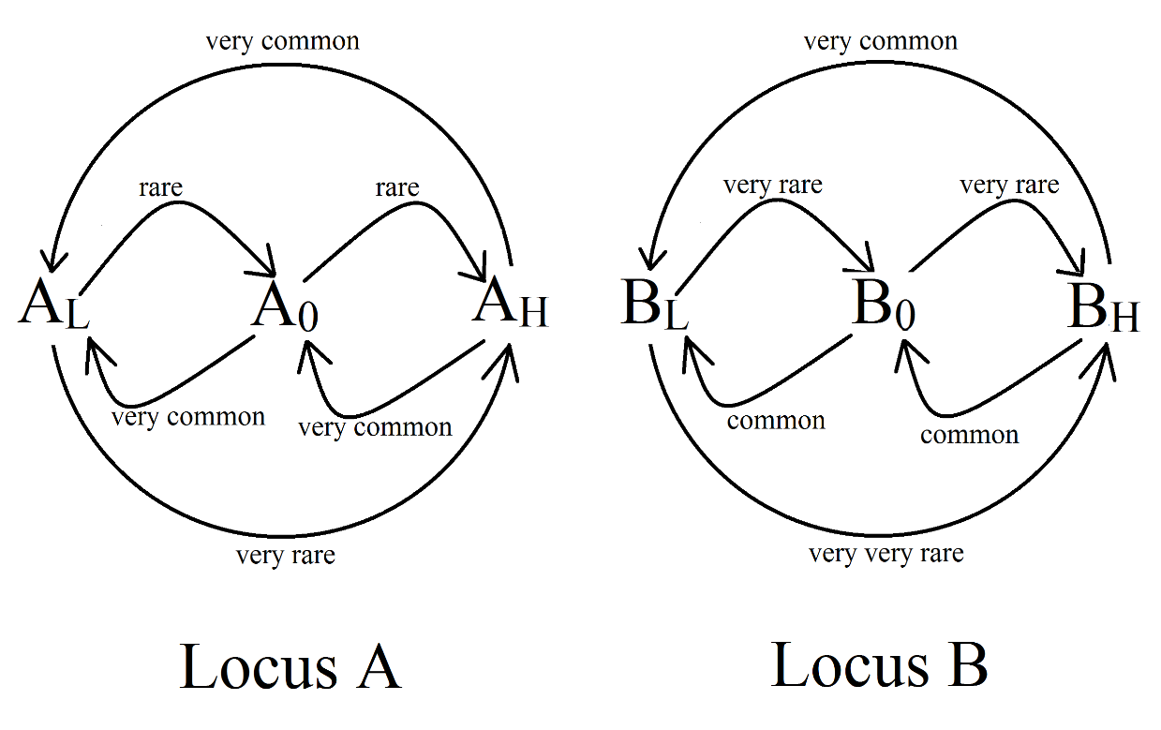
Mutationrates
very common | 1 / 10³
common | 5 / 10⁴
rare | 5 / 10⁵
very rare | 5 / 10⁸
very very rare | 1 / 10⁹

Slide 4
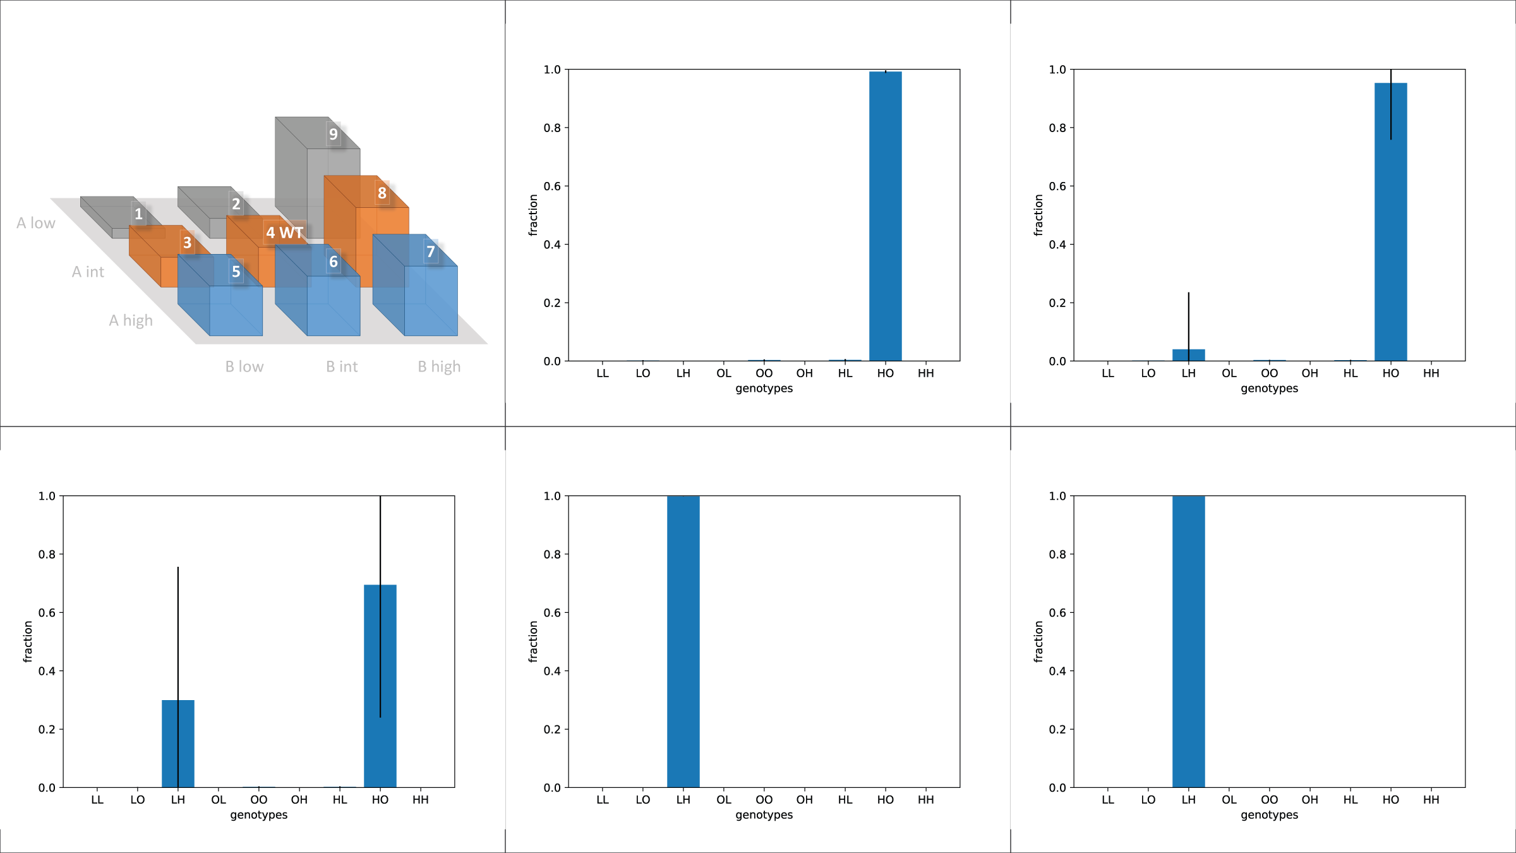
SimulationResults
10³
10⁴
10⁵
10⁶
10⁷

Slide 5
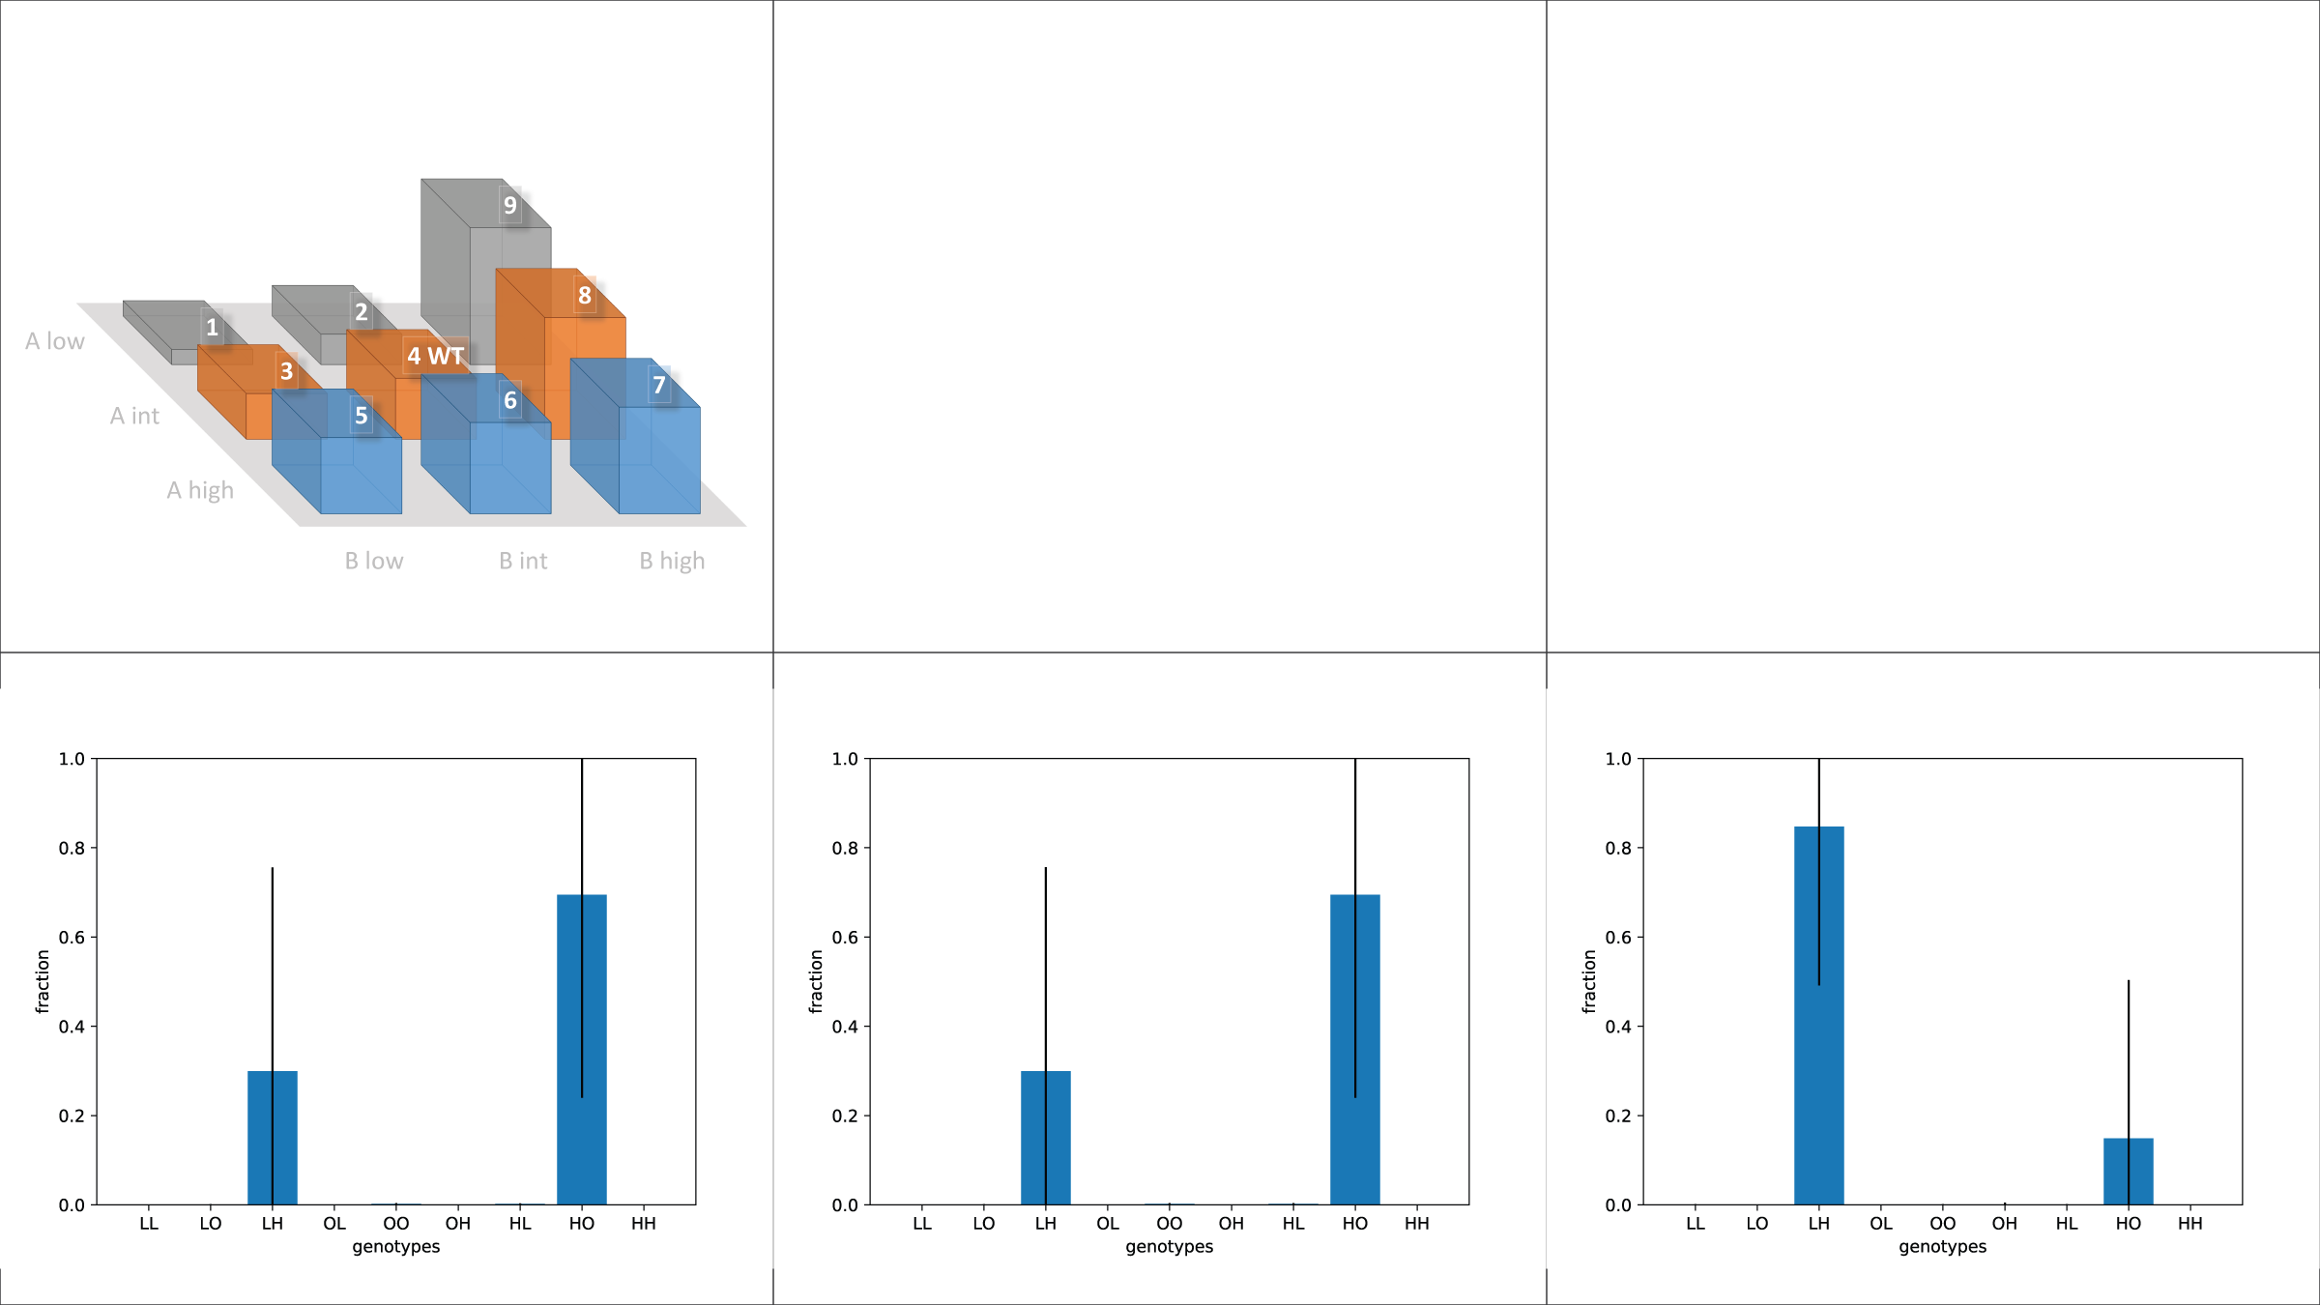
SimulationResults (zoomed in)
5x10⁴
10⁵
5x10⁵

Slide 6
EpistasisControl

Slide 7
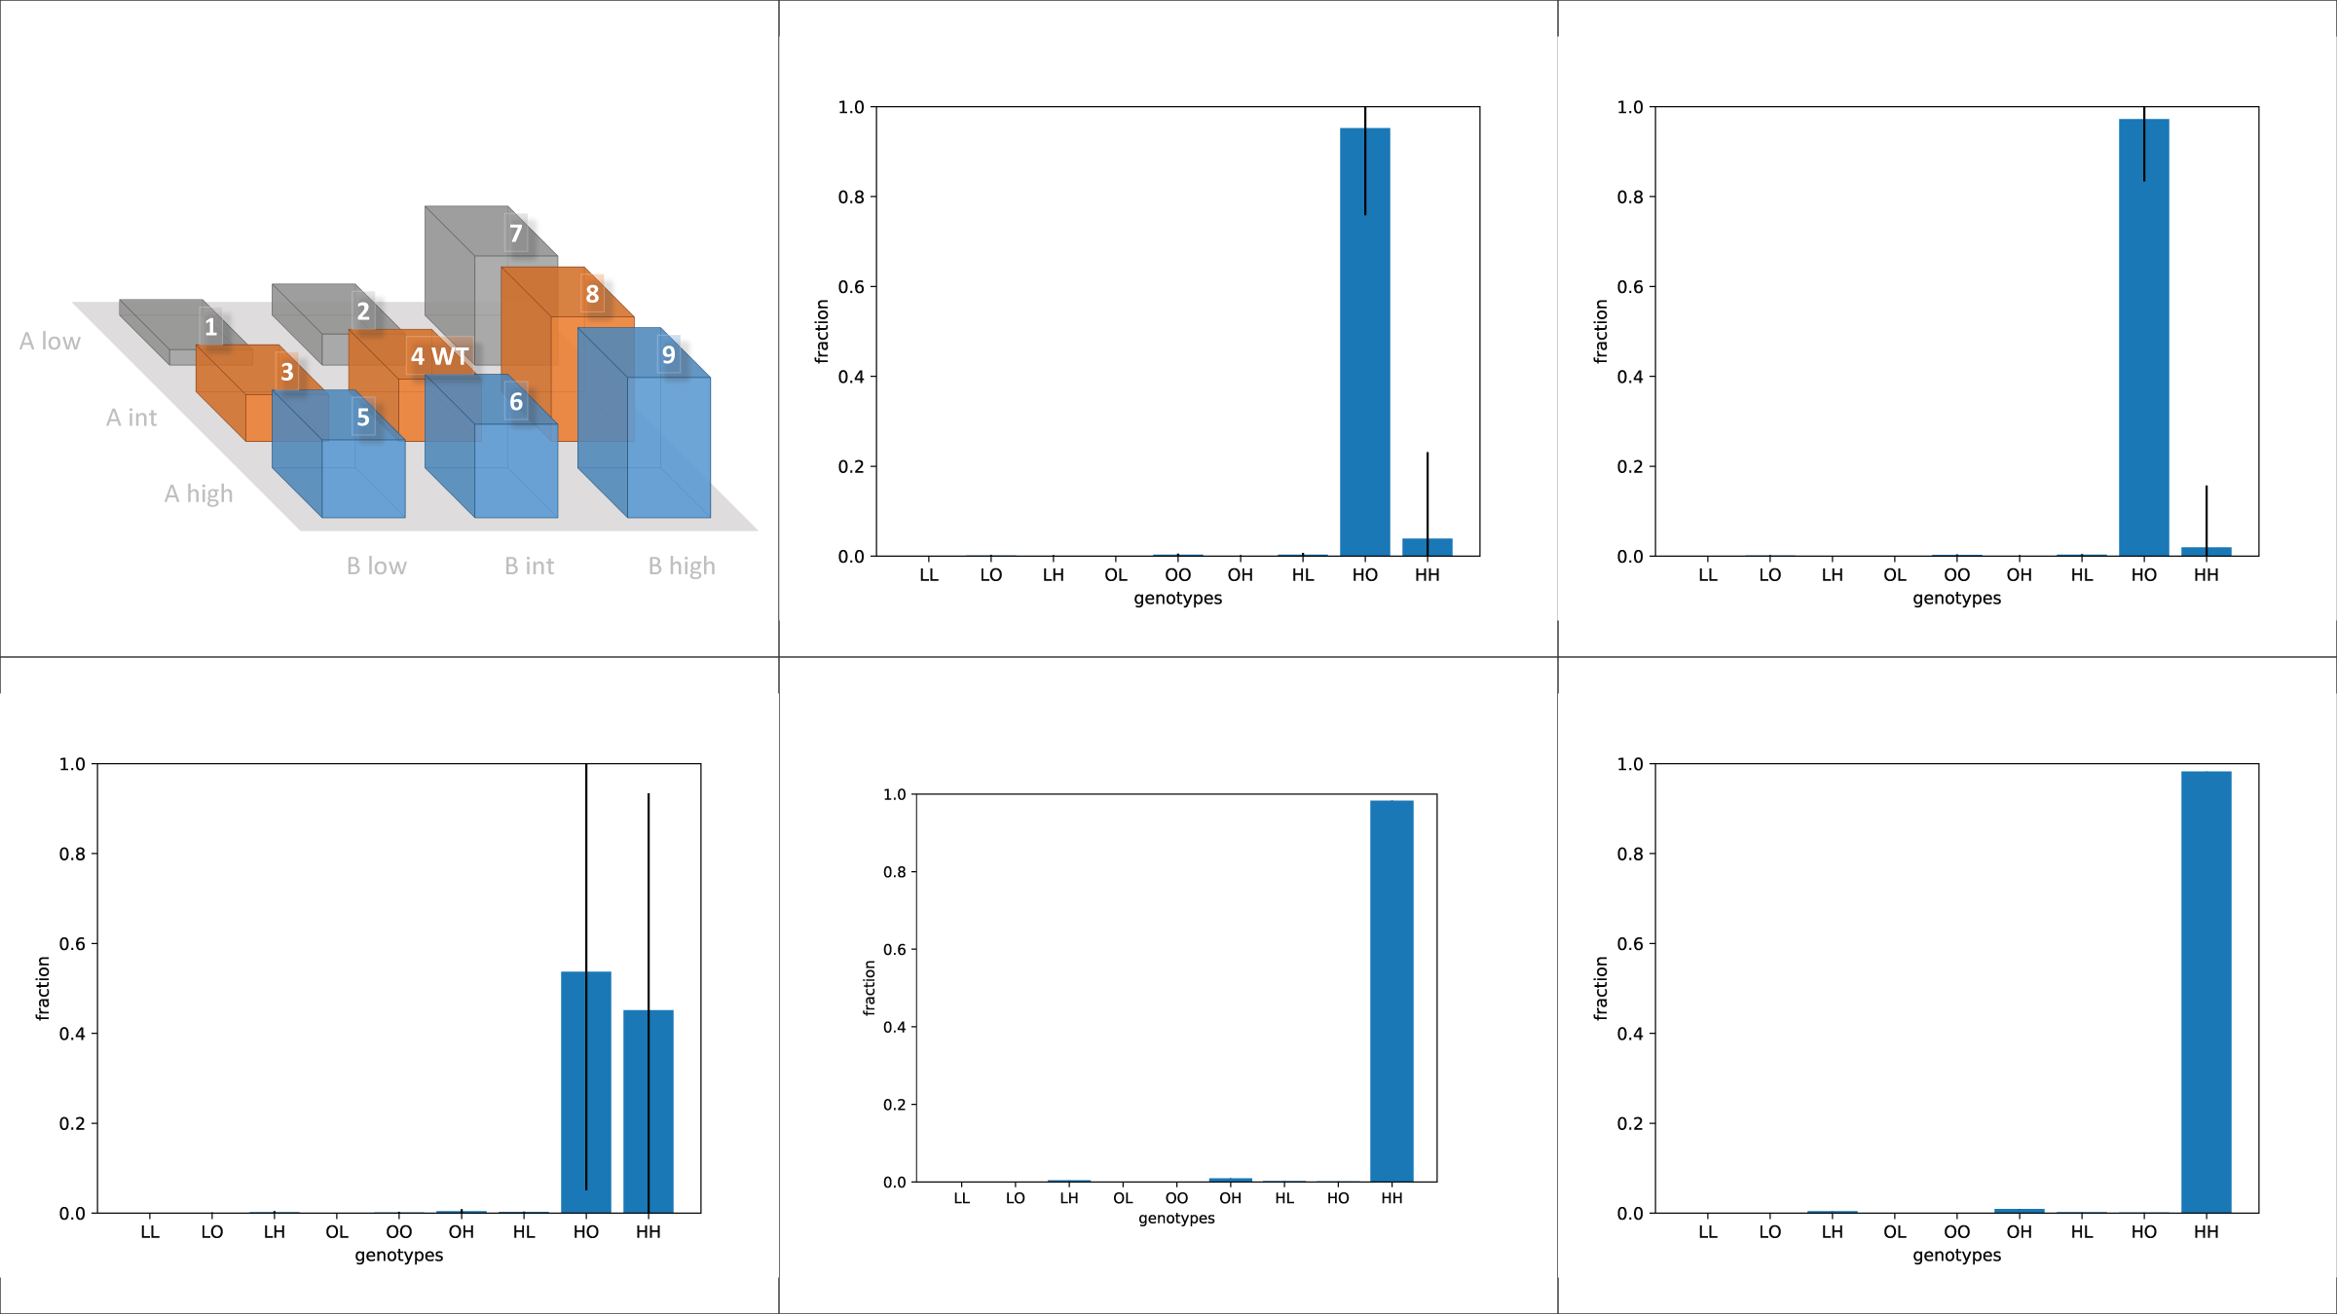
EpistasisControl
10³
10⁴
10⁵
10⁶
10⁷

Slide 8
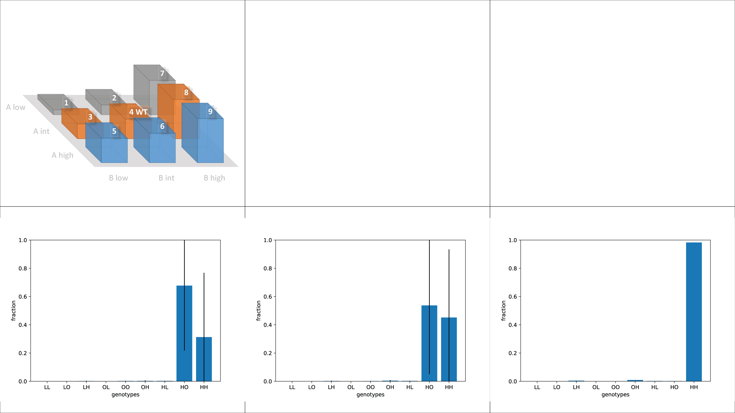
EpistasisControl (zoomed in)
5x10⁴
10⁵
5x10⁵

Slide 9
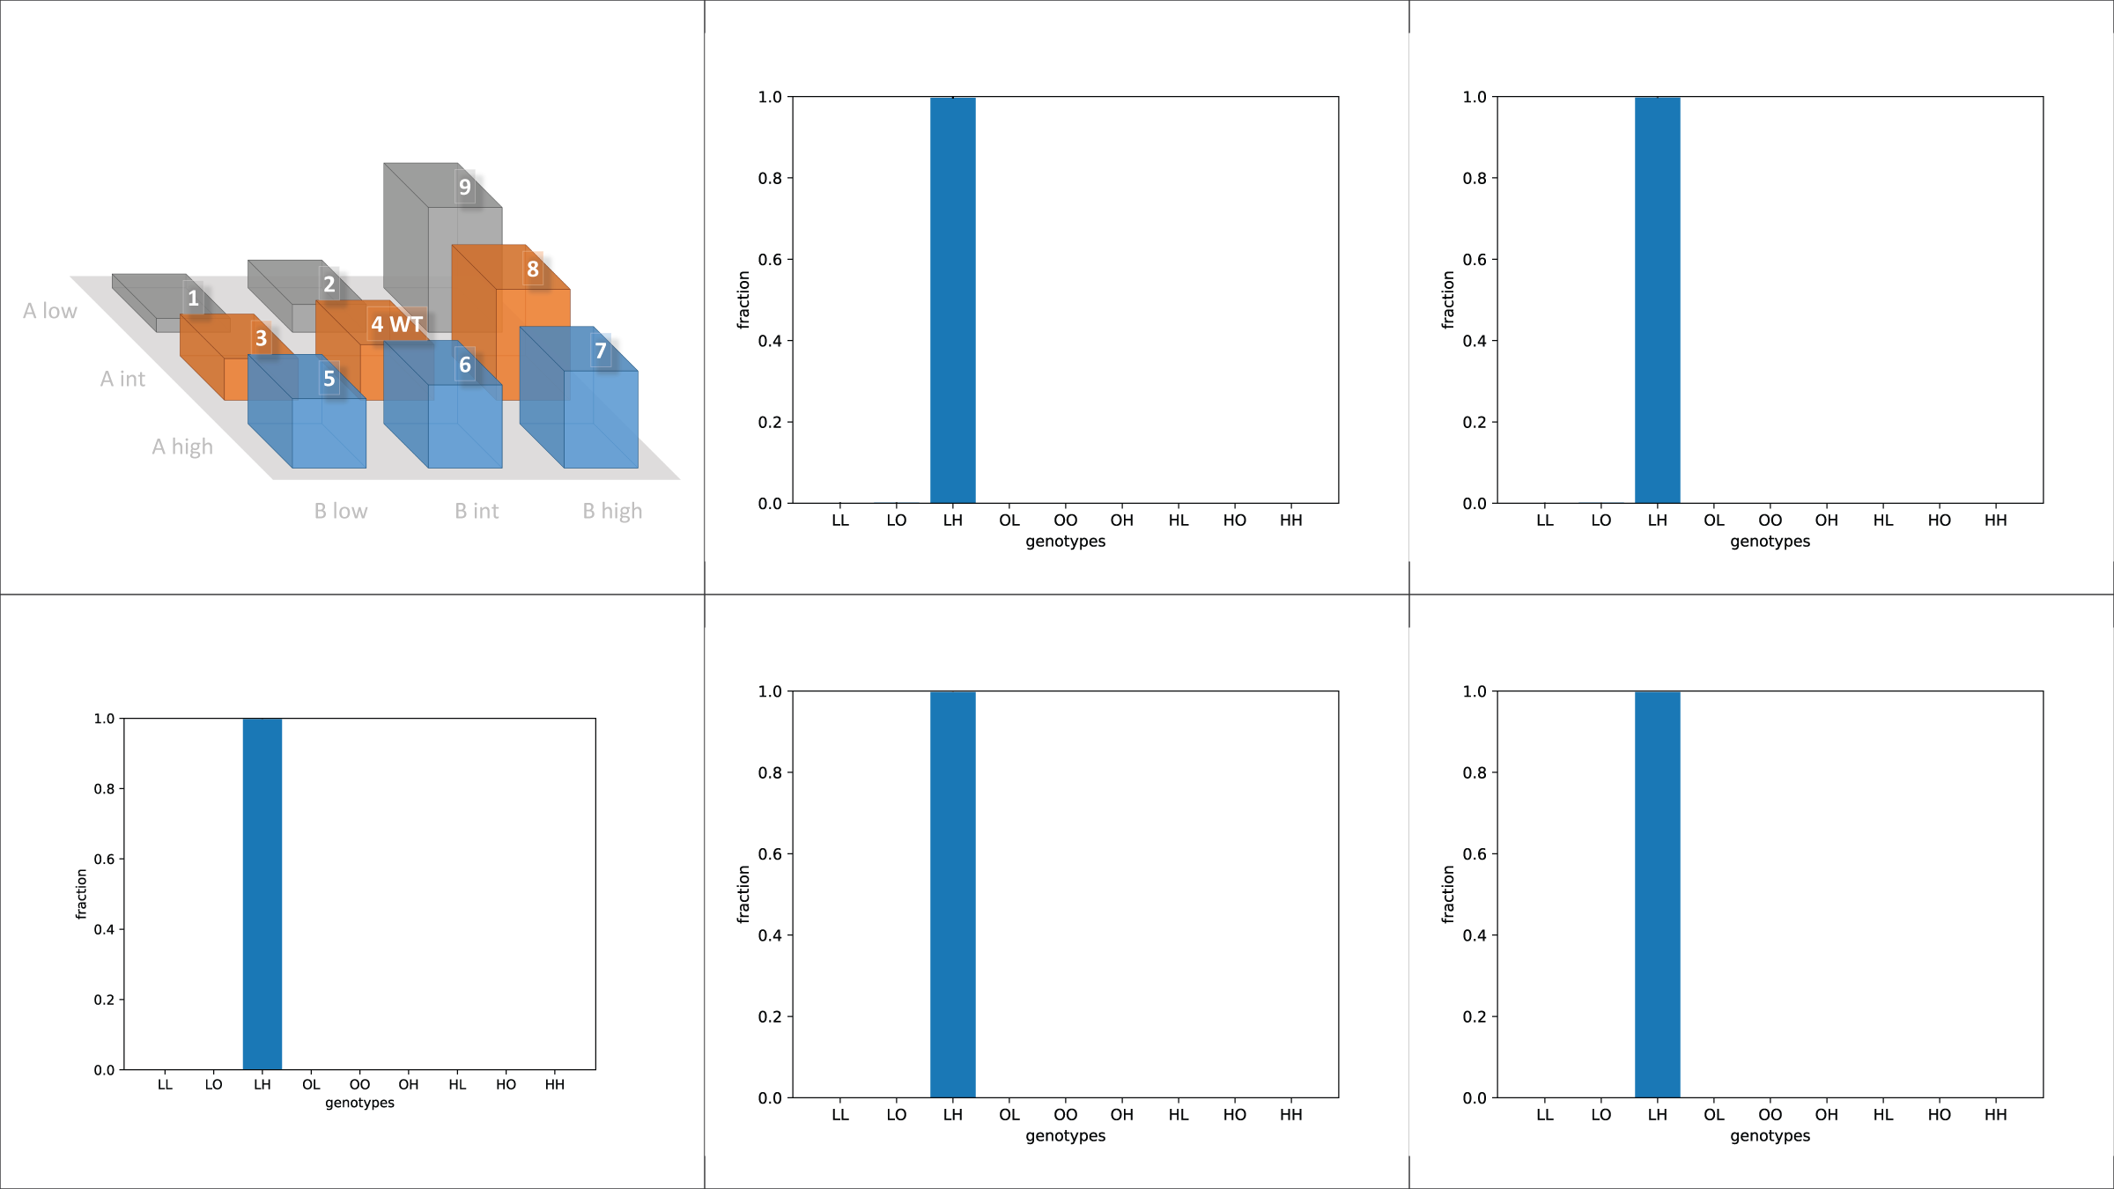
MutationControl (a-like)
10³
10⁴
10⁵
10⁶
10⁷

Slide 10
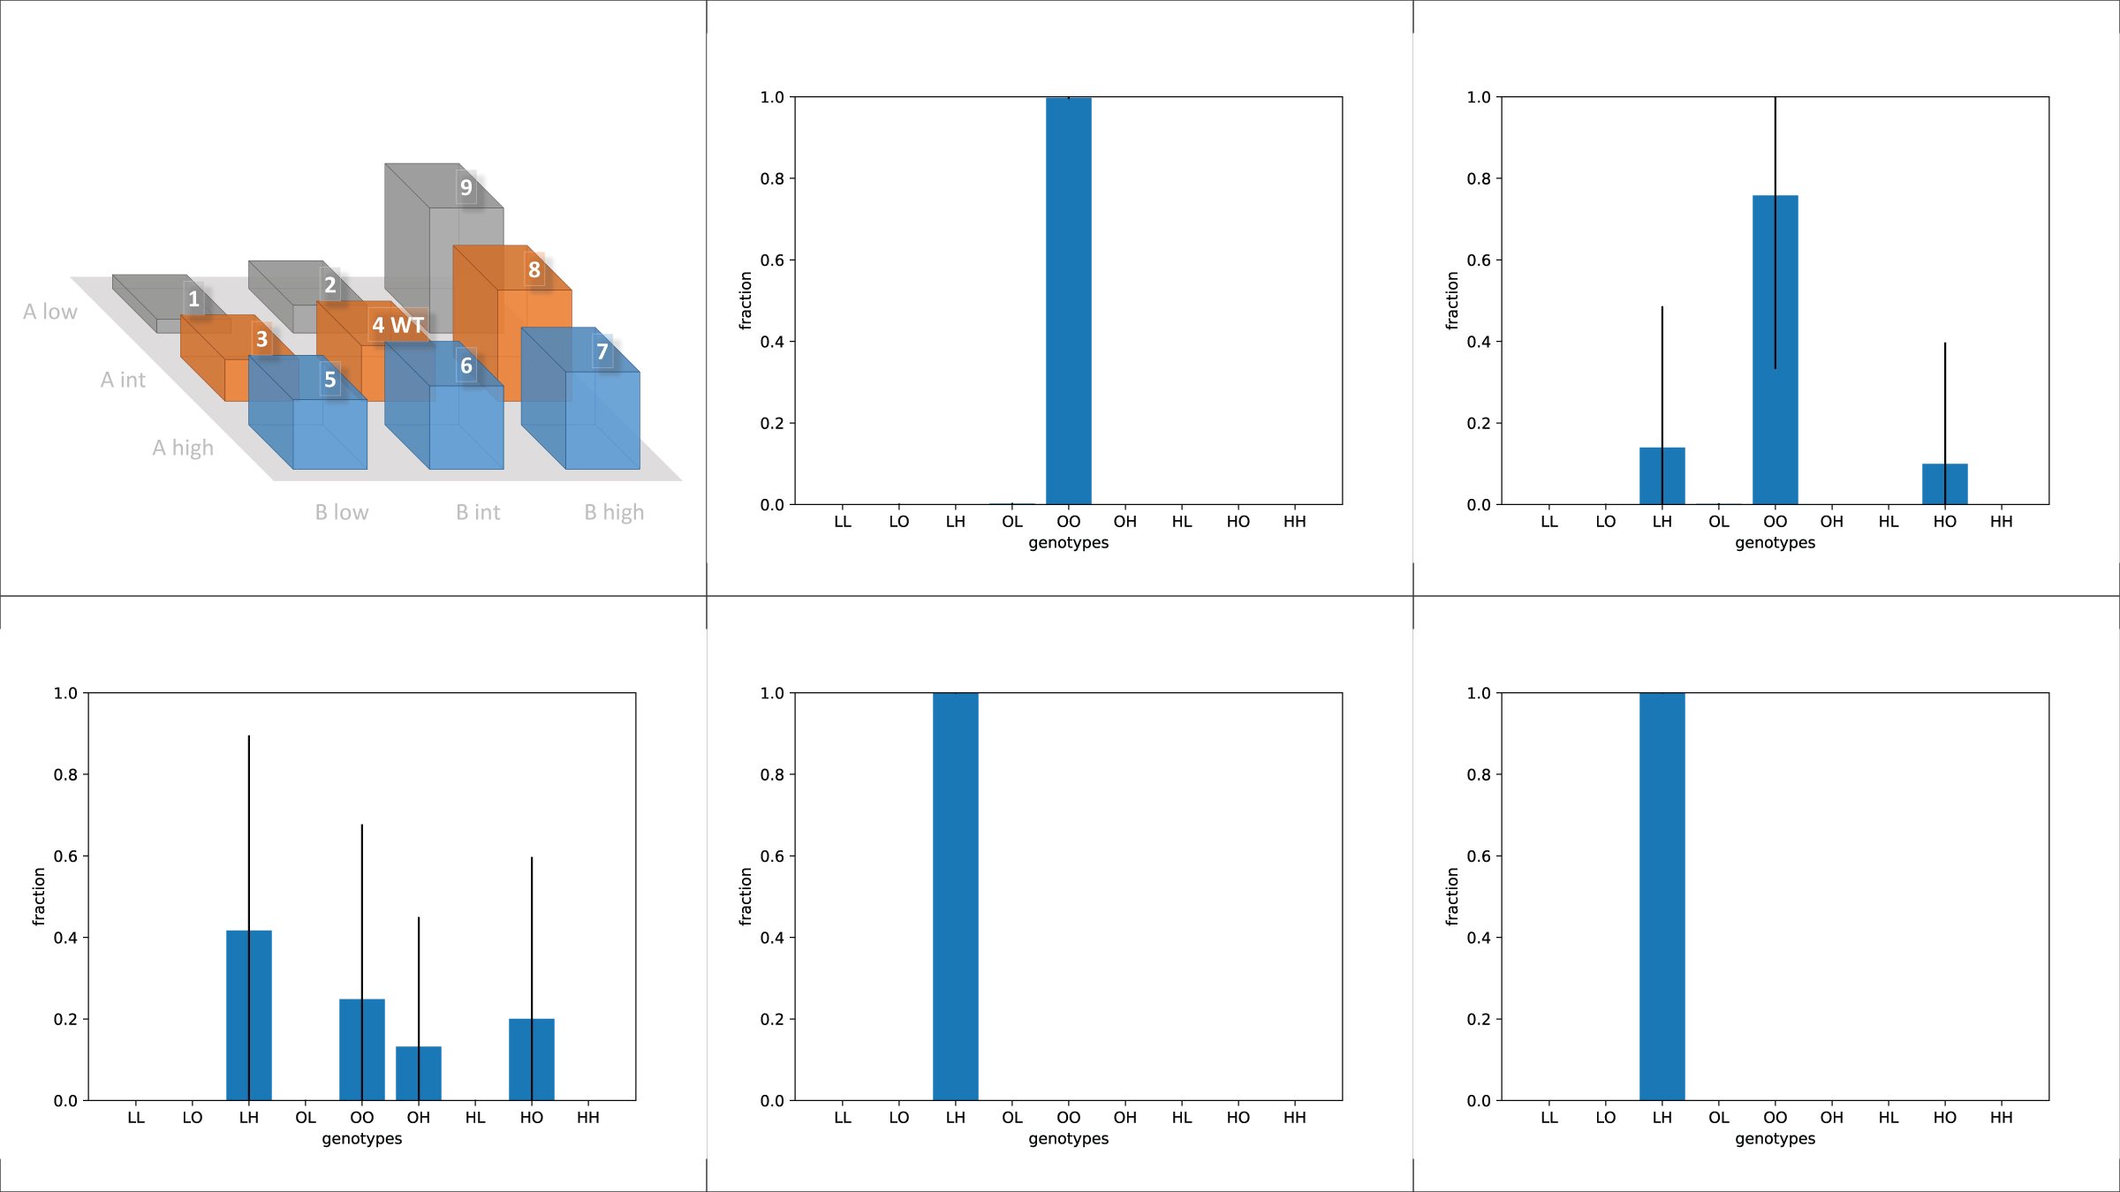
MutationControl (B-like)
10³
10⁴
10⁵
10⁶
10⁷

Slide 11
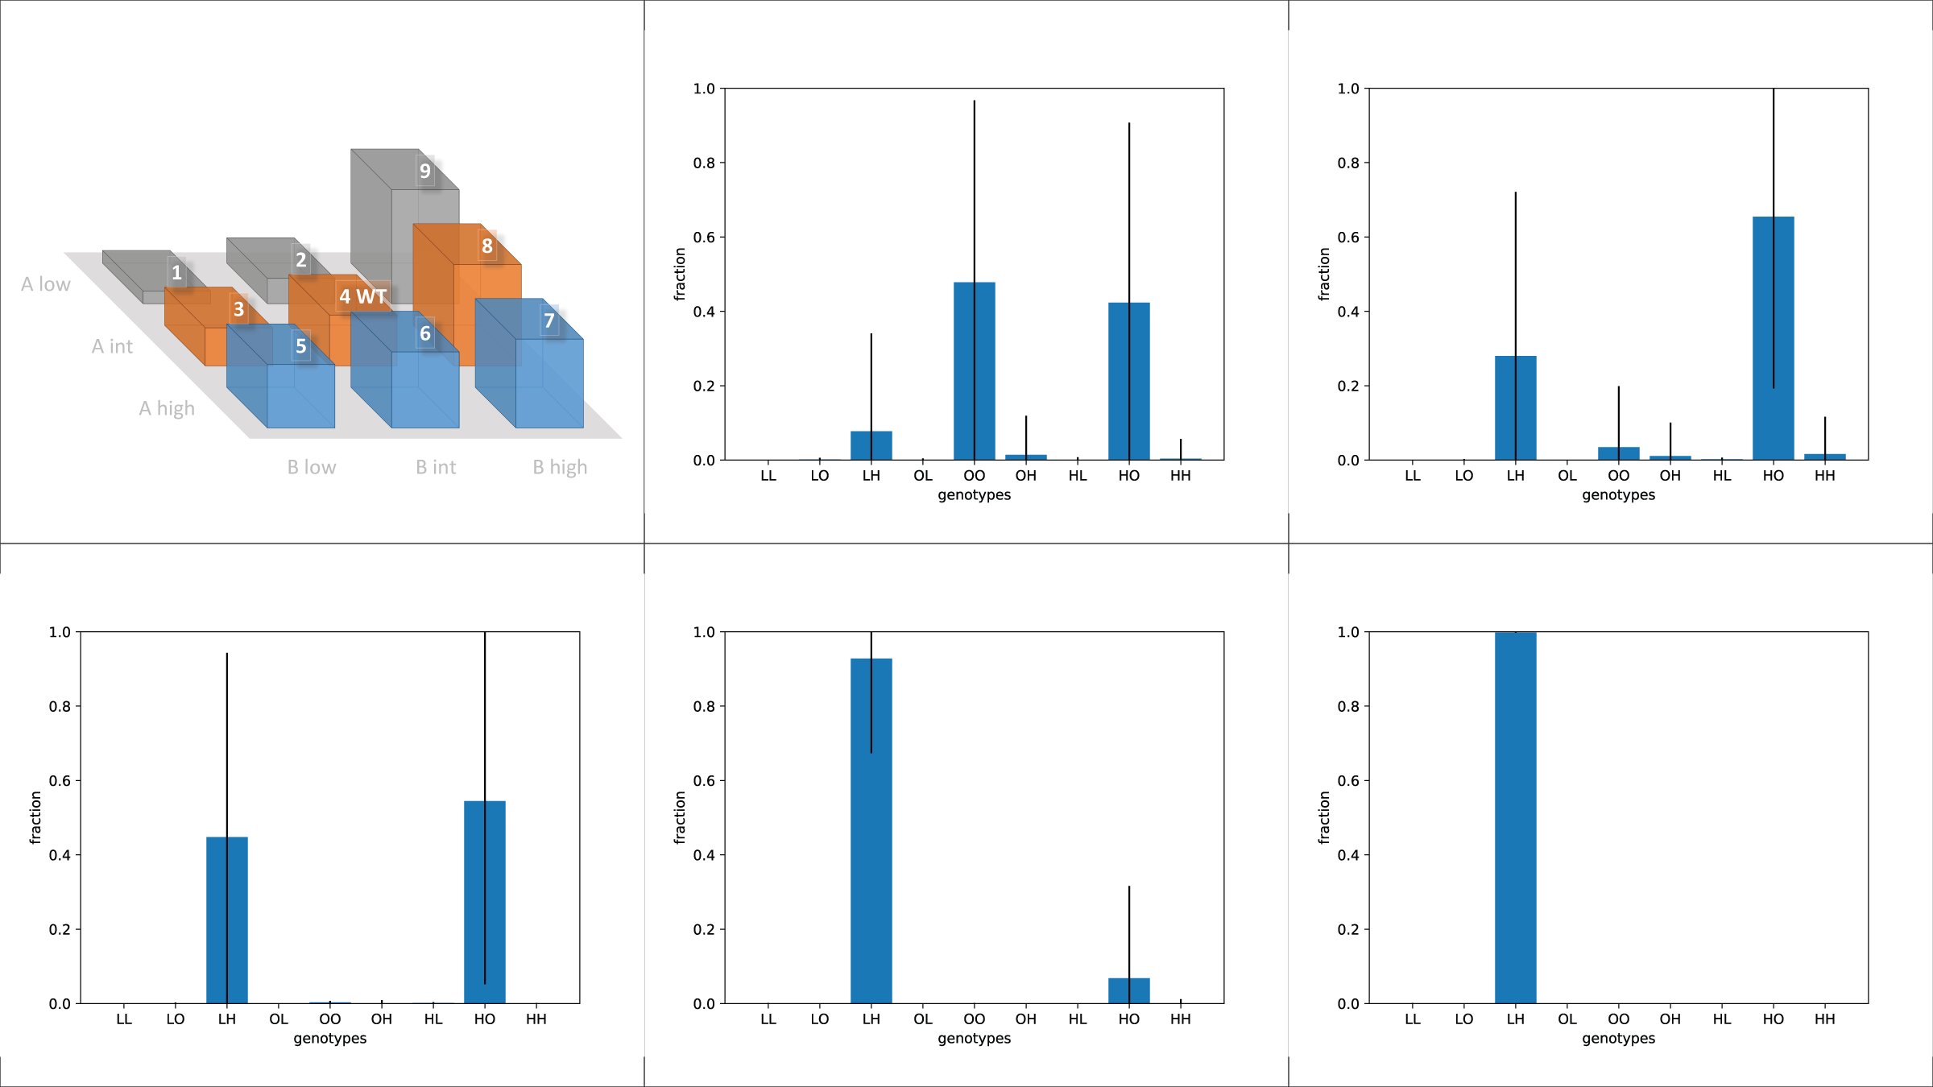
PositionShift
10²
5x10²
10³
5x10³
10⁴

