Slide 1
CSCI 205
Team ChordWare
Giles Thomas, Samuel Baldwin, Rah Hite, Griffin Miller

Slide 2
Who We Are
Samuel Baldwin - 2024 Computer Science and Engineering Major. Scrum Master.
Griffin Miller - 2024 Composition and Computer Science Major. Programmer
Giles Thomas - 2024 Computer Science and Engineering Major. Team Leader
Rah Hite - 2023 Composition Major. Programmer

Slide 3
Project
Goal:
Create a keyboard based synthesizer in java. The synthesizer would feature control over volume, note durations, and recording a score. We also desired to include control over the synthesized instrument such as different oscillators, attacks, etc. however, those were abandoned due to time constraints and technical problems.
Motivation:
Multiple members of our group are composition majors, and we wanted to connect the two passions in some way
Why is this important? What problem did it solve?
There are numerous synthesizers, but none of them have the standalone capabilities of our design. They generally require incredibly complex interfaces with Digital Audio Workstations and midi devices. Our project is designed to be a lightweight and capable alternative to existing synthesizer programs.
We wanted to make something that could help in the process of making music, in a non transient way

Slide 4
Project - Key User Stories
The most important user story in our case was the ability to play sound
-Utilizing the JMusic library, we wanted to allow the user to have access to a wide array of capabilities
We also wanted the user to be able to see a record of what they were playing
-An important part of our goal was to have the capability of learning while playing, and being able to use what you played in the future

Slide 5
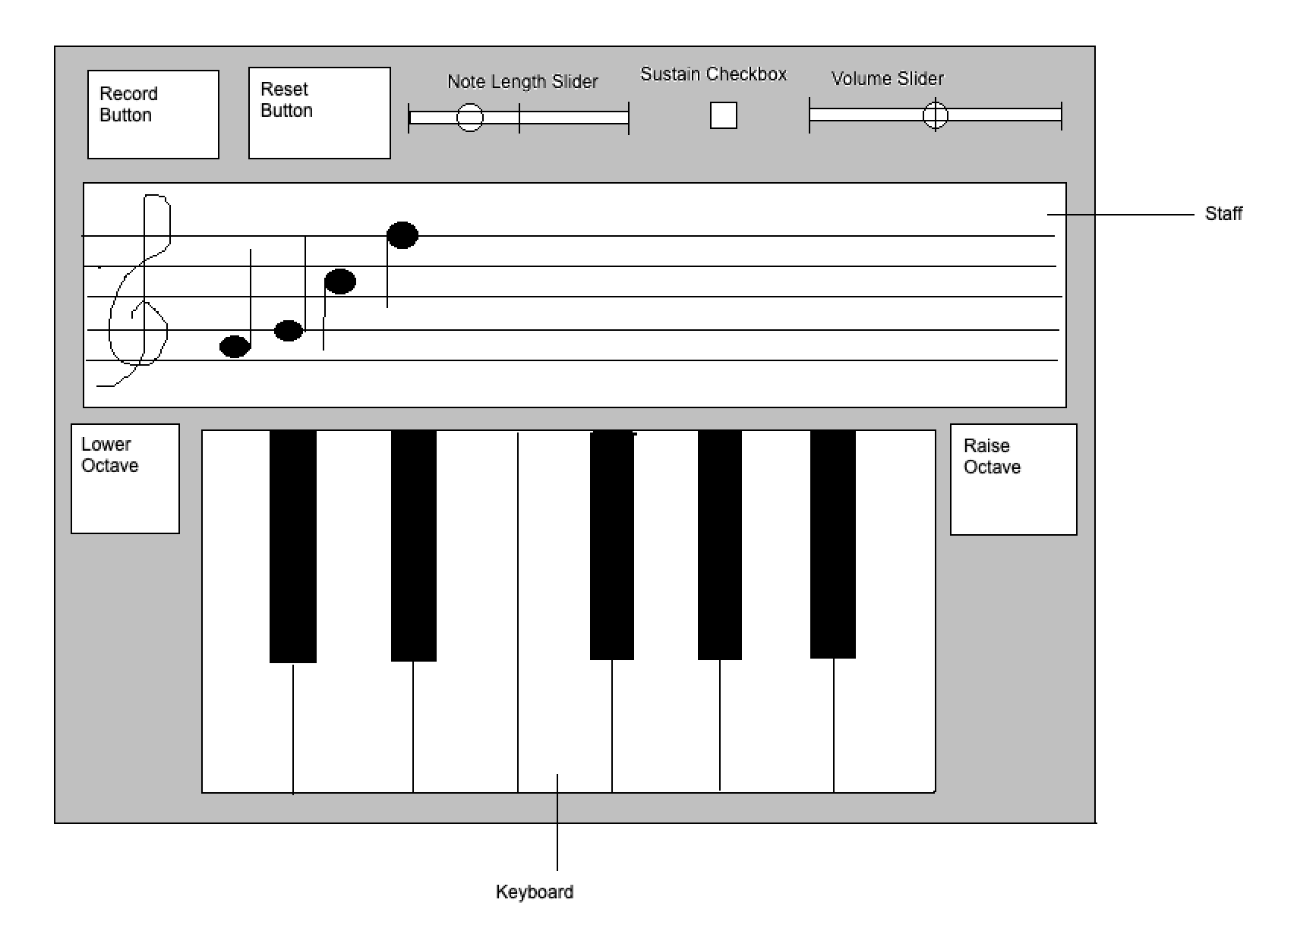
Design
The most difficult thing in our design was the delicate nature of all of the intertwining event handlers
Each portion of the UI relied heavily on the state of the other elements, and keeping that balance lightweight yet still functional offered a number of difficulties
Figuring out how to have the sound system be able to play without delay, especially when utilizing an old library took an enormous amount of effort

Slide 6
Implementation
Demonstration:
Basic Notes
Octave Control
Recording Capability and Score Demonstration
Control over Note Length
Output Audio Control
Sustain
3rd party library JMusic:
-Working with old libraries not designed for implementation with javafx is both annoying and very very very very hard

Slide 7
Scrum Reflection
Scrum Roles - Sam Baldwin (Scrum Master), Giles Thomas (Product Owner), Rah Hite (Developer), Griffin Miller (Developer)
Scrum challenges and Successes - managing scrum while simultaneously trying to develop a complex application was hugely challenging. The reason behind companies having professional project managers makes a lot more sense now.
Project Successes - We created a synthesizer which completed much of our goal.
Project Challenges - jMusic became an absolute nightmare and the interconnected nature of the UI
Estimates - Our estimates were generally incredibly off especially when related to jMusic

Slide 8
Conclusion
Accomplishments:
We managed to create a synthesizer which can control:
Note duration
Volume,
Sustain
Record a score
Control Note Octave
Changes for version 2.0:
Centralize the Design around a more OOP system
Allow for the replaying of notes from a score
Possibly save to a text file, that can be played by a class of the synthesizer
Better time tracking/management

