Slide 1
Chapter 3 – Planning and Mgt of Projects
Dr. Hassan Reza

Slide 2
Objectives
Discuss a range of technical mgt issues
Project scheduling Techniques
WBS, PERT, Gantt charts
Cost/effort Estimation techniques
Expert-based techniques
Algorithmic (or formal)

Slide 3
Software Project Management: 1
Software project mgt?
An umbrella of activity within software engineering
Begins before any technical activity is initiated
Continues throughout the modelling, construction, and deployment of computer software
Key factors affecting the software project mgt:
People (highly skilled and talent people)
Product (goals, objectives, scope)
Process (a set of activities)
Project (conduct planned, monitored, controlled project to meet product objectives)

Slide 4
Software Project Management:2
The main objective of Project Mgt are
To built the products meeting the customer’s needs
All desired product attributes are met
e.g., quality, security, etc.
Deliverable and Milestones are met
Team members are operating effectively
The sources are available, optimized, etc.
Notes:
Milestone: refers to the completion of an activity at specific point. Example include the requirements specification.

Slide 5
Confusion between Software project mgt and software engineering process
Software Project Mgt?
NOT a software engineering process
Follows a management process to ensure that the appropriate software engineering process is implemented
Software Project Mgt process (POMA)
Planning
Organizing
Monitoring (Tracking)
Adjusting

Slide 6
Why Project mgt?
Before expanding any resources, customer may have lots of questions
Typical questions customer may ask:
Do you understand my needs?
Can you design a system that will solve my problem?
How long will it take to develop such a system?
How much will it cost to develop such a system?

Slide 7
Project planning
Planning?
Essential phase of any project
Could be maker or breaker
Helps to facilitate the changes
Used to communicate how the work will be done to both the project team and customers
planning involves
breaking down the work into parts
assigning these to project team members
anticipating problems that might arise
preparing tentative solutions to those problems.

Slide 8
Essential elements of Project mgt
Scheduling/planning Techniques
Estimation Techniques
Risk Assessments
People mgt

Slide 9
Project scheduling?
Project scheduling?
Describes the software development cycle for a specific projects
Consists of phases (stages) of the project
Each phase consists of a set of sub-phases (activities)
Shows the interactions among these activities together with estimates of the time that each activity will take
Notes:
Project scheduling is the process of deciding how the work in a project will be organized as separate tasks, and when and how these tastes will be executed. You estimate the calendar time needed to complete each task and the effort required, and you suggest who will work on the tasks that have been identified.

Slide 10
Schedule 1 : Phases and activities (Fig 3.1)

Slide 11
Schedule 2: Phases, Steps, and Activities of Building a House (Table 3.1)
Example of building a house:
Phase 1 (landscaping)
Phase 2 ( building house)

Slide 12
Work breakdown
Work breakdown structure (WBS)
Refers to deliverable-oriented decomposition of a project into smaller components
Components can be
data, service, product, or combinations of all
Used to control/monitor project and cost estimation
Precursor (preconditions)
Due date (delivery date)
Endpoint (milestones/deliverable)

Slide 13
Program Evaluation and Review Technique (PERT) Charts or activity graph
Activity graph is used to show the dependencies and WBS
PERT (Program Evaluation and Review Technique) chart
boxes (or circles) representing milestones
arrows dependencies or activities among milestones
activity at the head of an arrow cannot start until the activity at the tail of the arrow is finished

Slide 14
Work Breakdown (table.3.2)
Milestones? Successful completion of an activity

Slide 15
Activity Graph (Table 3.3)

Slide 16
Time Estimation (building House)

Slide 17
Activity Graphs with durations (Fig.3.3)
39
days
Paths:
From 2.2-2.7 requires 39 days
From 2.2 through 2.8 takes 42 days
From 2.2 -3.4 takes 54 days
From 2.2 - 3.6 takes 54 days

Slide 18
Milestones and deliverables
Milestones?
points in the schedule against which we can assess progress
E.g., Completion of Unit Testing
Deliverables?
Refer to work products that are delivered to the customer
E.g., A requirements document for the system, source code, etc

Slide 19
Table 3.4 : CPM Bar Chart
Slack time = latest start time – earliest start time

Slide 20
Gantt charts
A project control/progress technique
Designed by Henry L. Gantt
Used for several purposes such as
scheduling
budgeting
resource planning

Slide 21
Gantt chart
Duration of a activity
Notes:
Activities shown by dashes and F’s are not on critical paths.
* indicates the critical path.

Slide 22
Resource Allocations (people) Histogram

Slide 23
Tracking planned cost vs. actual cost

Slide 24
Work Breakdown Structure (WBS)
WBS describes a break down of project goal into intermediate goals
Each in turn broken down in a hierarchical structure

Slide 25
Example: a compiler project (WBS)

Slide 26
Example: a compiler project (Gantt)
Notes:
WHITE part shows the length of time needed to complete the task.
Gray part shows the “slack” time, which is the latest time by which the task can be done.
Design: 45 days
Scanner: 20 days
Parse: 60 days
CG: 180 days
Integration Testing 90 days
Writing Manuel: 90 days

Slide 27
Example: a compiler project (PERT Chart)
Notes:
Box represents activities (e.g., design).
The tick black arrows represents the Critical path.

Slide 28
Example: a compiler project
45
180
Notes:
Design: 45 days
Scanner: 20 days
Parse: 60 days
CG: 180 days
Integration Testing 90 days
Writing Manuel: 90 days

Slide 29
Analysis of PERT charts
Critical path for the project
any delay in any activity in the path causes a delay in the entire project
activities on the critical path must be monitored more closely than other activities

Slide 30
Gantt & PERT charts
Force the manager to plan
Show interrelationships among tasks
PERT clearly identifies the critical path
PERT exposes parallelism in the activities
helps in allocating resources
Allow scheduling and simulation of alternative schedules
Enable the manager to monitor and control project progress and detect deviations

Slide 31
Cost Estimation Techniques
Part 2

Slide 32
Cost Estimation
Cost estimation is part of planning stage of any engineering activity
The dominating cost is the number of people (engineers) needed to implement the system
Effort estimation?
An integral part of software project management (during planning and monitoring a software project)
Cost and schedule overruns have been a common risk in software projects.
According to the Oxford University study on 5,400 large scale IT projects
on average large software projects run 66% over budget and 33% overtime
Notes:
Effort estimation? how many engineers are needed

Slide 33
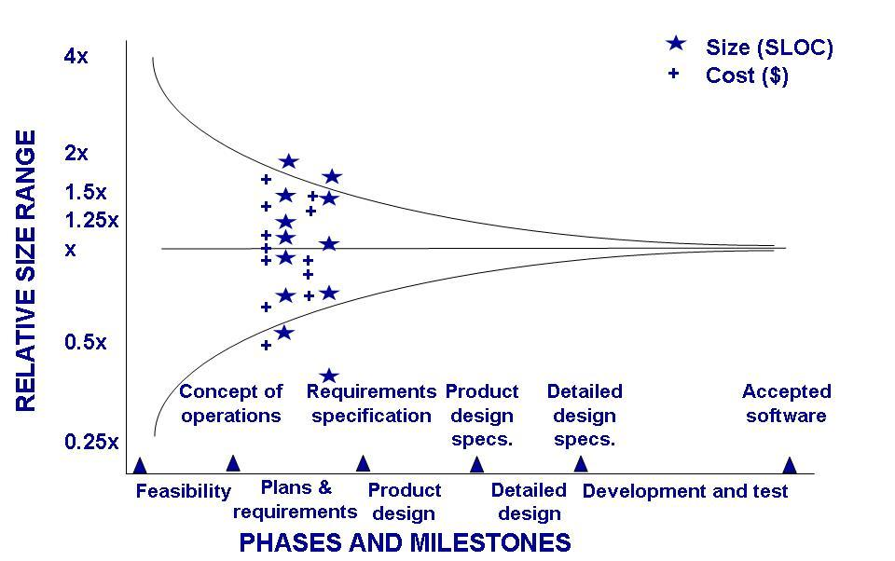
Estimate uncertainty

Slide 34
Effort Estimation: 1
Once requirements are defined, estimates can be made
Estimates are made to identify the cost to the developer of a software system.
Estimates takes into include:
Hardware cost
Software cost
Travel expenses
Training and effort costs
Staff
…

Slide 35
Effort Estimation:2
The main goal of estimation?
To determine a set of parameters that provide a high level of confidence to deliver an acceptable product meeting the project constraints (budget and time)
The parameters and constraints can be
Product features (SIZE)
Quality attributes (constraints)
Effort (estimated parameter)
Other resources
Schedule and budget
Technology (TOOLS)

Slide 36
Effort Estimation: 3
MAIN techniques:
Experience-based techniques
Algorithmic cost modeling
AI-based techniques

Slide 37
Experience-based techniques
Experience-based techniques
The estimate of future effort is based on the manager’s experience of past projects and the application domain. (i.e., the manager makes an informed judgment of what the effort are needed)
Experts may be over-optimistic or past experience may be incorrect/incomplete

Slide 38
Experience-based approaches: 2
A projection from past experiences to the future which may be adjusted to account for differences between past and future
Requires to have past experience to make some judgments
Need to know something about future
May need to make some adjustment to account for the differences between past and future
Documented in a spreadsheet, estimate them individually and compute the total effort required.

Slide 39
Algorithmic cost and AI-based Techniques
Algorithmic cost modeling
Formulaic approaches to compute the project effort based on estimates of product attributes (e.g., size, functions, etc.)
Examples:
COCOMA models (I, and II)
AI-Based
ML (Neural-Net Works (e.g., Deep learning model for estimating story points))
Case-based Reasoning (CBR)

Slide 40
Estimate using Size: 1
Most estimations models, tools, and methods use some measure of size as the main product attribute
Suppose we have estimated that the future product size in Line Of Code (LOC) will be 50,000 LOC,
Assuming no further adjustments is needed if the future project is similar to past project
Using past experiences, the software productivity for the same type of project is 500 LOC per person-month (i.e., 500 LOC/PM)

Slide 41
Using Size to compute Effort/Duration: 2
Using Size, the effort and duration(i.e., calendar time) can be calculated as follows:
Effort = 50,000-LOC/500-LOC/PM =100 PM (Person/Month)
Suppose we have 10 Full Time Equivalent (FTE) persons, then
Duration =100PM/10P=10M

Slide 42
Project Size (revisited)
Project Size metrics
Used in both Algorithmic and Experts-based cost estimation techniques
Size can be computed using
Code size (i.e., SLOC)
Functionalities (i.e., Function Points)
Applicability (i.e., application points)
…

Slide 43
How to estimate Size?
Size Estimation may involve:
by analogy/comparing with other projects
by converting function (or application Points) to LOC
by engineering judgement
…

Slide 44
Estimating Size: Pros and Cons
When size is used as primary factor for estimation
can be used as indicator of complexity
can have a direct relationship to project attribute such as effort and schedule
can be measured very accurately
easy to collect data about the size of the project
Problems with using Size
difficult to estimate LOC early in a project
difficult to relate changes to the requirements to changes in estimated LOC
poor quality LOC can be created

Slide 45
Factors influencing the final size
Several factors influence the final size
Use of COTS and components (e.g., DBMS)
Programming language (low level vs. high level)
Modern development methods (Model-based and Model-driven)
Complexity of the design which requires more coding, more testing

Slide 46
Factors affecting productivity
Study based on LOC identifies two key attributes:
Capability of the personnel
Complexity of the product (i.e., reliability and performance)
The least important factors include
Schedule
Previous experience with languages used in project

Slide 47
Function Point (FP) metric: 1
Function Point?
Used to measure the functionality delivered by the system
Using historical data (e.g., productivity), the FP metric can be used to estimate
Cost or effort to design, code, and test the software
Predict the number of errors (defects) that will be encounter during testing
Forecast the number of components and/or SLOC in delivered system

Slide 48
Function Points (FP): 2
FP attempts to quantify the functionality of a software system
Derived empirically
Used extensively for business applications and IT
The bottom line is
to calculate a single number, Function Point, representing all aspects of a system (e.g., complexity)

Slide 49
FP: Information domain
Function Points (FP) can be calculated by counting and weighting
Number of external inputs (EIs)
Number of external outputs (EOs)
Number of Internal logical files (ILFs)
Number of external Queries (EQs)
Number of external interfaces files (EIFs)
To compute FP, use
FP = count_total X [0.65 + 0.01 X ∑(F_{i})] where
count_total = sum of all FP entries
∑(F_{i})] = F_{i} ( for i =1 to 14) (called relative complexity adjustment factor (RCAF))
the constant .065 and weight factor 0.01 are determined empirically

Slide 50
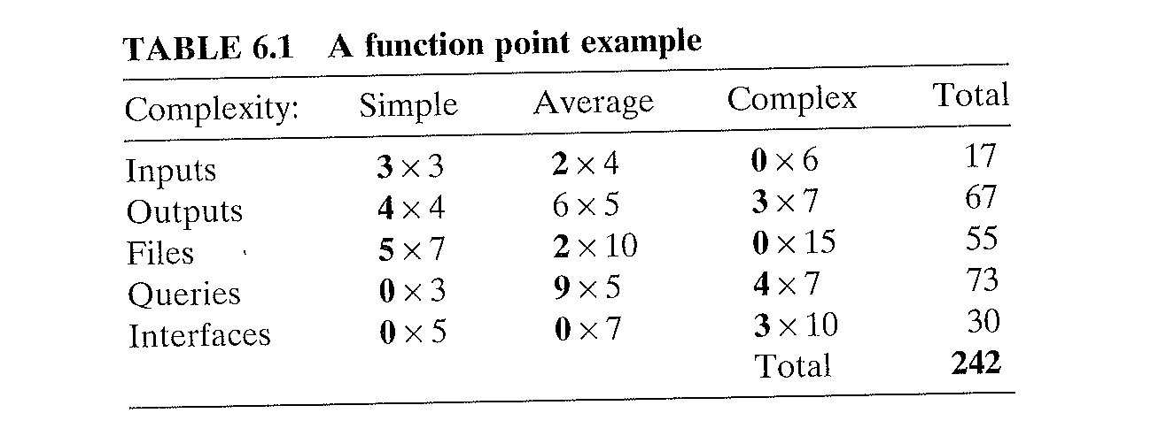
Example of Function Points with Relative Complexity Adjustment Factor (RCAF)

Slide 51
Example of Function Points with relative complexity Adjustment factor (RCAF of zero)
Assuming productivity = 6.5 FP/PM, and RCAF (relative complexity adjustment factor) = 0:
Effort = Total_FP/ Productivity =242/6.5= 37 PM
Total Cost = 37 X $1230 (avg cost per FP) = $ 45,510
2) Assuming that each FP = 66 LOC of C++, convert FP to LOC
Size (FP) = 37 X 66 = 2442 (LOC in C++)
3) Suppose also we have 6 Full Time staff, it then takes 6 months to finish the job
Duration = EFFORT/#Staff = 37/6 = 6 month

Slide 53
Notes:
Each of these questions is answered using a scale that ranges from 0 (not important or applicable) to 5 (absolutely important).

Slide 54
Notes:
Output: 3 queries, 1 letter, 2 reports
Inputs: 2 records
External Interface: Human Master Systems, and Wage Master System
Internal Files: 2 files

Slide 59
Algorithmic Cost Modelling (Revisited)
Uses a mathematical formula to predict project cost using size and following attributes
product
project
process
Effort = A× Size^{B} × M
A= a constant factor depending on the type of software (2.94)
B= it depends on the of complexity; (it ranges 1 to 1.5)
M= a multiplier reflecting product, process and people attributes
The estimations of the factors related to B, and M are subjective!
Notes:
Also known as regression-based estimation models. It is based on equations derived from historical data collected from past projects. Devising equations from data is known as regression analysis

Slide 60
Algorithmic models: Main Issues
Models are complex and difficult to use because
Too many attributes and the uncertainty can be used when estimating the value of attributes
Requires calibration (the modelers need to calibrate their model and attribute values using their own data)
Requires a range of estimates
Worst
Expected
Best
Model can be accurate estimate if
Understand the type of software to be produced
Know how properly to calibrate the cost modeling using local and/or past data

Slide 61
The COnstructive COst MOdel (COCOMO) cost modeling
An empirical model based on project experiences
Developed by Barry Boehm at USC
Not tied to a specific software vendor
Long history from initial version published in 1981 (COCOMO-81) through various instantiations to COCOMO II.
COCOMO II
Takes into account different modern approaches to software development, reuse, etc.

Slide 62
COCOMO-81
Three COCOMO modes of software engineering
Organic Model
small software teams develop software in a highly familiar, in-house environment.
Semidetached Model
intermediate between the organic and embedded modes.
Embedded Model
need to operate within tight constraints. (electronic funds transfer system or an air traffic control system)

Slide 63
COCOMA-81
Software project | a_{b} | b_{b} | c_{b} | d_{b}
Organic | 2.4 | 1.05 | 2.5 | 0.38
Semi-detached | 3.0 | 1.12 | 2.5 | 0.35
Embedded | 3.6 | 1.20 | 2.5 | 0.32
Where a, b, c, d are constants
Effort = a_{b}(KLOC)^{b}_{b} [ person-month ]
Development Time (D) = c_{b}(Effort Applied)^{d}_{b} [months]
People (P) = Effort / Development Time [count]

Slide 64
COCOMO II models
Incorporates a range of sub-models to generate more detailed and hence accurate software estimates
The sub-models in COCOMO II include:
Application composition model (reusable components, application points, etc.)
Early design model (FP)
Reuse model (integrate reusable and generated code)
Post-architecture model (SA and 17 cost drivers)

Slide 65
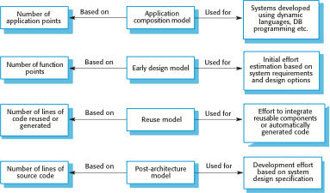
COCOMO estimation models

Slide 66
Application composition model (or objects)
Supports prototyping projects and projects where there exist extensive reuse
Based on standard estimates of developer productivity in application points/month
Formula
Effort = ( NAP X (1 - %reuse/100 ) ) / PROD
Effort = the effort in Person-Months (PM)
NAP = the Number of Application Points
PROD = NAP/Month (i.e., number of application point per months)
%reuse = an estimate of the amount of reused code
Notes:
PROD represents productivity . It depends on the developer’s experience and capability, and the capability of tool

Slide 67
Application Point PROD
Notes:
PROD represents productivity . It depends on the developer’s experience and capability, and the capability of tool.

Slide 68
Early design model
Estimates are made after the requirements have been finalized and agreed
Based on a standard formula for algorithmic models
Effort = A ∗ Size^{B} ∗ M where
M = PERS ∗ RCPX ∗ RUSE ∗ PDIF ∗ PREX ∗ FCIL ∗SCED;
PERS: Personnel Capability
RCPX: Reliability and Complexity
RUSE: Reuse required
PDIF: Platform difficulty
PREX: personnel experience
SCED: Schedule
FCIL : The team support facilities
A = 2.94 in initial calibration,
Size = KLOC
B = complexity (1.1 - 1.24)
Effort = 2.94 ∗ Size ^{(1.1-1.24)} ∗ M
Effort = 2.94 * 128000^{1.17} * 1= 730 PM
Notes:
B = complexity (1.1 -1.24) depending on novelty of the project, development flexibility, risk management approaches and the process maturity.

Slide 69
Multipliers (M)
Multipliers reflect the capability of
the developers
the non-functional requirements
the familiarity with the development platform, etc.
Seven Multipliers:
RCPX - product reliability and complexity
RUSE - the reuse required
PDIF - platform difficulty
PREX - personnel experience
PERS - personnel capability
SCED - required schedule
FCIL - the team support facilities

Slide 70
The reuse model
Used to estimate effort needed to integrate reusable components, codes, etc.
Takes into account black-box code and white-box reused code
There are two versions:
Black-box reuse (code is not modified)
No need to understand the code
White-box reuse (code is modified)
Need development effort to understand and reuse the code

Slide 71
Compute the source code equivalent
The formula used to compute the source code equivalent is complex and consists of
ESLOC = (ASLOC X 1-AT/100) X AAM
Where
ESLOC = the equivalent number of lines of new source code
ASLOC = an estimate of LOCs in the reused components that have to be changed
AT = the percentage of reused code that can be modified automatically
AAM = An adaptation Adjustment Multiplier refracting the additional effort needed to assess, understand, and modify the reuse component
Effort = A X ESLOC^{B} X M
Where A, B, and M have the same values as used in the early design model

Slide 72
Post-architecture level
The most detailed of Models in the COCOMOII
Applied when the software architecture becomes available
Uses standard formula with 17 multipliers!
Effort = A * Size^{B} * M
The code SIZE is computed by adding the following estimates:
Number of new SLOC to be developed
Estimate of reused costs using ESLOC;
An estimate of the number of lines of modified code
i.e., code that may be modified because of changing requirements

Slide 73
About Exponent term B
B exponent in formula
reflects project complexity
depends on 5 factors
B= (∑F_{i}/ 100) + 1.01 Where I (factor) is from 1 -5
Factors are rated on a six-point scale from 0-5
0 (i.e., extra high)
5 (i.e., very low)

Slide 74
Scale factors used in the exponent computation in the post-architecture model
Scale factor | Explanation
Precedentedness | Reflects the previous experience of the organization with this type of project. Very low (5) means no previous experience; extra-high (1) means that lots of experience
Development flexibility | Reflects the degree of flexibility in the development process. Very low means a prescribed process is used; extra-high means that the client sets only general goals.
Architecture/risk resolution | Reflects the extent of risk analysis carried out. Very low means little analysis; extra-high means a complete and thorough risk analysis.
Team cohesion | Reflects how well the development team knows each other and work together. Very low means very difficult interactions; extra-high means an integrated and effective team with no communication problems.
Process maturity | Reflects the process maturity of the organization. The computation of this value depends on the CMM Maturity Questionnaire, but an estimate can be achieved by subtracting the CMM process maturity level from 5.
Notes:
CMM: Capability Maturity Models from 1 to 5, where I means ad hoc and 5 means very optimized /systematics and hence a measurable process is used by organization.

Slide 75
Example1:
Suppose a company takes on a project
The project is in a new domain with new hiring
The client has not demanded a process to be used
Not enough time for risk analysis.
The company has a CMM level is 2 rating

Slide 76
Solution
Rank the 5-factor on scale of 0 to 5
Precedenteness: new project means low(4)
Development flexibility: no client involvement means very high (1)
Architecture/risk resolution: no risk analysis means very Low (5)
Team cohesion: new team which means nominal (3)
Process maturity: some control which means nominal (3)
Compute B (add the factors)
B = (4+1+5+3+3)/100 + 1.01=1.17

Slide 77
Example of Multipliers
Product attributes
Describes quality of the software product being developed.
E.g., reliability (RELY), complexity (CPLX)
Platform attributes (Computer)
Time/SPACE Constraints imposed on the software by the hardware platform.
E.g., execution time (TIME), Memory, etc.
Personnel attributes
Has to do with expertise and skills of the people working on the project into account.
E.g., language skill and experience (LEXP)
Project attributes (process)
Concerned with the particular characteristics of the software development project.
E.g., CASE tool (TOOL)

Slide 78
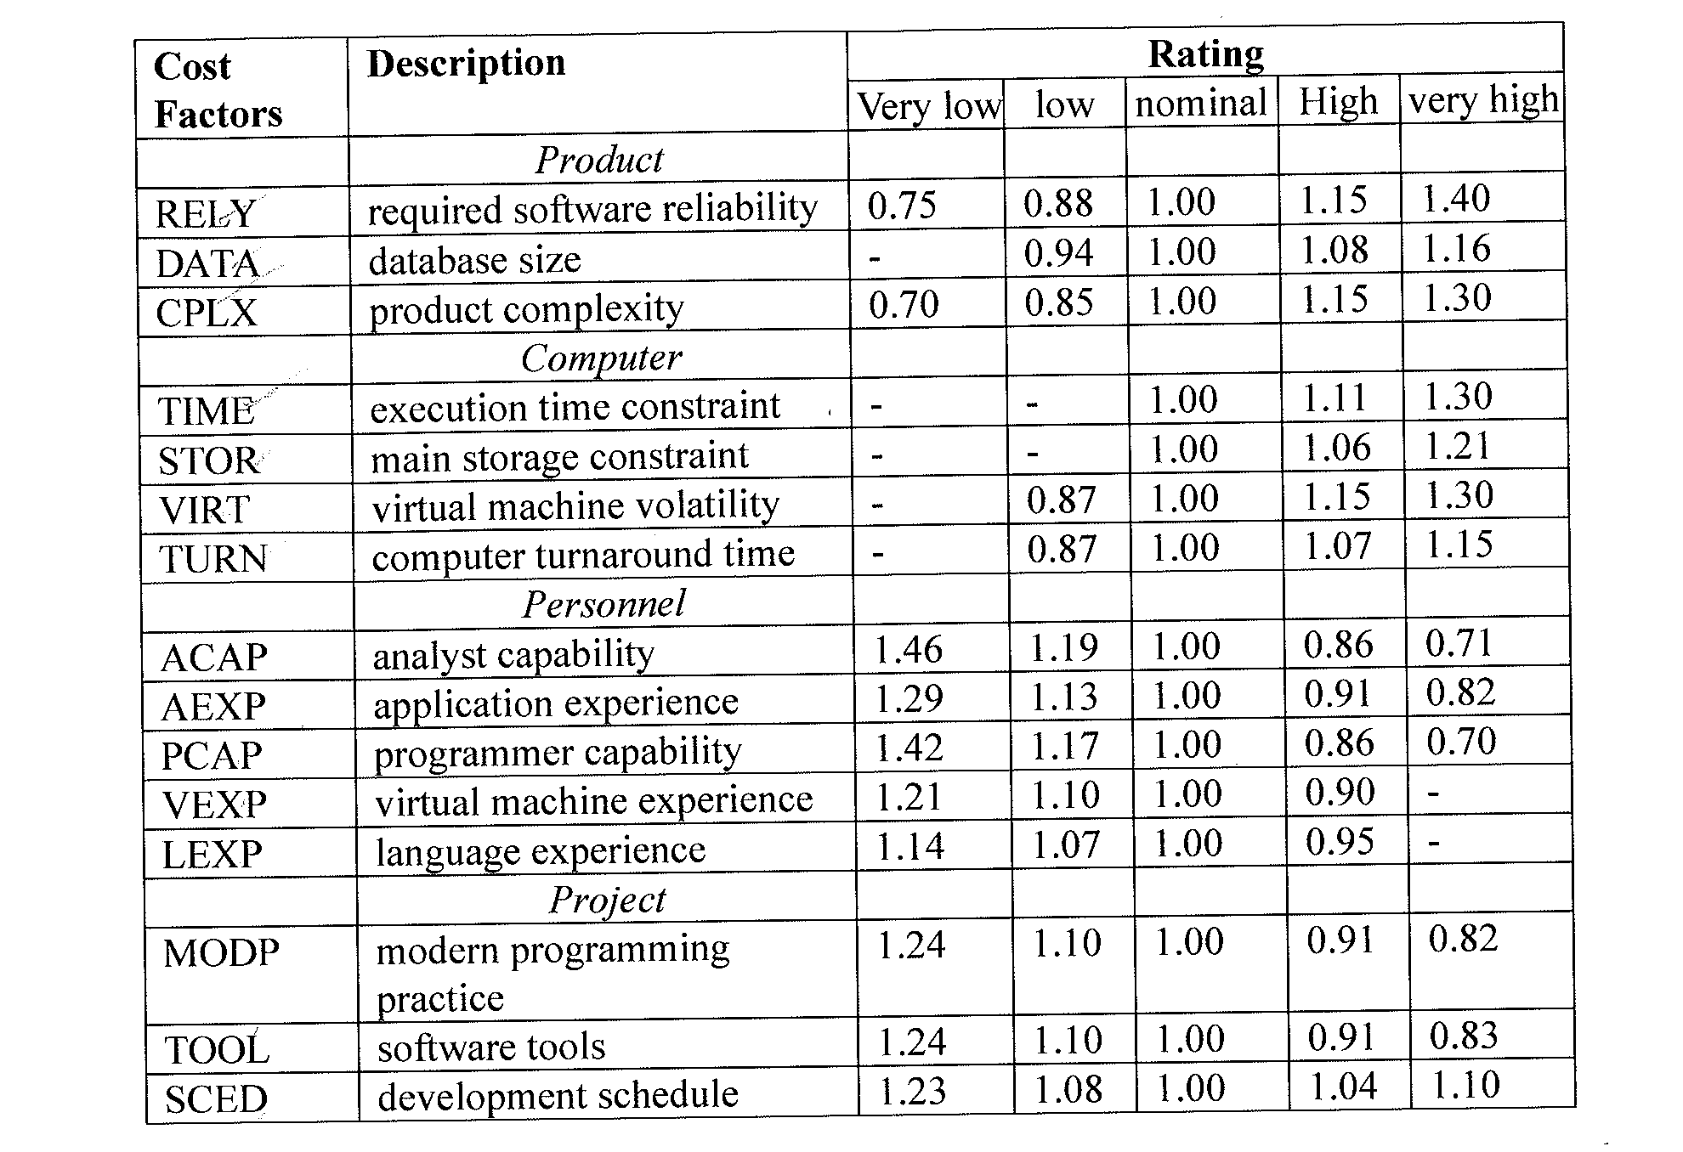
Table of Cost Factors (15 factors)

Slide 79
The effect of cost drivers on effort estimates
Exponent value (B)=1.17 | B= 1.17 = (4+1+5+3+3)/100 + 1.01
Initial COCOMO estimate no cost drivers | 596 PM for base model where M =1 , Size =128, B=1.17, A = 2.04 Effort = A * Size^{B} * M = 730 PM
Reliability (RELY) | Very high (multiplier = 1.39)
Complexity(CPLX) | Very high (multiplier = 1.3)
Memory constraint(STOR) | High ( multiplier = 1.21)
Tool use (TOOL) | Low, (multiplier = 1.12)
Schedule (SCED) | Accelerated( multiplier = 1.29)
Adjusted COCOMO estimate | 1895 PM for High Model where M=3.18, A = 2.04, B = 1.17 Effort = A * Size^{B} * M = 2306 PM
Key cost drivers

Slide 80
The effect of cost drivers on effort estimates
Effort = A * Size^{B} * M where
B= 1.17,
A = 2.04,
M = 0.41,
Size=128K
Exponent value (B) | B=1.17
Reliability | Very low, multiplier = 0.75
Complexity | Very low, multiplier = 0.75
Memory constraint | None, multiplier = 1
Tool use | Very high, multiplier = 0.72
Schedule | Normal, multiplier = 1
Adjusted COCOMO estimate | 244 PM for Low Model where M=0.41, A = 2.04, B = 1.17 Effort = A * Size^{B} * M = 295PM

Slide 81
Project duration and staffing
Managers must estimate the calendar time required to complete a project and when staff will be required.
Calendar time can be estimated using a COCOMO II formula
TDEV = 3 ∗ (Effort) ^{(0.33+0.2 * (B-1.01))}
Effort = PM
B = the exponent computed as discussed above (B is 1 for the early prototyping model)

Slide 82
Example
Suppose:
B =1.17
Effort = 60 then
TDEV = 3 ∗ (Effort) ^{(0.33+0.2*(B - 1.01))}
TDEV = 3 * (60)^{0.36} = 13 months
Normally the time required is independent of the number of people working on the project

Slide 83
Staffing requirements
Staff needed to perform the job can’t be computed by dividing the total effort by the required schedule
The number of people working on a project varies depending on the phase of the project.
Very small team at beginning (initial design)
Large team during development and testing
Small team for deployment
The more people working on the project, the more total effort is usually required!

Slide 84
Pros and Cons of COCOMO II
COCOMO II
Strengths
Objective, repeatable,
Analyzable formula
Efficient, good for sensitivity analysis
Weaknesses
Subjective inputs because of M, B
Assessment of exceptional circumstances
Calibrated to past, not future

Slide 85
Expert Judgment (revisited)
A typical method for estimating the code size by experts involves three possible code-sizes, Sl, Sm, Sh
Estimated size S is computed as
S = (Sl+Sh+4Sm)/6
Strengths (GOOD)
Assessment of representativeness, interactions, exceptional circumstances
Fast estimate
Weakness (BAD)
No better than participants
Suffers from biases, incomplete

Slide 86
Performance of estimation models
Many studies have attempted to evaluate the cost estimation models
Results are NOT encouraging!
No model can estimate the cost of software with a high degree of accuracy because of
A large number of interrelated factors such as user screens, volatility of system requirements
Using COTS
Lack of Complexity measurements
Development environments
Type of applications
Lack of established data repository of the projects by industries

Slide 87
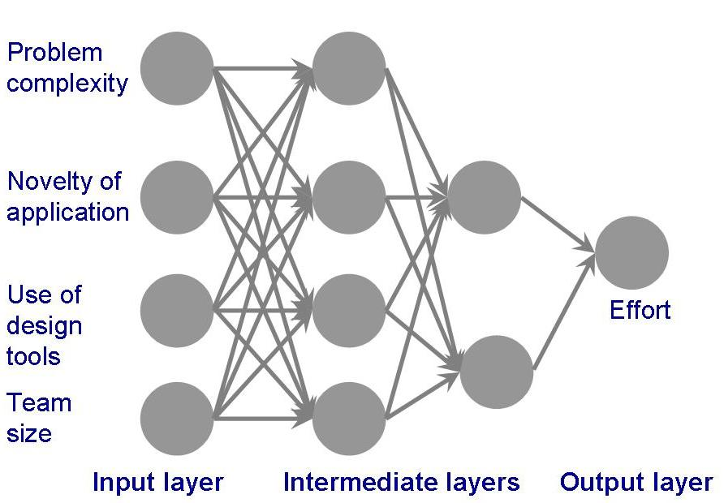
Effort Estimation Machine learning techniques: Neural Network
Neural network used by Shepperd to produce effort estimation
Notes:
AI is a set of Machine Learning Algorithms that learn from data. Once trained, display intelligent behaviour typically assigned to humans.

Slide 88
The Content of Project Plan Documentation
Project scope
Project schedule
Project team organization
Technical description of system
Project standards and procedures
Quality assurance plan
Configuration management plan
Documentation plan
Data management plan
Resource management plan
Test plan
Training plan
Security plan
Risk management plan
Maintenance plan

Slide 89
References
Ian Summerville, Software Engineering, 10th edition, 2016
Managing and Leading Software Projects. Richard E. Fairley. Wiley 2009
Fundamentals of Software Engineering by Carlo Ghezzi, Mehdi Jazayeri, and Dino Mandrioli, Prentice Hall, 2003

Slide 90
Summary:
Estimation techniques for software may be experience-based
or algorithmic, where the effort required is computed from other estimated project parameters.
The COCOMO II costing model
An algorithmic cost model
Uses project, product, and personnel attributes
Uses product size and complexity attributes to derive a cost estimate.

Slide 91
HW 1: Due Tuesday Feb.18
A software mgr is in charge of the development of a safety critical software systems, which is designed to control a radiotherapy machine to treat patient suffering from cancer. This system is embedded in the machine and must run on a special-purpose processor with a fixed amount of memory (256 Mbytes).
The machine must communicate with a patient database system to obtain the details of the patient and, after treatment, automatically records the radiation dose delivered and other treatment details in the database.
The COCOMO II method is used to estimate the effort required to develop this system and an estimate of 26 PM is computed. All cost drivers were set to 1 when making this estimate.
A) Explain why this estimate should be adjusted to take project, personnel, product, etc. into account.
B) Can you suggest four FACTORS that might have significant effects on the initial COCOMO estimate and possible values for these factors.
C) Explain why you have included each factor.

