Slide 1
Chapter 5

Slide 2
PROCESS SYNCHRONIZATION:
Processes are concurrent if they exist at the same time (includes processes in the ready queue and the CPU).
Processes are simultaneous (and concurrent) if they are executing at the same time (requires multiple processors).
Concurrent processes can function completely independent of each other, or they can be asynchronous (they require occasional synchronization and cooperation).
A cooperating process is one that can affect or be affected by other processes executing in the system. This may be due to the use of a common data structure or use of a parallel algorithm.
Since we cannot guarantee any particular ordering of the execution of the cooperating processes, the resulting values in the shared resource may be dependent on the order of the execution of the cooperating processes (race condition – a.k.a. lost update in database terms).

Slide 3
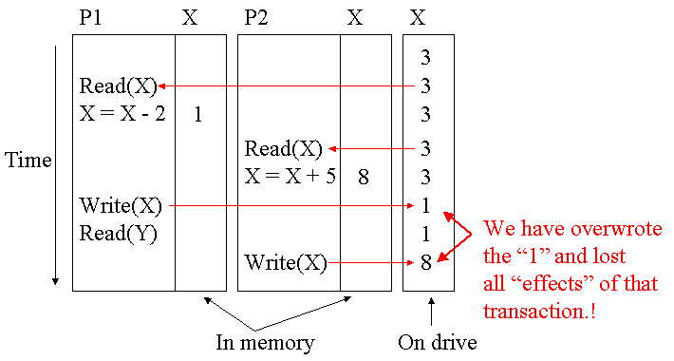
PROCESS SYNCHRONIZATION:
Race Condition:
Race Condition (aka Lost update) occurs when two processes that access the same resource have their operations interleaved in a way that makes the state/value of the shared resource incorrect.
Example: Two processes reading and writing the shared variables X and Y.
P1: P2:
read(X) read(X)
X = X - N X = X + M
write(X) write(X)
read(Y)
It's not hard to prove that if you reorder the execution of the two processes that you will get the "correct" result (X = 6, regardless of ordering of P1 and P2).

Slide 4
PROCESS SYNCHRONIZATION:
In some cases, it may be possible to use database serializability methods to insure data consistency. However, a direct application (i.e. 2 phase locking or graph theoretic methods) of this approach would probably add too much overhead to be feasible for this application.
A simpler / more efficient approach is to synchronize the cooperating processes such that they cannot conflict. If they do conflict, we could end up in a state of deadlock. However, if we are not careful our synchronization method may result in starvation.

Slide 5
PROCESS SYNCHRONIZATION:
CRITICAL SECTION:
Any portion of a program where shared data resources are accessed is called a critical section. The “other” portions are called the remainder section(s).
It is important to note that any given program may have several unrelated critical sections and that these unrelated critical sections may require synchronization with other different processes.
Requirements - Any solution to the critical section problem must satisfy the following:
  Mutual exclusion - Only 1 program may be executing in its critical section at any given time. Programs not executing in their critical sections can continue without interference.
  Progress – Processes operating outside their critical sections cannot prevent other processes from entering their critical sections.
  Bounded waiting – Processes cannot be indefinitely delayed from entering their critical section. If a process terminates while in its critical section, some method must be provided that “releases” the mutual exclusion rights held by the terminated process.
  Performance – No assumptions can be made about the relative performance of the involved programs.

Slide 6
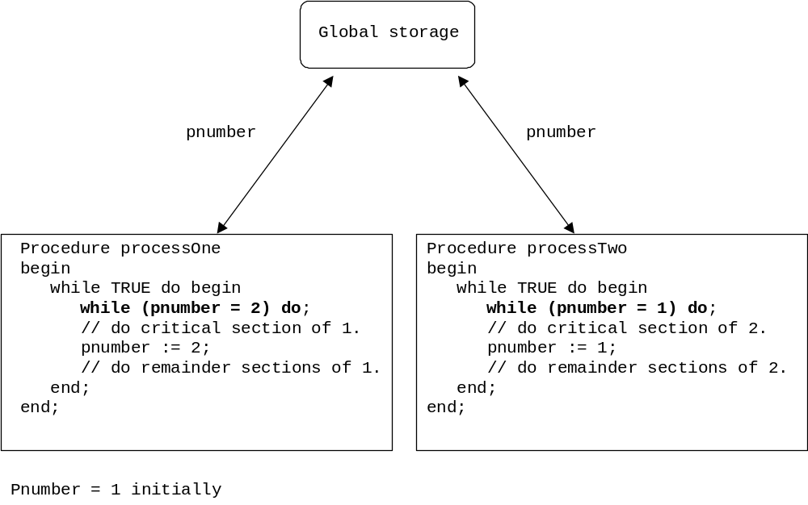
PROCESS SYNCHRONIZATION:
A first effort (lockstep synchronization).
Can only manage 2 processes.
Processes must enter and exit critical sections in strict alternation.
Bounded waiting is not guaranteed. The termination of one causes the remaining to be indefinitely delayed. And, if one process no longer requires execution of its critical section, the other process is indefinitely delayed.

Slide 7
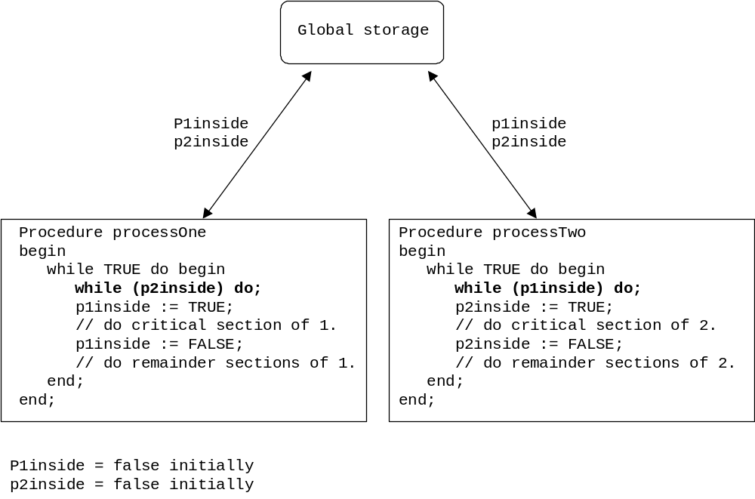
PROCESS SYNCHRONIZATION:
A second effort.
Can only manage 2 processes.
Mutual exclusion is not guaranteed due to concurrent processing .
Bounded waiting is not guaranteed. The termination of one causes the remaining to be indefinitely delayed.

Slide 8
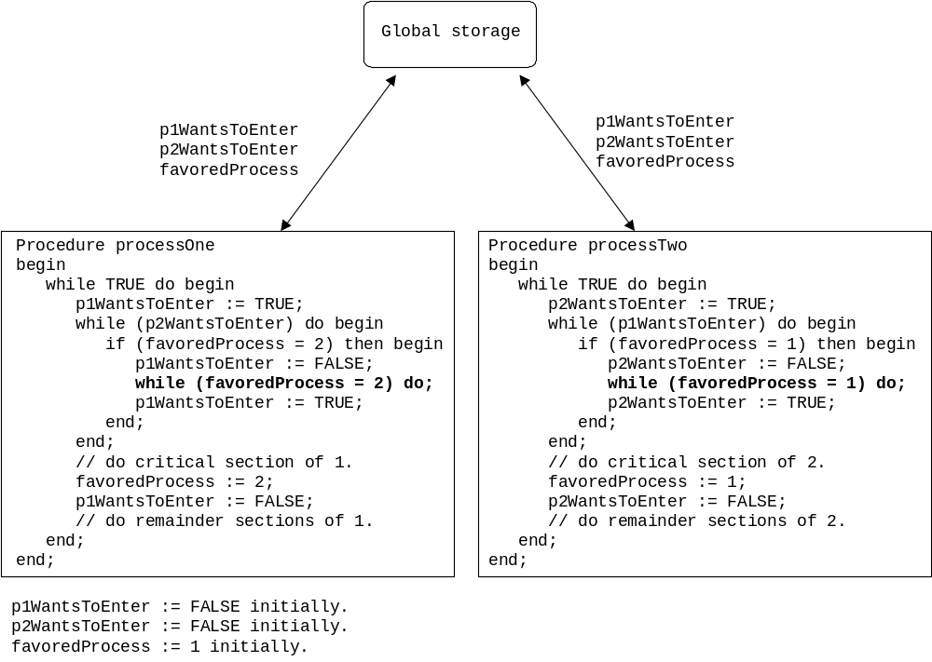
PROCESS SYNCHRONIZATION:
Dekker’s algorithm.
Can only manage 2 processes.

Slide 9
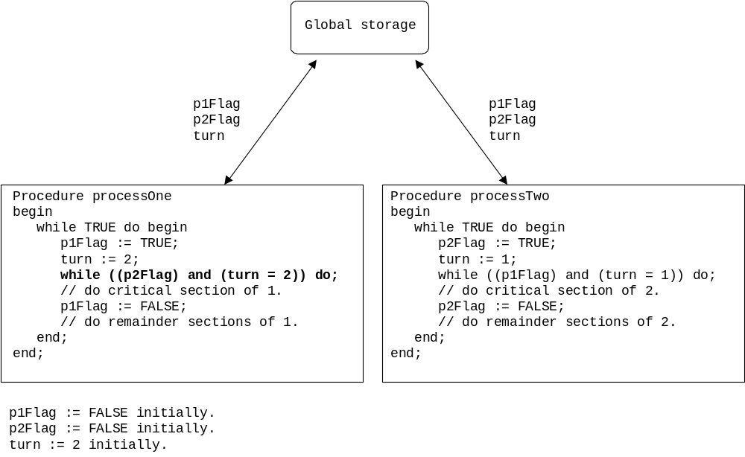
PROCESS SYNCHRONIZATION:
Peterson’s algorithm.
Can only manage 2 processes.

Slide 10
PROCESS SYNCHRONIZATION:
N-PROCESS CRITICAL SECTION:
Dijkstra – The first (1965) to present a software solution for implementation of an n-process mutual exclusion. However, his method allowed the possibility of indefinite postponement.
Knuth – Presented (1966) a software solution that eliminated the possibility of indefinite postponement. However, his method not prevent the possibility of lengthy delays.
Eisenberg and McGuire – Presented (1972) a solution for the Critical Section Problem for N Processes. The algorothm organizes the processes into a circle:
Lamport – Presented the Bakery (Baker’s) algorithm (1974). The algorithm uses the “take a ticket” method commonly found in bakeries, service counters, etc.
0
turn
6
1
me
5
2
The first process clockwise from "turn" who is not idle gets to run.
4
3

Slide 11
PROCESS SYNCHRONIZATION:
INTERRUPT DISABLING:
On a uniprocessor system, since only one program can be executing at a time, we could disable interrupts guaranteeing mutual exclusion. Why?
SPECIAL MACHINE INSTRUCTIONS:
A variety of multiple machine instruction pairs (which execute as a single atomic “instruction”) have been proposed to manage critical sections, including:
  Set & test
  Compare & swap
  Exchange
Using any of the above, we can easily modify the “second effort” algorithm to provide a good, but not perfect, solution (indefinite postponement is slightly possible).

Slide 12
PROCESS SYNCHRONIZATION:
SEMAPHORES:
Critical section solutions are not easily generalized to more complex synchronization problems. Semaphores (Dijkstra 1965) overcome this limitation.
A semaphore is an integer variable that is accessed through 2 atomic operations:
Wait: while (S <= 0) do; S--;
Signal: S++;
The above is an example of a spinlock semaphore. A semaphore type that wastes CPU cycles spinning in the while-loop.
Binary semaphore – Can be 1 or 0.
Counting Semaphore – Can be any integer value. Useful for allocating / sharing N identical resources to M concurrent processes (N <= M).
Semaphores can be used to manage critical section problems and can be used to force a specific execution sequence of a set of processes.
Incorrect use of semaphores (or any mutual exclusion method) can result in 2 processes being in their critical sections at the same time.

Slide 13
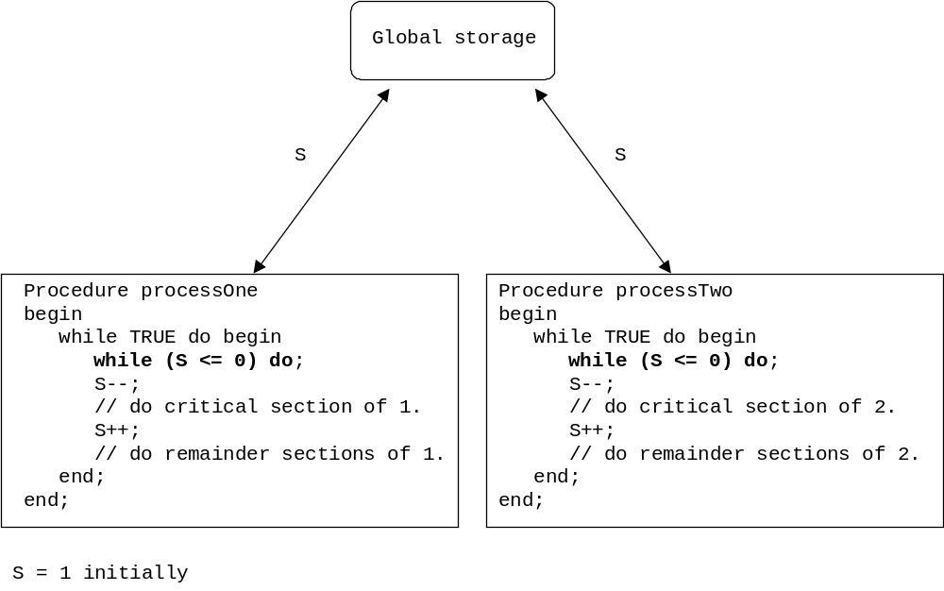
PROCESS SYNCHRONIZATION:
Lockstep synchronization modified with binary semaphores .
Wait
Signal

Slide 14
PROCESS SYNCHRONIZATION:
PRODUCER - CONSUMER:
Producer – produces goods, one at a time, and passes the item to the consumer.
Consumer – receives goods, one at a time, from a producer.
If their relative operating speeds are nicely matched – no problem. But, we cannot guarantee this. Therefore, we need either:
A message passing method (i.e. handshaking).
A fixed capacity storage facility (with message passing).
An infinite capacity storage facility (message passing not needed).
Approach 1 can be achieved using any mutual exclusion method. Even our first approach will, sort of, work.
Approach 2 can be achieved using any mutual exclusion method. Even our first approach will, sort of, work.
Approach 3 is not feasible.

Slide 15
PROCESS SYNCHRONIZATION:
MONITORS:
Mutual exclusion methods and semaphores work, but they have a number of weaknesses. Including:
  It is difficult to use to express solutions to more complex concurrency control problems.
  It is difficult to prove the correctness of a program using these methods.
  It is easy to misuse these methods.
Monitors (Dijkstra 1971, Hoare 1974, and Hansen 1975) are a higher-level construct that solves many of the problems associated with earlier mutual exclusion methods and semaphores. Characteristics of monitors include:
  Monitors are a concurrency construct that contains both the data and procedures required to perform the allocation of a shared resource.
  Monitors enforce information hiding.
  Monitors rigidly enforce mutual exclusion (at the monitor boundaries).
  Monitor processes waiting for a resource wait in a queue (free up CPU) until signaled by another process that the resource is available.
  Monitor processes waiting have priority over any new processes.
  Monitors are a programming language construct, so it is up to the compiler to enforce the mutual exclusion. Therefore, it is less likely that something will go wrong (we assume that the compiler is correct).

Slide 16
PROCESS SYNCHRONIZATION:
HOARE VS HANSEN MONITOR:
The difference between Hoare’s and Hansen’s approaches can be described as follows: Consider a producer-consumer n-buffer process pair. The producer finds the buffer full and does a wait. The consumer consumes one item and signals the producer to “wakeup”. We now need some method to prevent the two processes from being in the monitor at the same time.
Hoare proposed that the awakened process (the producer) suspend the consumer process.
Hansen proposed that the process sending the “wakeup” call exit the monitor immediately (the wakeup call must be the last statement in the monitor process).
Hoare’s method may be more powerful, but Hansen’s is simpler to understand and implement.

Slide 17
