Slide 1
Chapter 9

Slide 2
PAGED MEMORY ALLOCATION
Paging is a method used to manage the overlay process in virtual memory systems (UNIX and Windows10 are virtual memory systems).
Paging requires the memory to be divided into equal sized chunks. Physical memory chunks are called page frames and logical/virtual memory chunks are called pages. The frames and pages are always of equal size. A data structure is used to log the location and use of each page.
Paging allows noncontiguous memory allocation.
Paging is a form of dynamic relocation.
Paging eliminates external fragmentation (any free page frame can be allocated to any waiting page).
Paging does not eliminate internal fragmentation.

Slide 3
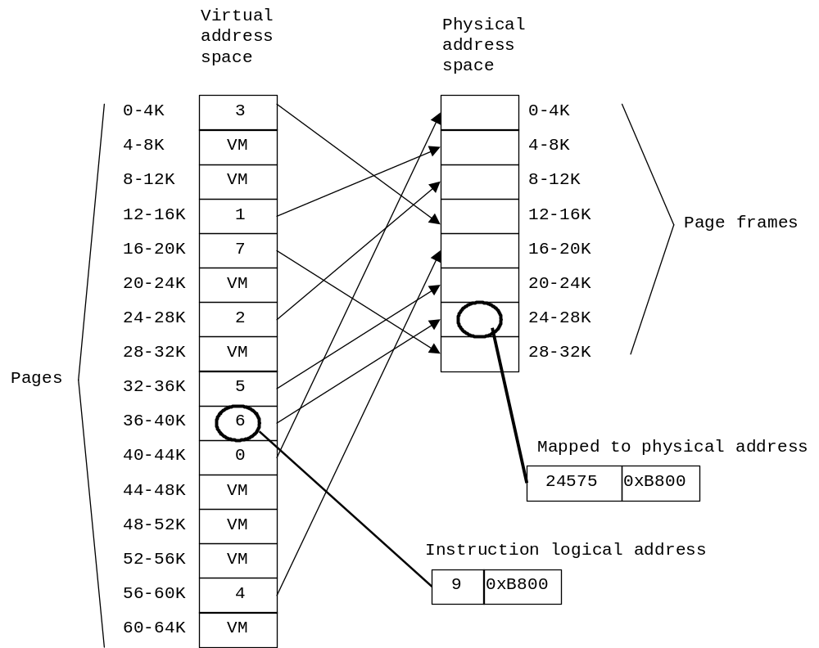
PAGED MEMORY ALLOCATION
EXAMPLE – A system w/32K of RAM, 64K of virtual memory, and 4K pages:

Slide 4
PAGED MEMORY ALLOCATION:
PAGE TABLES:
We must expect a lot of page (memory) accesses and we want these accesses to be fast, thus any data structure (page table) that is used to manage the pages must be efficient. Methods include:
  Hardware – Using a set of dedicated registers. Fast, but limits the number of pages possible.
  Hardware – Using a protected area of main memory and a single register (page-table base register). Allows for many pages, but is very slow.
  Hardware – Using a memory cache (translation look-aside buffer). Fast, but expensive. So we only keep the part of the page table that references active pages in the buffer. Other page requests require accessing the main memory version of the page table. However, each context switch requires that the buffer be flushed (to prevent using the wrong pages).
To provide memory protection, the page table may also include a set of bits for protection.

Slide 5
PAGED MEMORY ALLOCATION:
PAGE TABLES:
Because modern computer systems can include large amounts of memory, the flat-file approach to page tables is not feasible. Options include:
  Two-level page tables – An index to an index idea.
  Multi-level page tables – Similar to the above, except multiple layers of tables are possible. Advantages and disadvantages are the same.
  Inverted page tables – Usually, each process has a page table associated with it that records the pages required by the process. However, the individual page tables may be very large.
  Inverted page tables only have an entry for each frame page (physical memory). Each entry in the page table includes the PID of the process (owning the associated frame page) and a page number (what virtual memory page is located there). Advantages are that less memory is required to store the page table. Disadvantages are it is slower (since the table is not sorted by PID or page number, a linear search is required).

Slide 6

PAGED MEMORY ALLOCATION:
PAGE TABLES:
Page number/size – 2 possibilities:
Split the memory into N frame pages (may be limited by hardware constraints).
Smaller page sizes tend to reduce internal fragmentation, yet result in a larger page table. If we consider only wasted memory and the page table size, the optimal page size (P) can be computed from:
s is the average process size
e is the number of bytes per page table entry.

Slide 7
PAGED MEMORY ALLOCATION:
PAGE FAULTS:
Whenever a process tries to access a page not in physical memory, a page fault is generated. This causes the CPU to pick an unused or little used frame page, write its contents to disk (if it was being used), fetch and load the referenced page (which caused the page fault), re-map the page table (to reflect the page swap), and continue processing the process.
Sounds simple enough, but how do we decide exactly what page to remove?
We must also realize that some pages should never be replaced. We use frame locking to “lock” those pages in memory.

Slide 8
PAGED MEMORY ALLOCATION:
PAGE FAULTS:
Page replacement options include (we assume that all of the pages are in use):
  Optimal page replacement – We remove the page that will not be required for the longest time. Impossible to implement!
  Least Recently Used (LRU) – Assuming that we have a method to keep track of the usage of pages, we can remove a page that has not been used in the longest time. Theoretically possible, but expensive.
  Least-Frequently-Used (LFU) – By keeping a counter for each page, we can determine which page to remove by determining the least referenced page. Expensive and faulty!
  Most-Frequently-Used (MFU) – By keeping a counter for each page, we can determine which page to remove by determining the least referenced page

Slide 9
PAGED MEMORY ALLOCATION:
  PAGE FAULTS:
  Clock – Requires 1 additional bits (use bit) associated with each page. Whenever we load or access a page we set the use bit to 1. Whenever we want to replace a page, we scan the buffer (implemented as a circular list) looking for a page with a use bit set to 0. If we find a page with a use bit of 1, we reset that bit to 0 and move on.
  Additional-Reference-Bits – By keeping an n-bit word for each page in the page table, we can determine which page(s) have not been used recently. At regular intervals the OS shifts the word right by 1 bit. The reference (R) bit is put on the left. The numeric value of the word indicates how long ago it was last referenced.

Slide 10
PAGED MEMORY ALLOCATION:
  PAGE FAULTS:
  Not-Recently-Used (NRU)– Requires 2 additional bits associated with each page (a referenced bit “R” and modified bit “M”). Whenever we read from or write to a page we set the R bit to 1. Whenever we write to a page we set the M bit to 1. When a process is started, both bits for all of its pages are set to 0. Periodically, the OS resets the R bit to 0. When a page fault occurs the OS inspects all pages and assigns them to 1 of 4 categories:
Class 0: R = 0, M = 0
Class 1: R = 0, M = 1
Class 2: R = 1, M = 0
Class 3: R = 1, M = 1
The OS removes (at random) a page from the lowest non-empty class set.
Easy to implement and provides good (but not optimal) performance.
Also known as the Enhanced-Second-Chance algorithm.
  Also considered a variation of the Clock approach.

Slide 11
PAGED MEMORY ALLOCATION:
  PAGE FAULTS:
  First-In, First-Out (FIFO) #1 – We simply remove the oldest page.
  First-In, First-Out (FIFO) #2 – We modify the NRU algorithm by removing the oldest page from the lowest non-empty class set.
  Second-Chance – A modification of the FIFO method. We inspect the reference bit of the oldest page. If the bit is 0 it is removed. Otherwise, we reset its reference bit to 0 reset its time-stamp to the current time.
It would seem that the more memory, the fewer page faults would be generated. However, it has been shown (Belady et al 1969) that with FIFO this is not always the case. This is known as Belady’s anomaly.

Slide 12
PAGED MEMORY ALLOCATION:
PAGING PERFORMANCE:
  Page-buffering – The OS keeps a set of free pages, so it can load a page and get the process started before spending the time to write the replaced page out to disk.
  Pre-paging – The working set pages (or neighboring pages) are loaded before execution starts.
  Paging on demand – Pages are not loaded into memory until they are required.
  Proportional allocation – Allocate the number of frames based on the size of the program.

Slide 13
PAGED MEMORY ALLOCATION:
  PAGING PERFORMANCE:
  Local vs global allocation policies – When the OS chooses a page to remove does the OS only consider pages belonging to the process causing the page fault (local policy) or does the OS consider all pages (global policy)?
  Generally, global policies work better.
Cleaning – When does the OS synchronize a page with that on the disk? Two common methods:
  Demand cleaning – A “dirty” page is written out only when selected for replacement.
  Pre-cleaning – Writes “dirty” pages out before selected for replacement. Allows for “batch” writes to disk.

Slide 14
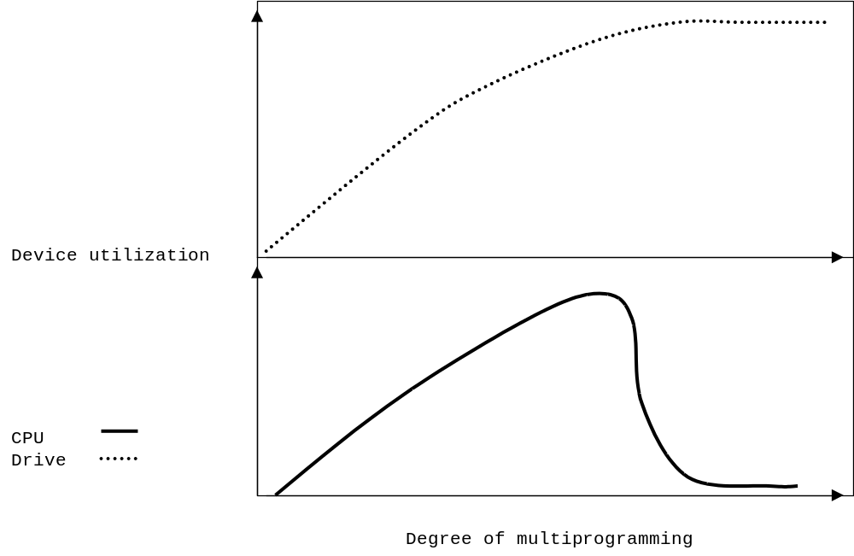
PAGED MEMORY ALLOCATION:
  THRASHING:
Thrashing – When page faults occur every few instructions. Typically, the case is that several processes will be in contention for memory space and (assuming a global allocation policy) will generate page faults that will remove each other pages. It’s a vicious cycle.
We can run into a similar problem when we have a shared file system (on a server). As more and more processes request a file from the server, the server gets backlogged. However, this is not the same as thrashing:
Harddrive
Utilization
CPU
Thrashing – CPU can’t do much work because pages are not in memory.
Utilization

Slide 15
PAGED MEMORY ALLOCATION:
  THRASHING:
Methods to reduce thrashing include:
  Local allocation policy.
  Page fault frequency (PFF) allocation – With Least-Recently-Used (LRU), increasing the number of pages available reduces the number of page faults. Therefore, if a process is generating a lot of page faults, we would remove some other process’s page(s) giving the problem process more pages to work with.
  Working-Set model allocation – We keep track of N currently active pages for each process. The OS only allows a degree of multiprogramming such that each process can be allocated its working-set of pages. Prevents thrashing and provides a near optimal use of memory, however it is expensive to implement and the determination of N is/can be difficult.

Slide 16


