Slide 1

Mini-Pascal Compiler Project
CSCI 465 – Principles of Translation
Sam Dressler
December 10th, 2020

Slide 2




Project Overview
Delivery
Lexical Analyzer
Intermediate Code Generator
Code Generator
Notes:
The Project was divided into three deliveries where the first included the lexical analyzer. The second included the first half of the intermediate code generation. The third and final delivery included the second half of the intermediate code generator as well as the machine dependent code generation

Slide 3
Lexical Analyzer
Convert input file to character stream
01
Convert character stream into symbols
02
Classify the symbols with a token type and then also record its value
03
Notes:
The first part of my compiler was the lexical analyzer. This functionality in my program worked by taking the input file and converting it to an array of characters. Once the input file was converted to characters it was further grouped into preliminary symbols based on the language. And then the final step was to identify and store the symbols that would be used by the intermediate code generator.

Slide 4

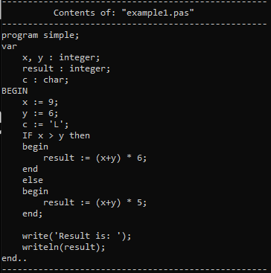
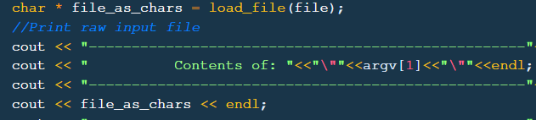

Example Input File Converted to characters
Notes:
The characters are loaded from the file and place simply into a character array that would mirror what is in the actual file.

Slide 5
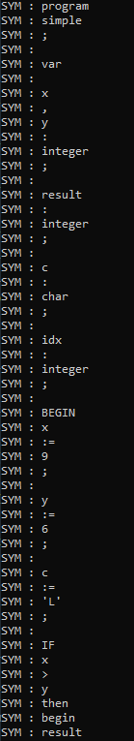
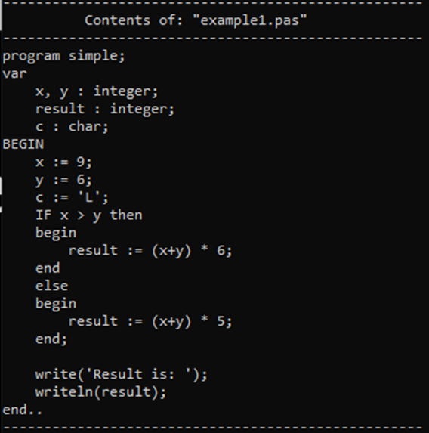
Character Array Conversion to Symbols
Notes:
The characters are loaded from the file and place simply into a character array that would mirror what is in the actual file. This print out was used to help debug during development and to ensure that the char array was being processed correctly. Note that this symbol vector still contains spaces which will be removed during the next step.

Slide 6
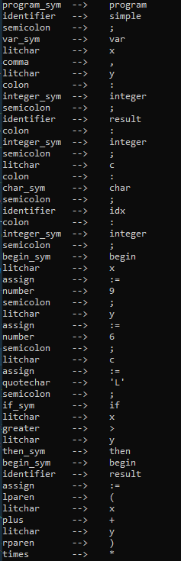
Classification of Symbols
Notes:
Spaces are excluded and each of the symbols were classified. The symbols are pushed onto a new vector that contains the token type as well as its value.

Slide 7
Intermediate Code Generation
Analyze the symbols, fill symbol table, and generate three address code to be used in the final code generation.

Slide 8
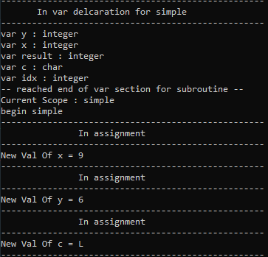
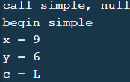
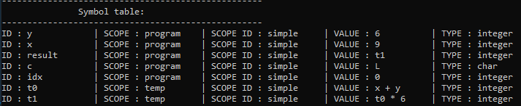
ICG Examples
Delivery 2
Variable Declaration and Storage
Notes:
Since there are a large variety of different token types that can be processed, I chose one from each of the deliveries to go over. From delivery 2, I will go over how a variable is declared and initialized in the symbol table. These variables are then assigned a value in the symbol table and a three-address code is generated. From the third delivery, I will go over how If-else statements are handled and how the compiler chooses what statement will be executed and given a three-address code.
Variables in the var section of code are created and given an initial entry in the symbol table as undefined.
Once an assignment token is read then the following expression is evaluated and assigned an entry in the symbol table is updated.
Variables can be declared as type integer or char
Type checking occurs when values are assigned to the variables. Examples of error output will be included later in the presentation

Slide 9
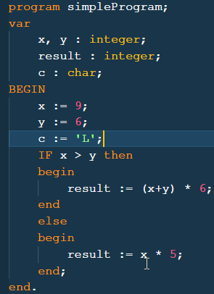

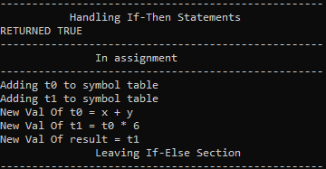
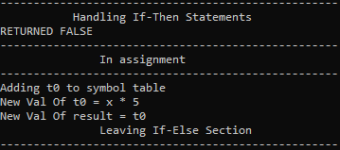

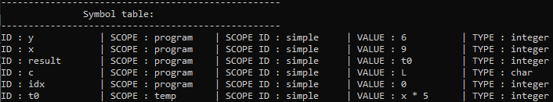
ICG Examples
Delivery 3
If-else conditional
Notes:
Conditional statements are formed and then evaluated.
If true, the following block of statements will be executed
In this case the result variable is assigned its value and can be seen in the symbol table.
If false, the first block will be skipped and the second block of code is executed.

Slide 10
Final Code Generation
Use three-address code and symbol table to generate the assembly code

Slide 11

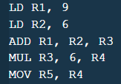
Output
Values of x and y are declared earlier in the program and the three-address code allows the values to be loaded.
Input of:
Will generate:
- Value of x is loaded into R1
- Value of y is loaded into R2
- R1 and R2 are added and stored in R3
- R3 is multiplied by a constant value 6 and stored in R4.
- R4 is then moved to R5 which is the result register.

Slide 12


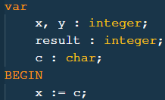
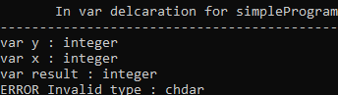


Error Handling Examples for ICG
Handling certain errors will cause the compiler to cease executing. i.e. Type checking
Trying to assign a variable a value that had not been declared yet will cause an error.
Errors will be caught during expression evaluation
Notes:
Type checking variables and the type is not the same will cause the program to quit execution since the variable needs to have a value if its being used in the rest of the program

Slide 13
Lessons Learned
Developing a compiler takes a LOT of code and time – 2000+ lines of code
Writing out a detailed design for the code will save time spent debugging
Create versatile functions to reduce the code reuse.
Notes:
1st and 2nd bullets :
I think I could have saved a lot of time had I spent more time researching prior to writing a single line of code. Once the program grew to a certain size, adding a new feature required many things to be changed and caused a lot of fires that needed to be put out.
3rd bullet:
I implemented a function that take in a mode and then based on that mode it would write a value to the 3-address code file.

Slide 14


Thank you!
Questions?

