Slide 1
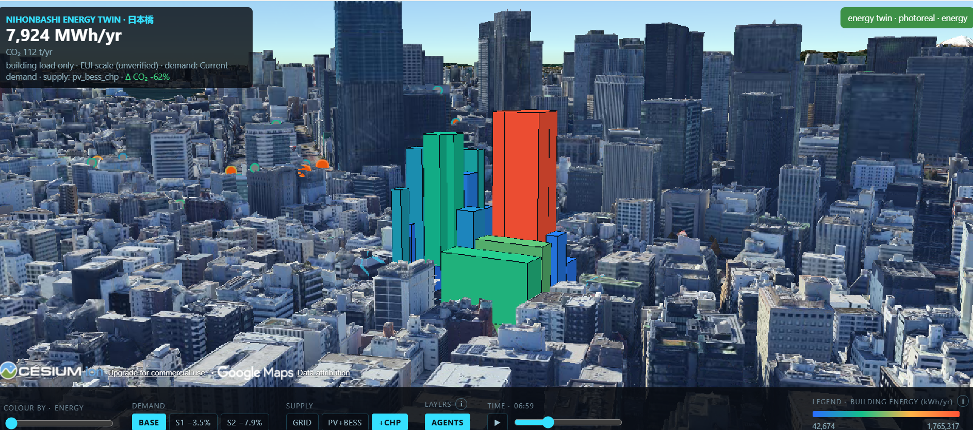
日本橋エネルギーツイン
From Georeferenced Digital Twin to Omniverse
Sam Duong · Advisor: Dr. Perry Yang

Slide 2
The question 問い
Does per-building energy use intensity, with ping-derived occupancy, materially change the cost-optimal PV and battery sizing for a Nihonbashi block?
10%
10%
5
2
PV capacity change
storage energy change
buildings change rank
top-5 members change

Slide 3
THE PRO-RATA SPLIT
49.93
every building, identical intensity · kWh/m²/yr

Slide 4
RANK DISPLACEMENT
14 of 22
buildings change rank under corrected intensities · ρ = 0.897 < 0.9

Slide 5
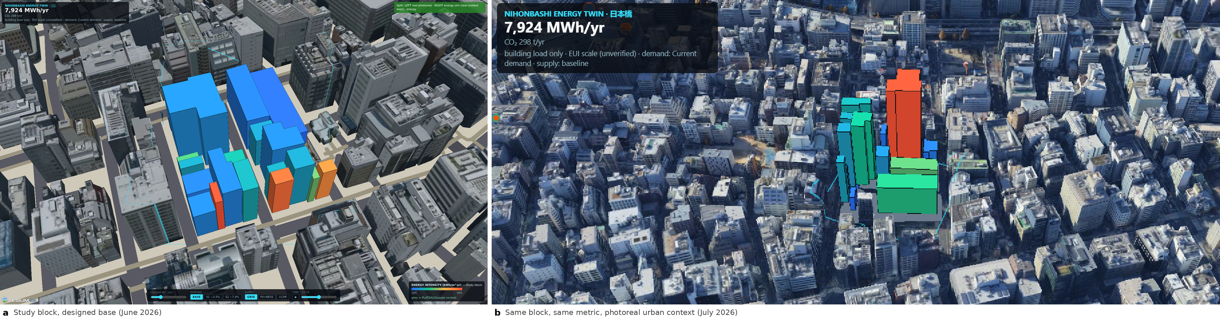
Context changed, not data

Slide 6
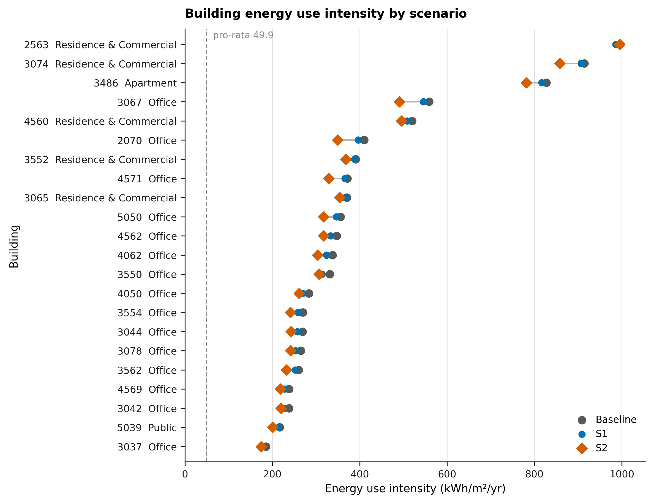
Building energy use intensity by scenario

Slide 7
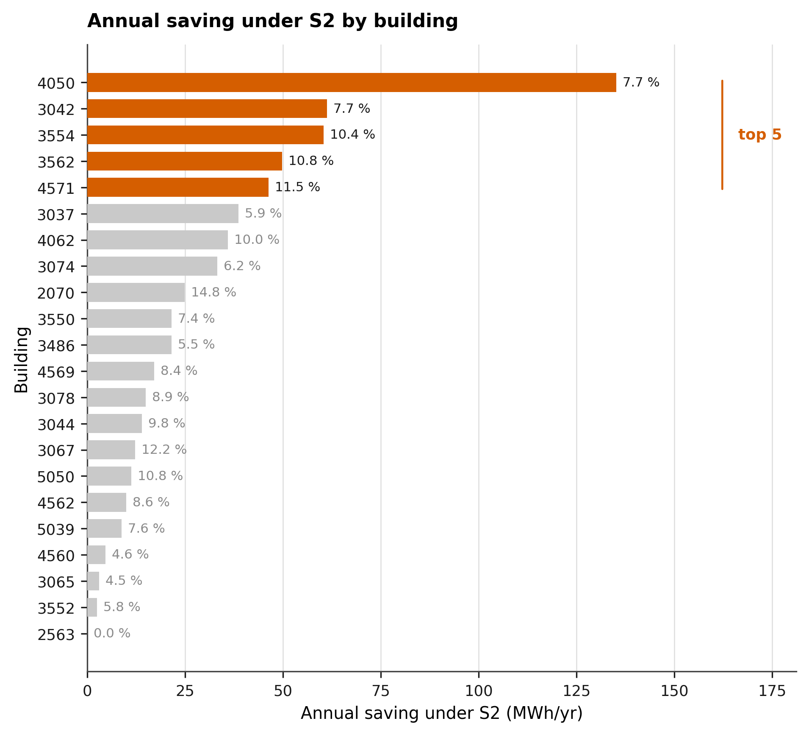
Annual saving under S2 by building
Largest absolute savers: 4050, 3042, 3554, 3562, 4571

Slide 8
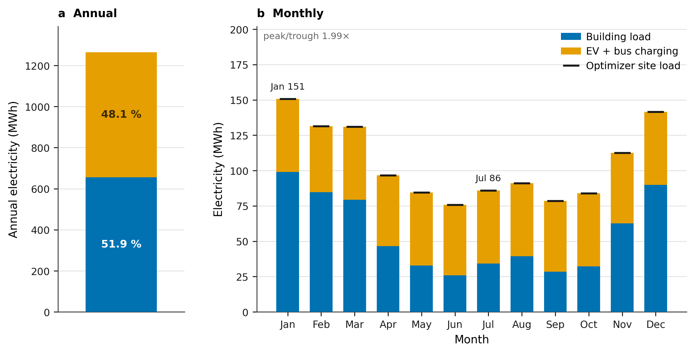
District electricity: composition and seasonality
48.1%
of the district total is vehicle charging

Slide 9
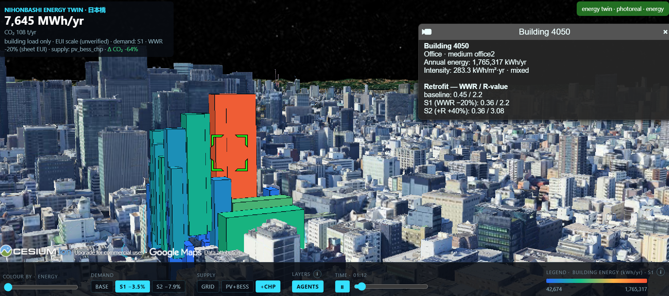
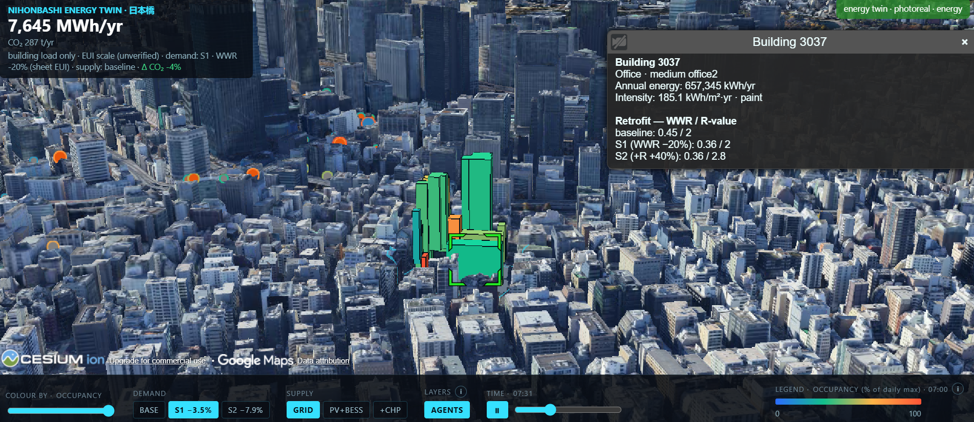
Per-building record
Occupancy and agents

Slide 10
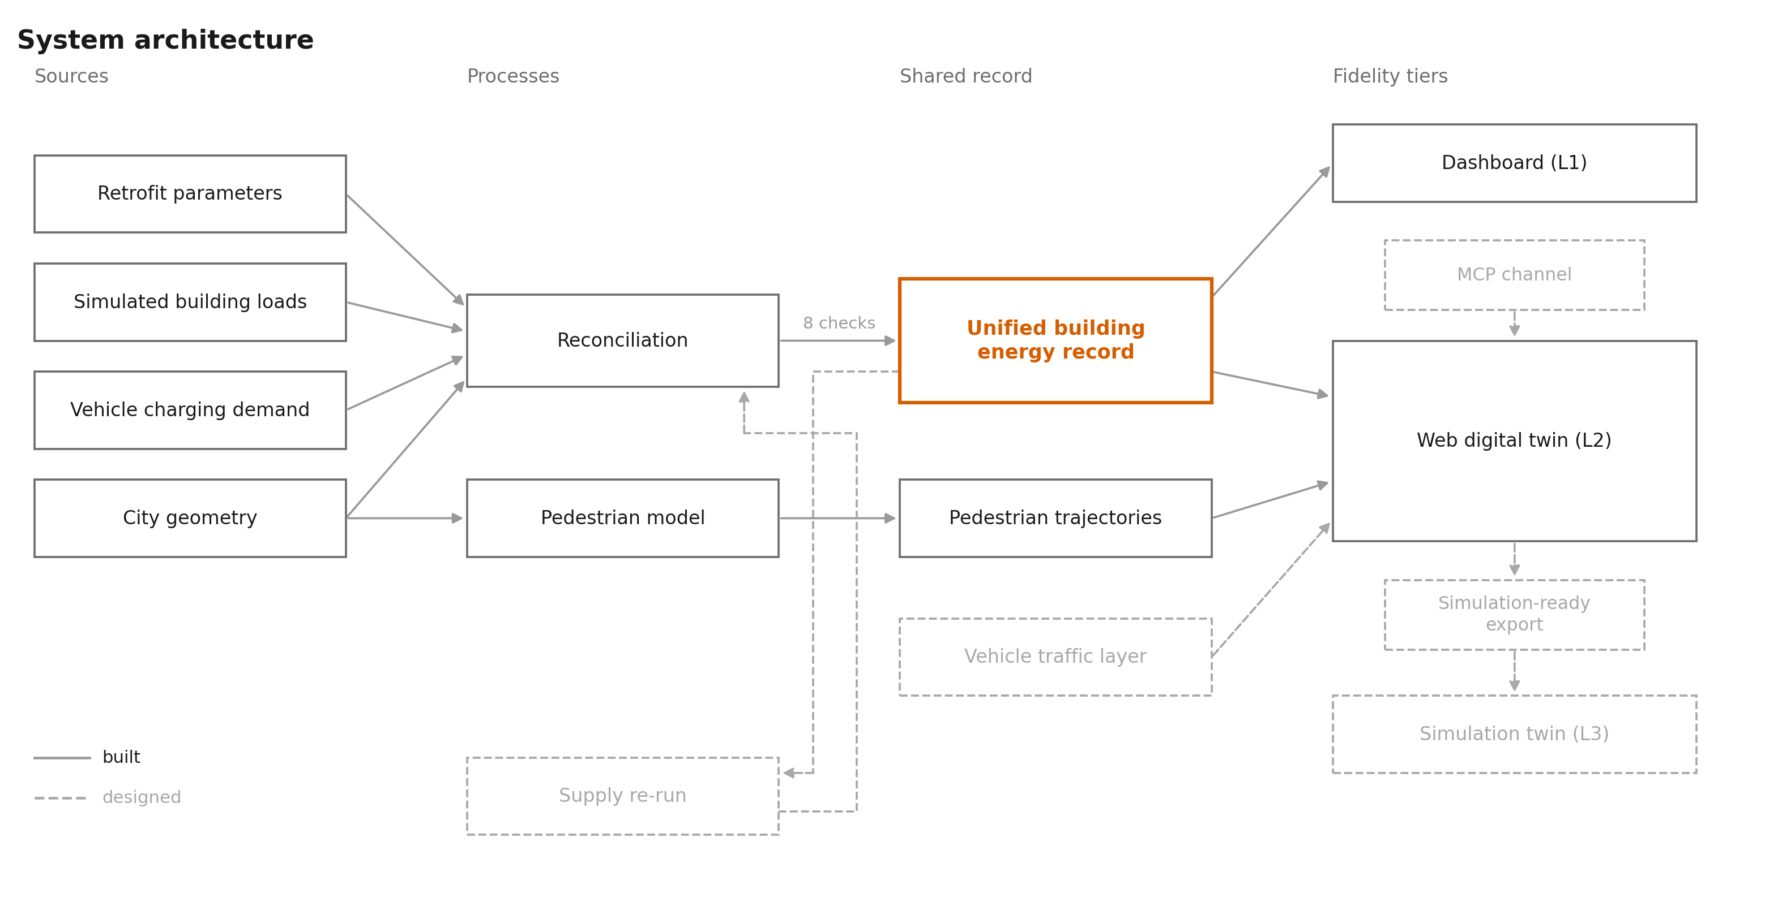

Slide 11
The fidelity ladder 忠実度の階層
L3
Simulation twin
L2
Web digital twin
L1
Dashboard
Hypothesis: D-1 settles at L1 or L2, D-2 settles at L2, and only D-3 requires L3.

Slide 12
At which fidelity tier does the answer to a given urban energy decision stop changing?
CUPUM 2027
github.com/SamDuo/nihonbashi-robot-sim · demo: outputs/energy_cesium_view.html

