Slide 1
House Hold Energy Data Analysis using MS SQL
Analyst : Dutse Samuel Yaula
4th April, 2023

Slide 2
Introduction
The data was collected by the publisher of the time series predictive model on kaggle from his apartment unit in San Jose for one plus year. The data is collected with smart meters and shared by the energy company. https://www.kaggle.com/datasets/jaganadhg/house-hold-energy-data
I used the data to practice some SQL queries, aim at providing hindsight to gain insight and provide foresight to energy consumption using smart meters.

Slide 3
Description of Data
The data contains eight attributes.
TYPE - This is an information column. The value is 'Electric usage' for all the observations.
DATE - Date of electric consumption. There is no timestamp in this field.
START TIME - Start time of the consumption.
END TIME - End time of the consumption
USAGE - Consumption in kWh
UNITS - This column denotes measurement unit. It is kWh for all the observations.
COST - Cost of consumption in $.
NOTES - Mostly an empty column

Slide 4
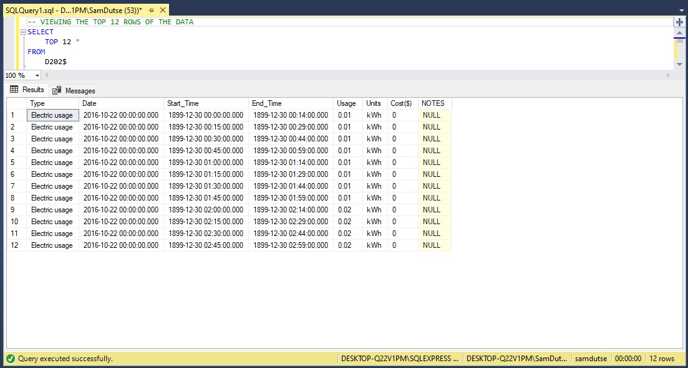
--1. VIEWING THE TOP 12 ROWS OF THE DATA
SELECT
TOP 12 *
FROM
D202$

Slide 5
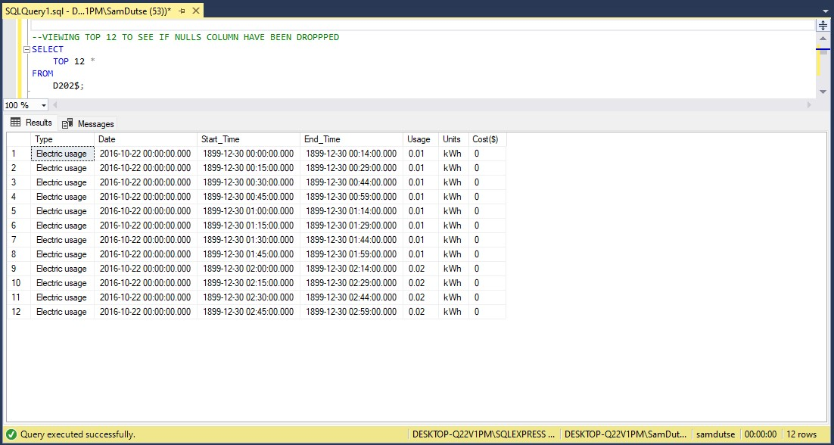
--2. DROPPING THE NOTES COLUMN SINCE ITS ALL EMPTY AND –-3 VIEWING THE FIRST 12 ROWS AGAIN
ALTER TABLE
D202$
DROP COLUMN
NOTES;
SELECT
TOP 12 *
FROM
D202$;

Slide 6
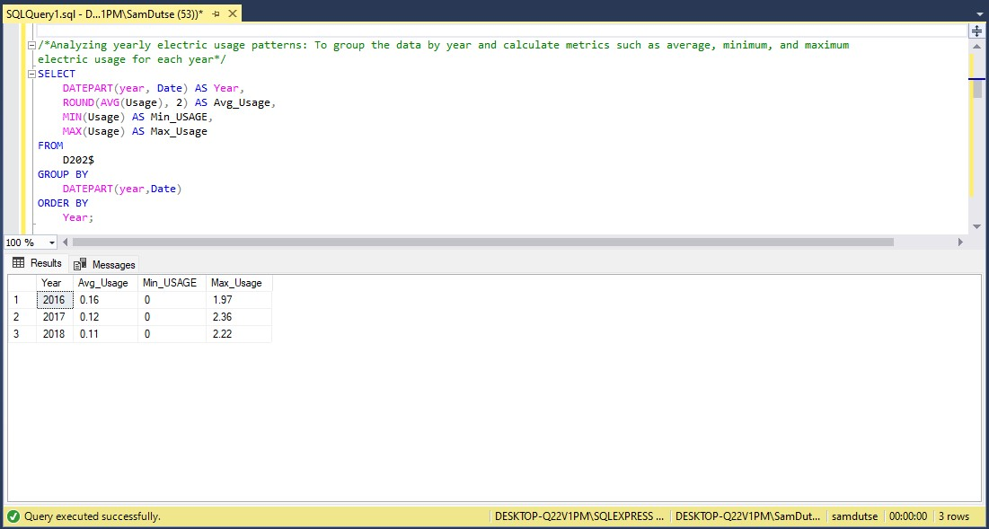
/*4. Analyzing yearly electric usage patterns: To group the data by year and calculate metrics such as average, minimum, and maximum electric usage for each year*/
SELECT
DATEPART (year, Date) AS Year,
ROUND(AVG(Usage), 2) AS Avg_Usage,
MIN(Usage) AS Min_Usage,
MAX(Usage) AS Max_Usage
FROM
D202$
GROUP BY
DATEPART (year, Date)
ORDER BY
Year;
THE DATEPART([year, month, weekday], column_name) function is use to extract a specific part of a date e.g DATEPART (year, Date) #extract the year from the Date column

Slide 7
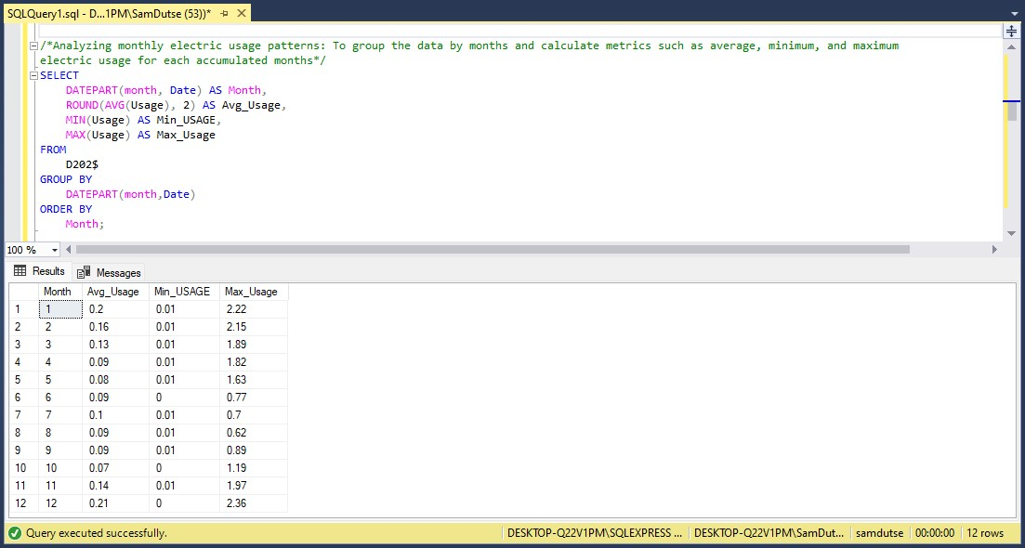
/*5. Analyzing monthly electric usage patterns: To group the data by months and calculate metrics such as average, minimum, and maximum electric usage for each accumulated month */
SELECT
DATEPART (month, Date) AS Month,
ROUND(AVG(Usage), 2) AS Avg_Usage,
MIN(Usage) AS Min_USAGE,
MAX(Usage) AS Max_Usage
FROM
D202$
GROUP BY
DATEPART (month, Date)
ORDER BY
Month;
THE ROUND(column_name, decimal_place) function is use to round numerical figures into a significant decimal place e.g ROUND(AVG(Usage), 2) #extract the year from the Date column

Slide 8
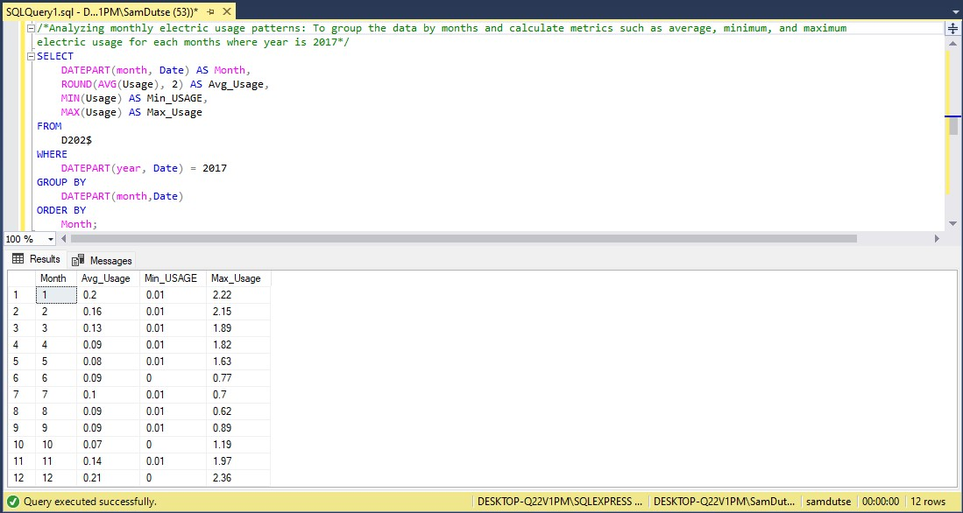
/*6. Analyzing monthly electric usage patterns: To group the data by months and calculate metrics such as average, minimum, and maximum electric usage for each month where year is 2017*/
SELECT
DATEPART (month, Date) AS Month,
ROUND(AVG(Usage), 2) AS Avg_Usage,
MIN(Usage) AS Min_USAGE,
MAX(Usage) AS Max_Usage
FROM
D202$
WHERE
DATEPART (year, Date) = 2017
GROUP BY
DATEPART (month, Date)
ORDER BY
Month;
THE AVG(column_name) function is use to find average of numerical a column

Slide 9
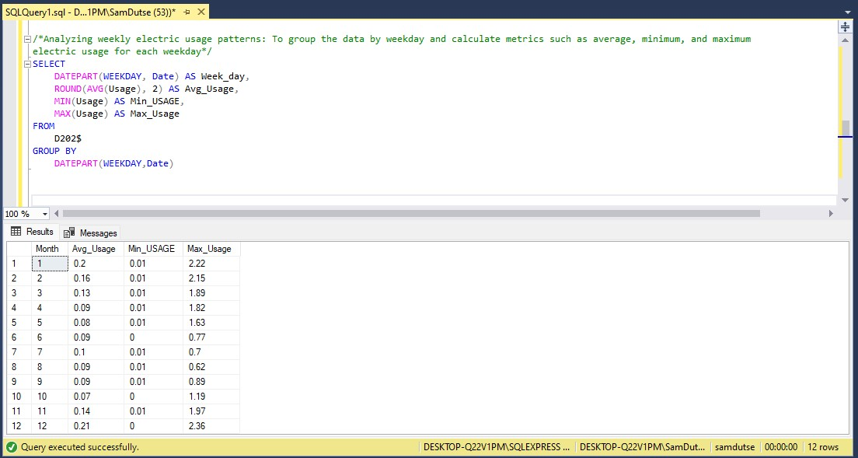
/*7. Analyzing weekly electric usage patterns: To group the data by weekday and calculate metrics such as average, minimum, and maximum electric usage for each weekday*/
SELECT
DATEPART (weekday, Date) AS Week_day,
ROUND(AVG(Usage), 2) AS Avg_Usage,
MIN(Usage) AS Min_USAGE,
MAX(Usage) AS Max_Usage
FROM
D202$
GROUP BY
DATEPART (weekday, Date)
THE MIN(column_name) function is use to pick minimum value in a column

Slide 10
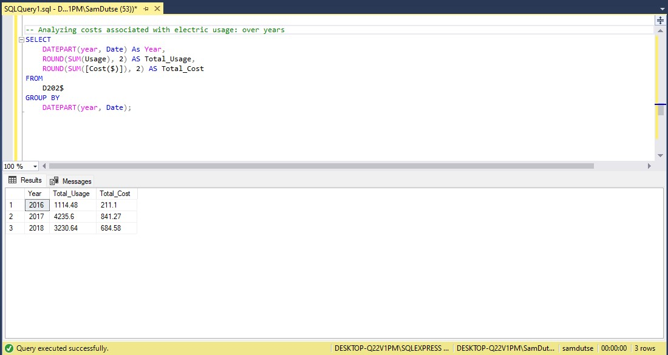
--8. Analyzing costs associated with electric usage: over years
SELECT
DATEPART (year, Date) As Year,
ROUND(SUM(Usage), 2) AS Total_Usage,
ROUND(SUM([Cost($)]), 2) AS Total_Cost
FROM
D202$
GROUP BY
DATEPART (year, Date);
THE SUM(column_name) function is use to extract SUM of numerical values in a column

Slide 11
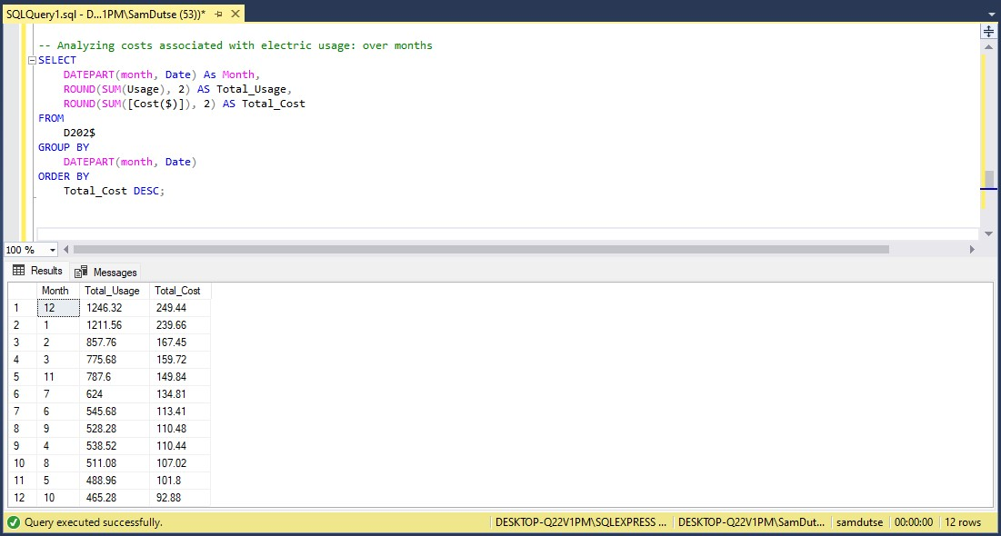
--9. Analyzing costs associated with electric usage: over months
SELECT
DATEPART (month, Date) As Month,
ROUND(SUM(Usage), 2) AS Total_Usage,
ROUND(SUM([Cost($)]), 2) AS Total_Cost
FROM
D202$
GROUP BY
DATEPART (month, Date)
ORDER BY
Total_Cost DESC;

Slide 12
--10. Analyzing costs associated with electric usage: over weekdays
SELECT
DATEPART (weekday, Date) As Week_Day,
ROUND(AVG(Usage), 2) AS Avg_Usage,
ROUND(SUM(Usage), 2) AS Total_Usage,
ROUND(AVG([Cost($)]), 2) AS Avg_Cost,
ROUND(SUM([Cost($)]), 2) AS Total_Cost
FROM
D202$
GROUP BY
DATEPART (weekday, Date)
ORDER BY
Total_Cost DESC;

Slide 13
Hi! My name is Samuel Yaula Dutse
Where to contact me:
Linkedin: https://linkedin.com/in/samdutse
Email: samuelyauladutse@gmail.com
Github: https://github.com/SamDutse
Medium: https://medium.com/@samuelyauladutse
Twitter: https://www.twitter.com/samdutze

