Slide 1

LottoTi
Clusterisation de container
Projet final ESGI
Cluster
Replicas (PDF)
Note projetee
1 master + 2 workers
2 backend + 3 frontend
20 / 15
k3s v1.31.5
Flask + Next.js + PG + Redis
15 base + 5 bonus
Date : 01 mai 2026

Slide 2
Sommaire
Plan de la presentation
01
Le projet LottoTi
Stack applicative existante (docker-compose)
02
Architecture cluster
Diagramme d'ensemble + topologie 3 noeuds
03
Steps d'installation
8 etapes scriptees pour reproduire le cluster
04
Securite
Secrets, HTTPS, NetworkPolicy zero-trust
05
Persistance
PVC + StatefulSets - donnees survivent
06
Haute disponibilite + Bonus + Bilan
Replicas, HPA, Rolling, Rollback - Note 20/15
LottoTi - Clusterisation de container - ESGI
2 / 15

Slide 3
Le projet LottoTi
Plateforme de location de vehicules entre particuliers
Stack applicative deja conteneurisee (docker-compose) - 5 services
Frontend
Next.js 15 (standalone) - port 3000 - SSR React
Backend
Flask + Gunicorn-gevent + Socket.IO - port 5000
Database
PostgreSQL 16 (alpine) - port 5432 - users, vehicules, paiements
Cache
Redis 7 (alpine) - port 6379 - sessions, rate limiting, pubsub
Reverse proxy
Nginx (compose) - remplace par Ingress Traefik en cluster
Mission ESGI : transposer cette stack vers Kubernetes pour HA + securite + persistance
LottoTi - Clusterisation de container - ESGI
3 / 15

Slide 4
Architecture cluster Kubernetes
Vue d'ensemble - flux des requetes
UTILISATEUR https://lottoti.local | | port 30443 (NodePort) v +============================================================+ || CLUSTER k3s || || || || +---------------------------------------------------+ || || | TRAEFIK (Ingress controller, namespace traefik) | || || | - termine TLS (cert lottoti-ca) | || || | - rate limit + security headers | || || +---------------------------------------------------+ || || | || || +-----------+-----------+ || || v /api/* v /* || || || || +----------------+ +----------------+ || || | Service backend| | Service frontend| || || | :5000 | | :3000 | || || +----------------+ +----------------+ || || | | (LB) | | | (LB) || || v v v v v || || +----+----+ +----+----+----+ || || |Pod1|Pod2| |Pod1|Pod2|Pod3| || || |API |API | |FE1 |FE2 |FE3 | || || +----+----+ +----+----+----+ || || | | || || v v || || +----------+ +----------+ +-----------------+ || || | postgres | -> | PVC 5Gi | | NetworkPolicies | || || | StatefulSet| | longhorn | | zero-trust (8) | || || +----------+ +----------+ +-----------------+ || || | redis | -> | PVC 1Gi | | Secrets + | || || +----------+ +----------+ | ConfigMaps | || || +-----------------+ || +============================================================+
LottoTi - Clusterisation de container - ESGI
4 / 15

Slide 5
Topologie : 3 noeuds (1 master + 2 workers)
Exigence PDF section 3.1
3 VMs Ubuntu 22.04 via Multipass - cluster k3s v1.31.5
master
worker1
worker2
control-plane
app + storage
app + storage
CPU
CPU
CPU
2 vCPU
2 vCPU
2 vCPU
RAM
RAM
RAM
2 Go
3 Go
3 Go
Pods
Pods
Pods
API server, scheduler, etcd, frontend(1)
backend(2), postgres, frontend(1)
redis, frontend(1)
PodAntiAffinity : frontend repartis sur les 3 nodes (resilience aux pannes)
Labels appliques : storage=true, lottoti.io/role=app
LottoTi - Clusterisation de container - ESGI
5 / 15

Slide 6
Steps d'installation
8 etapes scriptees - install-all.sh (~15 min)
1
Creation 3 VMs Multipass
Ubuntu 22.04 - master + worker1 + worker2
01-create-vms.sh
2
Installation k3s
server sur master + agents sur workers
02-install-k3s.sh
3
Installation Longhorn
Storage RWX pour le PVC uploads
03-install-storage.sh
4
Installation cert-manager
Generation CA local + ClusterIssuer
04-install-cert-manager.sh
5
Installation Traefik Ingress
Helm chart - NodePort 30443/30080
05-install-ingress.sh
6
Build & import images
docker build + k3s ctr import sur les 3 nodes
06-build-images.sh
7
Deploy LottoTi
kubectl apply -k - 36 manifests Kustomize
07-deploy.sh
8
Tests HA
kill pods, scale, rolling update + captures
08-test-ha.sh
Resultat : cluster k3s + LottoTi up - https://lottoti.local:30443/
LottoTi - Clusterisation de container - ESGI
6 / 15

Slide 7
Securite : Secrets & ConfigMaps
PDF section 3.4 - separation valeurs sensibles vs config
SECRET
CONFIGMAP
Donnees sensibles - chiffrees dans etcd
Variables non sensibles - en clair
lottoti-secrets (5 cles Opaque):
backend-config (7 cles):
- POSTGRES_PASSWORD
- FLASK_ENV=production
- FLASK_SECRET_KEY
- PORT=5000
- JWT_SECRET_KEY
- LOG_LEVEL=info
- STRIPE_SECRET_KEY
- FRONTEND_URL=https://lottoti.local
- STRIPE_WEBHOOK_SECRET
- CORS_ORIGINS=https://lottoti.local
lottoti-tls (kubernetes.io/tls):
postgres-config:
- tls.crt + tls.key (cert HTTPS)
- POSTGRES_DB, POSTGRES_USER
- postgresql.conf (tuning DB)
kubectl describe secret ne montre
que les TAILLES (jamais les valeurs)
Injectes dans les pods via
envFrom: configMapRef
Regle d'or : si la valeur etait fuitee, est-ce un probleme ? -> Secret. Sinon -> ConfigMap.
LottoTi - Clusterisation de container - ESGI
7 / 15

Slide 8
Securite : HTTPS + Ingress
PDF section 3.4 et 3.5 - cert-manager genere automatiquement le cert TLS
selfsigned-bootstrap (ClusterIssuer) | | signe v lottoti-ca (Certificate) <-- notre Autorite de Certification locale | | devient un v lottoti-ca-issuer (ClusterIssuer) | | signe v lottoti-tls (Certificate) <-- cert pour lottoti.local | | utilise par v Ingress (Traefik) <-- termine TLS sur :443 | | route HTTPS v Services backend / frontend
Routes Ingress
/api/health
-> backend
ratelimit-health (1/s)
/api/auth
-> backend
ratelimit-auth (5/s)
/api/*
-> backend
ratelimit-api (30/s)
/socket.io
-> backend
WebSocket
/*
-> frontend
Next.js SSR
Securite :
+ HTTP -> HTTPS redirect 301
+ HSTS, CSP, X-Frame-Options
+ Renouvelement auto 30j avant
Demo live : https://lottoti.local:30443/ -> Lottoit en HTTPS, cert signe par lottoti-ca
LottoTi - Clusterisation de container - ESGI
8 / 15

Slide 9
Securite : NetworkPolicy zero-trust
Bonus 3 (+1 pt) - 8 policies
Approche : default-deny + allow explicite. Si un pod est compromis, il ne peut atteindre QUE ce qui est autorise.
DESTINATION | postgres | redis | backend | frontend | DNS | Internet ============================================================================ frontend | BLOQUE | BLOQUE | OK | - | OK | HTTPS backend | OK 5432 | OK 6379 | - | BLOQUE | OK | HTTPS postgres | - | BLOQUE | BLOQUE | BLOQUE | OK | BLOQUE redis | BLOQUE | - | BLOQUE | BLOQUE | OK | BLOQUE traefik (ns) | BLOQUE | BLOQUE | OK 5000 | OK 3000 | OK | - OK = trafic autorise par une NetworkPolicy BLOQUE = TCP REJECT (default-deny + pas de policy explicite)
Tests d'enforcement (live) :
frontend -> postgres:5432 [BLOQUE - TCP REJECT] backend -> postgres:5432 [OK - Connection succeeded] default ns -> backend:5000 [BLOQUE - Connection refused] frontend -> redis:6379 [BLOQUE - NetworkPolicy zero-trust]
LottoTi - Clusterisation de container - ESGI
9 / 15

Slide 10
Persistance : PVC + StatefulSets
PDF section 3.3 - donnees survivent aux redeploiements
3 PersistentVolumeClaim provisionnes par Longhorn
pgdata-postgres-0
5 Gi
RWO
Donnees Postgres
redisdata-redis-0
1 Gi
RWO
AOF Redis (persistance)
uploads
5 Gi
RWX
Photos uploadees (partage 2 backend)
TEST LIVE : la donnee survit au kill du pod
1. INSERT INTO persistence_test (marker) VALUES ('proof_1777283282'); 2. PVC pgdata-postgres-0 -> volume = pvc-64fbba8e-fa93-49f7-aeed-03138a8a8abe 3. kubectl delete pod postgres-0 --grace-period=0 --force [NUKE] 4. Pod recreate par le StatefulSet en ~13 secondes (memes labels, meme PVC) 5. SELECT * FROM persistence_test; -> proof_1777283282 TOUJOURS LA 6. PVC volume = pvc-64fbba8e-fa93-49f7-aeed-03138a8a8abe [IDENTIQUE] Verdict : la persistance fonctionne objectivement
(Voir capture 07-kill-db-persistence.png pour la sortie kubectl reelle)
LottoTi - Clusterisation de container - ESGI
10 / 15

Slide 11
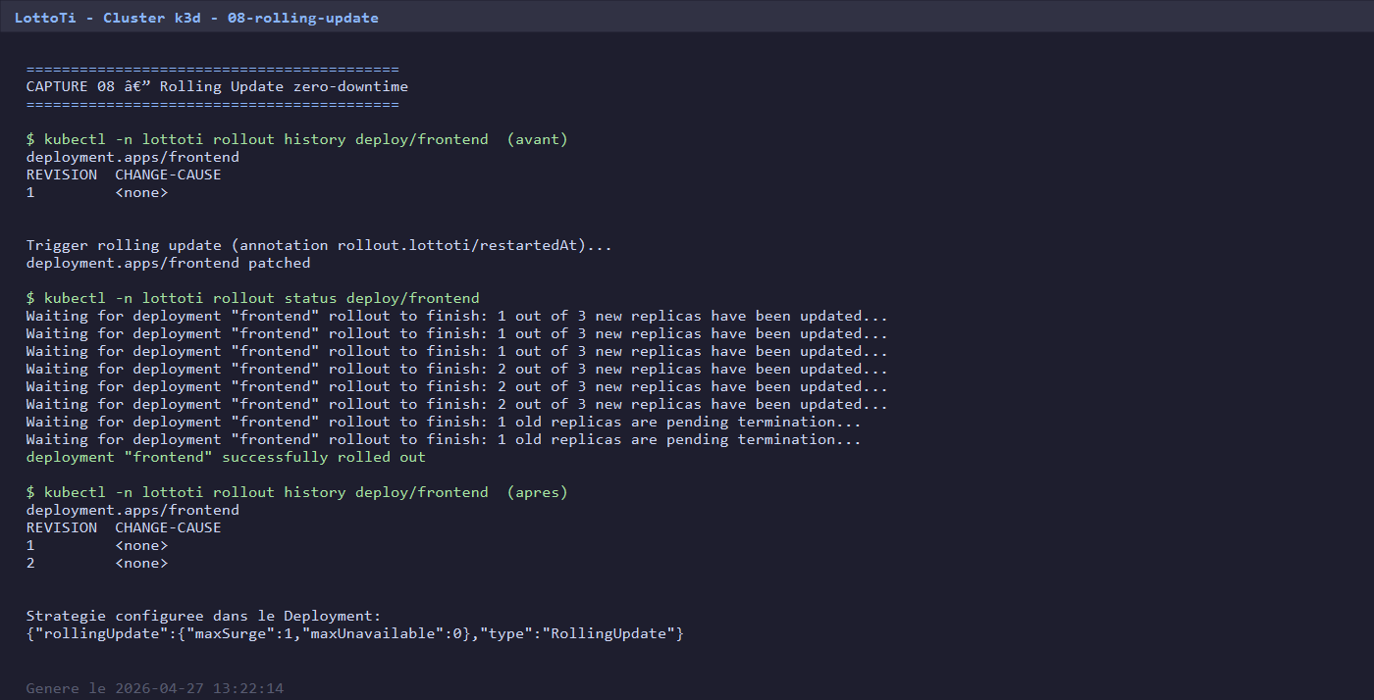
Haute Dispo : Replicas + Rolling Update
Bonus 4 (+1 pt) - zero downtime
Replicas (PDF section 3.2.4)
Rolling Update strategy
backend Deployment : replicas: 2
strategy: type: RollingUpdate rollingUpdate: maxSurge: 1 # +1 pod en plus maxUnavailable: 0 # JAMAIS moins
frontend Deployment : replicas: 3
PodAntiAffinity : repartit sur les 3 nodes
PodDisruptionBudget : minAvailable=2 frontend, =1 backend
Resilience : si un node tombe, les autres prennent le relais
= Toujours >= 3 frontend Ready durant la maj
= Service jamais down
LottoTi - Clusterisation de container - ESGI
11 / 15

Slide 12
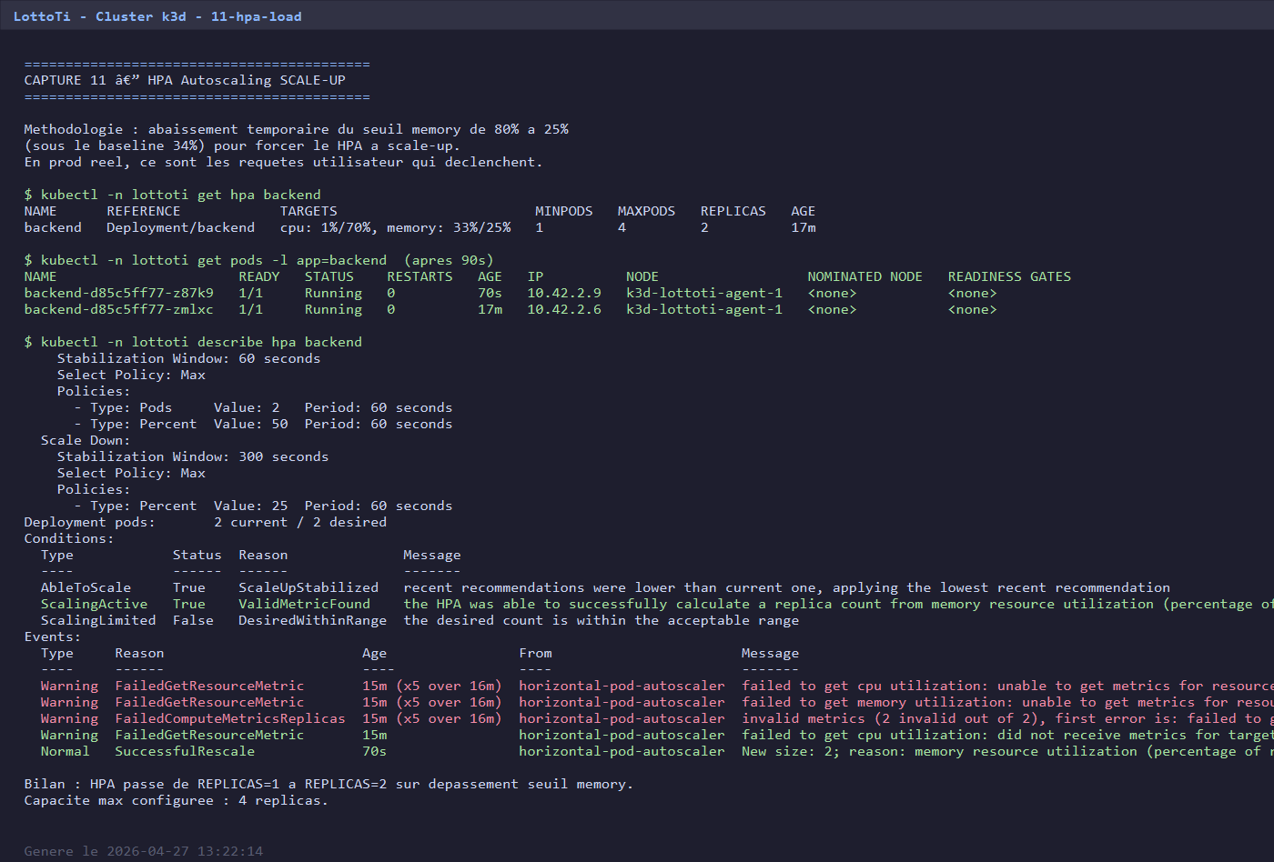
Haute Dispo : HPA + auto-healing
Bonus 5 (+1 pt) - autoscaling + recovery automatique
HPA (HorizontalPodAutoscaler)
Auto-healing (kill pod recovery)
backend HPA : 2 -> 8 replicas frontend HPA : 3 -> 10 replicas Metriques : - CPU > 70% -> scale up - Memory > 80% -> scale up Test live : -> SuccessfulRescale 1 -> 2
1. kubectl delete pod frontend-X --force 2. ReplicaSet detecte le manque (-1 vs spec) 3. Cree un nouveau pod automatiquement 4. ~8 secondes -> nouveau pod Running Pas d'intervention humaine. Service jamais down (les 2 autres pods continuent de servir).
LottoTi - Clusterisation de container - ESGI
12 / 15

Slide 13
Bonus implementes (6 / +5 plafond)
PDF section 4 - une marge prise pour la securite
1
Resource Requests + Limits + QoS
+1 pt
Burstable sur tous les pods - protege le cluster
3
NetworkPolicy zero-trust
+1 pt
8 policies - default-deny + allow explicite
4
Rolling Update zero-downtime
+1 pt
maxSurge=1 maxUnavailable=0 - service jamais down
5
HPA autoscaling
+1 pt
2 -> 8 (backend), 3 -> 10 (frontend) - CPU + memory
7
Rollback automatique
+1 pt
rollout undo - testes avec image cassee
8
Helm Chart parametrable
+1 pt
charts/lottoti/ - install + upgrade + rollback testes
6 bonus x +1 pt = +6 pts -> plafonne a +5 pts par le sujet -> resultat +5/5
LottoTi - Clusterisation de container - ESGI
13 / 15

Slide 14
Bilan bareme
Mapping PDF section 5 - tous criteres valides objectivement
BASE (15 / 15 pts)
OK
Cluster (1 master + 2 workers)
2 pts
capture 01
Total projete
OK
Deploiement (front + back + DB)
5 pts
capture 02 + 10
OK
Persistance (volumes survivent)
2 pts
capture 03 + 07
20
OK
Securite (Secrets + HTTPS)
2 pts
capture 04 + 14
OK
Exposition (Ingress + DNS)
2 pts
capture 04 + 10
OK
Documentation & scripts
2 pts
16 captures + scripts
BONUS (+5 / +5 pts plafond)
/ 15
OK
Bonus 1 - Resource Limits + QoS
+1 pt
capture 15
OK
Bonus 3 - NetworkPolicy zero-trust
+1 pt
capture 12
OK
Bonus 4 - Rolling Update zero-downtime
+1 pt
capture 08
15 base + 5 bonus
OK
Bonus 5 - HPA Autoscaling
+1 pt
capture 11
Tous les criteres
OK
Bonus 7 - Rollback automatique
+1 pt
capture 09
valides objectivement
OK
Bonus 8 - Helm Chart parametrable
+1 pt
capture 13
LottoTi - Clusterisation de container - ESGI
14 / 15

Slide 15
Merci !
Questions / Demo live
Demo en direct :
https://lottoti.local:30443/
Repo + documentation : c:\cluster
LottoTi - ESGI - 2026

