Slide 1

Model SmartHome device
Samuel Fatuga
CENG 319
Sensor: RGB LED YSL-R596CR3G4B5C-C10

Slide 2
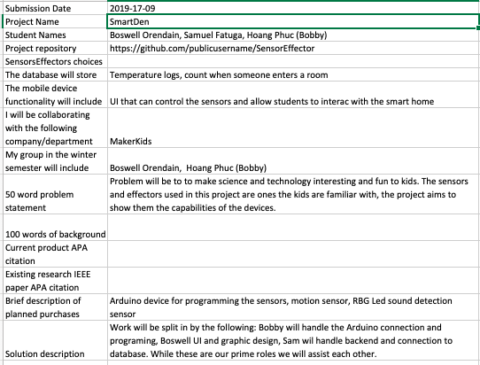
Proposal

Slide 3
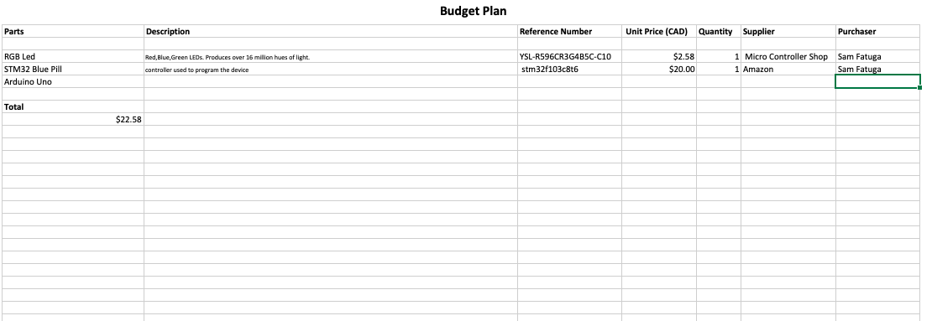
Budget

Slide 4
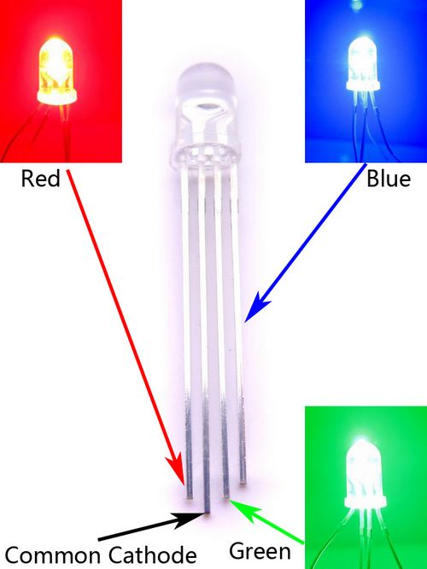
SENSOR
Can be used as status indicator for each color, or PWM to produce variations of different colors

Slide 5
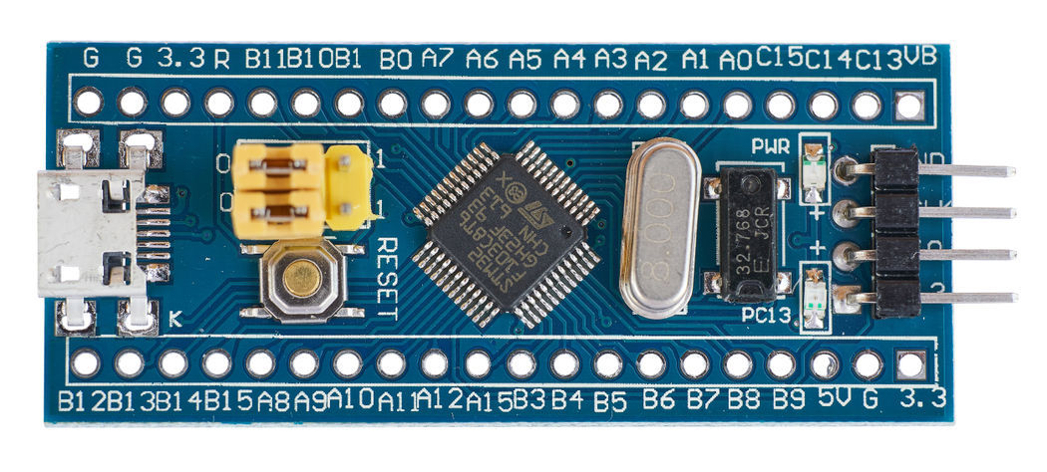
Development board
Less expensive than an Arduino UNO, can be used with with Arduino IDE.
20k RAM and option of 64k or 128k Flash

Slide 6
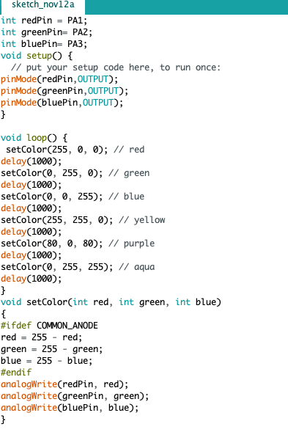
Source Code

Slide 7
Courses that came in handy
CENG 215 –Digital and Interface Systems
CENG 252- Embedded Systems
CENG 209- Micro Assembly Language
TECH 101-Electric Circuits and Devices

