Slide 1
Basic Arithmetic Circuits
Appendix of Lecture 05
Recall: add/sub of digital circuit course

Slide 2
Outline
Adder Design
Signed Number Representation
Exercise: |A-B|
  C-code
  hardware design

Slide 3
Addition

Slide 4
How a computer performs binary addition
0 1 1 0
A
for each bit i=0 to N-1 do {
{C[i+1], S[i]} = A[i]+B[i]+C[i]
}
+)
0 0 1 1
B
S

Slide 5
How a computer performs binary addition
Step 1: addition for bit 0
0 1 1 0
A
for each bit i=0 to N-1 do {
{C[i+1], S[i]} = A[i]+B[i]+C[i]
}
+)
0 0 1 1
B
S

Slide 6
How a computer performs binary addition
Step 1: addition for bit 0
Carry C[1]
0
0 1 1 0
A
for each bit i=0 to N-1 do {
{C[i+1], S[i]} = A[i]+B[i]+C[i]
}
+)
0 0 1 1
B
1
S
Sum S[0]

Slide 7
How a computer performs binary addition
Step 2: addition for bit 1 with carry
0
0 1 1 0
A
for each bit i=0 to N-1 do {
{C[i+1], S[i]} = A[i]+B[i]+C[i]
}
+)
0 0 1 1
B
1
S

Slide 8
How a computer performs binary addition
Step 2: addition for bit 1 with carry
1
0
0 1 1 0
A
for each bit i=0 to N-1 do {
{C[i+1], S[i]} = A[i]+B[i]+C[i]
}
+)
0 0 1 1
B
0
1
S

Slide 9
How a computer performs binary addition
Step 2: addition for bit 1 with carry
Carry C[2]
1
0
0
0 1 1 0
A
for each bit i=0 to N-1 do {
{C[i+1], S[i]} = A[i]+B[i]+C[i]
}
+)
0 0 1 1
B
0
1
S
Sum S[1]

Slide 10
How a computer performs binary addition
repeat the procedure and we get the result
0 1 1 0
A
for each bit i=0 to N-1 do {
{C[i+1], S[i]} = A[i]+B[i]+C[i]
}
+)
0 0 1 1
B
1 0 0 1
S
So, what’s the basic cell for the addition?

Slide 11
Full Adder: the basic component for an adder
a combinational circuit doing the following truth table
to perform addition for a bit i
Y
X
X
Y
Cin
Cout
S
1
0
0
0
0
0
0
0 1 1 0
A
Cin
0
0
1
0
1
+)
0 0 1 1
B
FA
0
1
0
0
1
0
1
1
1
0
0
1
S
1
0
0
0
1
1
0
1
1
0
S
1
1
0
1
0
Cout
1
1
1
1
1

Slide 12
Full Adder: the basic component for an adder
a combinational circuit doing the following truth table
to perform addition for a bit i
1
1
Y
X
X
Y
Cin
Cout
S
1
0
0
0
0
0
0
0 1 1 0
A
Cin
0
0
0
1
0
1
+)
0 0 1 1
B
FA
0
1
0
0
1
0
1
1
1
0
0
1
S
1
0
0
0
1
1
0
1
1
0
S
1
1
0
1
0
Cout
0
1
1
1
1
1
1

Slide 13
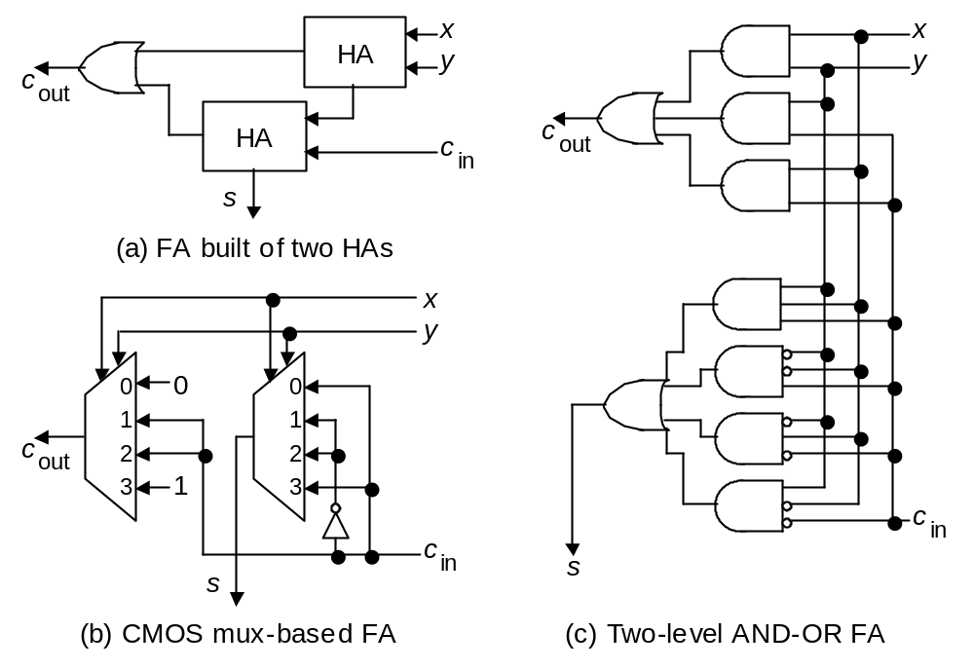
Full-adder implementation

Slide 14
Ripple-Carry Adder
B
A
n
n
always @(*)
{Cout, S} = A+B+Cin;
Cout
Adder
Cin
n
S
B[n-1]
A[n-1]
B[n-2]
A[n-2]
B[2]
A[2]
B[1]
A[1]
B[0]
A[0]
0 1 1 0
A
+)
0 0 1 1
B
Cin
FA
FA
FA
FA
FA
1 0 0 1
S
…
Cout
S[n-1]
S[n-2]
S[2]
S[1]
S[0]

Slide 15
Ripple-Carry Adder
B
A
n
n
always @(*)
{Cout, S} = A+B+Cin;
Cout
Adder
Cin
n
S
B[n-1]
A[n-1]
B[n-2]
A[n-2]
B[2]
A[2]
B[1]
A[1]
B[0]
A[0]
0 1 1 0
A
+)
0 0 1 1
B
Cin
FA
FA
FA
FA
FA
1 0 0 1
S
…
Cout
S[n-1]
S[n-2]
S[2]
S[1]
S[0]

Slide 16
Ripple-Carry Adder
B
A
n
n
always @(*)
{Cout, S} = A+B+Cin;
Cout
Adder
Cin
n
S
B[n-1]
A[n-1]
B[n-2]
A[n-2]
B[2]
A[2]
B[1]
A[1]
B[0]
A[0]
0 1 1 0
A
+)
0 0 1 1
B
Cin
FA
FA
FA
FA
FA
1 0 0 1
S
…
Cout
S[n-1]
S[n-2]
S[2]
S[1]
S[0]

Slide 17
Signed number and subtraction

Slide 18
Signed number representation (2’s complement)
the general format
  4-bit signed number
  representing -8 ~ 7
sign bit

Slide 19
Signed number representation (2’s complement)
Example: representing positive number +5
positive number
0
1
0
1
sign bit

Slide 20


Signed number representation (2’s complement)
Example: representing negative number -5
Rule:
A=+5
0
1
0
1
negative number
1
0
1
0
1
0
1
1
1
0
1
1
sign bit

Slide 21

Signed number representation (2’s complement)
Property:
A=-5
1
0
1
1
0
1
0
0
+5
0
1
0
1
0
1
0
1
sign bit

Slide 22
How to do subtraction
use adder with 2’s complement encoding

Slide 23
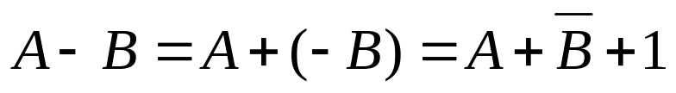


Method to do subtraction
Rule:
Example: A=5, B=3
A=5
0
0
1
1
0
1
0
1
B=3
-B=-3
+)
1
1
0
1
1
1
0
0
1
0
0
1
0
1
1
0
1
A-B=2

Slide 24
Method to do subtraction
Rule:
Example: A=3, B=5
A=3
0
1
0
1
0
0
1
1
B=5
-B=-5
+)
1
0
1
1
1
0
1
0
0
1
1
1
0
1
0
1
1
A-B=-2

Slide 25
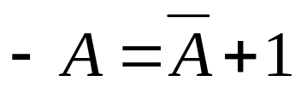
Rule of thumb
Key Properties:
Apply whenever positive or negative
Why?
  lots of mathematics
  I will talk about this more in “computer arithmetic” course

Slide 26
In-Class Exercise
to help you learn the above concept

Slide 27
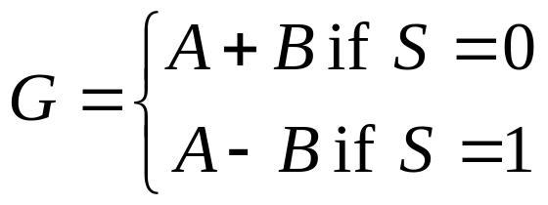
In-Class Exercise
(open book, may discuss with others)
Q1: write a C-code to calculate |A-B|
  you cannot use the following operators: -, >, <, >=, <=
  only add(+) and bit-wise logical operators available
Q2: design hardware for both addition and subtraction
B
A
n
n
adder/subtractor
S
n
G

Slide 28
Method to take absolute value
|A-B| in C

Slide 29
Problem
write a C-code to calculate |A-B|
  you cannot use the following operators: -, >, <, >=, <=
  only add(+) and bit-wise logical operators available

Slide 30
The Solution
write a C-code to calculate Q=|A-B|
  you cannot use the following operators: -, >, <, >=, <=
  only add(+) and bit-wise logical operators available
R = A+(~B)+1;
Q = (R & 0x80000000)? (~R)+1: R;

Slide 31

The Solution
write a C-code to calculate Q=|A-B|
  you cannot use the following operators: -, >, <, >=, <=
  only add(+) and bit-wise logical operators available
R = A+(~B)+1;
Q = (R & 0x80000000)? (~R)+1: R;

Slide 32
The Solution
write a C-code to calculate Q=|A-B|
  you cannot use the following operators: -, >, <, >=, <=
  only add(+) and bit-wise logical operators available
R = A+(~B)+1;
Q = (R & 0x80000000)? (~R)+1: R;
check if R₃₁=1 or 0

Slide 33

The Solution
write a C-code to calculate Q=|A-B|
  you cannot use the following operators: -, >, <, >=, <=
  only add(+) and bit-wise logical operators available
R = A+(~B)+1;
Q = (R & 0x80000000)? (~R)+1: R;

Slide 34
Adder/Subtractor Design

Slide 35
Goal
Design hardware for both addition and subtraction
B
A
n
n
adder/subtractor
S
n
G

Slide 36
The Design
B
A
n
n
~B
n
S
MUX
n
adder
Cin
S
n
G

Slide 37
Recall: the adder design
B
A
n
n
Carry-in
always @(*)
{Cout, S} = A+B+Cin;
Cout
Adder
Cin
n
S
B[n-1]
A[n-1]
B[n-2]
A[n-2]
B[2]
A[2]
B[1]
A[1]
B[0]
A[0]
0 1 1 0
A
+)
0 0 1 1
B
Cin
FA
FA
FA
FA
FA
Carry-in
1 0 0 1
S
…
Cout
S[n-1]
S[n-2]
S[2]
S[1]
S[0]

Slide 38
The Design
B
A
n
n
~B
n
0
S
MUX
n
adder
Cin
S
0
n
G
G=A+B+0

Slide 39

The Design
B
A
n
n
~B
n
1
S
MUX
n
adder
Cin
S
1
n
G
G=A+(~B)+1

Slide 40
Summary
Most important properties of 2’s complement encoding:
sign bit

