Slide 1
Data Science Internship Task – Classifying Transaction Categories
By Samir H. Gouhary

Slide 2
Introduction
I was tasked with creating a bank transaction classification algorithm. I was given two datasets containing 12500 rows of numerical, categorical and text data. Out of the total data, 10000 rows are used for training and 2500 for validation. I have used topic modelling with NLTK to create a transaction classifier.
First, let's begin with exploratory data analysis.

Slide 3
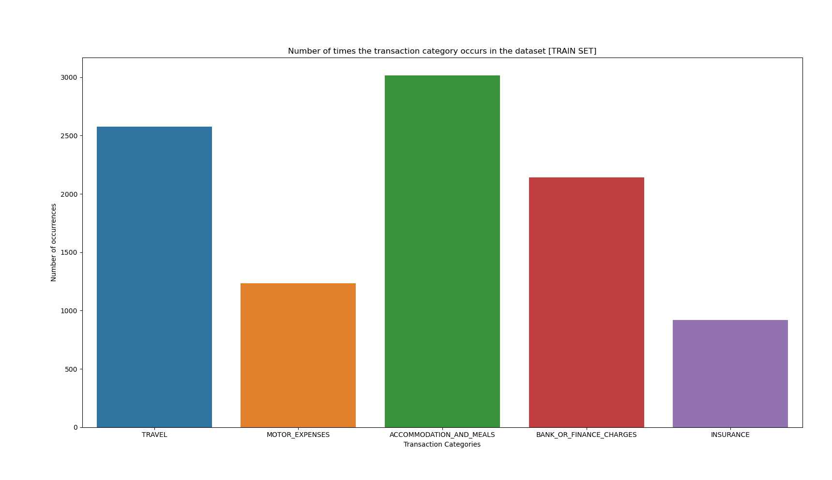
Exploratory Data Analysis - Number of transactions per type
This bar plot shows the number of transactions per category
The "TRAVEL", "ACCOMODATION AND MEALS" and " BANK OR FINANCE CHARGES" dominate the rest of the categories
The skewed data will possibly result in the model being more likely to classify a description as one of the more frequent categories

Slide 4
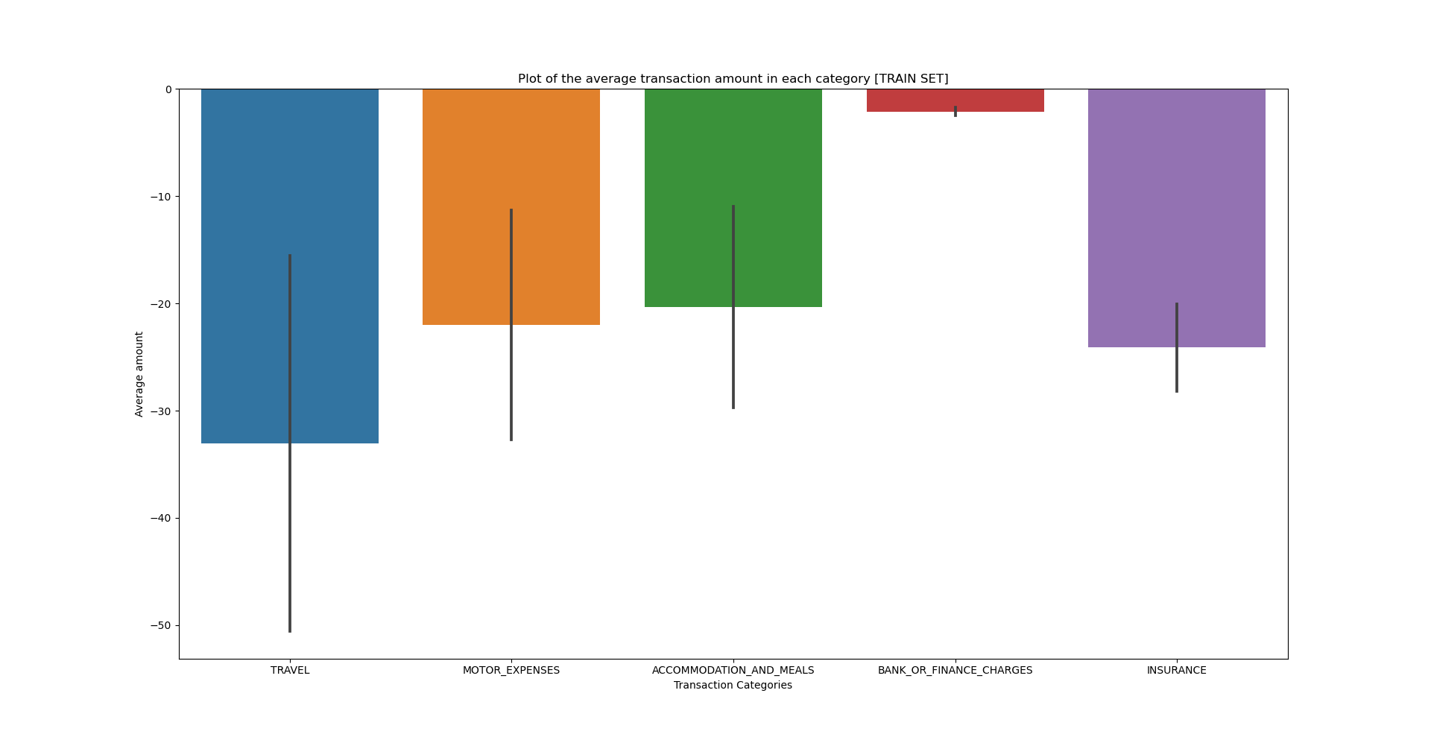
Exploratory Data Analysis - Average transaction amount per category
This bar plot shows the average transaction amount per category
This feature is not very useful as a classifier, since the only category that is sufficiently different from the rest is "BANK OR FINANCE CHARGES".
The rest of the categories are all very similar and within each other's confidence intervals

Slide 5
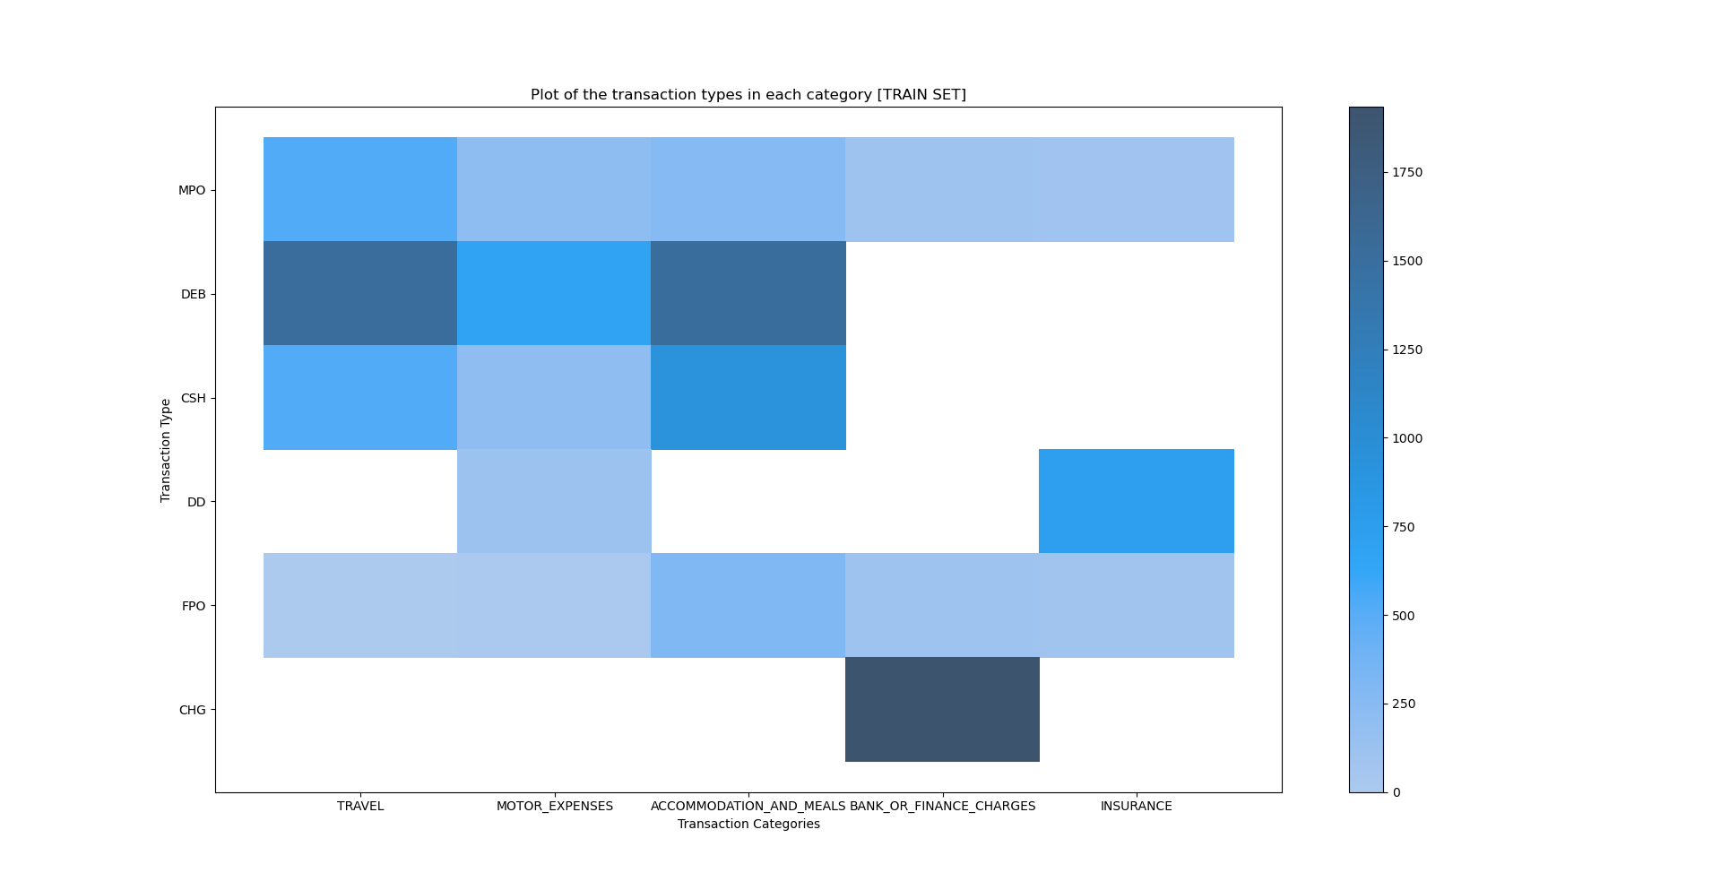
Exploratory Data Analysis - Transaction types in each category
This bivariate histogram shows the transaction types in each category
"TRAVEL" and "ACCOMODATION AND MEALS" have very similar distributions, suggesting that transaction type as a feature will not perform well separating these classes.
The rest of the classes vary more strongly, however they are still not different enough. Using this feature in the model is likely to result in high rate of misclassification.

Slide 6
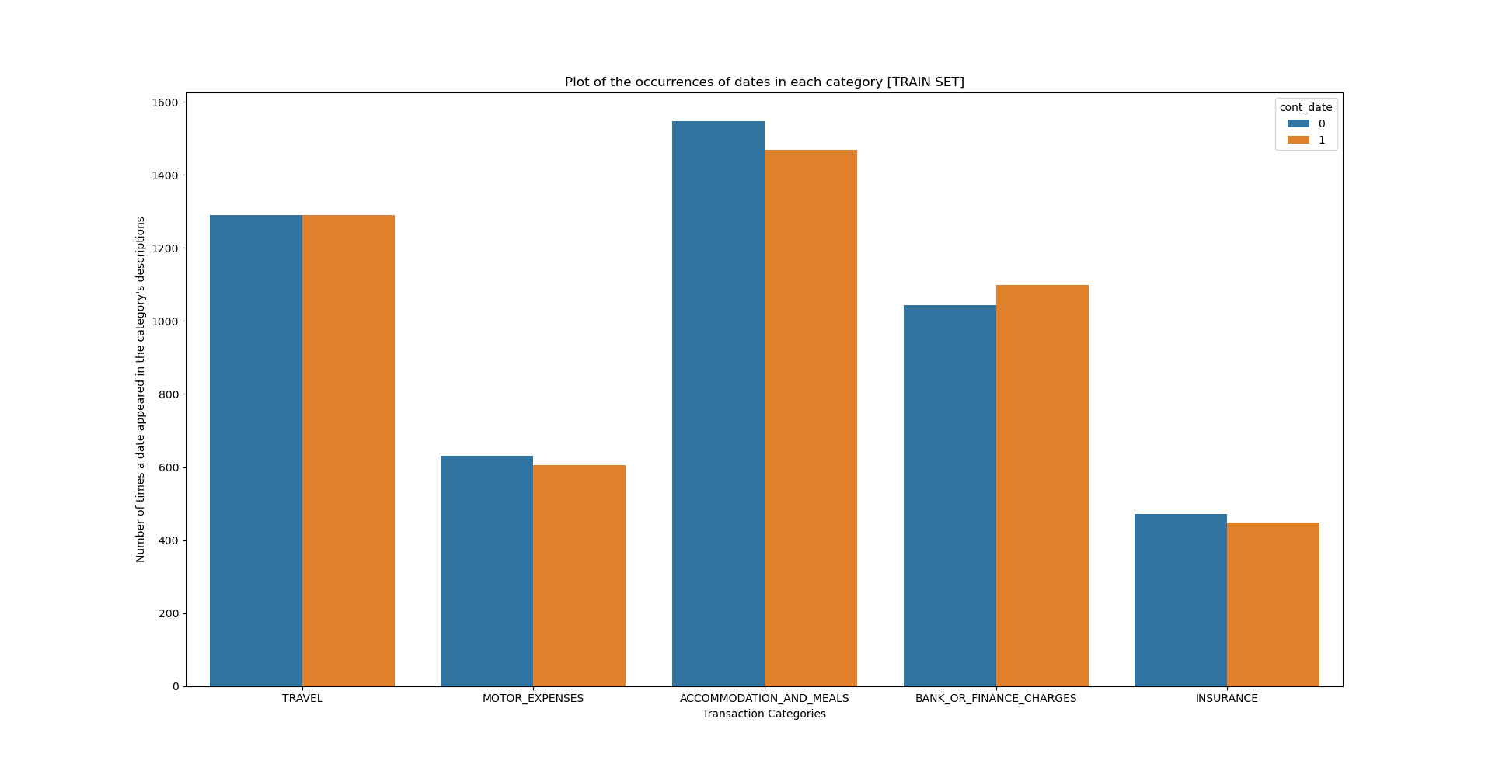
Exploratory Data Analysis - Occurrences of dates
This bar plot shows the transaction types in each category
Every category exhibits the same behaviour – there is a very nearly equal distribution of entries with and without dates. Neither is more likely.
Therefore, the presence of a date in the description holds no useful classification information.

Slide 7
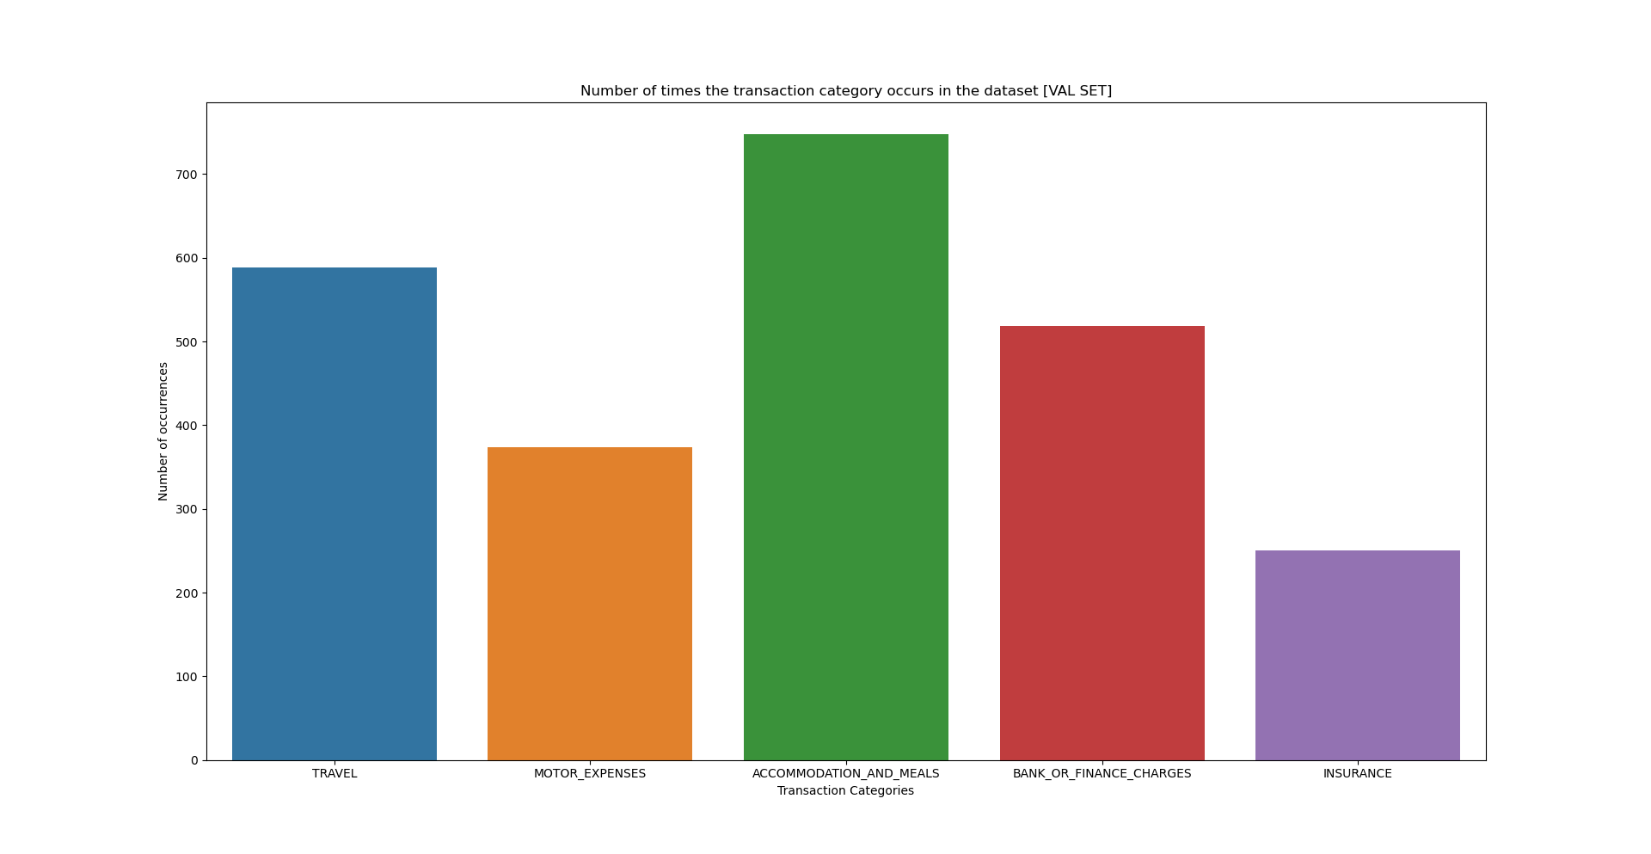
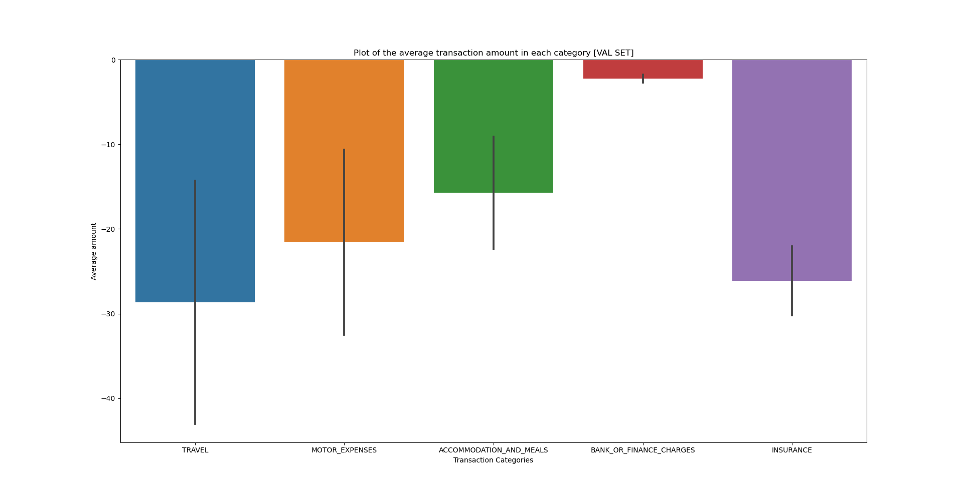
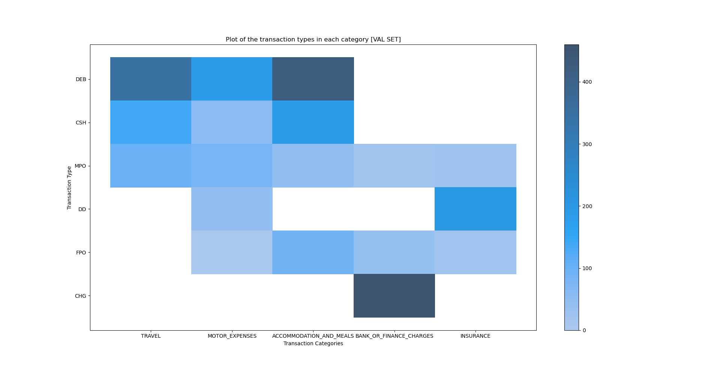
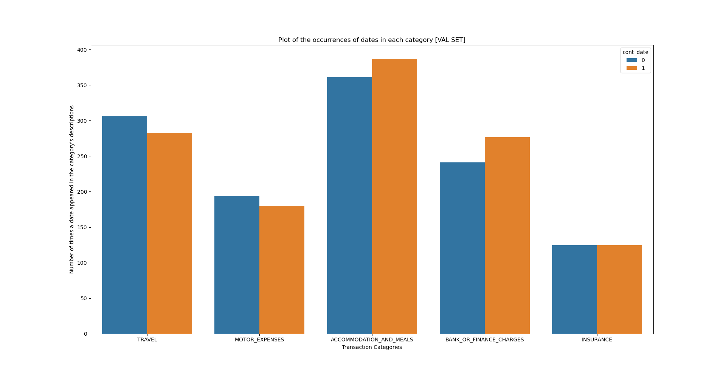
Exploratory Data Analysis - Comparison between training and validation data
These graphs represent the same 4 feature analyses that were covered for the training data.
All the features show a very similar behaviour. This means, the reasons why these features will make unsatisfactory classifiers still apply.

Slide 8
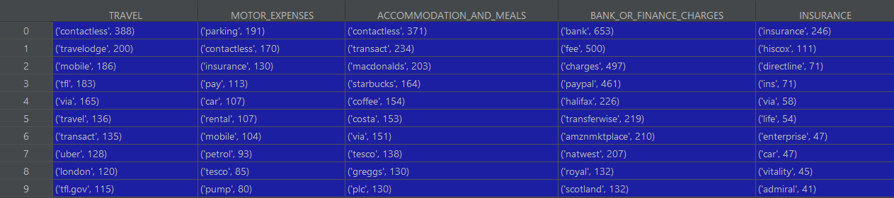
Exploratory Data Analysis - Description Analysis
This table shows the 10 most common words in each category
The word overlap in every category is minimal. This is a great sign that the transaction descriptions will perform well as a classifier feature.
Moreover, we can expect the words present in the table to come up as the words with highest weighting in the LDA model in the topic modelling stage.

Slide 9
Training the model
In the previous slide we established that we will have to use the descriptions as the classifying feature, meaning that this task is an NLP problem. For this reason I have used the NLTK and Gensim packages in Python for all language processing tasks.
The descriptions were cleaned, vectorized with a TF-IDF vectorizor and lastly turned into a corpus to be used in Gensim's LDA model. You can see the process in full detail at https://github.com/SamGou/Bank_Transaction_Classification

Slide 10
Results and findings
Using scikit-learn's accuracy score, the model was calculated to have an accuracy of 50.44%.
This is not an amazing result by any means. However, since there are 5 categories, that would mean a non-functional (randomly guessing) classifier would perform at around 20% accuracy. That confirms that the topic modeller is classifying based on the correct features.

Slide 11
Improvements
Data:
The dataset contains basic features which by themselves, do not perform well as classifier features. However, what could be causing a bigger issue, is the lack of data. There are only 12500 entries in total. Naturally, a lot less data is then available for training. Hence, a good time investment would be to collect more data.
One possible solution, since we are using an LDA model which can be constantly updated and improved, is to set up automatic online data acquisition, cleaning and model updating.
Model:
If topic modelling algorithm is to be applied to this problem, improving the performance will require a more sophisticated approach to feature engineering than just cleaning and parsing the description data. For example, a combination of the available features can be used to improve the classifier.
Since the labeling of the topics is manual, the problem could also arise from wrong labeling. This can be fixed by more careful study of which combinations of words represent which topics more strongly.

Slide 12
Thank you !

