Slide 1

Fraud detection Take–home task
Presentation and project by:
Sam Gouhary

Slide 2
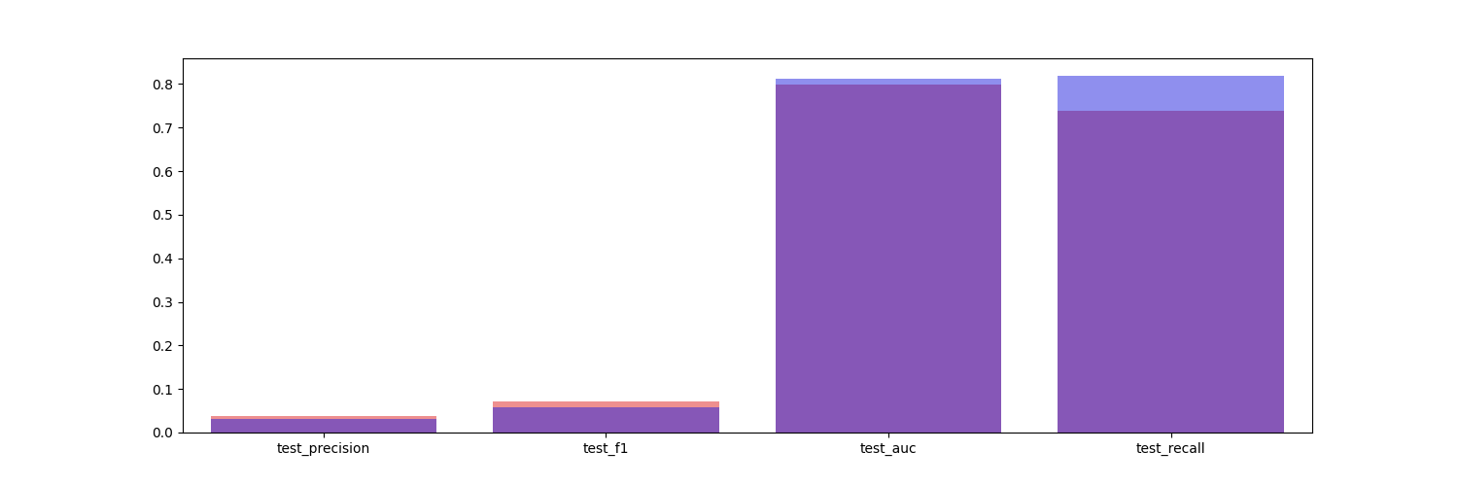
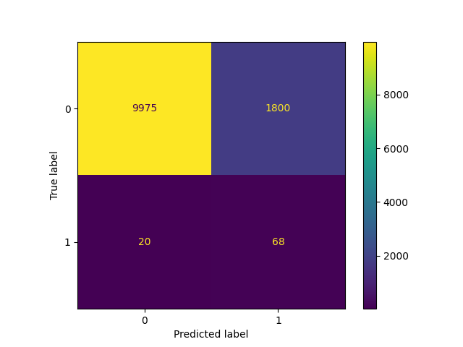

Model Performance
Test set performance
Log. Regression
The test set was selected as a random selection of the total dataset
On average, there are around 9000 transactions per month in the dataset and the test dataset reflects that with a little over 11000 transactions
The distribution of the test set also closely matches the average monthly distribution of fraud:non-fraud transactions at 1:99 (for every one hundred transactions there is on average 1 fraudulent one)
XGClassifier
Logistic Regression
XGClassifier
The confusion matricies showcase that both models often predict frauds despite the transaction being non-fraudulent (false positive rate).
Logistic regression has a 4.4% points better false positive rate (15.2%) than theXGClassifier and LR detected 77.3% of the frauds accurately (true positive rate)
The XGClassifier on the other hand appears to have an 84.1% true positive rate – an improvement of almost 7% points over LR.

Slide 3
What this means for Bank-X and your customers?
The data shows that for 2017, the average fraud transaction was £115. With 875 recorded ( this number represents only the reported cases) fraudulent transactions this amounts to a little over £100,000 just from a transaction perspective.
There are of course many other costs associated with fraud such as legal costs, processing, investigation and recovery. Seon's "Global Banking Fraud Index" finds that for every $1 in fraud, it can actually cost more than 4 times that amount in total costs. Therefore, fraud could be costing Bank-X more than half a million pounds a year.
The models presented in the previous slide show that they were able to detect between 77.2% and 84.1% of the fraud cases accurately. In financial terms, this translates to anywhere between £386,000 and £420500 savings made.
With the current capacity of 400 reviews a month from the team, the LR regression is preferable as it had lower false positive cases at 1800. This leaves 1400 false positive cases which can be tackled through various other safety measures such as 2-factor authenticated transactions or asking customers for fraud confirmation through your application.
Last but not least, there is the gain of customer satisfaction and feeling of protection they will get from an automatic fraud detection system. This in turn has the potential to draw in more customers to Bank-X through the most powerful advertisement method of all - word of mouth.

Slide 4
Thank you!
Any questions?

