Slide 1
Exoplanets
Sam Grobelny, Sacha Wible, Wentao Zhong

Slide 2
Motivations
Methods + Assumptions
When an exoplanet passes in between a star and the Earth, there is a dip in the star’s light. By measuring this flux we can determine the planet’s size and even atmosphere.
By using flux data and creating a model of the dip we can determine a planet’s size.

Slide 3
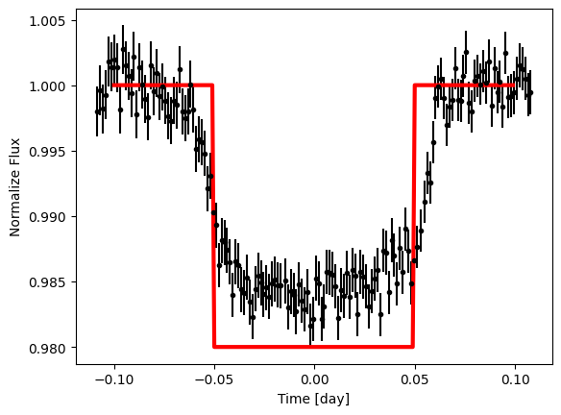
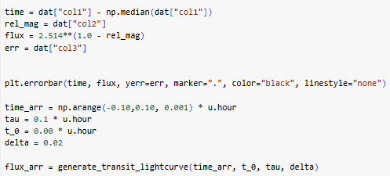

Slide 4
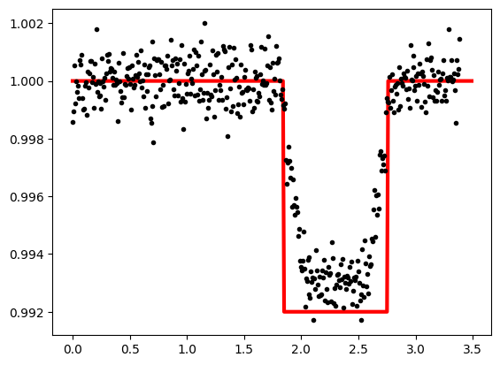
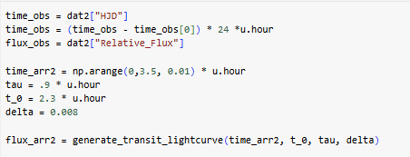

Slide 5
Conclusion
The drop in brightness is related to the area ratio of the planet and the star. So, a planet 1/10th the size of the star would result in a 1/100th brightness drop.
The first star dropped by about 1/1000, so the planet should be about 1/100th the size. The second star dropped 1/100, so the planet should be about 1/10th the size.

