Slide 1
Spatial Confounding
Sam Herold
Kayleigh Keller

Slide 2
Big picture/Outline
General Goal: Eliminate confounding in regression models **Spatial**
- x and y
confounding
model
way to eliminate the confounding
apply to Poisson regression

Slide 3
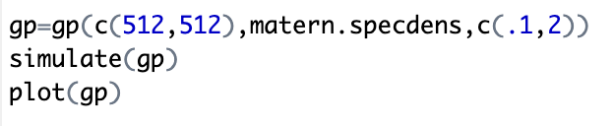
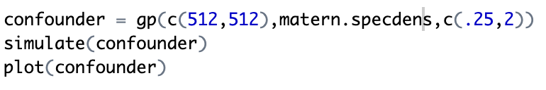
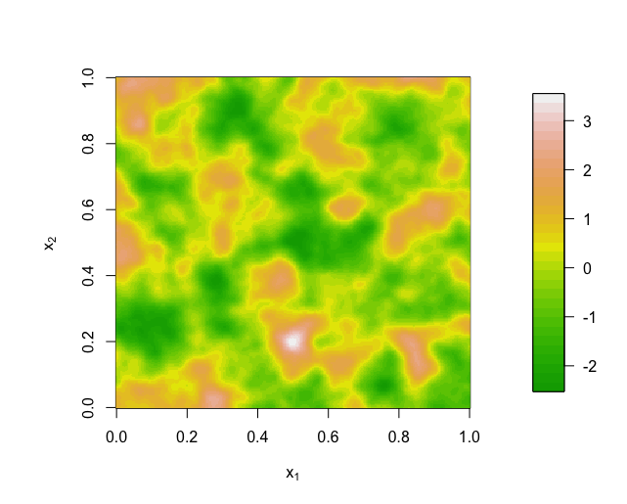
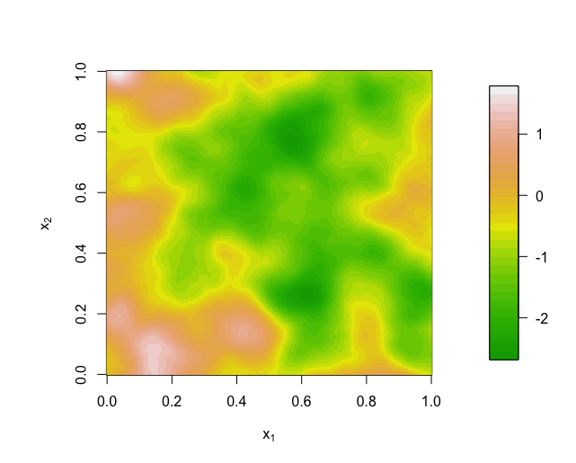
The spatial surface

Slide 4
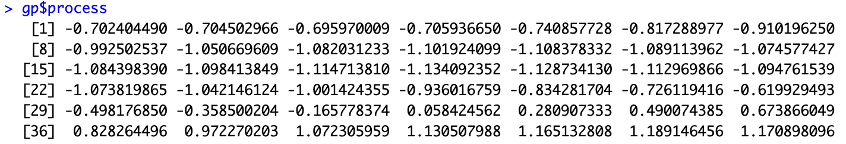
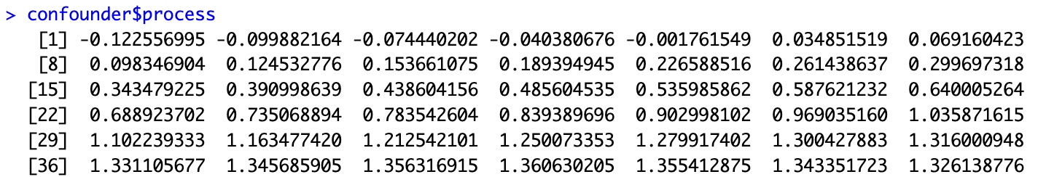
=
+
Notes:
We will start wil linear regression…

Slide 5
Income level
x
Air Quality
?
Health
y

Slide 6
Income level
Air Quality
?
Health

Slide 7
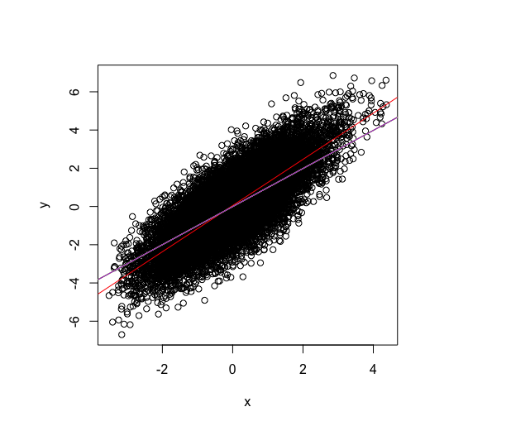
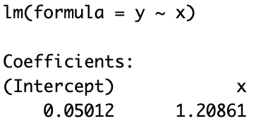
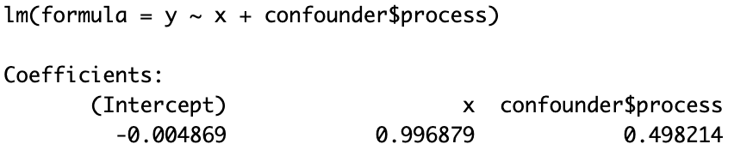
Goal: Represent the correlation of x and y
that doesn’t have to do with the confounder,
or simply: b1 =1.

Slide 8
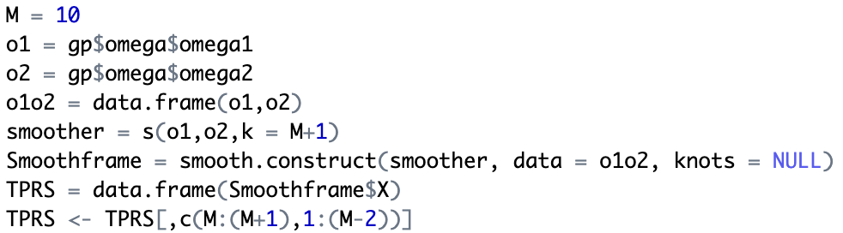
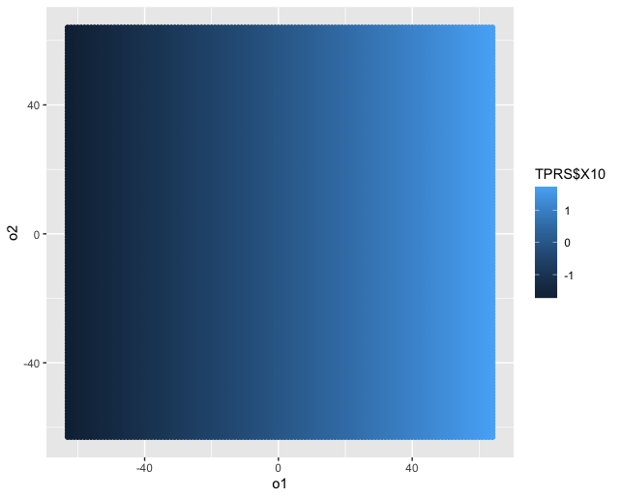
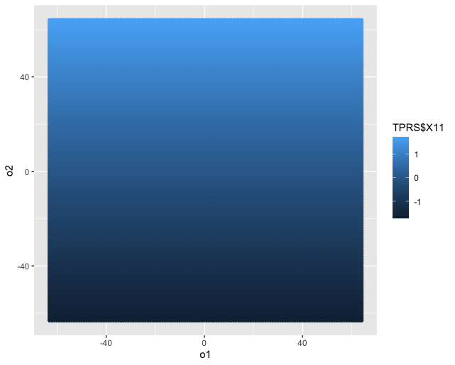
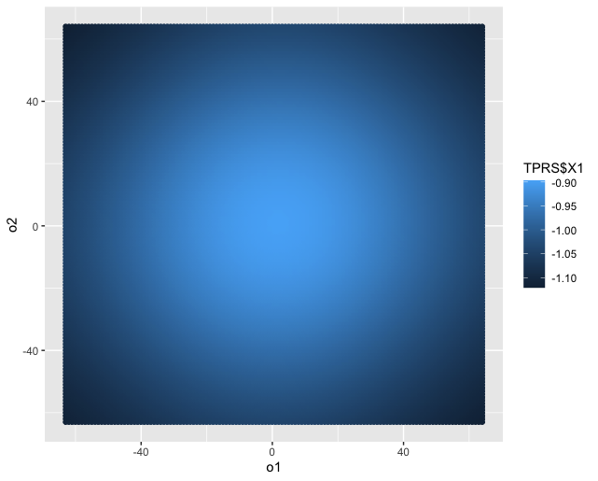
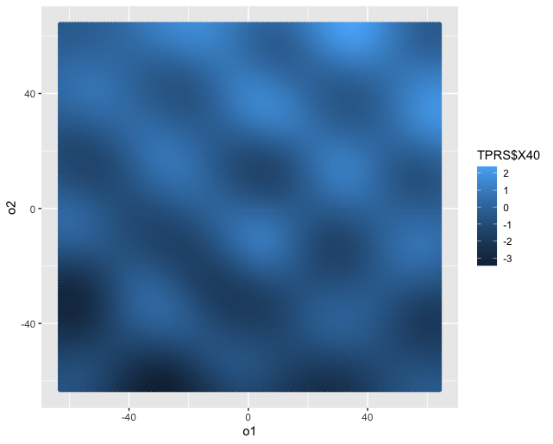
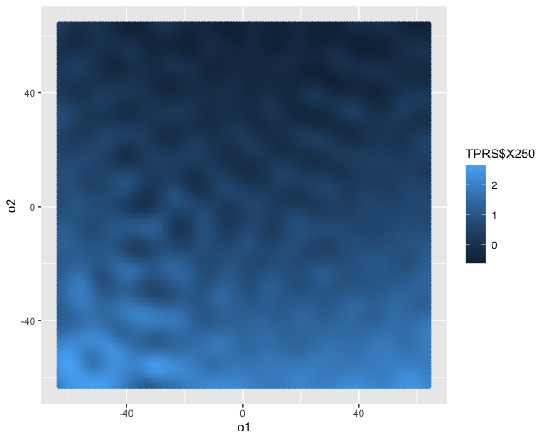
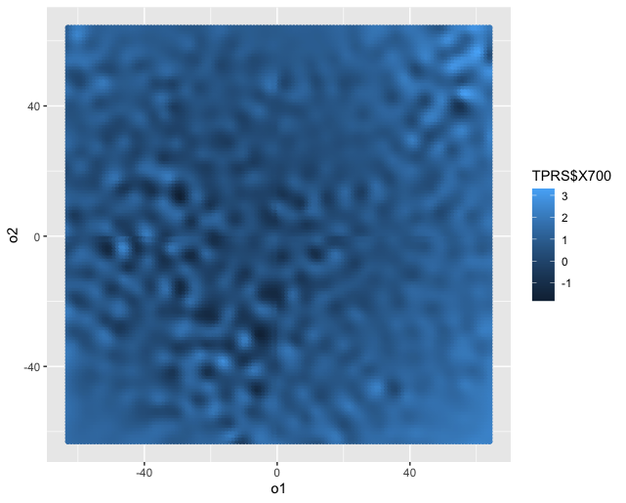
One solution: Thin Plate Regression Splines (TPRS)
Instances of TPRS are added to a model to try to represent the confounding surface
Exist in a set – “I added 50 thin plate regression splines to my model”
Created completely independent of x and y – “This is the set of TPRS’s for a 64x64 surface”
Get more and more detailed the higher you go
EX: The set of TPRS’s for 64x64 surfaces
1
2
3
40
250
900
...
...
...

Slide 9
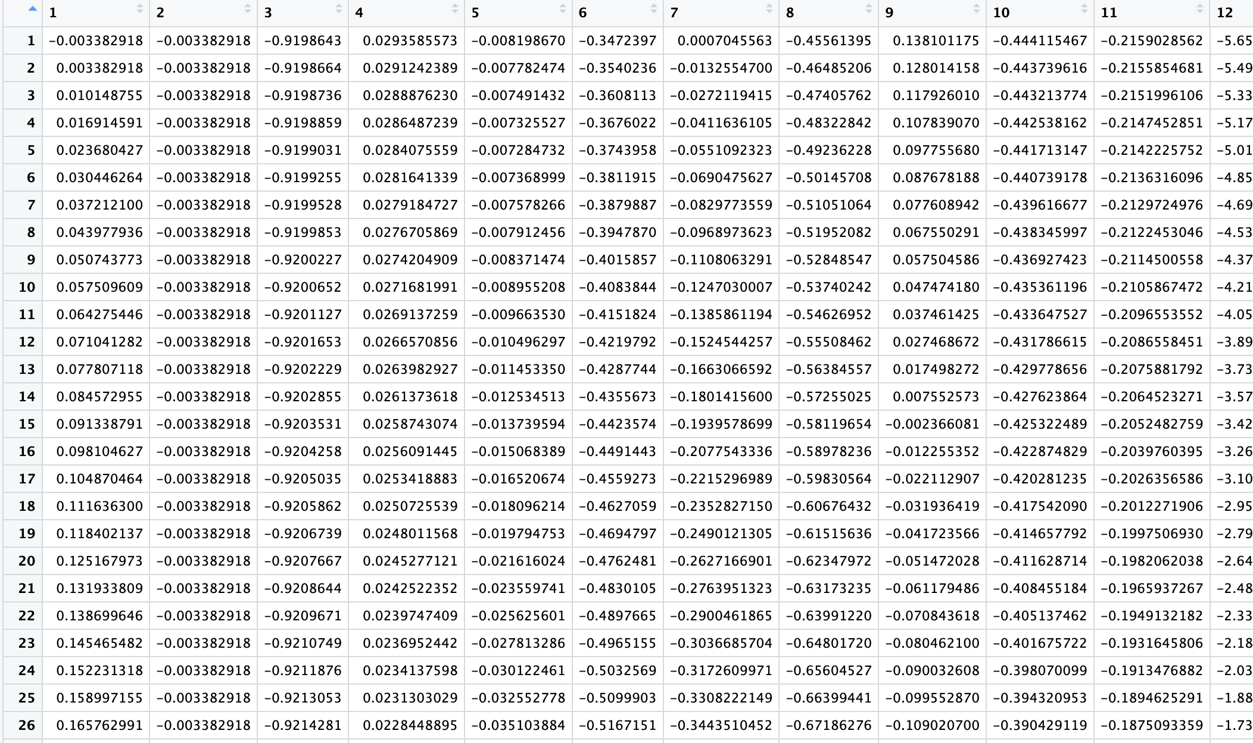
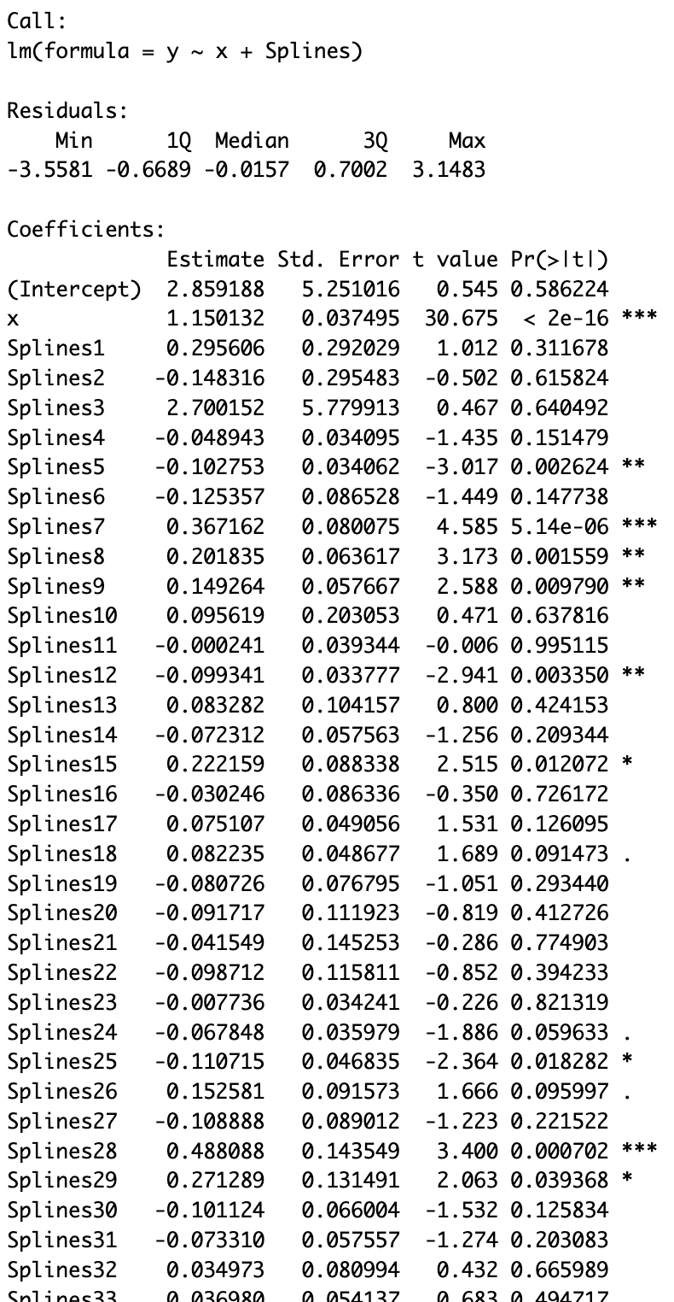
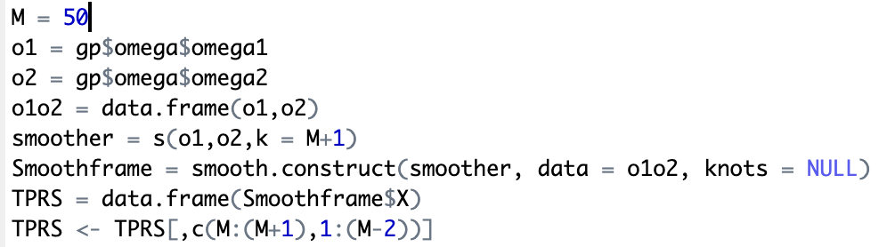
In the model…
50
‘Splines’
Some of the splines will represent some of the confounding.
Remember, the confounding surface looks like this:
- And splines look like this:
Notes:
Discuss significance, how if we add enough the surfaces will represent the confounding more and more and x can stand on its own.

Slide 10
You can add how ever many you want to a model.
The question becomes: How many TPRS do you add to your model??

Slide 11
ADD GRAPHS OF RESULTS

Slide 12
Poisson Regression – y becomes count data
Income level
Air Quality
?
Number of heart attacks
0,1,2…
Notes:
Just like linear regression, we want the simplest case. This is when b1 is 1 and the line follows e^x.

Slide 13
