Slide 1
Communications Project
Group 1
Samuel Hunt, Xiaoming Liang, Sadhana Chhetri, Tianzheng Cui

Slide 2
General Requirements
Create an application where employees of an organization will communicate with each other through text
The system is text-based with a Server/ Client connection over TCP/IP where users can chat synchronously and asynchronously
Two types of users will be there namely general users and IT users
IT users will create accounts for all the employees to be able to login and chat through the system
IT users will be able to access the chat logs that are stored in the system with details of the sender, receiver, time stamp and the message content in a separate file.

Slide 3
Overall Design
Data Storage
Communication Between Server And Client
Classes

Slide 4
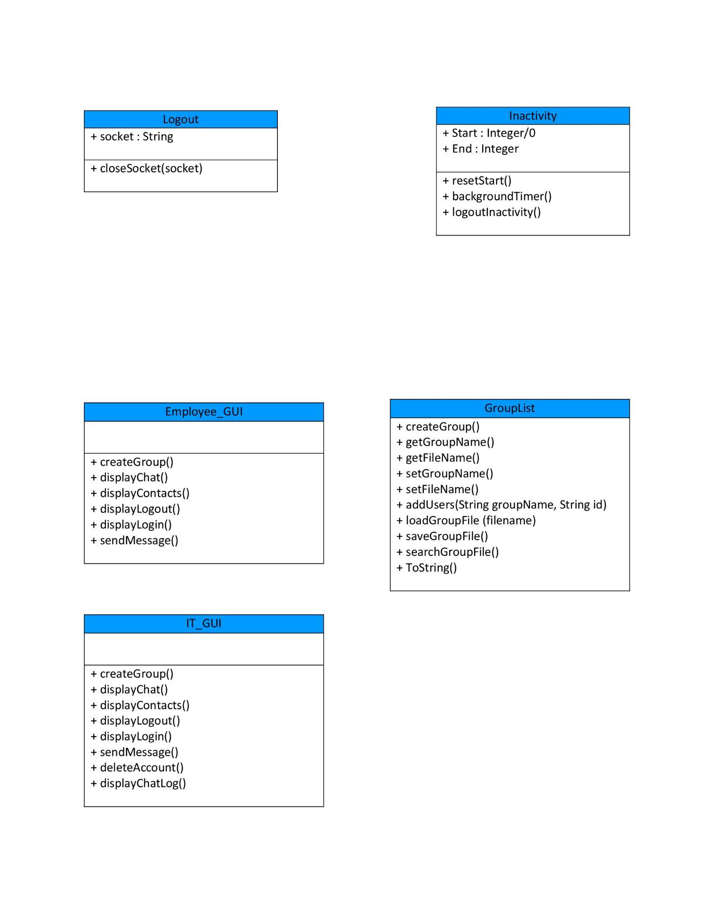
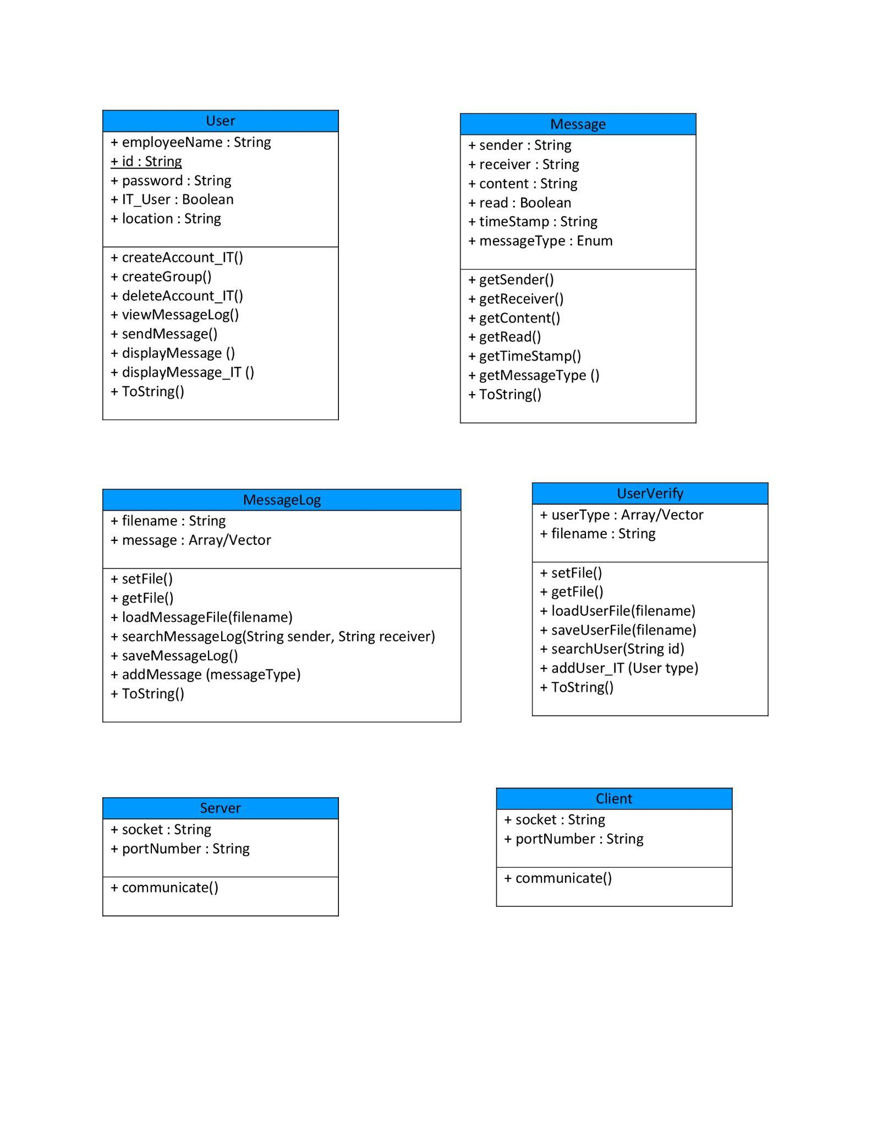
Class UML

Slide 5
Message Passing
Clients :
Message
MessageLog
Server:
Message
MessageLog

Slide 6
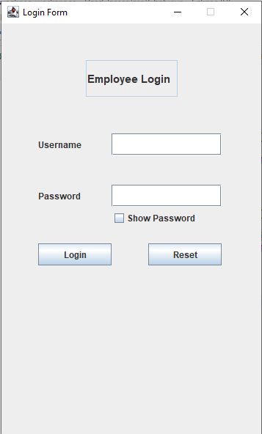
Login Display

Slide 7
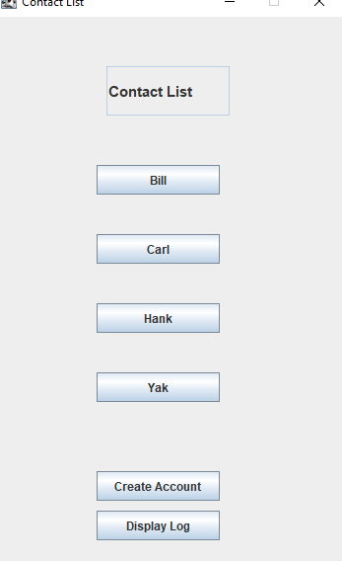
Contact Display

Slide 8
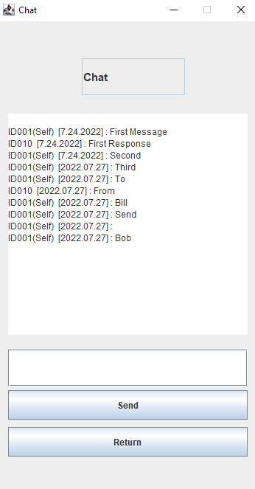
Chat Display

Slide 9
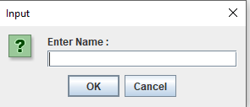
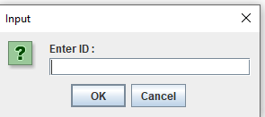
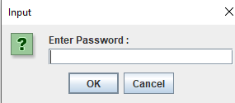
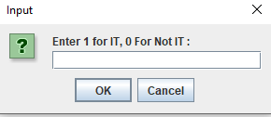
Project
Image of creating account (IT)

Slide 10
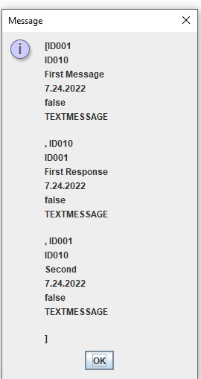
Display MessageLog (IT)

Slide 11
Hindsight lesson
Certainly, more time could have been available for implementing
Spending more time and thinking more in-depth about certain aspects
Communication
Design unit tests while implementing

Slide 12
Github Repository
SamHunt490/CS-401-Group-1-Communications-Project (github.com)

