Slide 1
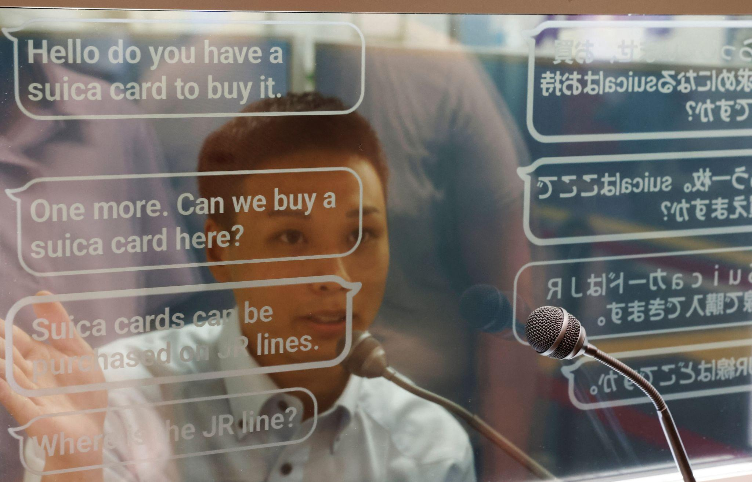
The Launch of Live AI Translation into South Korean Market
By: Brian, Matt, Aaron, and Samarpan

Slide 2

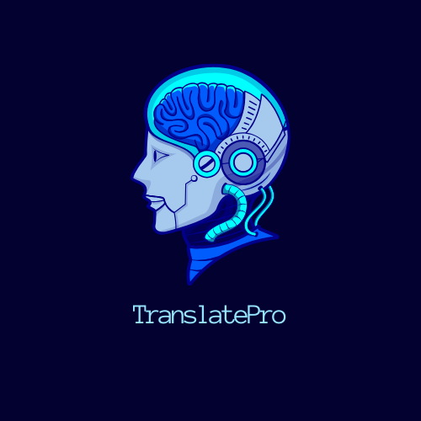
Platform Introduction
Company: TranslatePRO is U.S based company, we provide a Live AI translation platform that can be integrated throughout all electronic devices (phones, laptops, TVs, etc.). The platform aims to mitigate language barrier issues and allow users to interact more seamlessly when conversing verbally. The key point of the platform is supporting the context of a verbal conversation both formally and informally.

Slide 3
Platform Implementation strategy
Optimize the sprinkler strategy for a multi market campaign.
Launch targeted advertising campaigns on platforms like Naver, KakaoTalk, and Facebook to reach specific audience segments in South Korea.
Partner with influencers / celebrities for wider reach
Promotion through top tech websites - high internet penetration
Platform interface and content should be optimized for Korean language input, including Hangul characters, and that it reflects Korean cultural norms and preferences.
Support a seamless dialect recognition
Audience engagement via cultural wants / needs that prompts satisfaction.
Adaptive learning

Slide 4
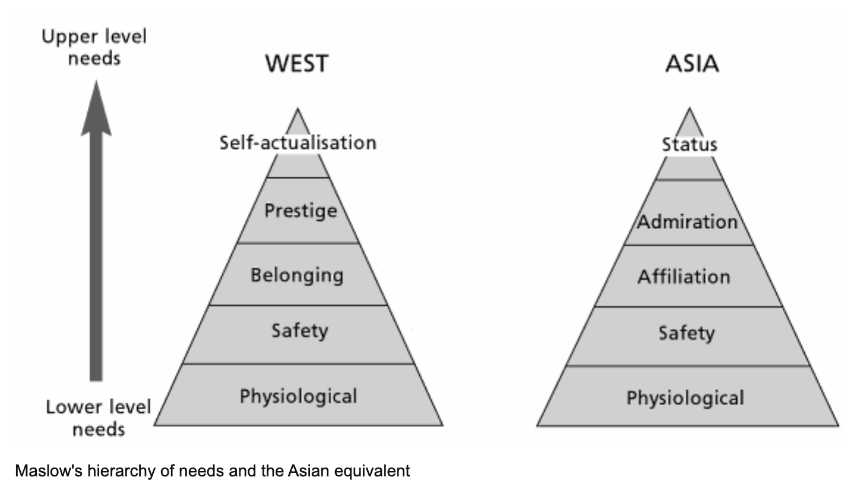
Market
Ranked 13th by global GDP
Ranked 4th of Asian Countries by GDP
36.5% of GDP in Exports (2021)
Focus on Export-oriented Industries– specialization + dependence on global demand
Resource Limitations– Necessitating importation of raw material and energy
Limited Domestic Market– Population of 51 Million
Major Trading Partners– China, USA, Vietnam, Hong Kong, and Japan

Slide 5
Culture
Korea
Confucianism: Respect for elders, authority, and hierarchy. Values group harmony, collective good, and social order.
Collectivism: Prioritize needs of the group (family, company, society) over individual desires.
Keeping Face: Dignity, showing respect, and avoiding embarrassment are important..
Non-verbal communication: Bowing, eye contact, and gestures play large role in communication
Korean Business Culture:
Hierarchy: Businesses like society are very hierarchical. Respect for those in senior positions is important
Indirect communication: Avoid direct confrontation and use indirect language to save face.
Decision-making: Decisions made by consensus and involve senior management.
Formal etiquette: Business meetings are formal, with specific protocols for greetings, introductions, and presentations. Punctuality and professionalism.

Slide 6
Segmentation Criteria:
Industry-specific language needs.
Real-time vs. document translation preferences.
User technological proficiency.
Notes:
Language nuances within different industries can be substantial. For example, legal professionals might require precise legal terminology, while healthcare professionals need accuracy in medical jargon. Understanding these specific language demands allows us to tailor our translation service with specialized dictionaries and terminology databases, ensuring precision for users across various sectors.

Slide 7
Demographics and User Needs:
Age group: 25-45.
Industries: Finance, technology, manufacturing, healthcare
Key needs: Accuracy, efficiency, industry-specific terminology.
Notes:
Our language translation service targets professionals aged 25-45 in finance, technology, and manufacturing, aiming to meet specific industry language demands. Focusing on accuracy and efficiency, our service caters to individuals managing tight schedules, providing industry-specific precision beyond generic translations programs.

Slide 8
Implementation and Features:
Seamless integration into existing platforms
Key features: Industry-specific language models, quick access to business-related translations, enhanced accuracy.
Notes:
The implementation strategy involves ensuring a smooth integration process into existing platforms, and enhancing user adoption. Key features like industry-specific language models and quick access to business-related translations cater directly to the identified needs of business professionals.

Slide 9
Competition
Naver Cloud Platform:
Korean company.
Accurate and natural sounding translation.
13 languages via text translation, but speech translation only available for subset
Google:
Most widely recognized and used.
Real-time translation of text, video, and speech in over 100 languages.
Generally accurate only
DeepL:
High-quality and nuanced translations.
Good accuracy (mostly in European languages);
46 languages

Slide 10
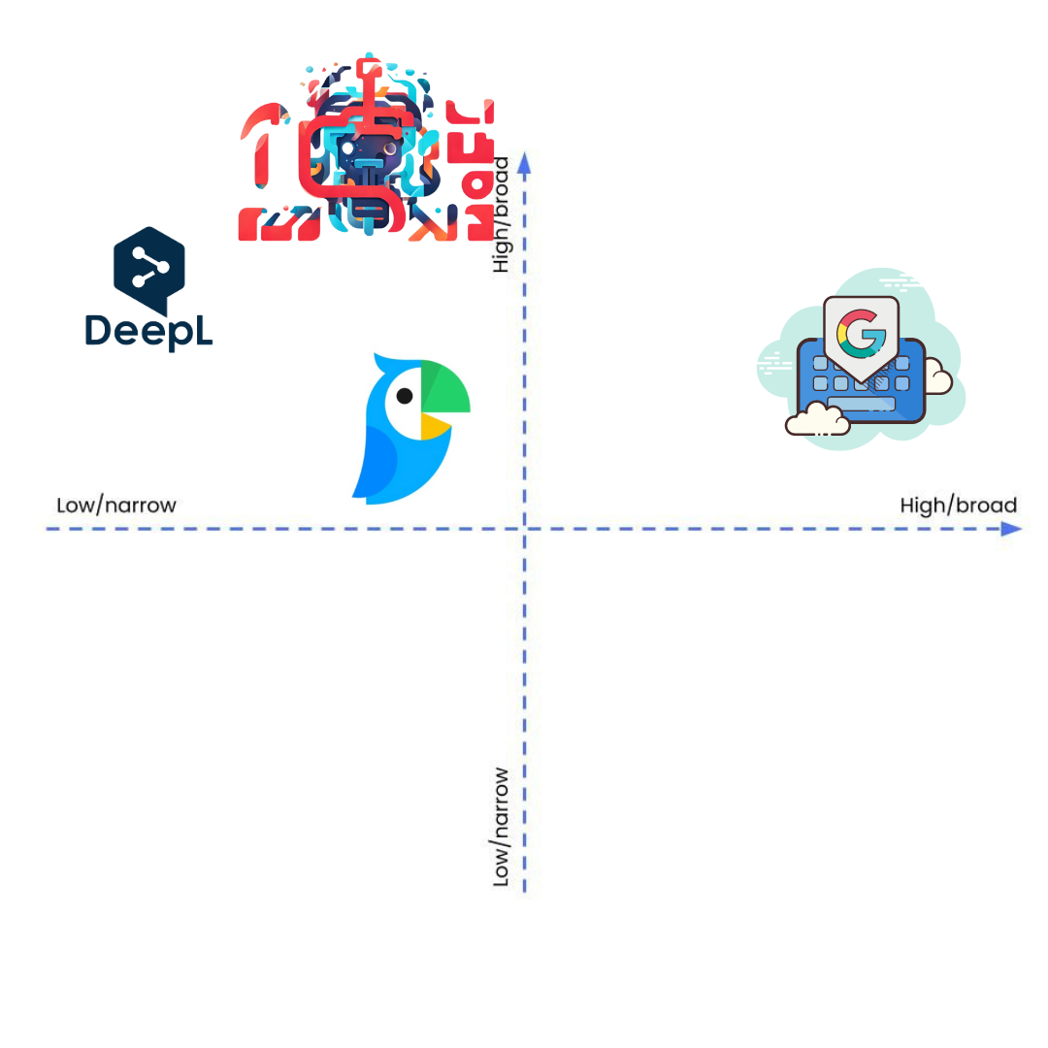
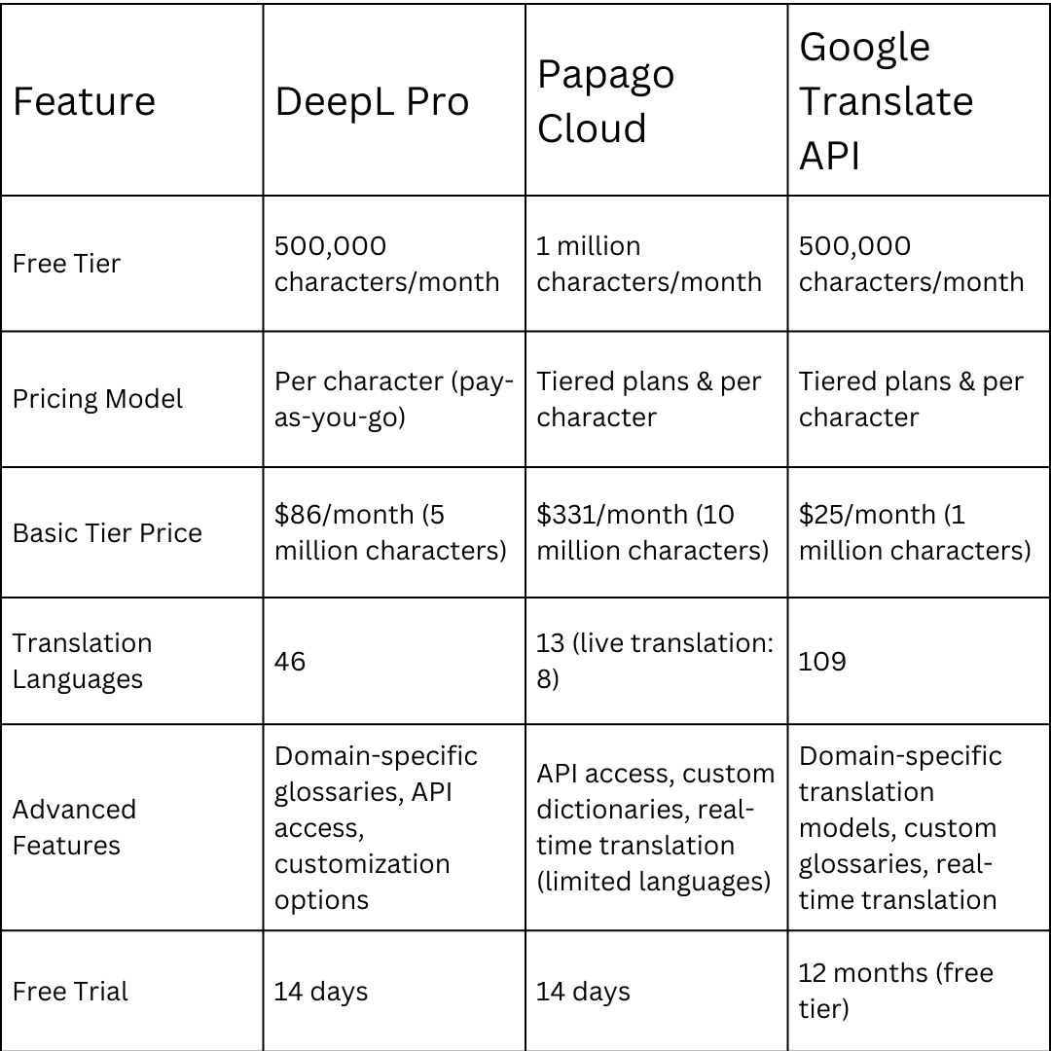
Competition Positioning + Pricing

Slide 11
Purchasing Based on Needs
Researching and identifying needs
The demand to overcome language barriers
Evaluation of potential solutions
A requirement to find consistency between devices via platform integrations for a more user-friendly experience.
Purchase decision
Evaluating the users experience through tested interactions using the live translation platform
Ensuring that expectations were met and that the functionality of the platform was exceptional
Notes:
The demand to overcome language barriers is a necessity for all individuals and businesses. The integration of TranslatePRO will help enhance communication struggles within the realm of contextual misunderstanding. The desire to understand emotions via text has always been a need.
Finding an authentic and reliable source to continuously implement throughout a company or individual’s lifestyle
Creating software that provides inflections through the voice translation

Slide 12
Buyer Behavior and Implementation
Seamless Integration
The AI translation platform should integrate smoothly with existing software, applications, content management systems, and communication tools used by buyers.
Compatibility
Compatibility with various file formats, devices, operating systems, and platforms enhances usability and adoption.
Ensure the strength of all elements perform as necessary
Scalability
Ensuring the platform can accommodate increasing translation volumes, user traffic, and demand without compromising performance or reliability.
Allow room for expansion within platform for future unseen demand.
Flexibility
Offering customizable features, settings, and language preferences allows users to tailor the platform to their specific needs and preferences.
Easy format in ways to choose different languages to fit specific needs
Notes:
User-friendly for 25-45 year olds along with businesses within the finance, technology, and manufacturing industries.
Integrate TranslatePRO smoothly into existing software applications and systems
Primary dialect is Seoul dialect, however there are many other other languages and dialects within South Korea due to globalization and immigration

Slide 13
Expansion of Opportunities
Additional information
Market Research : Understanding user preferences and Willingness to pay.
Competitor Analysis : Study competitor offerings, Evaluate distribution channels and pricing Models.
Scalability and Expansion : Assess scalability and Develop expansion strategies.
Emerging Technologies and Trends : Monitor industry trends.
Scope
Strategic Partnerships and Collaborations
Integration with existing platforms
Ethical considerations
Quality Assurance and Localization

