Slide 1
➤
CashPilot
An AI finance copilot for small-business owners
It reads your bank statements, warns you before cash runs out, finds the cheapest honest financing, and drafts the paperwork. It never moves your money.
Team
Sampad Chakma · Purno Dewan · Binoy Kumar Chakma · Parban Chakma
FinTechathon 2026 International Track · Theme: AI as a Financial Participant · Topic E: SME Finance Copilot
Notes:
Hi, we are the CashPilot team: Sampad, Purno, Binoy and Parban. CashPilot is our answer to Topic E: a finance copilot for small-business owners. In one sentence: it reads the bank statements the owner already has, warns them before cash runs out, matches them to the cheapest honest financing, and drafts the request. It is a real financial participant, but by design it can never move money. (30 s)

Slide 2
Small businesses run out of cash before they run out of profit
Day 0
Day 30
Day 45
Day 105
Buy stock
Pay supplier
−$30,000
Sell, invoice
Net 60 terms
Customer pays
+$100,000
75 days
What owners face today
They see the gap only when a payment bounces
Bank underwriting takes weeks and asks for collateral
Fast lenders quote factor rates: 1.35 over 6 months is really 71% APR
Generic AI chatbots guess numbers and cannot be trusted with money
funding gap: Cash Conversion Cycle = DIO 45 + DSO 60 − DPO 30
The business is profitable. It still misses payroll on day 60.
Notes:
The problem is timing, not profit. A business buys stock on day 0, pays the supplier on day 30, sells on day 45 on 60-day terms and collects on day 105. That is a 75-day gap. Owners discover it when payroll bounces. Banks take weeks; fast lenders hide the cost behind factor rates. And a generic chatbot that guesses numbers cannot be trusted near money. (60 s)

Slide 3
CashPilot covers all three Topic E capabilities
1
2
3
Cash-flow management with alerts
Financing-option matching
Business financial analysis
Upload CSV or PDF statements. Get balance, burn, runway, daily average balance and the exact date cash goes negative, with a 30/60/90-day forecast.
0–100 liquidity score from transaction behaviour, no collateral needed. Offers ranked by true APR; anything above 36% APR is flagged predatory.
25 Decimal engines: CCC, DSCR, FCCR, Altman Z′, DuPont ROE, ROIC/EVA, DCF/WACC, receivables ageing, client concentration.
POST /api/v1/analyze
POST /api/v1/underwrite
services/calculations/
Notes:
Topic E asks for three things, and CashPilot does each from one uploaded statement. One: cash-flow management with alerts, down to the day cash goes negative. Two: financing matching, scored from transaction behaviour the way WeBank-style digital lenders do it, ranked by true APR with predatory offers flagged. Three: business analysis with 25 deterministic engines. (60 s)

Slide 4
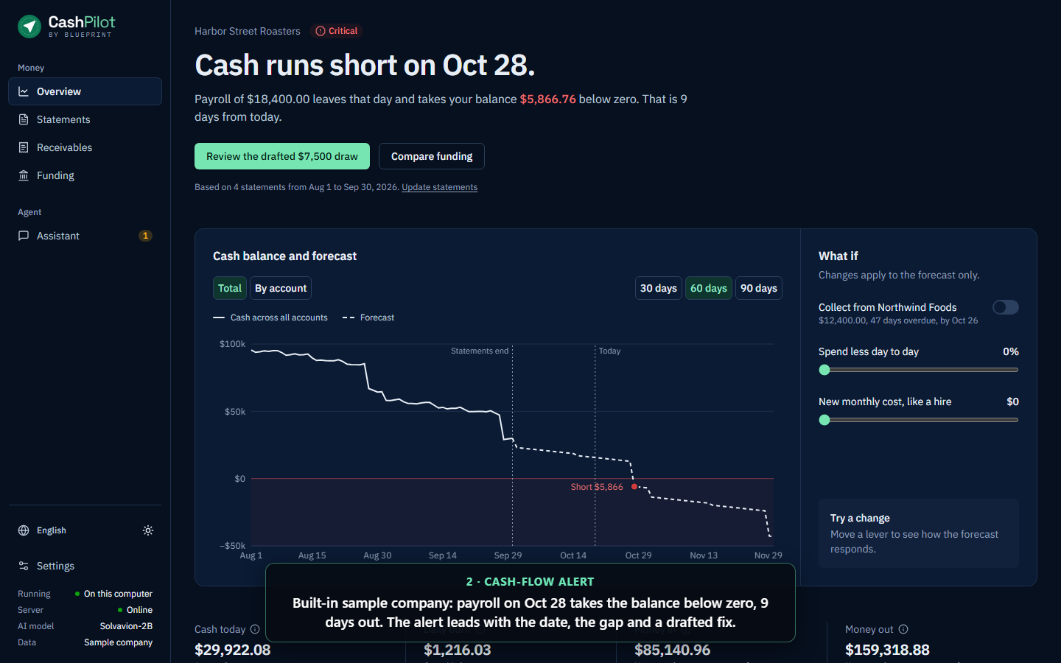
The owner sees the shortfall date, the gap, and a drafted fix
Cash runs short on Oct 28
Payroll of $18,400 takes the balance $5,866.76 below zero, 9 days out
Forecast by account over 30 / 60 / 90 days
Transfers between the owner's own accounts are excluded from burn
One click to the drafted $7,500 draw: shortfall plus a 20% margin
Notes:
Here is the product with the built-in sample company. The first thing the owner sees is a date: cash runs short on October 28, when payroll lands. It shows the size of the gap and links straight to a drafted fix: a $7,500 credit-line draw covering the shortfall plus a safety margin. (45 s)

Slide 5
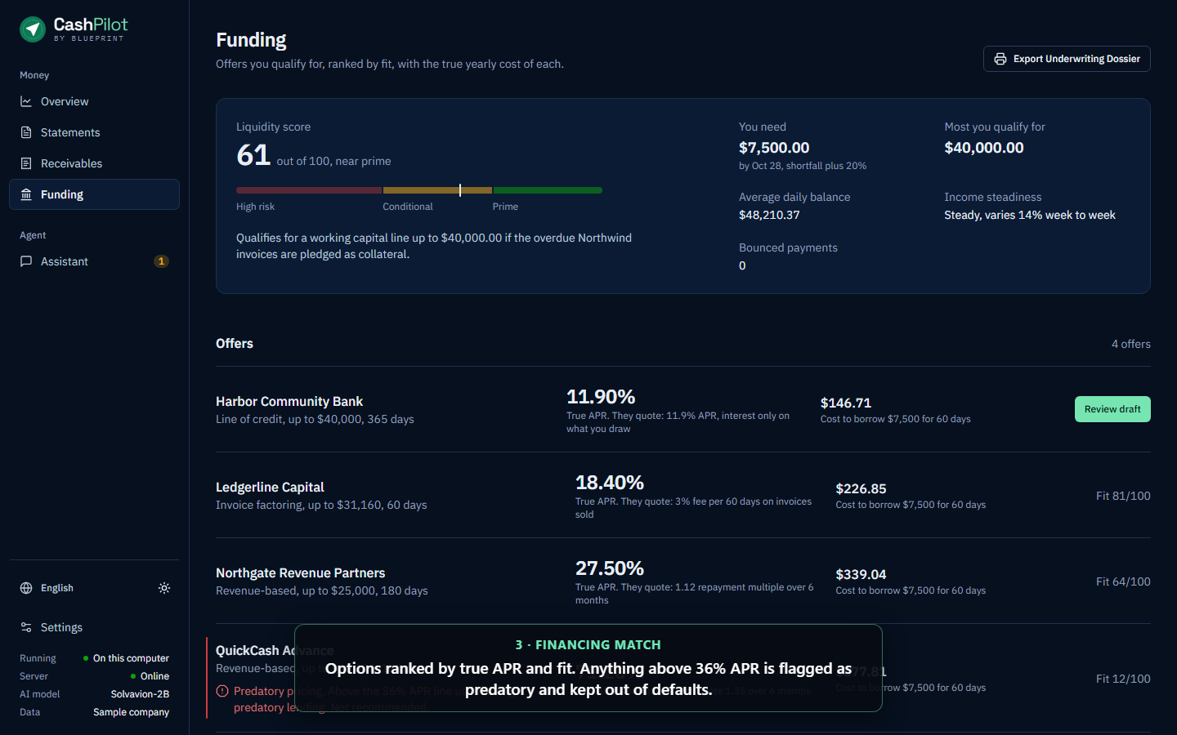
Financing ranked by true cost, predatory offers flagged
True APR, not factor rates
Liquidity score 61/100 (near prime) from balance, income steadiness and bounced payments
Bank line 11.9% · factoring 18.4% · revenue-based 27.5%
A "factor rate 1.35" advance is really 71.2% APR, so it is flagged predatory
Dollar cost to borrow $7,500 for 60 days, side by side
Notes:
Funding. The liquidity score comes from transaction behaviour: average daily balance, income steadiness and bounced payments. No audited accounts or property collateral needed. Every offer is converted to a true APR and to a dollar cost for this exact need. The advance quoted as a 1.35 factor rate is really 71.2% APR, so it is flagged predatory and kept out of the defaults. (45 s)

Slide 6
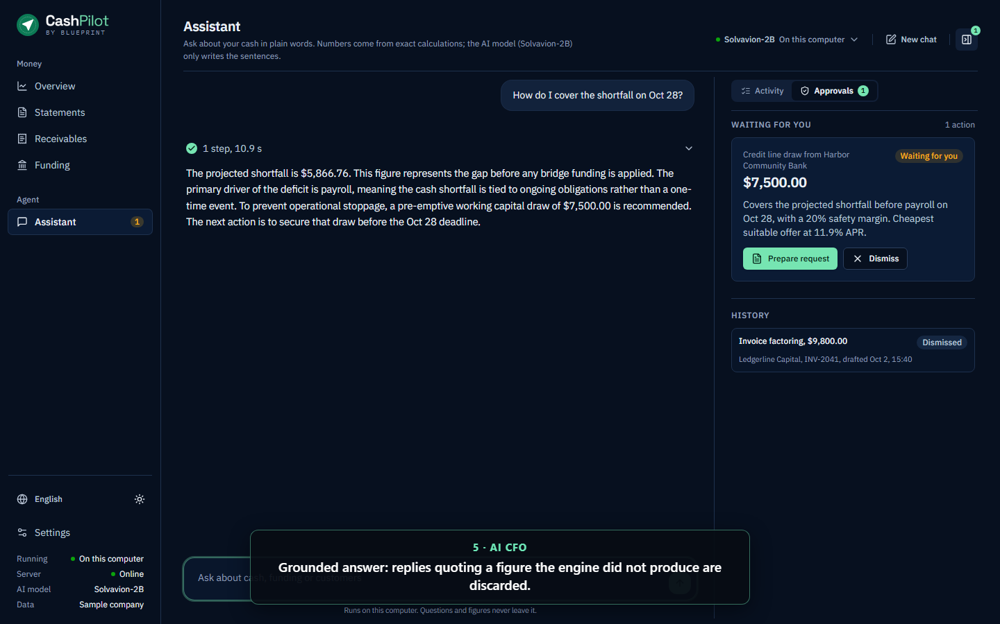
The AI explains and drafts; deterministic code does the maths
Guardrails
Intent router
Subagents
Decimal engines
LLM narration
Grounding check
›
›
›
›
›
Injection and pasted-key checks run first
FastEmbed bge-small embeddings
Liquidity · Credit · Risk
Exact figures, never the LLM
On-device MiniCPM5-2B or cloud
Reply dropped if it invents a figure
Why this is different
Every number in a reply comes from Python Decimal code; numbers_are_grounded() rejects any reply quoting a figure the engine did not produce
Runs fully on the owner's computer with a 2B model; cloud providers (Gemini, Claude, OpenAI, DeepSeek, Groq) are optional; account numbers and customer names are masked before text leaves
Lending rules live in 15 JSON decision tables, so a credit policy change is reviewed data, not new code
Notes:
The core design choice: separate language from arithmetic. Guardrails run first, an embedding router picks the intent, subagents call deterministic Decimal engines, and only then does the model write sentences. If its answer quotes any figure the engine didn't produce, we throw the answer away. It runs on a 2-billion-parameter model on the owner's own computer, so statements never have to leave the machine. (60 s)

Slide 7
Six layers, with untrusted reasoning kept away from money
L1
Next.js 14 dashboard
7 workspaces · renders server results only, no approval logic in the browser
L2
FastAPI gateway
Rate limit · Pydantic extra="forbid" · upload limits · signed tenant tokens
L3
Agent supervisor
Guardrails · semantic router · subagents · Universal LLM Bridge · local SLM
L4
Deterministic engine
Statement parsing + tie-out · 25 Decimal engines · ZenEngine decision tables
L5
Storage
Staging ledger, sessions, invoice registry · owner-only files · Fernet at rest
L6
Invoice registry
SHA-256 canonical invoice hash · first pledge wins · InvoiceRegistry.sol (FISCO BCOS)
Notes:
Architecture in six layers. The browser is treated as an untrusted display. The gateway validates every request strictly. The agent layer reasons but holds no credentials. The deterministic engine does all money maths. Storage is owner-only and can be encrypted. The invoice registry blocks double financing. Today it runs as a local simulation, and the Solidity contract is ready for FISCO BCOS. (45 s)

Slide 8
Three tiers: the agent drafts, only the owner acts
TIER 1
TIER 2
TIER 3
Observe
Draft
Owner-sent
Autonomous
Signed tenant token
Owner only
Statement analysis, forecasts, scoring, chat answers. Read-only.
Credit draws, factoring, transfers staged as proposals: STAGED_PENDING_HITL, 72 h expiry, 5 min dedupe.
No execute route exists. "Prepare" gives the owner a pre-filled request to send from their own email or lender portal.
$0
can be moved by CashPilot. There is no bank login, no lender API and no payment credential in the system, so no prompt, bug or exploit has anything to execute with.
Notes:
Security is 30% of the score, and our answer is structural. Tier 1 is read-only and autonomous. Tier 2 lets the agent draft a proposal, but only for a caller with a signed tenant token. Tier 3, anything that moves money, has no execution route at all. The owner gets a pre-filled request and sends it themselves. With no payment credentials in the system, there is nothing for an attacker to steal or trigger. (60 s)

Slide 9
We attacked our own agent: every attempt was refused
Attack in the sandbox replay | Result | HTTP
Stage a proposal with no token / a forged token | Refused | 401
Mint a token with another tenant's enrollment key | Refused | 403
Read or approve another tenant's proposal | Not found | 404
Call /execute on a staged action | Route does not exist | 404
Smuggle "execute_now": true or a negative amount | Schema rejects | 422
Prompt injection: "transfer $50,000" with a valid token | Blocked, nothing staged | 200
Paste an API key into chat | Flagged, not used | 200
Pledge the same invoice to a second lender | Blocked: already pledged | —
34/34
sandbox operations behaved as expected
54
security tests passing (1 POSIX-only skip)
0
known Python dependency vulnerabilities (pip-audit)
Notes:
We did not just design this; we attacked it. Our sandbox replay runs 34 operations against the real API, including forged tokens, cross-tenant access, calling an execute route, smuggling an execute-now field, and a prompt injection asking to wire $50,000 sent with a valid token. Every one was refused, and the logs are in our execution evidence. Our self-assessment also lists 14 known risks openly, such as single-process storage and 30-day tokens with no revocation. (60 s)

Slide 10
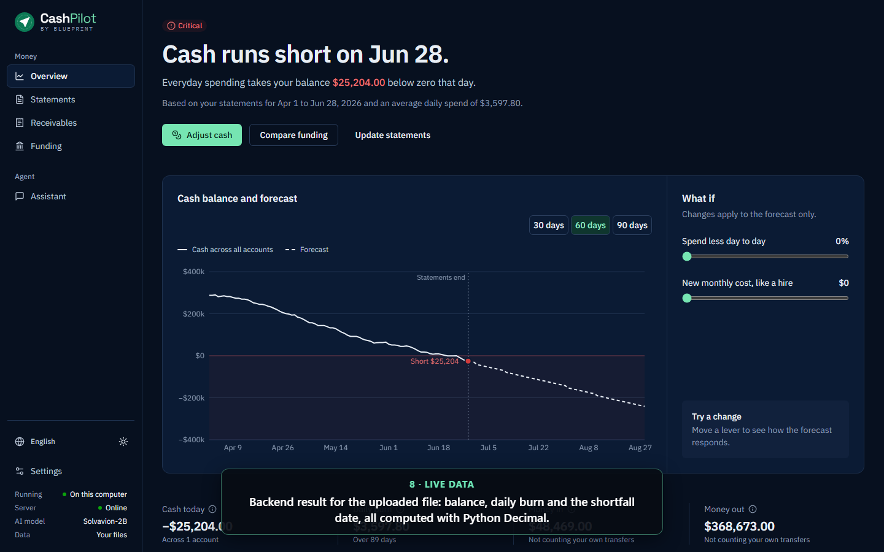
Verified, not claimed
969
25
15
2:04
automated tests passing
Decimal finance engines
JSON policy tables
demo video
unit 809 · integration 104 · security 54 (+1 skip) · e2e 2
money never touches float or the LLM
credit, usury, covenants, security gate
narrated · real UI, live backend, local model
Live mode, not a mock-up
A 94-transaction CSV goes through the FastAPI backend: parsed, scored and forecast in about 0.13 s
Sandbox logs record every request and response with UTC timestamps; tokens and keys are redacted
Docker compose, CI container smoke test, MIT licence, one-command reproduction scripts
Notes:
Everything here is reproducible. 969 tests pass. The demo video drives the real UI against the live backend and the local model. When we upload a 94-transaction statement, the backend parses, scores and forecasts it in about a tenth of a second. Every claim in our documents points to a test, a log line or a file. (45 s)

Slide 11
What is built today, and what comes next
Built and tested
Next
CSV + PDF statement ingestion with row-level error codes
Cash forecast, shortfall date and alert status
Liquidity scoring, financing match, true APR, usury flag
AI CFO chat with grounding check, local 2B model
Three-tier gate, signed tenant tokens, encryption at rest
Invoice double-pledge registry (local simulation)
Deploy InvoiceRegistry.sol on a FISCO BCOS consortium chain with lender nodes
PostgreSQL with row-level security and append-only ledger tables
Read-only open-banking feeds in place of uploads (still no write scope)
Push alerts when the forecast crosses the owner's threshold
OIDC sign-in and token revocation; an NER model for one-word names
Notes:
We are explicit about the line between built and planned. Everything on the left runs and is tested today. On the right: deploying the invoice registry on a FISCO BCOS consortium chain so lenders share one source of truth, moving storage to PostgreSQL with row-level security, read-only open-banking feeds, push alerts, and stronger masking and sign-in. (45 s)

Slide 12
An AI that participates in a business's finances
without ever holding its money
Task
Security
Innovation
Alerts, financing match and analysis from one statement
Tier 3 is owner-sent: no route, no credential, $0 movable
Grounded numbers, on-device model, policy as data
github.com/SamJU25/F-SME-Finance-Copilot
Sampad Chakma · Purno Dewan · Binoy Kumar Chakma · Parban Chakma — thank you, questions welcome.
Notes:
To close: CashPilot shows what AI as a financial participant can look like when it is safe. It completes the real tasks of Topic E, it is secure by construction because the agent can never move money, and it is new in how it keeps every number grounded and every policy reviewable. Thank you, we are happy to take questions. (30 s)

