Slide 1

Blockchain Hackathon Team 8
Trade finance solution for the Gems and Jewellery Trading Community
“… For the only way in which a durable peace can be created is by worldwide restoration of economic activity and international trade… ” - James Forrestal

Slide 2
Agenda
Problem Statement
Introduction to Team
Answers to the Questionnaire (Data)
Existing System
Proposed Solution
Platform Specifications
Business Applications, Post course
Demo
Q & A

Slide 3
Problem Statement
Develop alternate processes to ease authentication and verification of party, trade, credit documentation and transactions by Trade Finance participants
Authorized traders should be able to access a unified platform to upload trading and credit related documents for online verification and validation
Lending institutions should be able to access the unified platform to authorize traders, validate trade documents, status and release payment instructions with minimal manual intervention
Goals:
Reduce number of physical interfaces, manual effort and exchange of physical documents required for evaluation of credit worthiness, repayment risks, sanctioning credit limits, inventory valuation, tracking collateral security by lending institutions
Reduce physical interfaces required in the process of evaluating compliance with related party transactions and subsidiary financing guidelines
Notes:
Source: https://www.ibef.org/industry/gems-and-jewellery-presentation
https://www.sustainablegemstones.org/blog/2018/1/23/a-study-on-problems-faced-by-exporters-of-gems-and-jewellery-industry

Slide 4
Team
Nagendra – UI-WS Integration, Aruba
Senthil – Smart Contract Developer, Virtusa
Vani – UI-UX Development Expert
Aditi – Smart Contract Developer, Infobeans
Vamshi – UI, NodeJS Developer, Thinktalk Software Solutions
Narasinga Rao – Finance Domain Expert, Oracle
Vinay – Finance Domain Expert, HCL

Slide 5
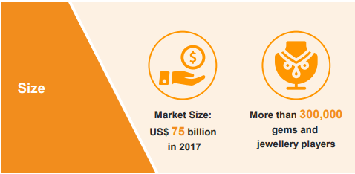
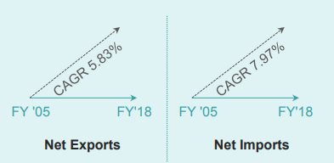
Answers to the Questionnaire (Data)
Global Gems and Jewellery Market Size:
US$ 75 billion as of 2018 and is estimated to reach US$ 100 billion by 2025
Characteristics of Indian Gems and Jewellery Trading
Third largest in the world, contributes to 29% of global jewellery consumption
Fragmented Industry. Paternal approach (workers-extended families)
Large number of MSME players
Capital Intensive, highly sensitive to Export-Import Regulations
Heavy dependence on Trade Finance instruments as source for working capital
NPA levels 1%
Notes:
India's gems and jewellery sector is one of the largest in the world contributing 29 per cent to the global jewellery consumption. The market size of the sector is about US$ 75 billion as of 2018 and is estimated to reach US$ 100 billion by 2025. The sector is home to more than 300,000 gems and jewellery players, contributes about 7 per cent to India’s Gross Domestic Product (GDP) and employs over 4.64 million employees.
India's gems and jewellery sector contributes about 15 per cent to India’s total merchandise exports. The overall net exports of gems and jewellery stood at US$ 32.71 billion during FY18 registering a compound annual growth rate (CAGR) of 5.83 per cent over FY05; whereas gems and jewellery imports increased at a CAGR of 7.97 per cent from US$ 11.63 billion in FY05 to US$ 31.52 billion in FY18.
India is the world’s largest centre for cut and polished diamonds in the world and exports 75 per cent of the world’s polished diamonds. Today, 14 out of 15 diamonds sold in the world are either polished or cut in India. India exported US$ 14.99 billion worth of cut and polished diamonds in April–October 2018.*

Slide 6
Existing System
Exchange of Invoice and other documents multiple times to multiple entities, involving trust and data to third parties
Fraudulent documents
Overvaluation/ Non-existence of Collateral
Dichotomies in sanctioning procedures (MSMEs vs. High Profile Clients)
Lack of Tools to identify high-risk patterns and transactions
Lack of oversight/ Collusion with Senior Management on compliance deviation
Inefficient and Manual verification and validation
High borrowing costs
Notes:
Nirav Modi took loans from foreign branches of Indian banks through an LOU issued by PNB.
SWIFT based LOU issued through a rogue employee (or many of them) at PNB.
The orders never showed up in the core banking system (CBS) for monitoring.
LOUs were rolled over all the way since 2011, and possibly increased over time too.
The rogue official retired in 2017, and the new officer refused to roll over the LOU which came due in Jan 2018 because he couldn’t find the past transactions in the system.
No rollover means a default, since there was no money to pay.
PNB quickly files an FIR thinking they have lost Rs. 280 cr. on the Jan 2018 LOUs.
Then someone checked, and the actual amount of fraud was estimated at Rs.11,400 cr. Further the fraud amount increased to Rs. 12,700 cr.
Here’s the Real Issue
PNB didn’t have any collateral
Typically this would not be a problem. If PNB had done things right, they would have had collateral worth the amount of LOU, and they would have sold that collateral and paid the foreign bank.
Why did PNB give an LOU guarantee without collateral?
It’s typical; banks give LOUs / guarantees for more than the amount that is given as collateral because of business relationships etc. (Almost every bank does it).
The loan was not a “fund based limit”. In a fund based limit like a term loan, the bank pays out money. In non-fund-based limit, the bank will only pay if someone else defaults or an event happens (like a Bank Guarantee or an LC or an LOU is invoked)
It means, PNB assumed that the foreign bank was giving a loan directly to Nirav Modi and that PNB needed to pay only in case Nirav Modi defaulted. So in the eyes of PNB it was always a “non-fund-based”
However, this is how a significant part of import financing works. They all rollover credit, and they all use LOUs for much higher than they can offer as collateral.
https://www.livemint.com/Opinion/iyJPHFdvbey7w7FrefLsUN/The-absence-of-trade-finance-threatens-global-trade.html
The absence of trade finance threatens global trade
While there has been no improvement in either overall trade volumes or values, costs have gone up for emerging and poor economies due to shrinking trade finance
Last Published: Mon, Jun 25 2018. 03 53 AM IST
“The average trade transaction now requires manual checking of 65 data fields from 15 different documents, with 40 pages to be reviewed.”
JP Morgan’s 2017 Trade Outlook said with trade activities requiring an average of 36 original documents, 240 copies and the involvement of 27 entities, Fortune 500 companies were spending an additional $81 billion annually on working capital.
The situation is worse for micro, small and medium enterprises (MSME). According to the Asian Development Bank (ADB), there’s a $1.5-trillion gap between demand and supply of trade finance, half of which arises in developing Asia and 70% of which relate to MSME units and mid-cap companies.

Slide 7
Proposed Solution
Blockchain based electronic negotiable instruments for Trade Finance in the Gems and Jewellery Industry
Enables uniform screening and sanctioning mechanisms
Ensures transaction integrity, member authentication and non-repudiation, assesses buyer credit limit, collateral security, inventory valuation
Protection against risk of non-completion via automated event-driven executing Smart Contracts
Reduces fraud risk by complementing paper documents with unique digital copies with full life cycle and audit trail
Addresses gap in regulatory scrutiny (Off Balance Sheet - contingent liabilities)
Concurrent auditing built-into the system
Immutable record of “Contingent Credits” for regulatory reporting
Highly Available systems
Cost Structure | Current State | Proposed Solution
Interest Charges | ✓ | ⬇
Cost of Issuing LC | ✓ | ⬇
Forward / Hedging Cost | ✓
Arrangement fee | ✓
Intermediary bank charges | ✓
Withholding Tax(WHT) | ✓
Notes:
Notes:
Should be implemented along with Supply Chain Blockchain solution to address risk to buyer – relies on seller to ship the goods described in the documents
Not a substitute for assessing credit quality of the borrower
* Concurrent audit: RBI mandated auditing mechanism
audit runs parallel to the functioning of a financial institution
shorten the interval between a transaction and its examination by an independent person
Mandatory for large branches, that deal in high risk businesses and activities including off-balance sheet items.

Slide 8
Application Specific - Architecture
Trade Finance Product Server
HTML/ CSS/ JS
MongoDB
Blockchain API Gateway
NodeJS
ExpressJS
Hyperledger Fabric SDK
Hyperledger Fabric
Smart Contract
CouchDB
Request LC
Issue LC
Request Payment
Identity
Bank
Seller
Buyer

Slide 9







Application Specific-Network
Bank User
Bank
Core Banking
System
Validate Transaction and Commit
Orderer
Channel
Join and Communicate Privately
Transaction sync and Endorsement
CA
Buyer
Seller
MSP
Peer
Ledger
Smart Contract
Buyer User
Seller User

Slide 10
User Actions
Buyer
Seller
Bank
Request Trade()
Request LC()
Receive Shipment()
Accept Trade()
Accept LC()
Send Shipment()
Request Payment()
Issue LC()
Make Payment()
Request Trade Status()
Request Trade History()
Request Letter of Credit Status()
Request Letter of Credit History()

Slide 11
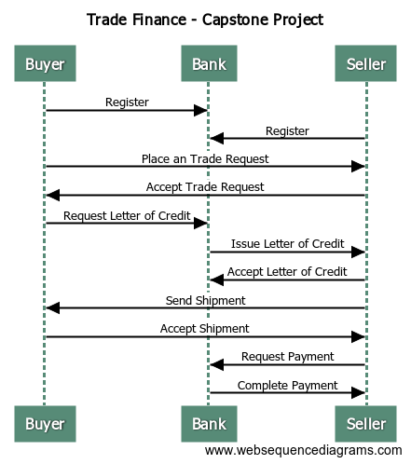
Sequence Diagram

Slide 12
Post Course
Technology Enhancements
End-to-End Functionality and Infrastructure Support:
Enhance solution to cater to Logistics, Insurance, Clearing Agents, Audit, Compliance, Regulation roles and functions
Integrity and Interoperability:
Enhance Security and Privacy, Vertical Integration and Interoperability within the value chain
Support additional Instruments:
Other types of Trade Finance, Pre-Shipment and Post Shipment Credit etc.
Support additional Use Cases:
Use cases beyond the Gems and Jewellery Trading Community
Marketing Efforts
Build strategic alliances (E.g. GJEPC, Bharat Diamond Bourse)
Educate and improve adoption among market participants
Adopt Industry Standards:
Drive participant compliance with AML/KYC standards
Drive solution compliance with Uniform Commercial Code (UCC) amendments suggested by the DLPC working group
Sustainability
Build subscription based revenue models tailored to specific participants to support operation, maintenance and growth strategy

Slide 13
Demo- Execution of the application

Slide 14
Q & A

Slide 15
Thank you!

