Slide 1
Messaging-Based Data Pipeline Using Kafka,
PySpark, HDFS and Hive
Dhruv Gupta - dg4394
Harshit Ojha - ho2228
Sampurna Khuntia - skk9199
Dhairyasheel Patil - dp3979

Slide 2
Problem Statement
Organisations face challenges in processing high-throughput data streams in real time
due to the limitations of monolithic data ingestion and processing systems. Many
existing pipelines are not modular or resilient, resulting in data loss or inefficiencies. A
robust architecture that leverages messaging systems like Kafka for decoupling and
PySpark for scalable transformations can address this. However, integrating and
orchestrating these tools into a single cohesive pipeline remains challenging.

Slide 3
A Big Data Problem?
Volume
Velocity
The system handles large-scale streaming data from APIs and stores it in HDFS. Kafka and HDFS ensure scalable and reliable data storage for massive datasets.
Real-time data is ingested, processed, and streamed using NiFi, Kafka, and PySpark. The architecture supports low-latency processing and continuous data flow.
Variety
Veracity
Data arrives in multiple formats like JSON and CSV and is normalized using NiFi. Different tools handle structured, semi-structured, and unstructured data seamlessly.
Timestamps, schema enforcement, and checkpointing ensure data accuracy and consistency. Airflow manages task dependencies and retries, improving data trustworthiness.

Slide 4
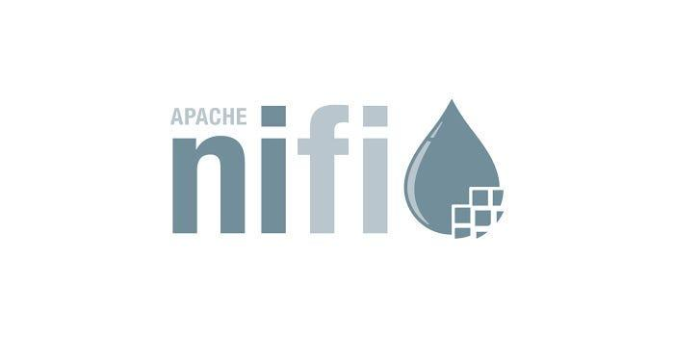


Big Data Technologies used
Provides powerful processors like InvokeHTTP, EvaluateJsonPath, and SplitJson.
Supports real-time data ingestion from APIs and file systems.
Enables distributed real-time data processing using Spark Streaming.
Supports schema-based parsing, aggregation, and transformation.
Acts as a distributed message broker for streaming data.
Decouples producers (like NiFi) and consumers (like PySpark).

Slide 5



Big Data Technologies used
Orchestrates and schedules complex workflows using DAGs.
Automates task dependencies, retries, and execution timing.
Monitors the health and progress of the full data pipeline.
Distributed file system designed for large-scale data storage.
Ensures fault-tolerant and replicated storage across nodes.
Acts as the data lake for historical and batch processing
Provides SQL-like access (HiveQL) to data stored in HDFS.
Maps data using external tables for structured querying.
Integrates with BI tools for easy reporting and visualization.

Slide 6
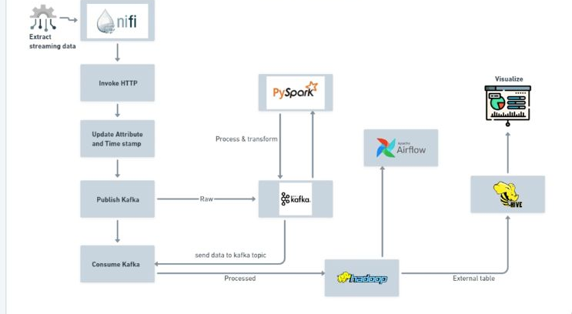
System Design

Slide 7
Data Processing
01

Slide 8
Extract Streaming Data (NiFi)
InvokeHTTP processor pulls real-time data from external APIs.
UpdateAttribute adds crucial metadata like timestamps for downstream use.
PublishKafka sends enriched data to Kafka under topic dezyre_data_csv.
This stage establishes the raw data pipeline using visual routing and flow management in NiFi.

Slide 9
Kafka (Raw Data Queue)
Kafka acts as a buffer between NiFi (producer) and PySpark (consumer).
Ensures scalability, decoupling, and fault-tolerant delivery.
Allows parallel and independent processing by downstream consumers.

Slide 10
Real-Time Processing (PySpark)
PySpark consumes messages from the Kafka topic (dezyre_data_csv).
Parses comma-separated values into structured data using a defined schema.
Performs aggregations and grouping (e.g., by country, timestamp).
Converts the output to JSON and publishes to another Kafka topic dezyre_out.

Slide 11
Hadoop HDFS (Storage)
Kafka-processed data is written into Hadoop HDFS for long-term storage.
HDFS acts as a data lake with distributed and fault-tolerant architecture.
Stores processed data for batch jobs and historical queries.

Slide 12
Orchestration (Airflow)
Apache Airflow manages the pipeline scheduling via DAGs.
Triggers Hive queries or ingestion workflows based on time/data availability.
Ensures coordination between Kafka, HDFS, and Hive.

Slide 13
Query & Visualize (Hive + BI Tool)
Hive maps HDFS data as external tables for SQL-like querying.
BI tools (e.g., Tableau) connect to Hive for visual dashboards and reports.
Enables business users to gain insights from processed, structured data.

Slide 14
Thank You!

