Slide 1
Student Alcohol Consumption
By age 18, about 58.0 percent of teens have had at least 1 drink.¹
¹ Methodology: Population prevalence estimates (%) are weighted by the person-level analysis weight and derived from the Center for Behavioral Health Statistics and Quality National Survey on Drug Use and Health 2018 (NSDUH-2018-DS0001) Public-Use File Dataset. Lifetime alcohol use is defined as ever, even once, having had a drink of any type of alcoholic beverage (a can or bottle of beer, a glass of wine or a wine cooler, a shot of distilled spirits, or a mixed drink with distilled spirits in it), not counting a sip or two from a drink. https://www.datafiles.samhsa.gov/study-dataset/national-survey-drug-use-and-health-2018-nsduh-2018-ds0001-nid18758. Accessed 11/18/19.
Notes:
This slide contains the editable pieces that were used to build infographic sample
Icons – Eye, PC

Slide 2
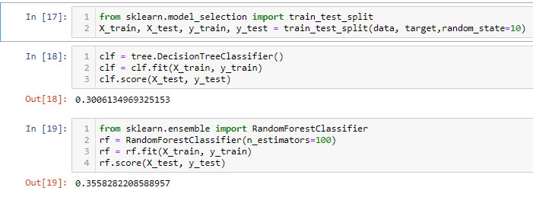
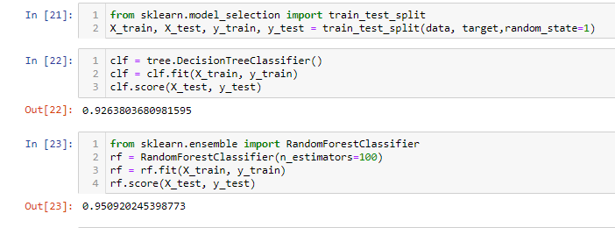
Decision Tree
Accuracy with
Accuracy with
Notes:
This slide contains the editable pieces that were used to build infographic sample
Icons – Eye, PC

Slide 3
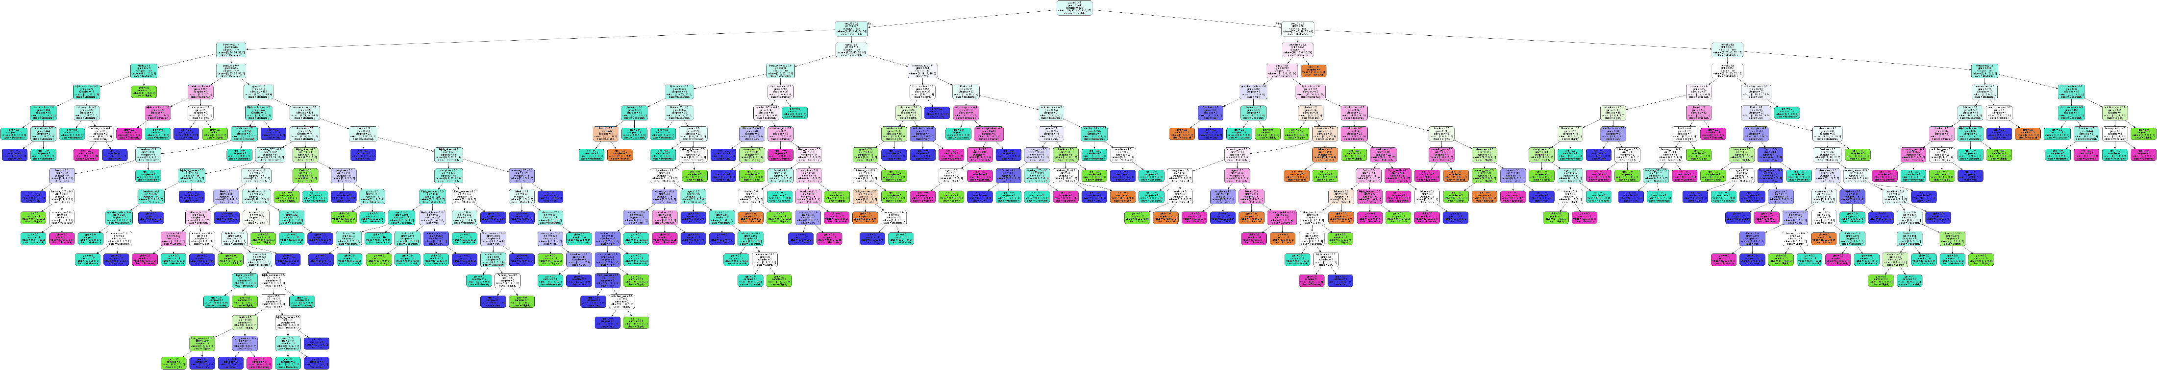
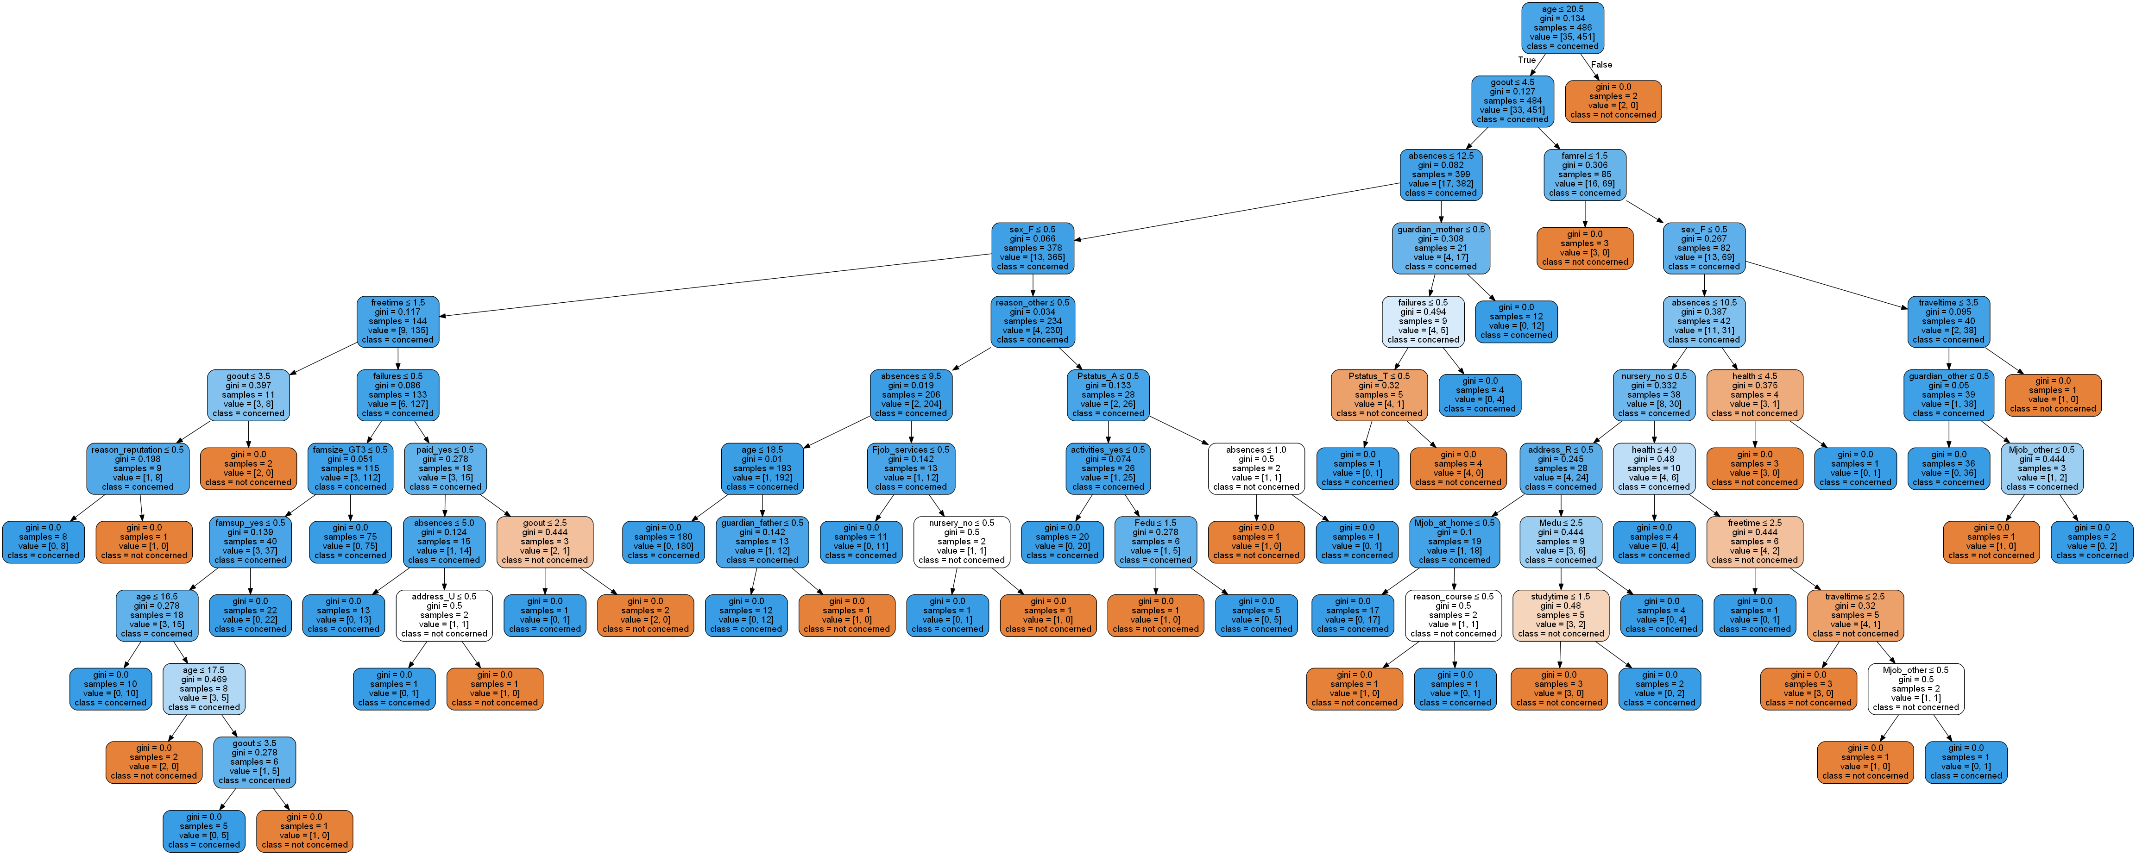
Decision Tree
Notes:
This slide contains the editable pieces that were used to build infographic sample
Icons – Eye, PC

Slide 4
Deep Learning
¹ Methodology: Populatio prevalence estimates (%) are weighted by the person-level analysis weight and derived from the Center for Behavioral Health Statistics and ality National Survey on Drug Use and Health 2018 (NSDUH-2018-DS0001) Public-Use File Dataset. Lifetime alcohol use is defined as ever, even once, having had a drink of any type of alcoholic beverage (a can or bottle of beer, a glass of wine or a wine cooler, a shot of distilled spirits, or a mixed drink with distilled spirits in it), not counting a sip or two from a drink. https://www.datafiles.samhsa.gov/study-dataset/national-survey-drug-use-and-health-2018-nsduh-2018-ds0001-nid18758. Accessed 11/18/19.
Notes:
This slide contains the editable pieces that were used to build infographic sample
Icons – Eye, PC

Slide 5
Deep Learning
¹ Methodology: Populatio prevalence estimates (%) are weighted by the person-level analysis weight and derived from the Center for Behavioral Health Statistics and ality National Survey on Drug Use and Health 2018 (NSDUH-2018-DS0001) Public-Use File Dataset. Lifetime alcohol use is defined as ever, even once, having had a drink of any type of alcoholic beverage (a can or bottle of beer, a glass of wine or a wine cooler, a shot of distilled spirits, or a mixed drink with distilled spirits in it), not counting a sip or two from a drink. https://www.datafiles.samhsa.gov/study-dataset/national-survey-drug-use-and-health-2018-nsduh-2018-ds0001-nid18758. Accessed 11/18/19.
Notes:
This slide contains the editable pieces that were used to build infographic sample
Icons – Eye, PC

Slide 6
PERCENT WITH PIE CHARTS
This is a chart with graphics
To change the %, double-click on the graphic. Select Design within Chart Tools on the ribbon then select Edit Data. In the Excel table, change the number in B2 to your %. Click outside of B2 and close the dialog. You will need to re-adjust the location of % number in the center. The inner colored ring will automatically adjust in size to reflect the new %.
Percent chart elements Dots Excel chart Outer oval
COOL TRICK
Need to use the graphic in another document. Right-click on the graphic you want. Choose Save As Picture and select Enhanced Windows Metafile (.emf). Now you have a graphic that you can use for print and you can scale to any size
22%

Slide 7
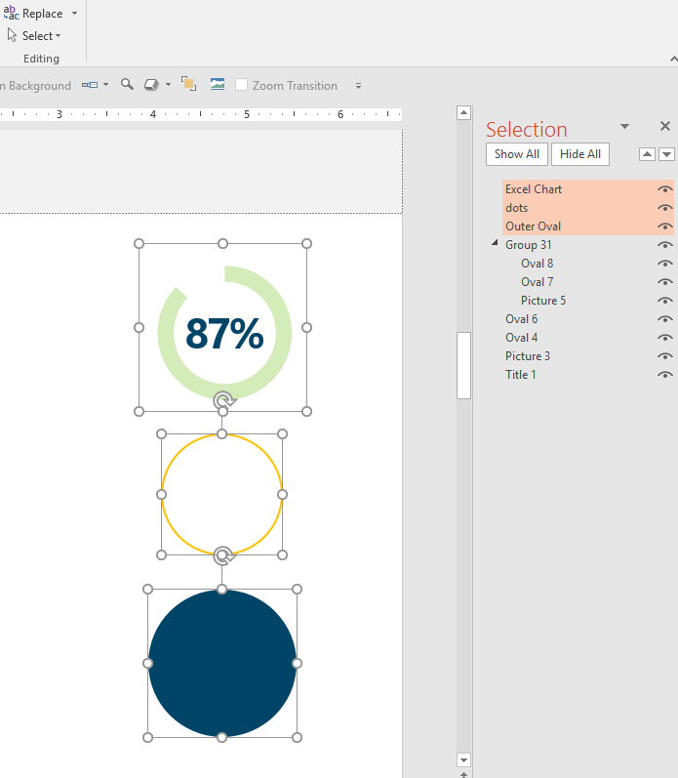
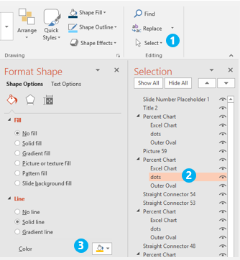
Advanced: PIE IN PIECES │ what’s in the pie chart
Changing pieces of the pie
If you are a more experienced PowerPoint graphics user, you can try customizing the colors and settings for each pie chart element using the Selection Pane.
Excel chart
dots
Outer Oval

Slide 8
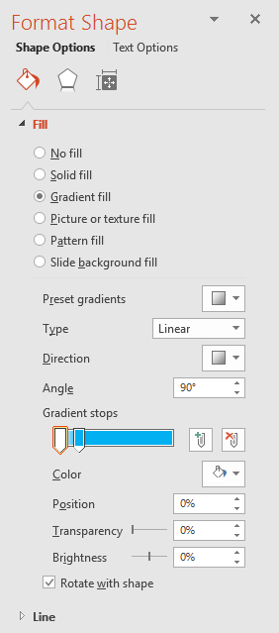
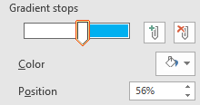
PERCENT WITH GRAPHICS
50%
70%
6.5 out of 10 males…
Graphic percentages Works with any native or Bezier graphic
The fill is a gradient. To change the percentage, right-click on the graphic. Select Format Shape from the dropdown menu. Change the % number by moving the sliders to new position. Note: both sliders need to be at the same position percentage to get a clean line between the two colors. You can change the color of each element. Drag the slider to see the color selection. You can also add a Line to outline a shape.
COOL TRICK
Need to use the graphic in another document. Right-click on the graphic you want – choose Save As Picture – select Enhanced Windows Metafile (.emf) from the dropdown menu You now have a scalable vector graphic!
1
2
2.3 females…
1
Works with any vector shape
25%
38%
2

Slide 9
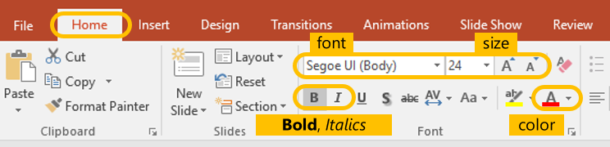
STACKED BAR CHART
These are Excel charts with data
To change the percentage, click on the chart. Select Design within Chart Tools on ribbon then select Edit Data. Change the number in column B2 to your %. Click outside of B2 and close the dialog. The title label is an editable text box overlaid on top of chart.
You can change the color of specific elements by double clicking on the part of the element you want to change and adjusting the Fill.
Stacked bar chart elements Color bar with 100% gray reference bar Data labels
COOL TRICK
Enlarge and bold #’s for added highlight and emphasis. To change the size of key numbers, double-click number to select, then use ribbon font tools on Home Tab.
TITLE
9

Slide 10
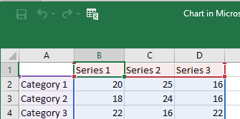

ANIMATED LINE CHART
These are Excel charts with data
To change the chart lines, right-click on the chart and select Edit Data. Change the number in columns B2…, C2…, or D2… Click outside of B2…, C2…, or D2… and close the dialog. The Title and 88% labels are editable text boxes overlaid on top of chart.
You can edit elements by double clicking on the part you want to change and then right-click for options.
Line bar chart elements Animated lines Data labels
COOL TRICK
To change the width or color of the lines, double-click to select. Then use ribbon font tools on Home Tab to change. The categories are hidden on this chart. Create new text boxes to overlay as labels on top of chart.
Title
88%
10

Slide 11
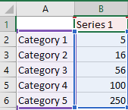
ANIMATED LINE CHART
These are Excel charts with data
To change the chart values, right-click on the graphic and select Edit Data. Change the numbers in column B2…, Click outside of B2…, C2…, or D2… and close. The Title and 88% labels are editable text boxes overlaid on top of chart.
You can edit elements by double clicking on the part you want to change and then right-click for edit options.
Line bar chart elements Animated lines Data labels
COOL TRICK
To change the size or color of the numbers or the line, double-click to select. Use ribbon font tools on Home Tab to change. The categories are hidden on this chart. Create new text boxes to overlay as labels on top of chart.
Single line
11

Slide 12
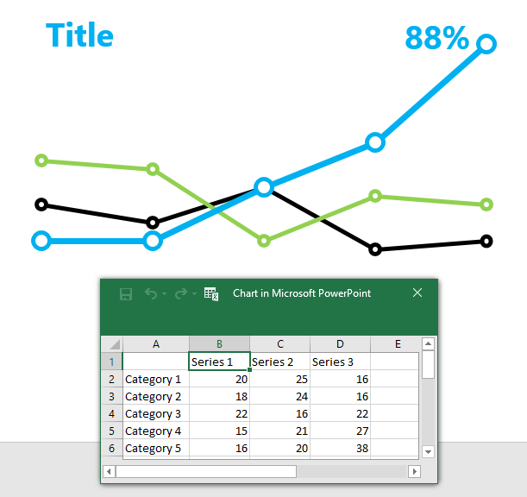
QUICK START │ VISUAL MARKER GUIDE OF CHART ELEMENTS
Detailed text directions for editing each of these charts on slides 6 & 7
Category 5
Category 1
Category 2
Series 2
Series 1
Category 4
Category 5
Series 1
Series 3
Category 3
Category 4
Black Series 1
Green Series 1
Blue Series 1
Category 3
Series 1
Category 1
Category 2
Category 1
Series 1
Series 1
Series 1
12

Slide 13
Notes:
TIP │Use color to tell story, arrange multiple graphics together, add icons on top of charts to create custom graphics.
EDITABLE GRAPHIC AT END OF PRESENTATION

