Slide 1
Student Alcohol Consumption
By age 18, about 58.0 percent of teens have had at least 1 drink.¹
¹ Methodology: Population prevalence estimates (%) are weighted by the person-level analysis weight and derived from the Center for Behavioral Health Statistics and Quality National Survey on Drug Use and Health 2018 (NSDUH-2018-DS0001) Public-Use File Dataset. Lifetime alcohol use is defined as ever, even once, having had a drink of any type of alcoholic beverage (a can or bottle of beer, a glass of wine or a wine cooler, a shot of distilled spirits, or a mixed drink with distilled spirits in it), not counting a sip or two from a drink. https://www.datafiles.samhsa.gov/study-dataset/national-survey-drug-use-and-health-2018-nsduh-2018-ds0001-nid18758. Accessed 11/18/19.
Notes:
This slide contains the editable pieces that were used to build infographic sample
Icons – Eye, PC

Slide 2
Data – Compilation and Cleanup
Student Alcohol Consumption – Found on Kaggle https://www.kaggle.com/uciml/student-alcohol-consumption
The data set breaks down students in 2 classes, a math and a Portuguese language class. Each student’s family demographics, such as family size, parents’ education levels & jobs, home location (urban or rural), as well as other outside inputs such as support from family and school, internet access and whether the student attended nursery school.
We used the “weekday alcohol consumption” and “weekend alcohol consumption” data the students reported (1-5 scale).
Initially broke output values to match level scale students used to self-evaluate drinking habits on weekdays and weekends (1-5 scale with 5 being more likely).
After running a few models we decided to look at changing our outputs to a binary model where we took 4’s and 5’s binned together.
We also combined the weekend and weekday data to form a new data set of a combined drinking score for each student.
Notes:
This slide contains the editable pieces that were used to build infographic sample
Icons – Eye, PC

Slide 3
Models
Decision Tree
KNN
Deep Learning
We looked at sorting the data by students who live in the city and those who live in the county. We then ran models on those to see if there was a significant difference. We did not see a noticeable accuracy difference.
Ran Weekend, Weekday and Combined Weekday/Weekend to see what sort of accuracy difference we could notice.
Examined how different outputs affected the models
Notes:
This slide contains the editable pieces that were used to build infographic sample
Icons – Eye, PC

Slide 4
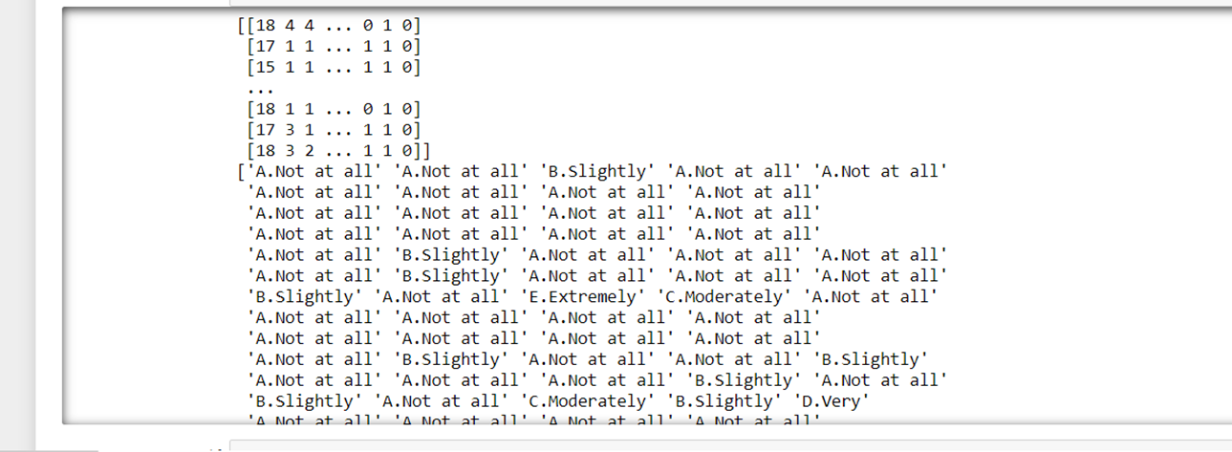
Issues In Cleanup Process
Encoding our 5 category output names which messed up in some of the reporting on Deep Learning and Grid Search (affect how we could transfer those to Tableau). By-passed it by putting letter in front of each value.
Another issue was we test/trained spilt before we encoded
Notes:
This slide contains the editable pieces that were used to build infographic sample
Icons – Eye, PC

Slide 5
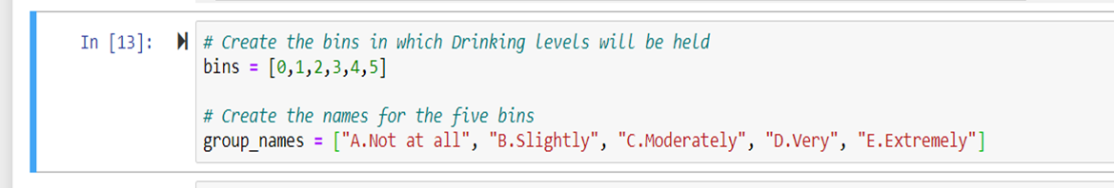
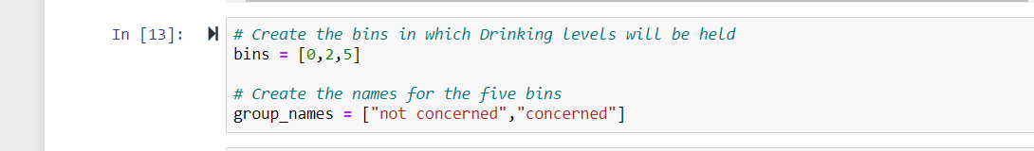
Initial Categorizing
Initially the 5 categories were: Not at all, Slightly, Moderately, Very & Extremely
Decided to narrow outputs to Not Concerned and Concerned to see what effect that would have on our models
Notes:
This slide contains the editable pieces that were used to build infographic sample
Icons – Eye, PC

Slide 6
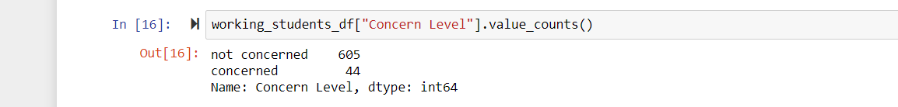
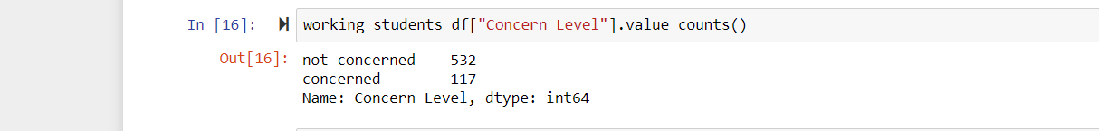
Categorizing for Better Results
Wanted to run with 4’s and 5’s as the level to set “Concern”, however data was too limited at that level.
Decided to run on 3’s, 4’s and 5’s to get better model.
Notes:
This slide contains the editable pieces that were used to build infographic sample
Icons – Eye, PC

Slide 7
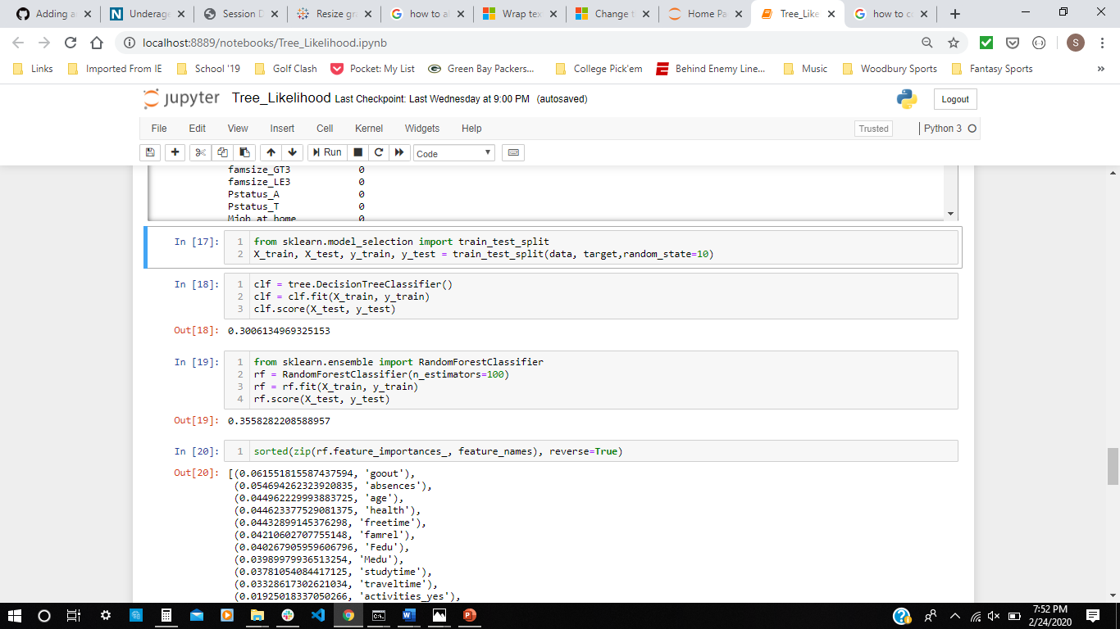
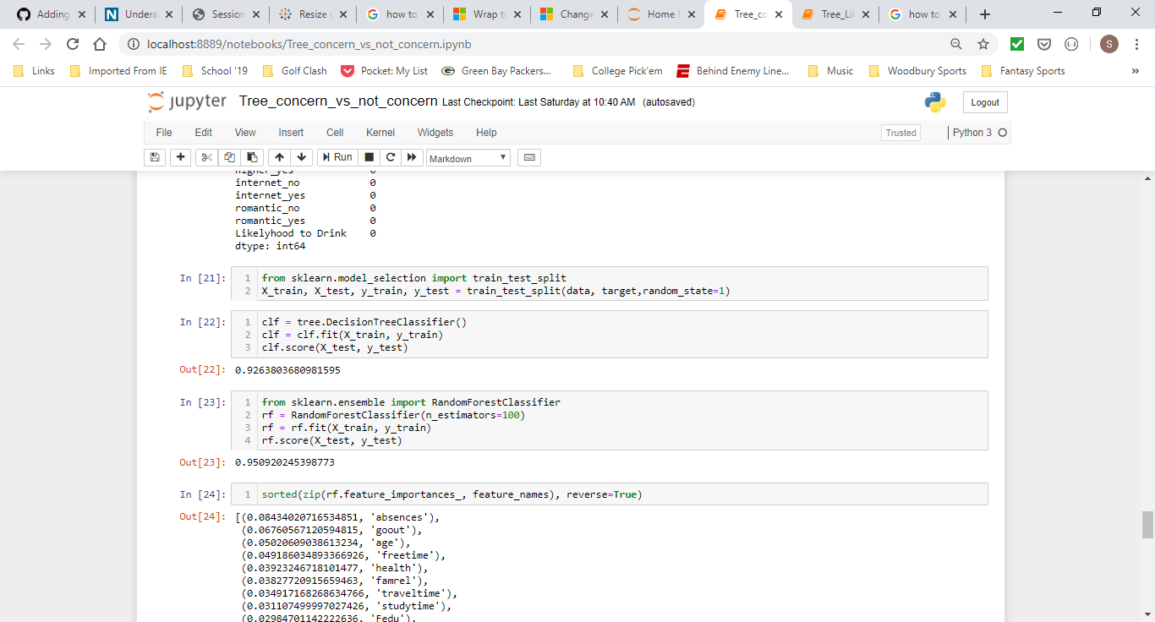
Decision Tree
Decision tree and random forest accuracy with five category output.
Decision tree and random forest accuracy with binary output
Notes:
This slide contains the editable pieces that were used to build infographic sample
Icons – Eye, PC

Slide 8
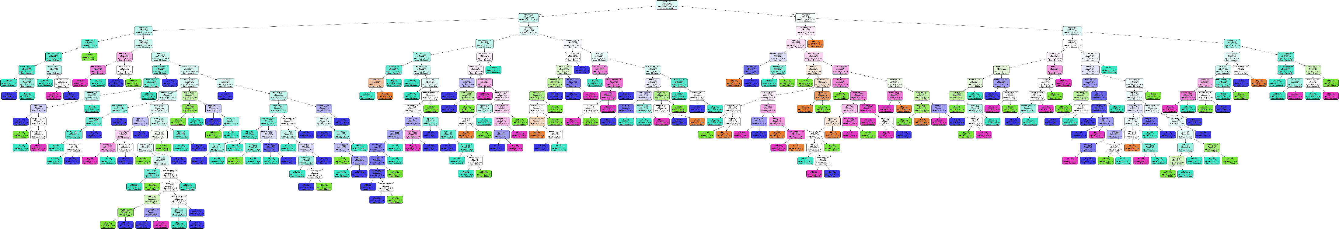
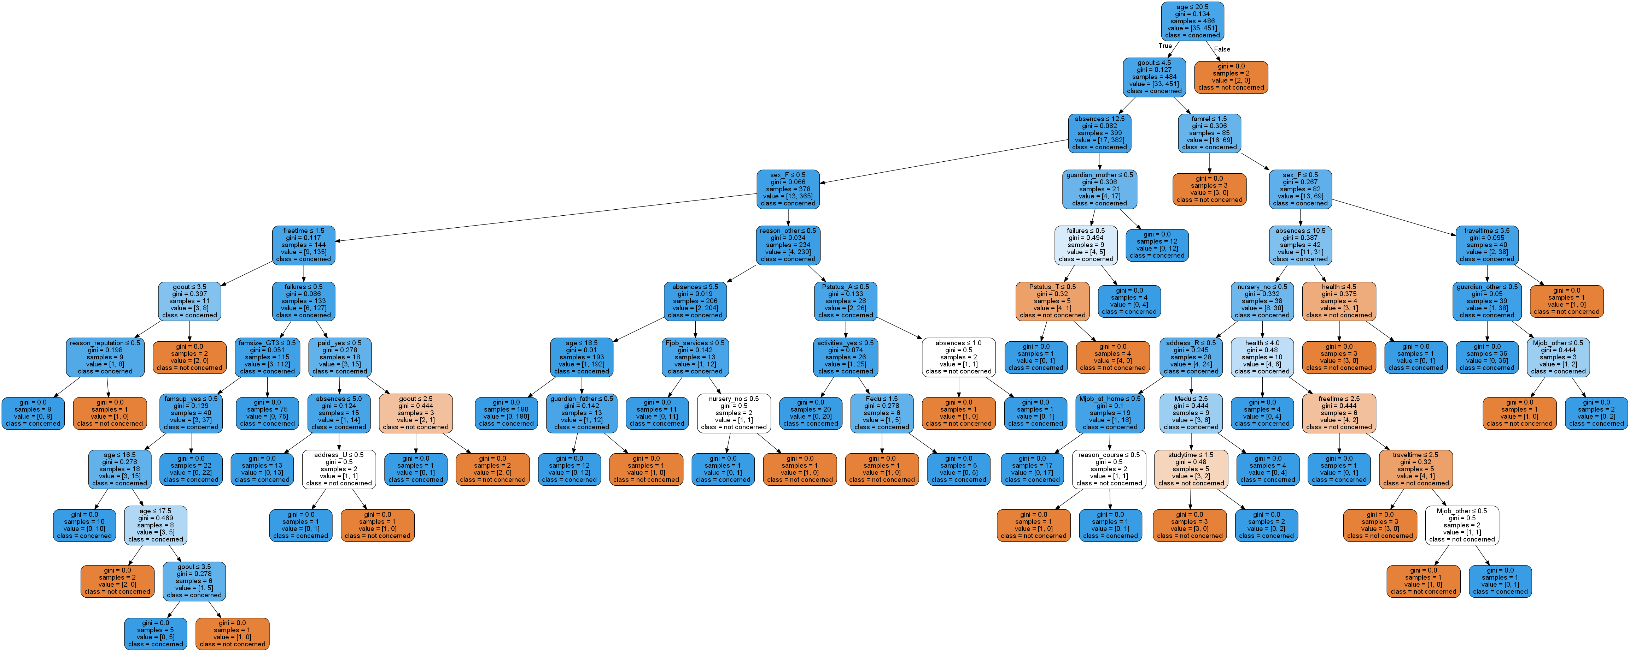
Decision Tree
Notes:
This slide contains the editable pieces that were used to build infographic sample
Icons – Eye, PC

Slide 9
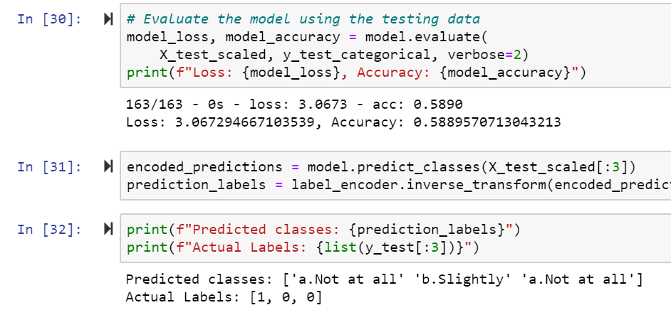
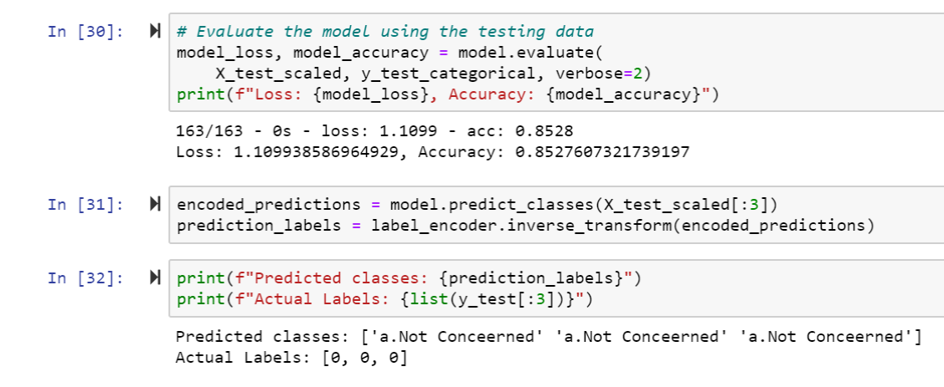
Deep Learning
Weekday Drinking Model with 5 outputs.
(acc = .5890)
(Predicted 1 out of 3)
Weekday Drinking Model with 2 outputs.
(acc = .8528)
(Predicted 3 out of 3)
Notes:
This slide contains the editable pieces that were used to build infographic sample
Icons – Eye, PC

Slide 10
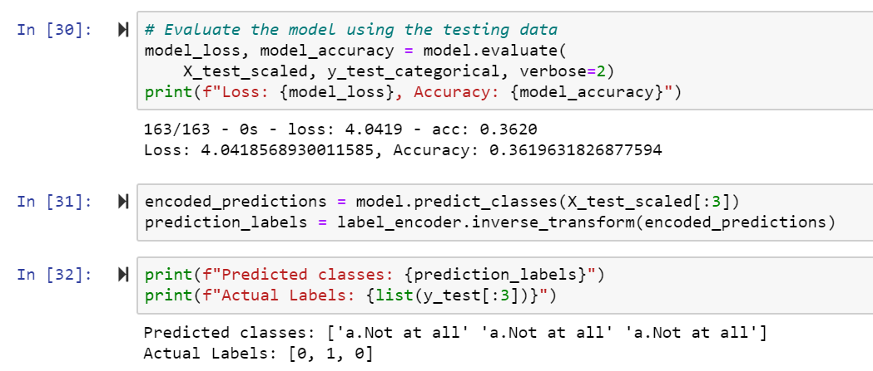
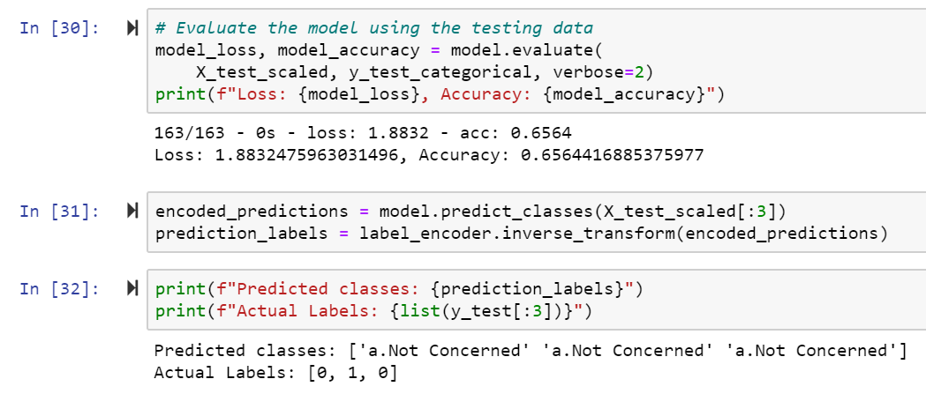
Deep Learning
Weekend Drinking Model with 5 outputs.
(acc = .3620)
(Predicted 2 out of 3)
Weekend Drinking Model with 2 outputs.
(acc = .6564)
(Predicted 2 out of 3)
Notes:
This slide contains the editable pieces that were used to build infographic sample
Icons – Eye, PC

Slide 11
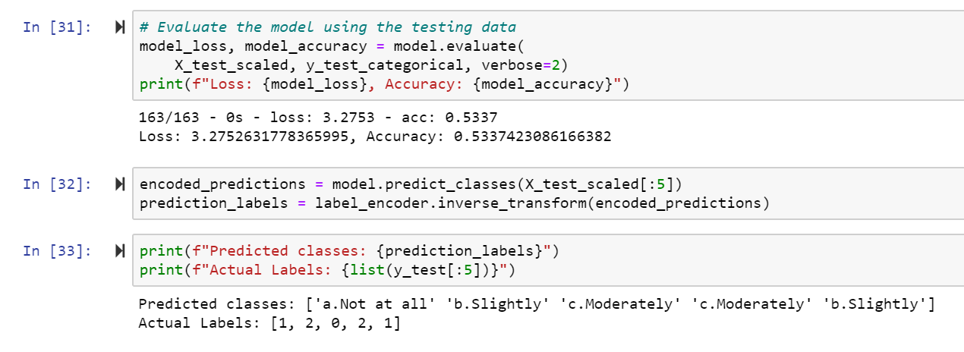
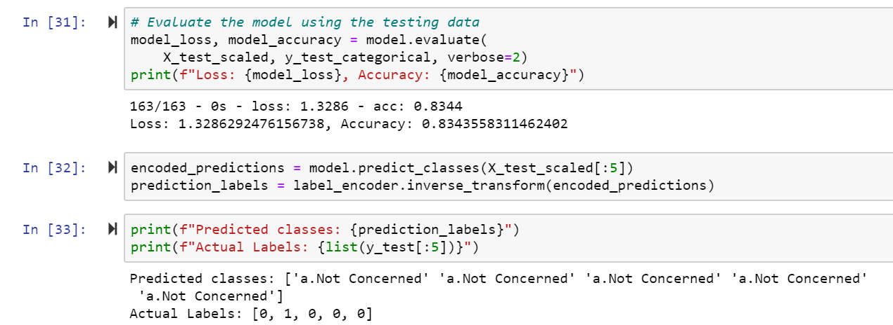
Deep Learning
Combined (Weekday/Weekend) Drinking Model with 5 outputs.
(acc = .5337)
(Predicted 2 out of 5)
Combined (Weekday/Weekend) Drinking Model with 2 outputs.
(acc = .8344)
(Predicted 4 out of 5)
Notes:
This slide contains the editable pieces that were used to build infographic sample
Icons – Eye, PC

Slide 12
Tableau
Once we compiled our data, we used Tableau to visualize our final results…
Notes:
This slide contains the editable pieces that were used to build infographic sample
Icons – Eye, PC

Slide 13
CHEERS!!!

