Slide 1
SLIDE 1
Present Problem
to explore in-novative approaches to predict and, consequently, reduce the rate of violent crimes within
our city. Your primary objective is to determine if and how various factors influence the
rate of violent crimes in Chicago.
Notes:
1 minute

Slide 2
SLIDE 2
describes the data you use and its appropriateness for answering the questions.
Notes:
How do we define a violent crime?
FBI website + Chicago Crime Gov
How we aggregate the data?
Seasonality
Unemployment

Slide 3
The Modeling Process
EDA
Lasso Variable Selection
Model Identification
Bayesian Estimation
Notes:
Note how we used lasso regression to select weather and holiday covariates (mention X covariate matrix includes things like holiday)
We used an autoregressive plot to select autoregressive lag variables

Slide 4
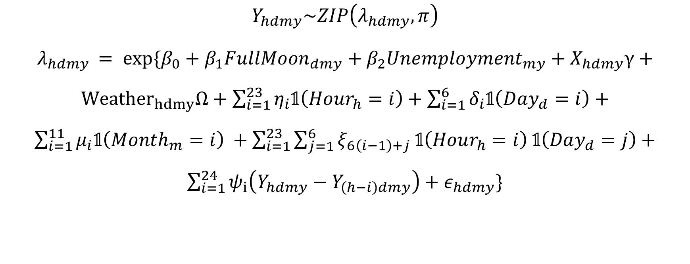
Bayesian Autoregressive Zero-Inflated Poisson Regression
$$Y_{hdmy}\sim ZIP\left(λ_{hdmy},π\right)$$
$λ_{hdmy }= exp⁡\{β_{0}+β_{1}FullMoon_{dmy}+β_{2}Unemployment_{my}+X_{hdmy}γ+{Weather}_{hdmy}Ω+\sum_{i=1}^{23}{η_{i}𝟙\left(Hour_{h}=i\right)}+\sum_{i=1}^{6}{δ_{i}𝟙\left(Day_{d}=i\right)}+$ $\sum_{i=1}^{11}{μ_{i}𝟙\left(Month_{m}=i\right) }+\sum_{i=1}^{23}{\sum_{j=1}^{6}{ξ_{6\left(i−1\right)+j} 𝟙\left(Hour_{h}=i\right) 𝟙\left(Day_{d}=j\right)}}+\sum_{i=1}^{24}{ψ_{i}\left(Y_{hdmy}−Y_{\left(h−i\right)dmy}\right)}+ε_{hdmy}\}$
Notes:
Note how we used lasso regression to select weather and holiday covariates (mention X covariate matrix includes things like holiday)
We used an autoregressive plot to select autoregressive lag variables

Slide 5
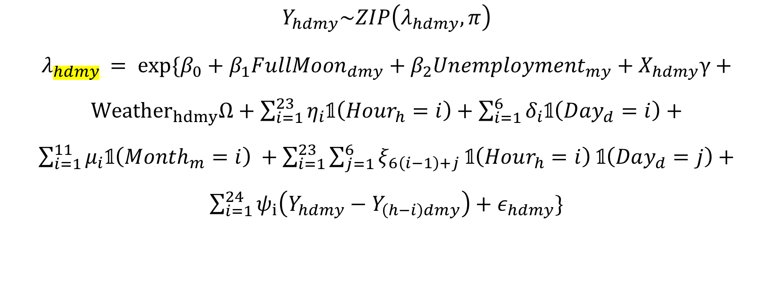
Bayesian Autoregressive Zero-Inflated Poisson Regression
Hour, Day, Month, Year
$$Y_{hdmy}\sim ZIP\left(λ_{hdmy},π\right)$$
$λ_{hdmy }= exp⁡\{β_{0}+β_{1}FullMoon_{dmy}+β_{2}Unemployment_{my}+X_{hdmy}γ+{Weather}_{hdmy}Ω+\sum_{i=1}^{23}{η_{i}𝟙\left(Hour_{h}=i\right)}+\sum_{i=1}^{6}{δ_{i}𝟙\left(Day_{d}=i\right)}+$ $\sum_{i=1}^{11}{μ_{i}𝟙\left(Month_{m}=i\right) }+\sum_{i=1}^{23}{\sum_{j=1}^{6}{ξ_{6\left(i−1\right)+j} 𝟙\left(Hour_{h}=i\right) 𝟙\left(Day_{d}=j\right)}}+\sum_{i=1}^{24}{ψ_{i}\left(Y_{hdmy}−Y_{\left(h−i\right)dmy}\right)}+ε_{hdmy}\}$

Slide 6
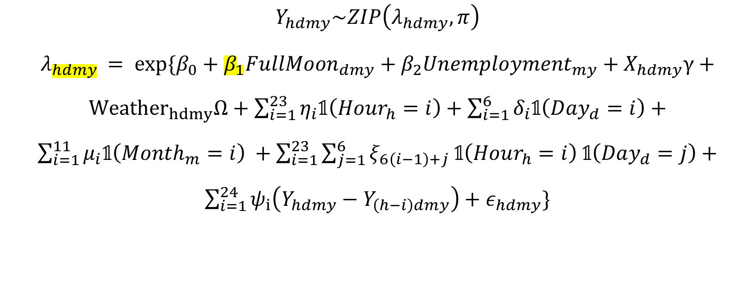
Bayesian Autoregressive Zero-Inflated Poisson Regression
Hour, Day, Month, Year
$$Y_{hdmy}\sim ZIP\left(λ_{hdmy},π\right)$$
$λ_{hdmy }= exp⁡\{β_{0}+β_{1}FullMoon_{dmy}+β_{2}Unemployment_{my}+X_{hdmy}γ+{Weather}_{hdmy}Ω+\sum_{i=1}^{23}{η_{i}𝟙\left(Hour_{h}=i\right)}+\sum_{i=1}^{6}{δ_{i}𝟙\left(Day_{d}=i\right)}+$ $\sum_{i=1}^{11}{μ_{i}𝟙\left(Month_{m}=i\right) }+\sum_{i=1}^{23}{\sum_{j=1}^{6}{ξ_{6\left(i−1\right)+j} 𝟙\left(Hour_{h}=i\right) 𝟙\left(Day_{d}=j\right)}}+\sum_{i=1}^{24}{ψ_{i}\left(Y_{hdmy}−Y_{\left(h−i\right)dmy}\right)}+ε_{hdmy}\}$
Main Effect of Interest

Slide 7

Bayesian Autoregressive Zero-Inflated Poisson Regression
Hourly, Daily, and Monthly Saturated Fixed Effects
Hour, Day, Month, Year
$$Y_{hdmy}\sim ZIP\left(λ_{hdmy},π\right)$$
$λ_{hdmy }= exp⁡\{β_{0}+β_{1}FullMoon_{dmy}+β_{2}Unemployment_{my}+X_{hdmy}γ+{Weather}_{hdmy}Ω+\sum_{i=1}^{23}{η_{i}𝟙\left(Hour_{h}=i\right)}+\sum_{i=1}^{6}{δ_{i}𝟙\left(Day_{d}=i\right)}+$ $\sum_{i=1}^{11}{μ_{i}𝟙\left(Month_{m}=i\right) }+\sum_{i=1}^{23}{\sum_{j=1}^{6}{ξ_{6\left(i−1\right)+j} 𝟙\left(Hour_{h}=i\right) 𝟙\left(Day_{d}=j\right)}}+\sum_{i=1}^{24}{ψ_{i}\left(Y_{hdmy}−Y_{\left(h−i\right)dmy}\right)}+ε_{hdmy}\}$
Main Effect of Interest

Slide 8

Bayesian Autoregressive Zero-Inflated Poisson Regression
Hourly, Daily, and Monthly Saturated Fixed Effects
Hour, Day, Month, Year
$$Y_{hdmy}\sim ZIP\left(λ_{hdmy},π\right)$$
$λ_{hdmy }= exp⁡\{β_{0}+β_{1}FullMoon_{dmy}+β_{2}Unemployment_{my}+X_{hdmy}γ+{Weather}_{hdmy}Ω+\sum_{i=1}^{23}{η_{i}𝟙\left(Hour_{h}=i\right)}+\sum_{i=1}^{6}{δ_{i}𝟙\left(Day_{d}=i\right)}+$ $\sum_{i=1}^{11}{μ_{i}𝟙\left(Month_{m}=i\right) }+\sum_{i=1}^{23}{\sum_{j=1}^{6}{ξ_{6\left(i−1\right)+j} 𝟙\left(Hour_{h}=i\right) 𝟙\left(Day_{d}=j\right)}}+\sum_{i=1}^{24}{ψ_{i}\left(Y_{hdmy}−Y_{\left(h−i\right)dmy}\right)}+ε_{hdmy}\}$
Main Effect of Interest
Autoregressive lag variables from the past 24 hours

Slide 9
SLIDE 4
describe the modeling and/or summarizing efforts that were taken, along with useful
figures or relevant model results.

Slide 10
SLIDE 5
includes a summary and conclusions that directly relate to the problem you have been
given.

