Slide 1


SITUATION
PREDICT NUMBER OF VIOLENT CRIMES PER HOUR IN CHICAGO’S 11th DISTRICT
DETERMINE FACTORS THAT INFLUENCE VIOLENT CRIME

Slide 2
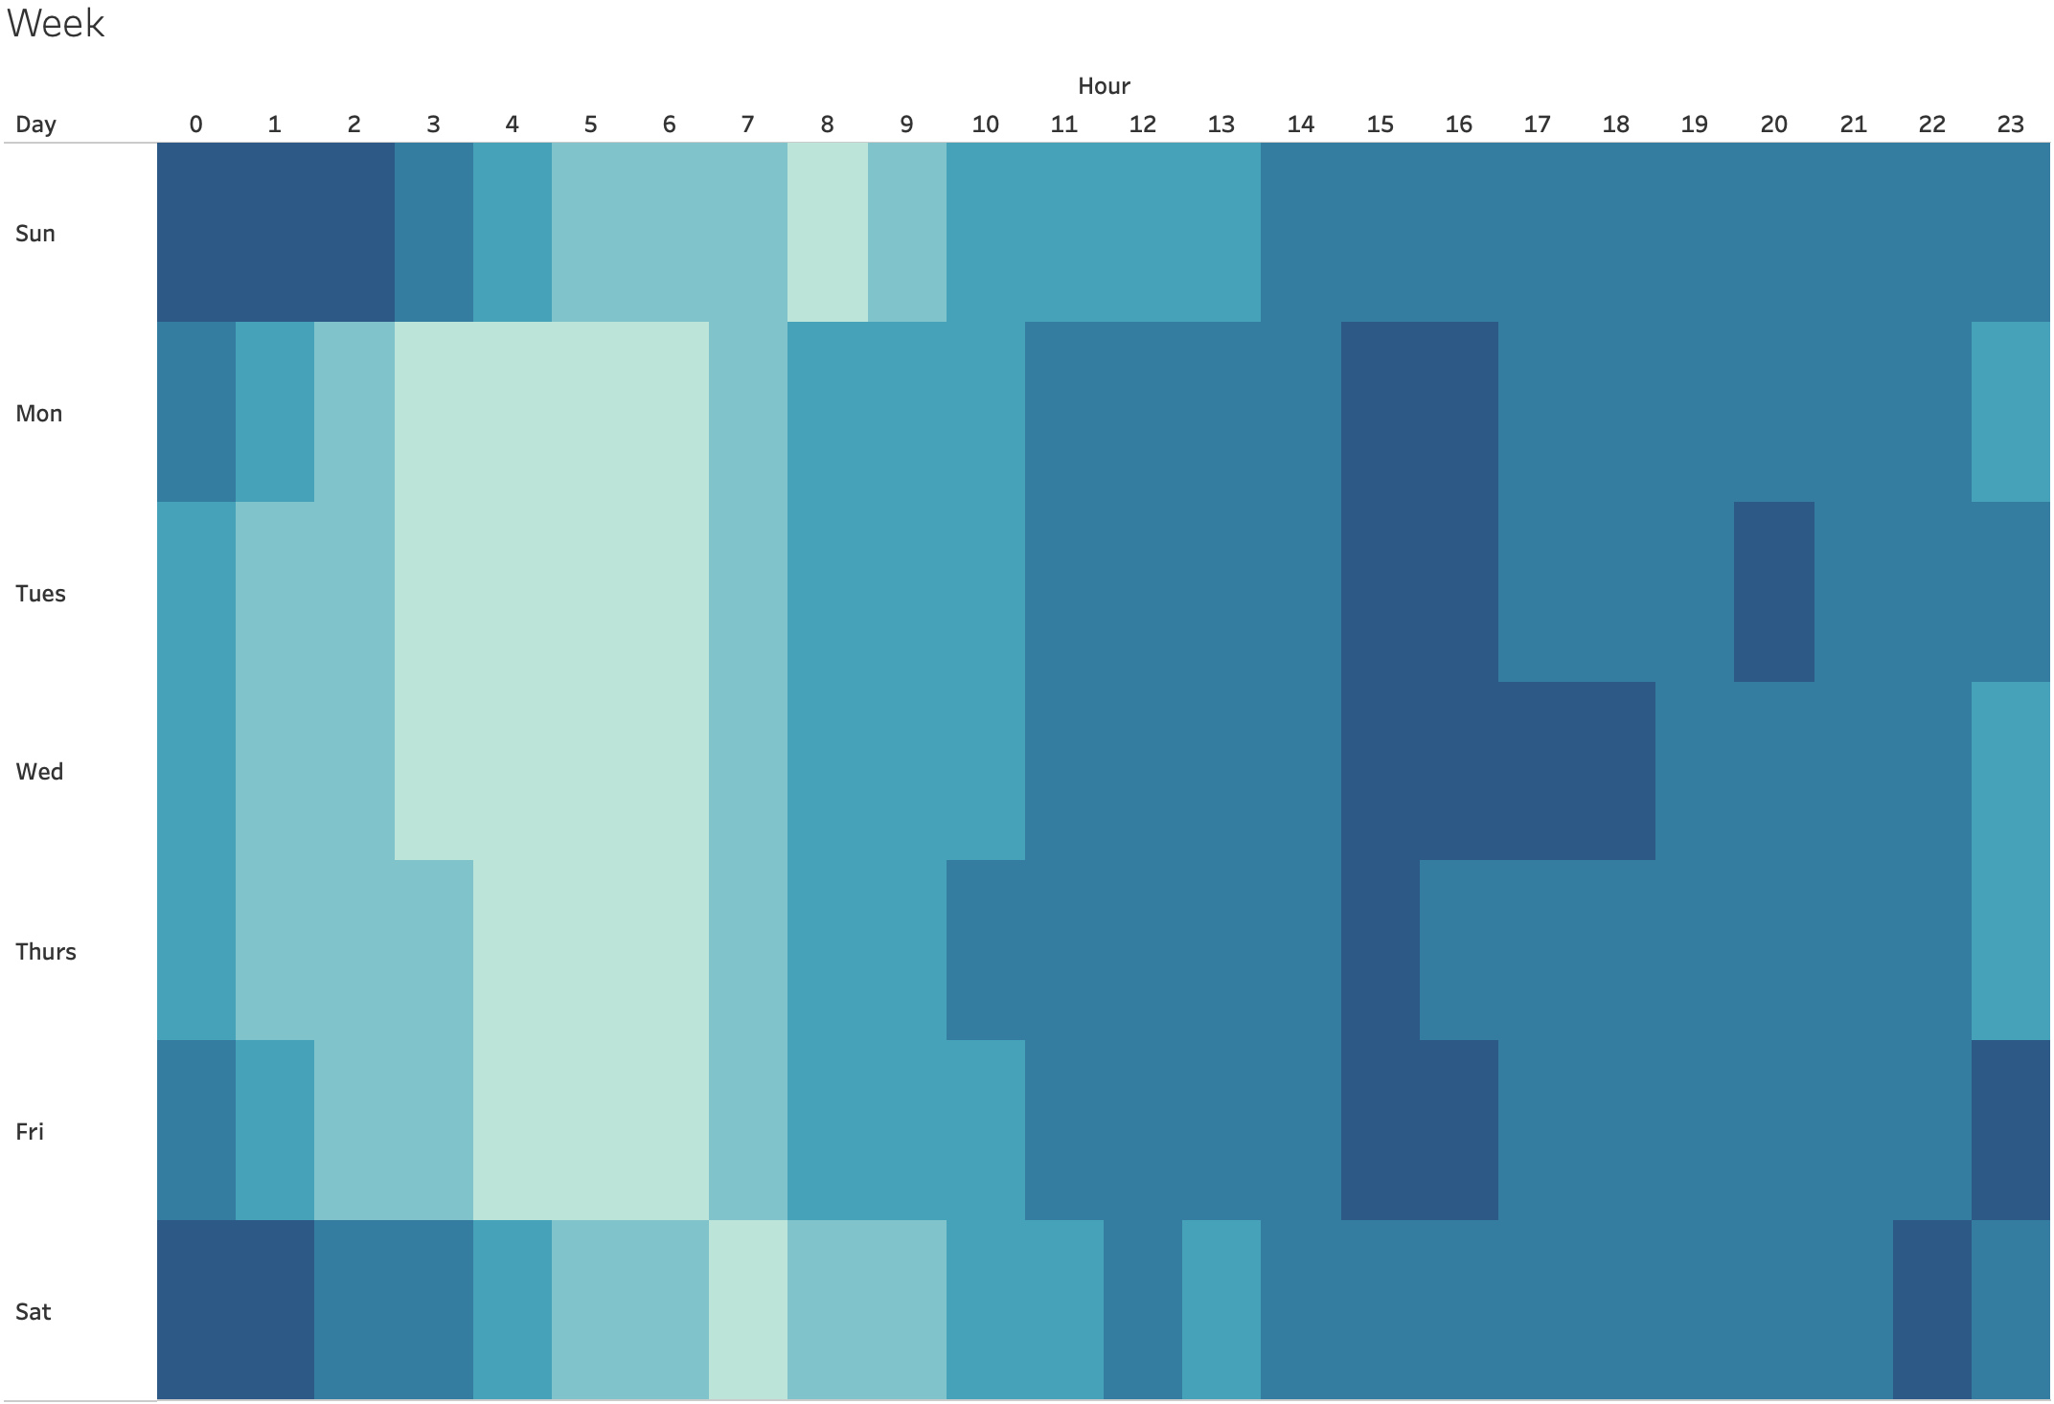
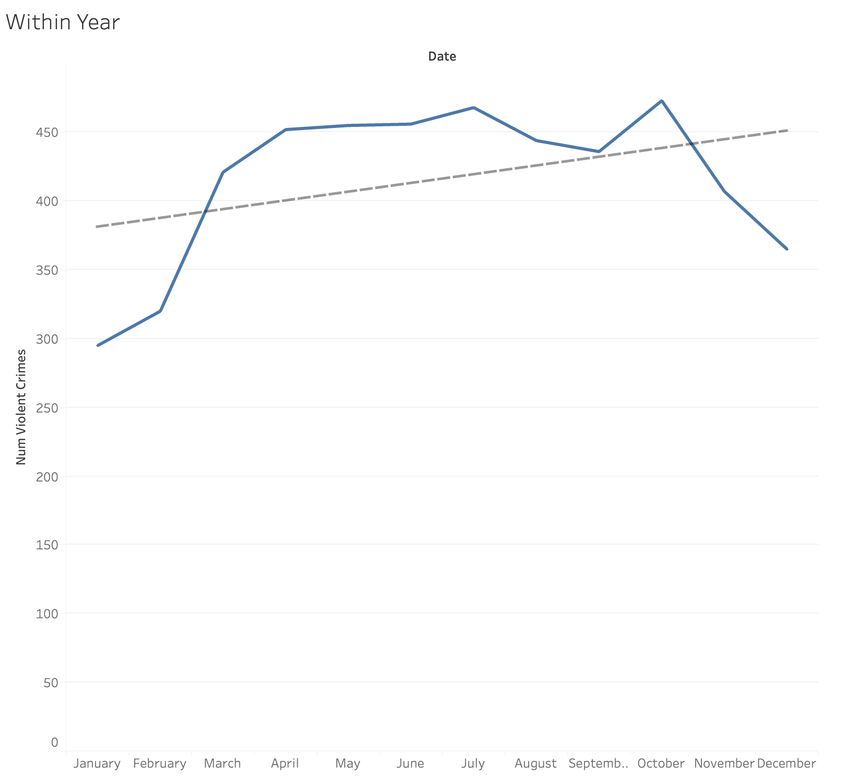
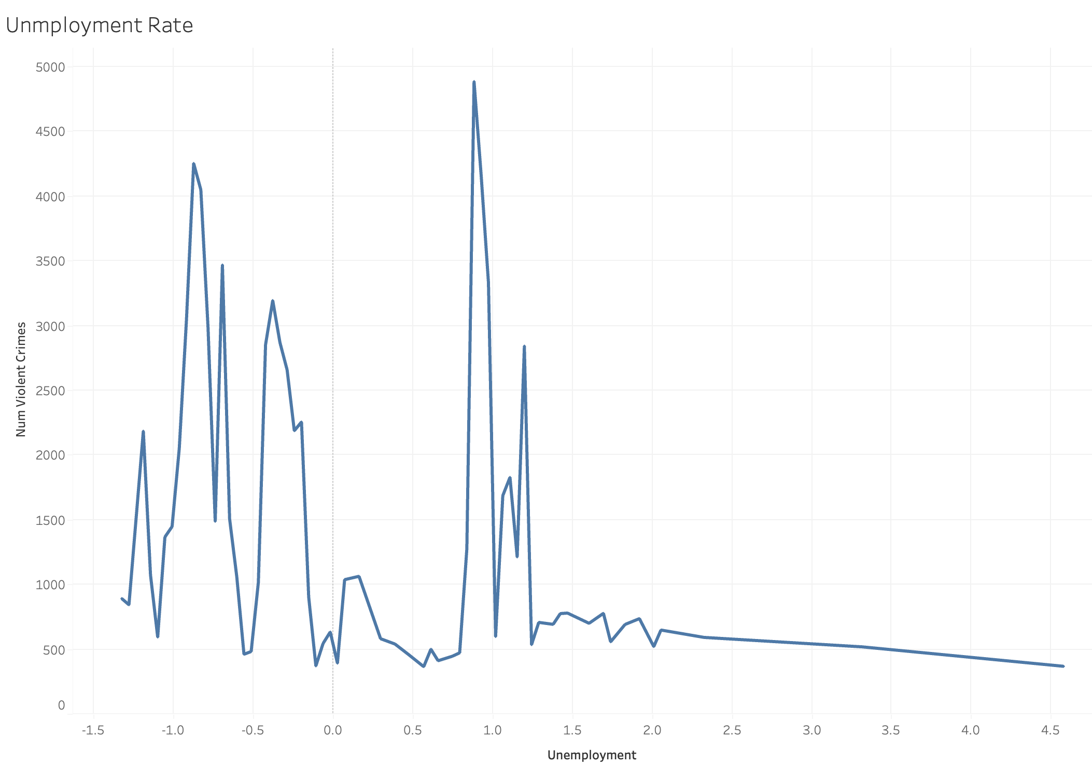
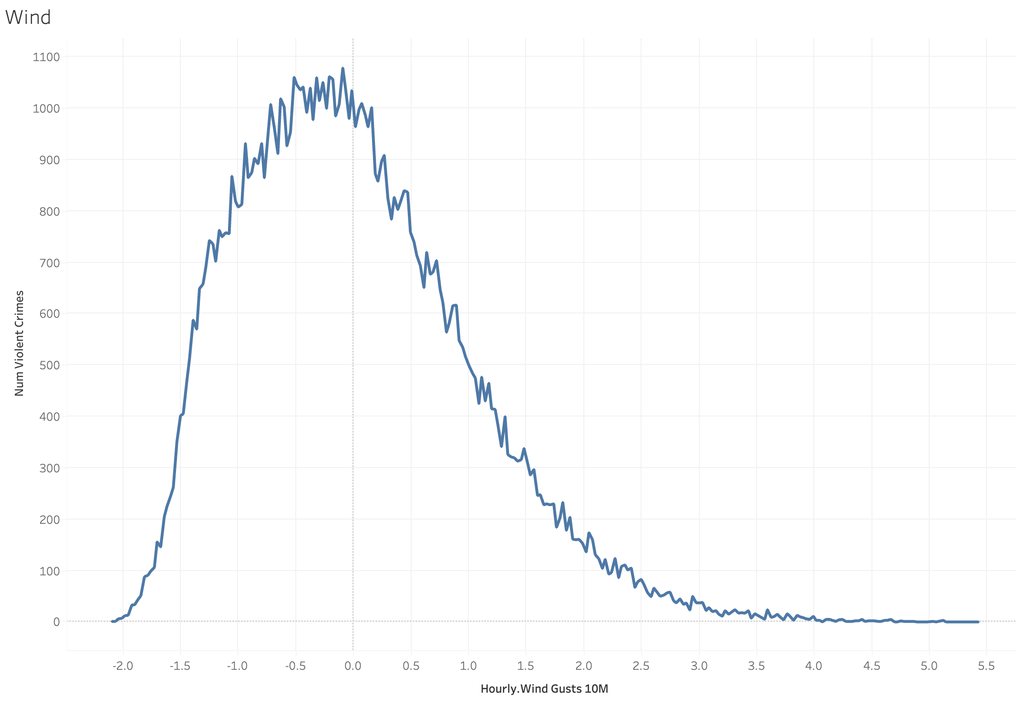
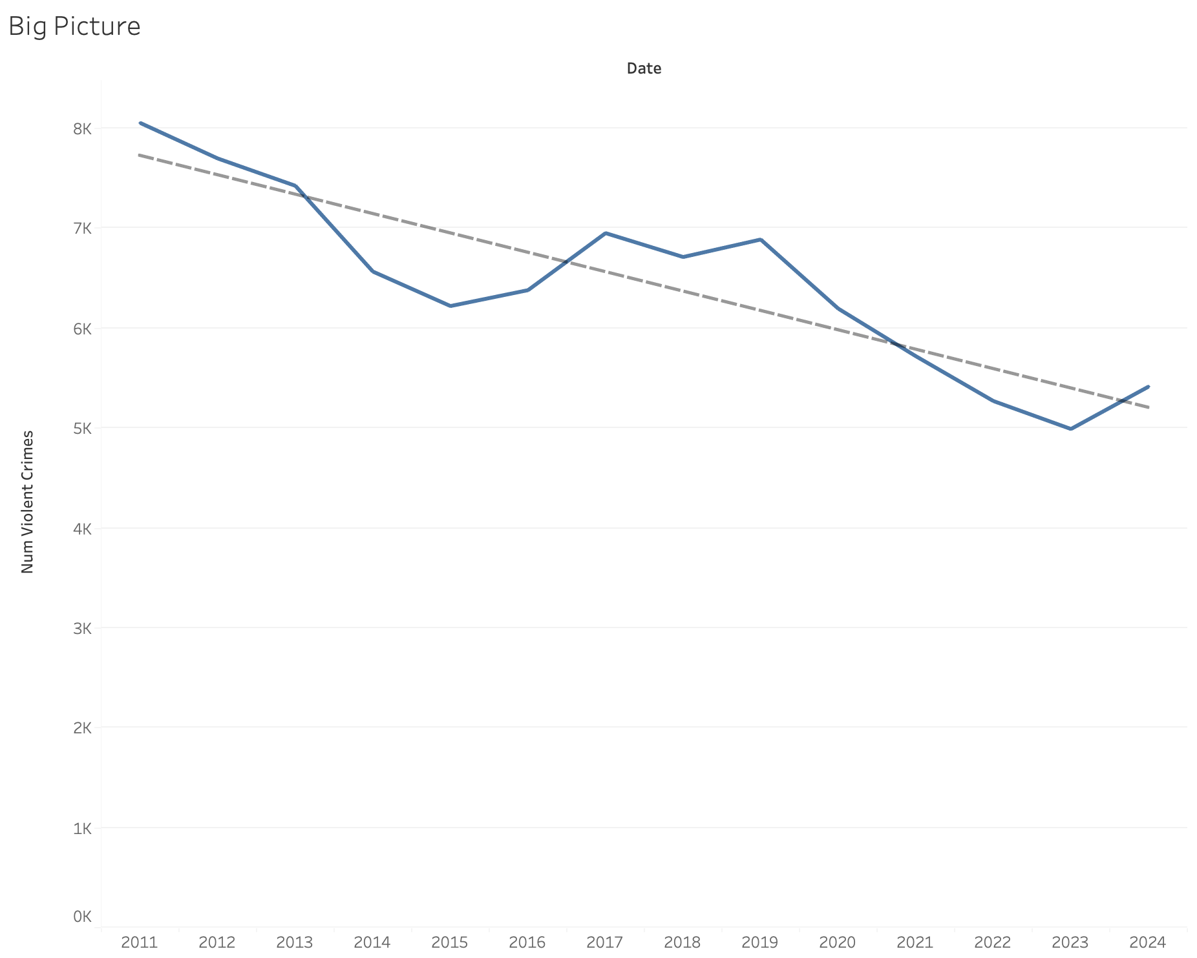
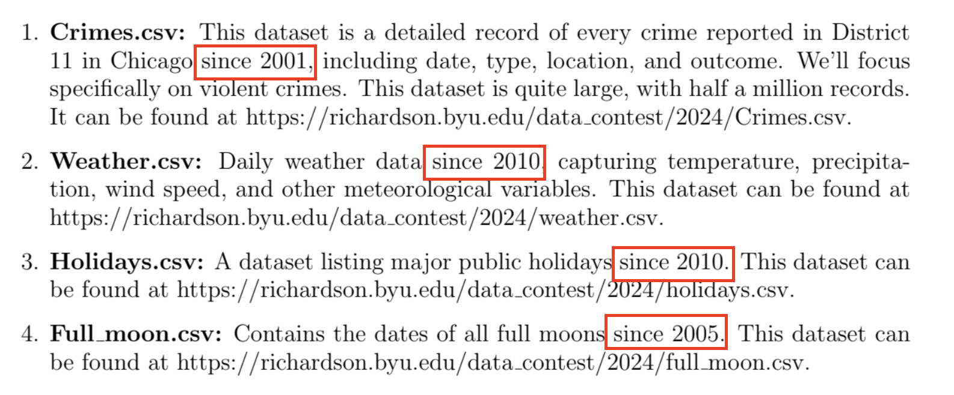
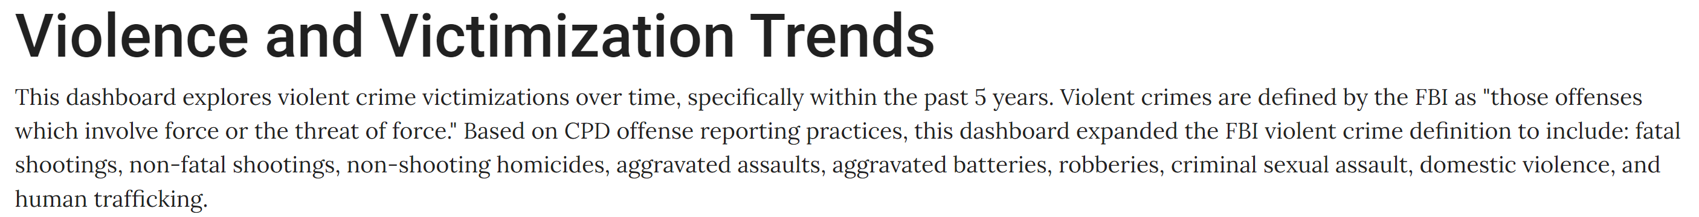
The Data
Notes:
How do we define a violent crime?
FBI website + Chicago Crime Gov
How we aggregate the data?
Seasonality
Unemployment

Slide 3
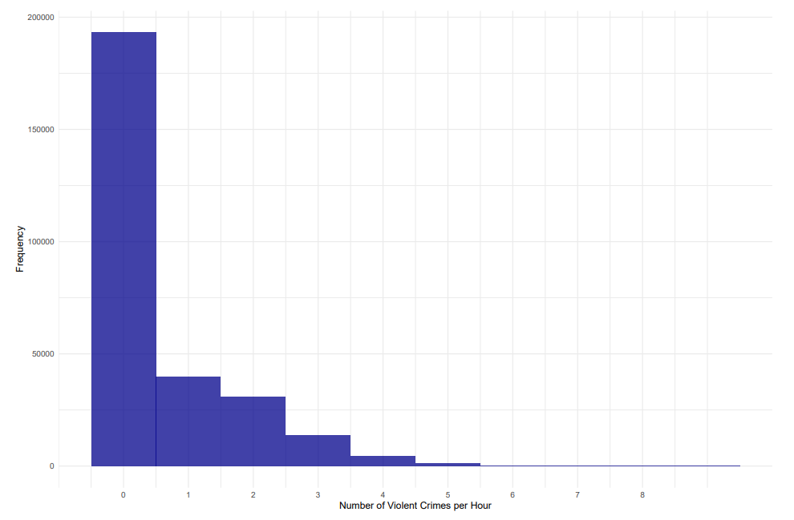

The Modeling Process
$$Y_{hdmy}\sim ZIP\left(λ_{hdmy},π\right)$$
$λ_{hdmy }= exp⁡\{β_{0}+β_{1}FullMoon_{dmy}+β_{2}Unemployment_{my}+X_{hdmy}γ+{Weather}_{hdmy}Ω+\sum_{i=1}^{23}{η_{i}𝟙\left(Hour_{h}=i\right)}+\sum_{i=1}^{6}{δ_{i}𝟙\left(Day_{d}=i\right)}+$ $\sum_{i=1}^{11}{μ_{i}𝟙\left(Month_{m}=i\right) }+\sum_{i=1}^{23}{\sum_{j=1}^{6}{ξ_{6\left(i−1\right)+j} 𝟙\left(Hour_{h}=i\right) 𝟙\left(Day_{d}=j\right)}}+\sum_{i=1}^{24}{ψ_{i}Y_{\left(h−i\right)dmy}}\}, 𝔼\left[ε_{hdmy} | 𝕏_{hdmy}\right]=0$
EDA
Lasso Variable Selection
Model Identification
EDA
Lasso Variable Selection
Model Identification
Estimation
Weather Covariates:
Temperature
Apparent Temperature
Cloud Cover
Humidity
Snow Depth
Hourly Rain
Hourly Snowfall
Solar Radiation
(Shortwave/Direct)
Wind Speed
Wind Gusts
Holidays (Dummy Variables)
New Year’s Day
MLK Jr. Day
Presidents’ Day
Memorial Day
Independence Day
Thanksgiving
Christmas
Valentine’s Day
NYE
Christmas Eve
St. Patrick’s Day
Halloween
Columbus Day
Notes:
Note how we used lasso regression to select weather and holiday covariates (mention X covariate matrix includes things like holiday)
We used an autoregressive plot to select autoregressive lag variables

Slide 4

The Modeling Process
Model Identification
Hour, Day, Month, Year
$$Y_{hdmy}\sim ZIP\left(λ_{hdmy},π\right)$$
$λ_{hdmy }= exp⁡\{β_{0}+β_{1}FullMoon_{dmy}+β_{2}Unemployment_{my}+X_{hdmy}γ+{Weather}_{hdmy}Ω+\sum_{i=1}^{23}{η_{i}𝟙\left(Hour_{h}=i\right)}+\sum_{i=1}^{6}{δ_{i}𝟙\left(Day_{d}=i\right)}+$ $\sum_{i=1}^{11}{μ_{i}𝟙\left(Month_{m}=i\right) }+\sum_{i=1}^{23}{\sum_{j=1}^{6}{ξ_{6\left(i−1\right)+j} 𝟙\left(Hour_{h}=i\right) 𝟙\left(Day_{d}=j\right)}}+\sum_{i=1}^{24}{ψ_{i}Y_{\left(h−i\right)dmy}}\}, 𝔼\left[ε_{hdmy} | 𝕏_{hdmy}\right]=0$
EDA
Lasso Variable Selection
Estimation
Notes:
Note how we used lasso regression to select weather and holiday covariates (mention X covariate matrix includes things like holiday)
We used an autoregressive plot to select autoregressive lag variables

Slide 5

The Modeling Process
Model Identification
Hour, Day, Month, Year
$$Y_{hdmy}\sim ZIP\left(λ_{hdmy},π\right)$$
$λ_{hdmy }= exp⁡\{β_{0}+β_{1}FullMoon_{dmy}+β_{2}Unemployment_{my}+X_{hdmy}γ+{Weather}_{hdmy}Ω+\sum_{i=1}^{23}{η_{i}𝟙\left(Hour_{h}=i\right)}+\sum_{i=1}^{6}{δ_{i}𝟙\left(Day_{d}=i\right)}+$ $\sum_{i=1}^{11}{μ_{i}𝟙\left(Month_{m}=i\right) }+\sum_{i=1}^{23}{\sum_{j=1}^{6}{ξ_{6\left(i−1\right)+j} 𝟙\left(Hour_{h}=i\right) 𝟙\left(Day_{d}=j\right)}}+\sum_{i=1}^{24}{ψ_{i}Y_{\left(h−i\right)dmy}}\}, 𝔼\left[ε_{hdmy} | 𝕏_{hdmy}\right]=0$
EDA
Main Effect of Interest
Lasso Variable Selection
Estimation
Notes:
Note how we used lasso regression to select weather and holiday covariates (mention X covariate matrix includes things like holiday)
We used an autoregressive plot to select autoregressive lag variables

Slide 6

The Modeling Process
Model Identification
Hour, Day, Month, Year
Hourly, Daily, and Monthly Saturated Fixed Effects
$$Y_{hdmy}\sim ZIP\left(λ_{hdmy},π\right)$$
$λ_{hdmy }= exp⁡\{β_{0}+β_{1}FullMoon_{dmy}+β_{2}Unemployment_{my}+X_{hdmy}γ+{Weather}_{hdmy}Ω+\sum_{i=1}^{23}{η_{i}𝟙\left(Hour_{h}=i\right)}+\sum_{i=1}^{6}{δ_{i}𝟙\left(Day_{d}=i\right)}+$ $\sum_{i=1}^{11}{μ_{i}𝟙\left(Month_{m}=i\right) }+\sum_{i=1}^{23}{\sum_{j=1}^{6}{ξ_{6\left(i−1\right)+j} 𝟙\left(Hour_{h}=i\right) 𝟙\left(Day_{d}=j\right)}}+\sum_{i=1}^{24}{ψ_{i}Y_{\left(h−i\right)dmy}}\}, 𝔼\left[ε_{hdmy} | 𝕏_{hdmy}\right]=0$
EDA
Main Effect of Interest
Lasso Variable Selection
Estimation
Notes:
Note how we used lasso regression to select weather and holiday covariates (mention X covariate matrix includes things like holiday)
We used an autoregressive plot to select autoregressive lag variables

Slide 7
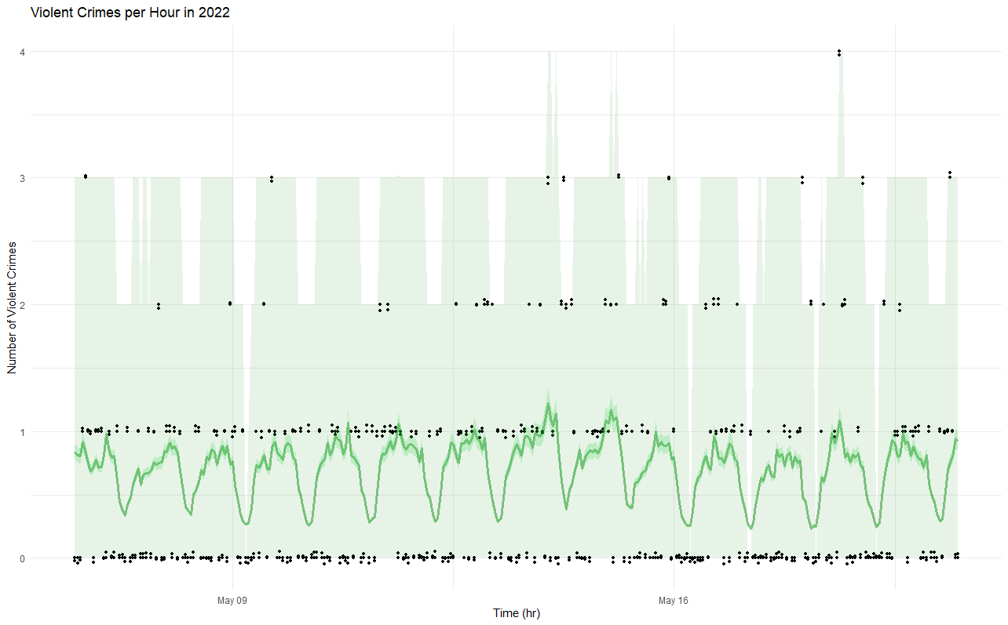

The Modeling Process
Model Identification
Hour, Day, Month, Year
Hourly, Daily, and Monthly Saturated Fixed Effects
Model Identification
$$Y_{hdmy}\sim ZIP\left(λ_{hdmy},π\right)$$
$λ_{hdmy }= exp⁡\{β_{0}+β_{1}FullMoon_{dmy}+β_{2}Unemployment_{my}+X_{hdmy}γ+{Weather}_{hdmy}Ω+\sum_{i=1}^{23}{η_{i}𝟙\left(Hour_{h}=i\right)}+\sum_{i=1}^{6}{δ_{i}𝟙\left(Day_{d}=i\right)}+$ $\sum_{i=1}^{11}{μ_{i}𝟙\left(Month_{m}=i\right) }+\sum_{i=1}^{23}{\sum_{j=1}^{6}{ξ_{6\left(i−1\right)+j} 𝟙\left(Hour_{h}=i\right) 𝟙\left(Day_{d}=j\right)}}+\sum_{i=1}^{24}{ψ_{i}Y_{\left(h−i\right)dmy}}\}, 𝔼\left[ε_{hdmy} | 𝕏_{hdmy}\right]=0$
Lasso Variable Selection
Model Estimation
EDA
Main Effect of Interest
Estimation
Maximum Likelihood Estimation
MSE 0.76 (Using the predicted mean)
Bootstrap sampling to simulate 95% predictive confidence intervals
Autoregressive lag variables from the past 24 hours
Notes:
Note how we used lasso regression to select weather and holiday covariates (mention X covariate matrix includes things like holiday)
We used an autoregressive plot to select autoregressive lag variables

Slide 8
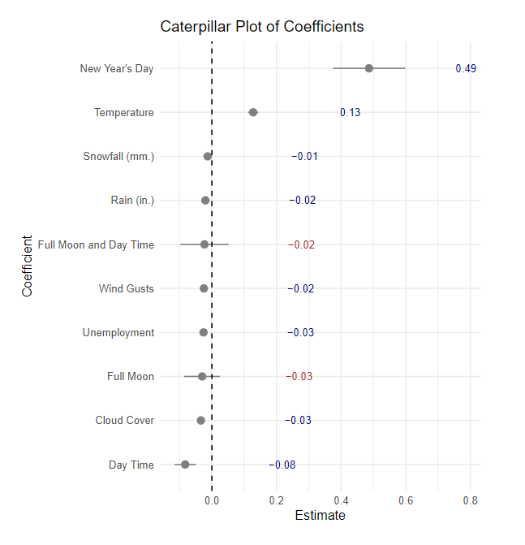
Concluding Effects from Model Estimation

Slide 9




Recommendations

