Slide 1
SLIDE 1
Present Problem
to explore in-novative approaches to predict and, consequently, reduce the rate of violent crimes within
our city. Your primary objective is to determine if and how various factors influence the
rate of violent crimes in Chicago.
Notes:
1 minute

Slide 2
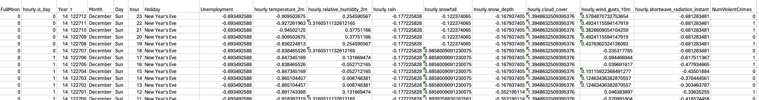
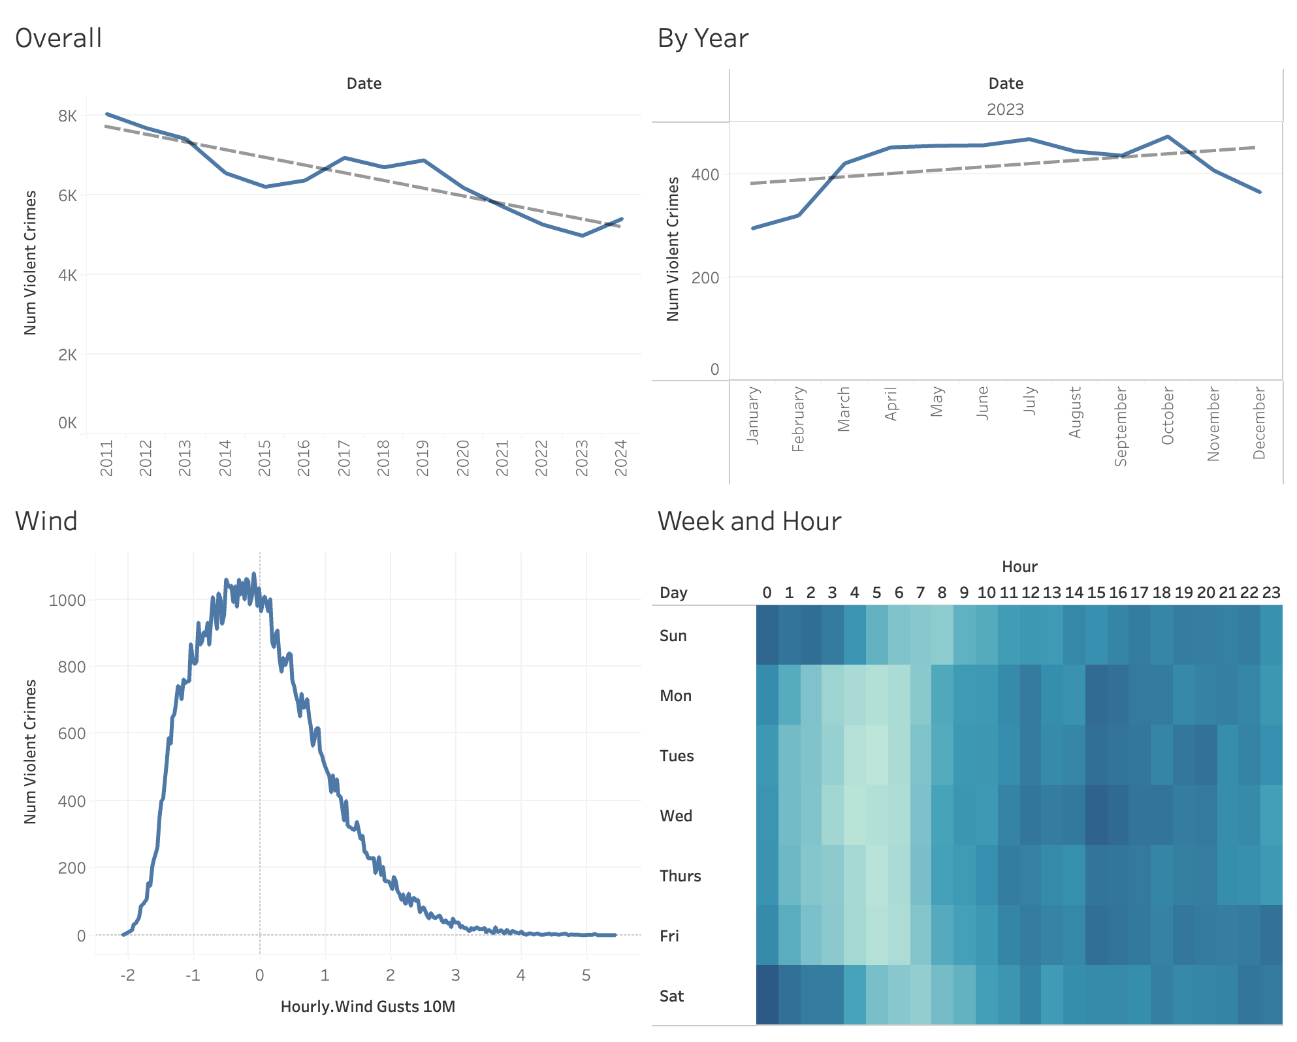
SLIDE 2
describes the data you use and its appropriateness for answering the questions.
Notes:
Since our goal is to predict and reduce the violent crime rate in Chicago, our efforts was focused on understanding those factors that influence, especially in vulnerable periods. Then, we make some decisions about the data.
Our first step was ensuring the date consistency across our datasets. We “standardized” our data to cover the period from 2010 to 2024. This decision allows us to work with the most relevant and recent data, capturing the current dynamics of crime and environmental factors
Recognizing the potential influence of socio-economic factors on crime rates, we integrated monthly unemployment data for Chicago. This addition enriches our analysis, enabling us to explore the interplay between economic conditions and crime.
Definition of violent crime, we adopted the FBI and Chicago's definitions of violent crime. This categorization includes crimes such as HOMICIDE, KIDNAPPING, BATTERY, and ASSAULT, among others. It ensures our study precisely targets the most detrimental crime types to public safety.
Our dataset is meticulously structured to count violent crimes by the hour, incorporating variables like the presence of a full moon, daylight status, weather conditions, and socio-economic indicators. This detailed structuring is pivotal for identifying patterns and correlations.
This thorough preparation enhances our analysis, allowing for a nuanced exploration of when violent crimes occur and their potential triggers. It lays a solid foundation for predictive modeling
However, our focus on timing over location means we've excluded detailed location data. While this decision narrows the scope of our predictions, it aligns with our objective to identify when, rather than where, crimes are most likely to happen within the district we're studying.
In summary, our data preparation phase was guided by the principle of making informed trade-offs to best meet our project's goals. Despite certain limitations, our dataset stands as a robust platform for understanding and predicting violent crime trends in Chicago

Slide 3
SLIDE 3
describe the modeling and/or summarizing efforts that were taken, along with useful
figures or relevant model results.

Slide 4
SLIDE 4
describe the modeling and/or summarizing efforts that were taken, along with useful
figures or relevant model results.

Slide 5
SLIDE 5
includes a summary and conclusions that directly relate to the problem you have been
given.

