Slide 1


SITUATION
PREDICT NUMBER OF VIOLENT CRIMES PER HOUR IN CHICAGO’S 11th DISTRICT
DETERMINE FACTORS THAT INFLUENCE VIOLENT CRIME

Slide 2
SITUATION
PREDICT NUMBER OF VIOLENT CRIMES PER HOUR IN CHICAGO’S 11th DISTRICT
DETERMINE FACTORS THAT INFLUENCE VIOLENT CRIME

Slide 3
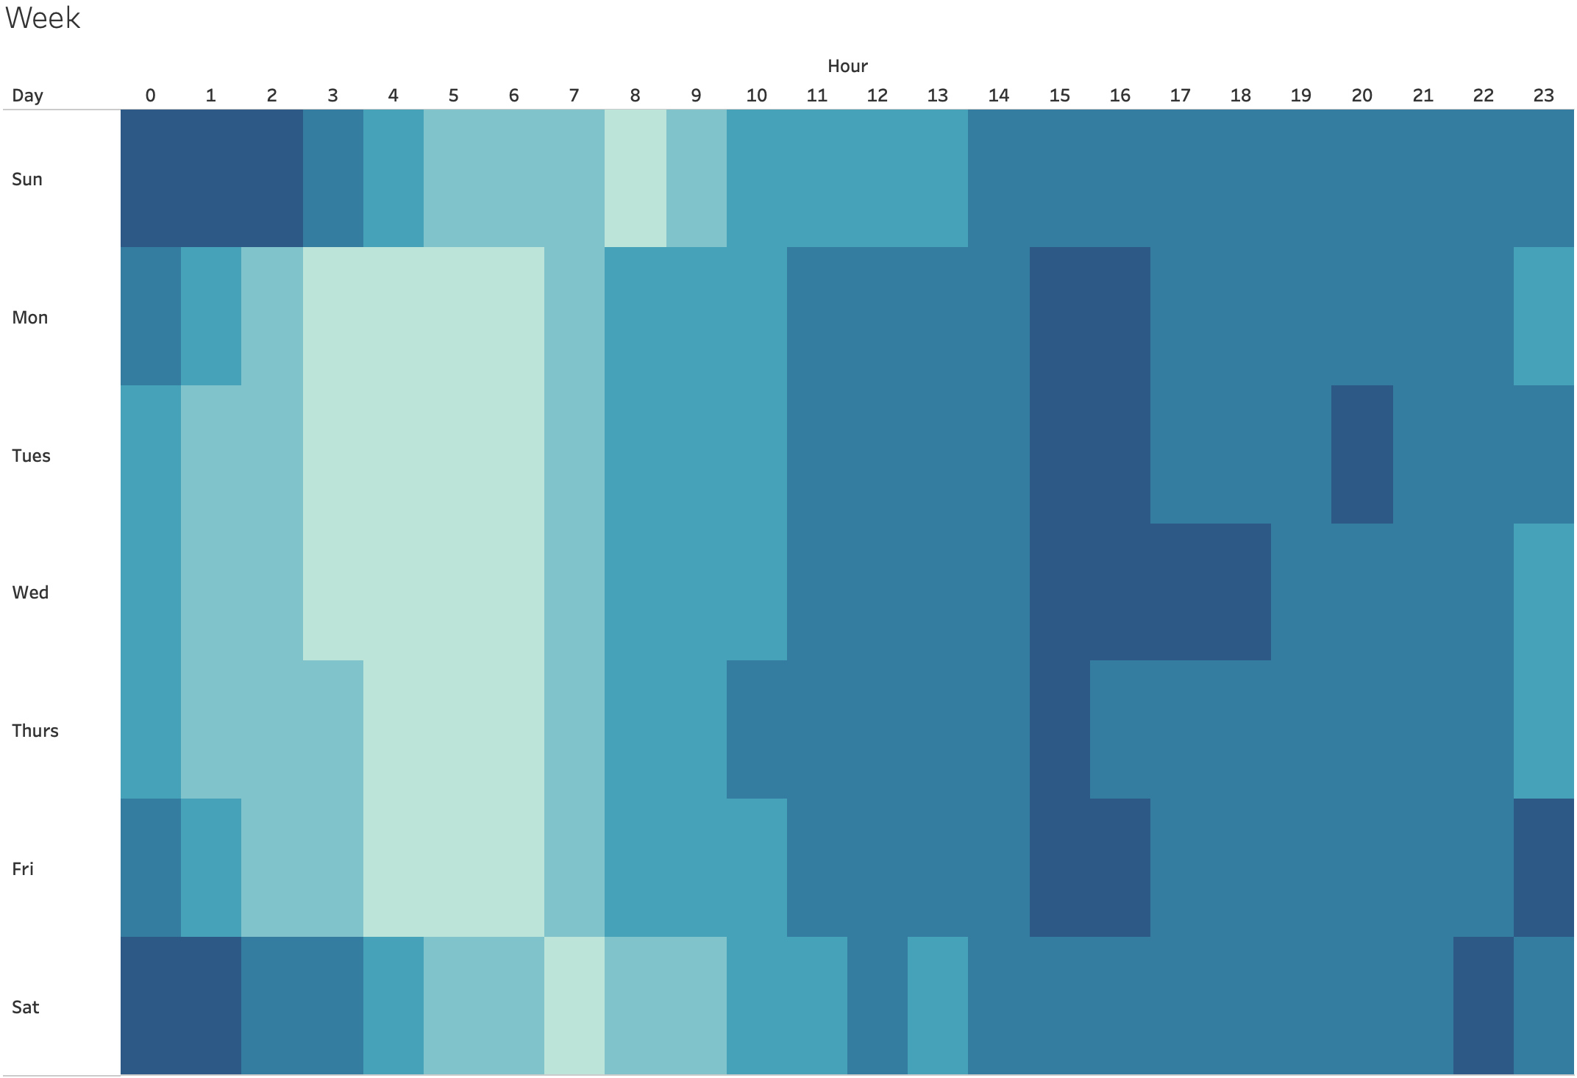
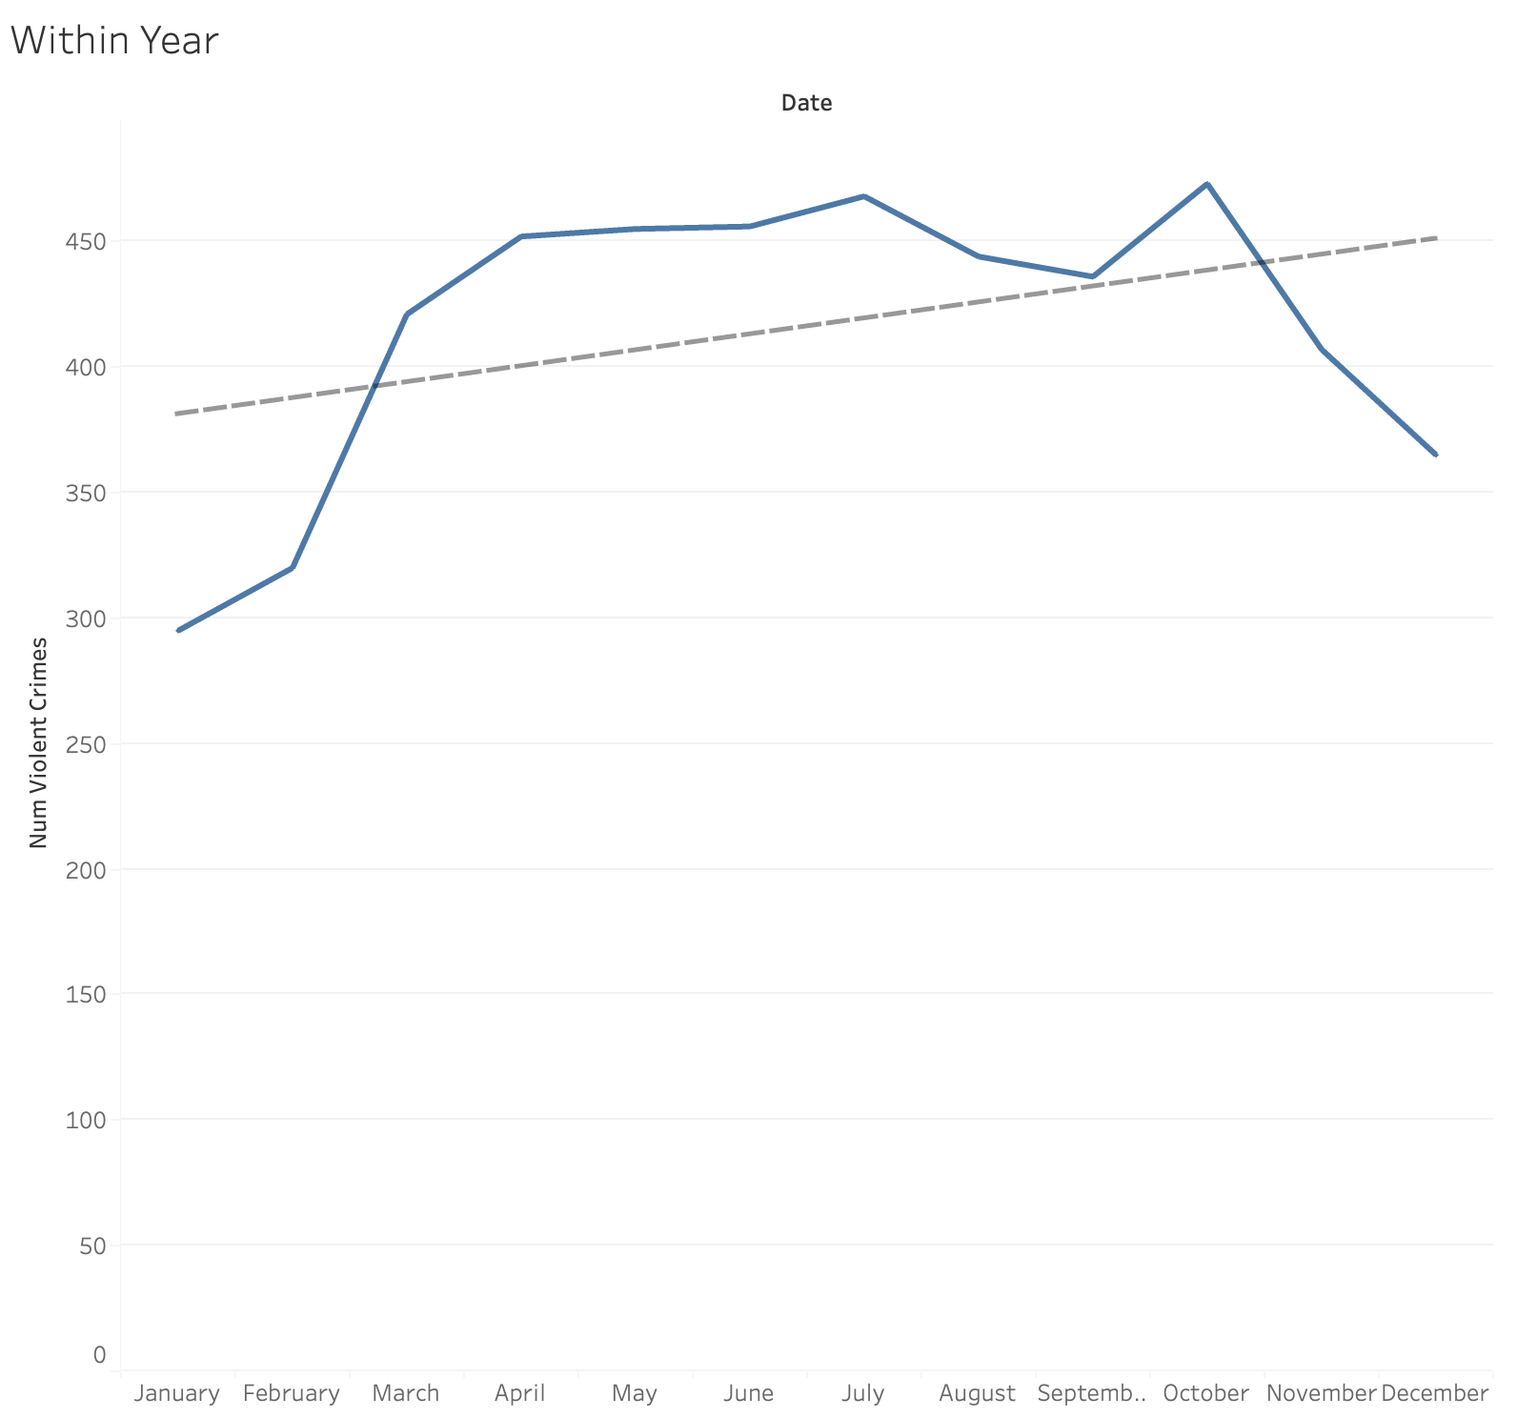
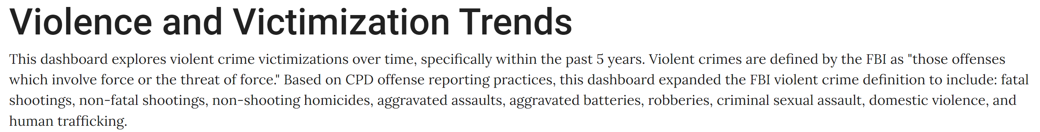
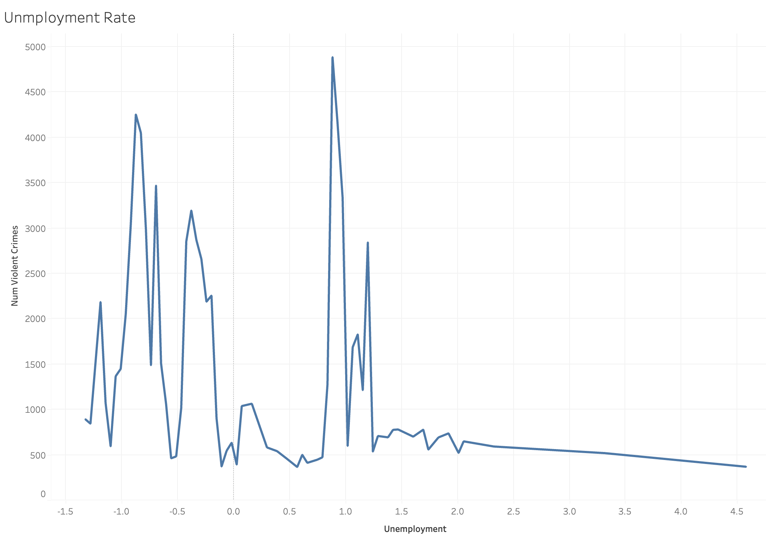
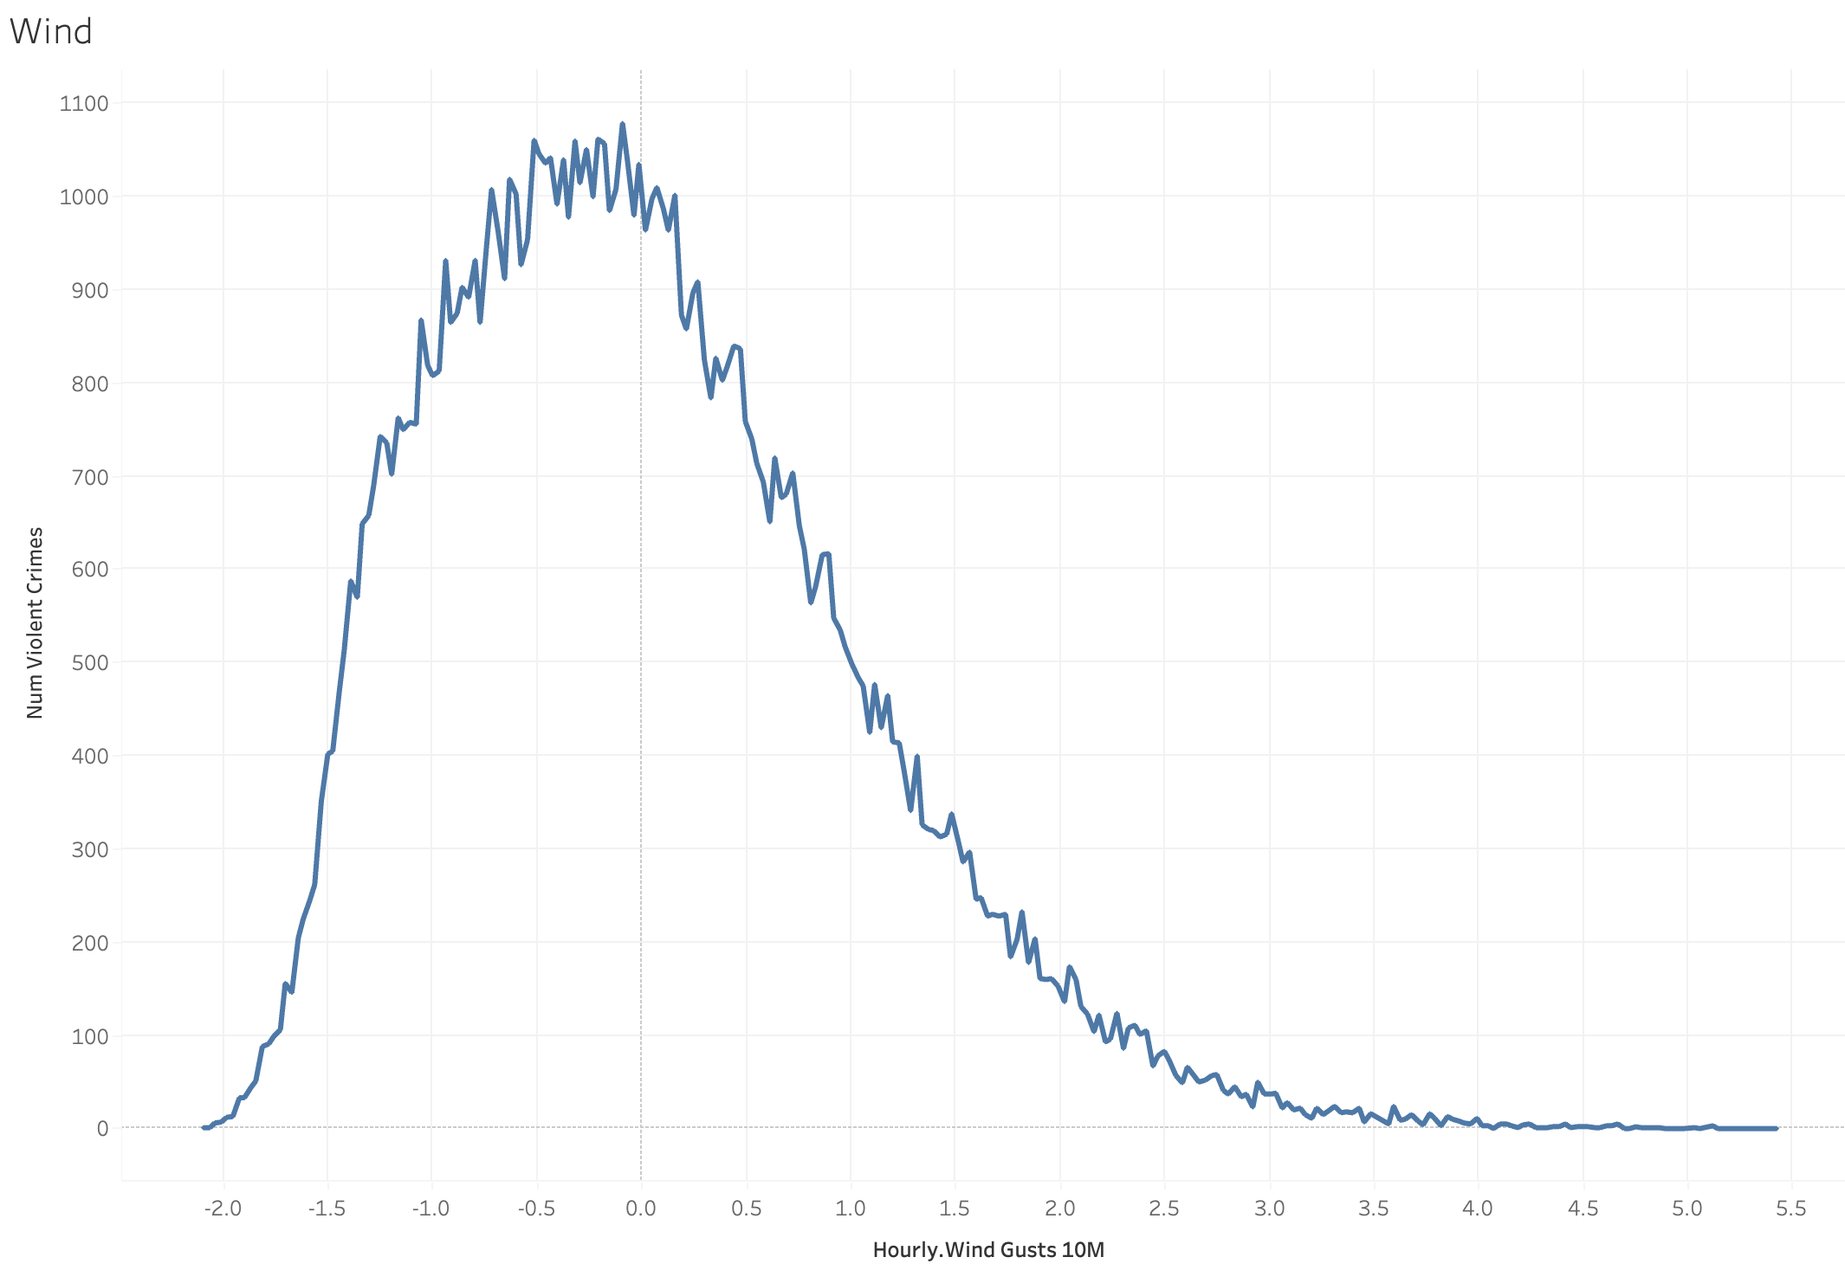
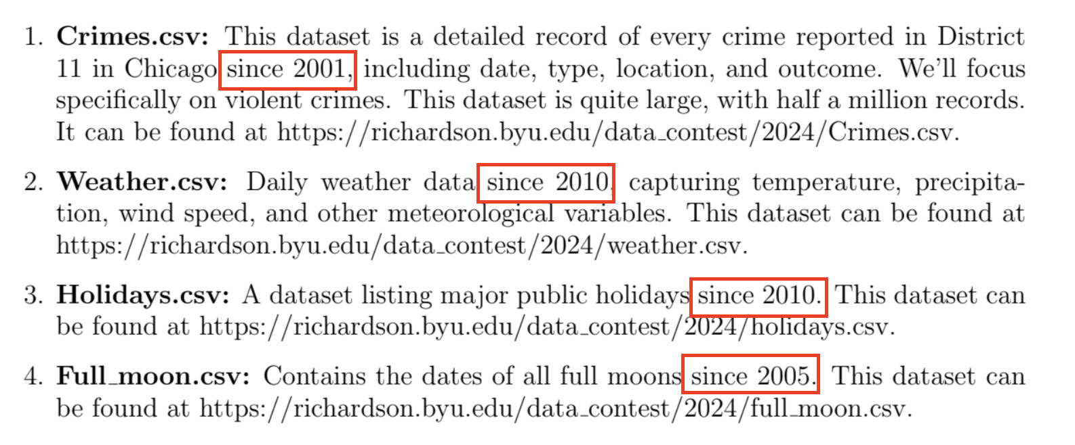
The Data

Slide 4
The Data

Slide 5
The Data

Slide 6
The Data

Slide 7
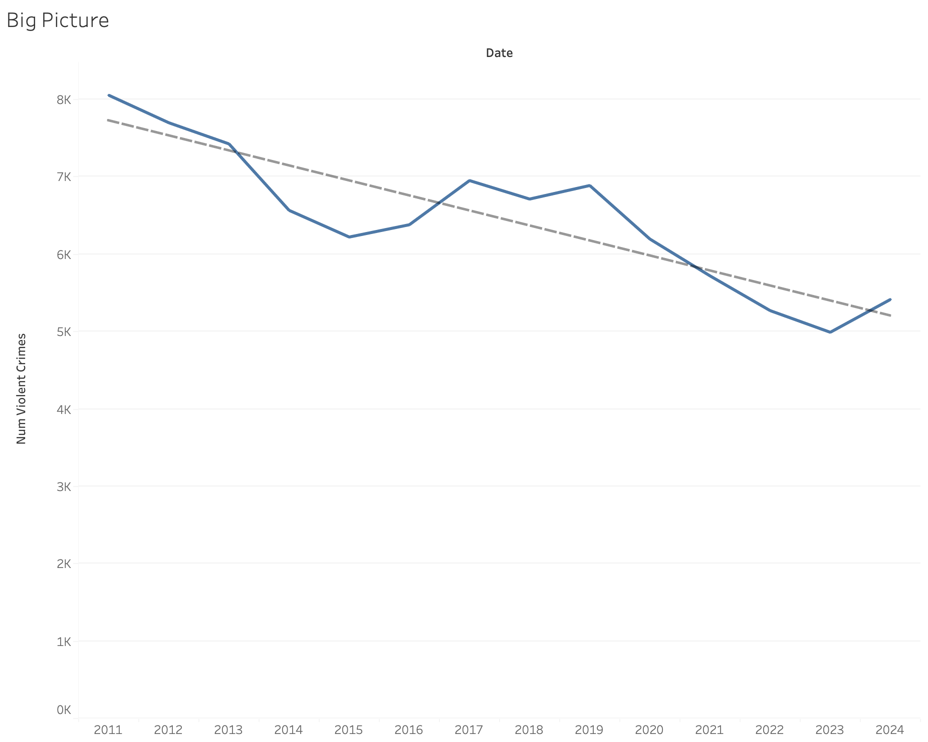
The Data

Slide 8
The Data

Slide 9
The Data

Slide 10
The Data

Slide 11
The Data

Slide 12
The Modeling Process
EDA
Lasso Variable Selection
Model Identification
Estimation

Slide 13
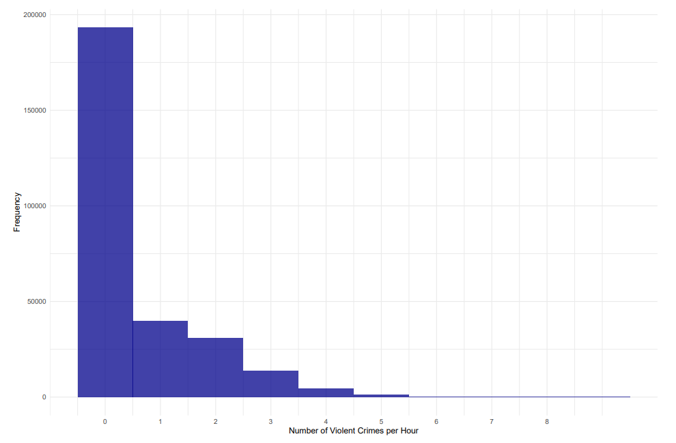
The Modeling Process
EDA
Lasso Variable Selection
Model Identification
Estimation
EDA

Slide 14
The Modeling Process
Lasso Variable Selection
Model Identification
EDA
Lasso Variable Selection
Estimation
Weather Covariates:
Temperature
Apparent Temperature
Cloud Cover
Humidity
Snow Depth
Hourly Rain
Hourly Snowfall
Solar Radiation
(Shortwave/Direct)
Wind Speed
Wind Gusts
Holidays (Dummy Variables)
New Year’s Day
MLK Jr. Day
Presidents’ Day
Memorial Day
Independence Day
Thanksgiving
Christmas
Valentine’s Day
NYE
Christmas Eve
St. Patrick’s Day
Halloween
Columbus Day

Slide 15

The Modeling Process
Model Identification
$$Y_{hdmy}\sim ZIP\left(λ_{hdmy},π\right)$$
$λ_{hdmy }= exp⁡\{β_{0}+β_{1}FullMoon_{dmy}+β_{2}Unemployment_{my}+X_{hdmy}γ+{Weather}_{hdmy}Ω+\sum_{i=1}^{23}{η_{i}𝟙\left(Hour_{h}=i\right)}+\sum_{i=1}^{6}{δ_{i}𝟙\left(Day_{d}=i\right)}+$ $\sum_{i=1}^{11}{μ_{i}𝟙\left(Month_{m}=i\right) }+\sum_{i=1}^{23}{\sum_{j=1}^{6}{ξ_{6\left(i−1\right)+j} 𝟙\left(Hour_{h}=i\right) 𝟙\left(Day_{d}=j\right)}}+\sum_{i=1}^{24}{ψ_{i}Y_{\left(h−i\right)dmy}}\}, 𝔼\left[ε_{hdmy} | 𝕏_{hdmy}\right]=0$
EDA
Lasso Variable Selection
Estimation

Slide 16

The Modeling Process
Model Identification
Hour, Day, Month, Year
$$Y_{hdmy}\sim ZIP\left(λ_{hdmy},π\right)$$
$λ_{hdmy }= exp⁡\{β_{0}+β_{1}FullMoon_{dmy}+β_{2}Unemployment_{my}+X_{hdmy}γ+{Weather}_{hdmy}Ω+\sum_{i=1}^{23}{η_{i}𝟙\left(Hour_{h}=i\right)}+\sum_{i=1}^{6}{δ_{i}𝟙\left(Day_{d}=i\right)}+$ $\sum_{i=1}^{11}{μ_{i}𝟙\left(Month_{m}=i\right) }+\sum_{i=1}^{23}{\sum_{j=1}^{6}{ξ_{6\left(i−1\right)+j} 𝟙\left(Hour_{h}=i\right) 𝟙\left(Day_{d}=j\right)}}+\sum_{i=1}^{24}{ψ_{i}Y_{\left(h−i\right)dmy}}\}, 𝔼\left[ε_{hdmy} | 𝕏_{hdmy}\right]=0$
EDA
Lasso Variable Selection
Estimation
Notes:
Note how we used lasso regression to select weather and holiday covariates (mention X covariate matrix includes things like holiday)
We used an autoregressive plot to select autoregressive lag variables

Slide 17

The Modeling Process
Model Identification
Hour, Day, Month, Year
$$Y_{hdmy}\sim ZIP\left(λ_{hdmy},π\right)$$
$λ_{hdmy }= exp⁡\{β_{0}+β_{1}FullMoon_{dmy}+β_{2}Unemployment_{my}+X_{hdmy}γ+{Weather}_{hdmy}Ω+\sum_{i=1}^{23}{η_{i}𝟙\left(Hour_{h}=i\right)}+\sum_{i=1}^{6}{δ_{i}𝟙\left(Day_{d}=i\right)}+$ $\sum_{i=1}^{11}{μ_{i}𝟙\left(Month_{m}=i\right) }+\sum_{i=1}^{23}{\sum_{j=1}^{6}{ξ_{6\left(i−1\right)+j} 𝟙\left(Hour_{h}=i\right) 𝟙\left(Day_{d}=j\right)}}+\sum_{i=1}^{24}{ψ_{i}Y_{\left(h−i\right)dmy}}\}, 𝔼\left[ε_{hdmy} | 𝕏_{hdmy}\right]=0$
EDA
Main Effect of Interest
Lasso Variable Selection
Estimation
Notes:
Note how we used lasso regression to select weather and holiday covariates (mention X covariate matrix includes things like holiday)
We used an autoregressive plot to select autoregressive lag variables

Slide 18

The Modeling Process
Model Identification
Hour, Day, Month, Year
Hourly, Daily, and Monthly Saturated Fixed Effects
$$Y_{hdmy}\sim ZIP\left(λ_{hdmy},π\right)$$
$λ_{hdmy }= exp⁡\{β_{0}+β_{1}FullMoon_{dmy}+β_{2}Unemployment_{my}+X_{hdmy}γ+{Weather}_{hdmy}Ω+\sum_{i=1}^{23}{η_{i}𝟙\left(Hour_{h}=i\right)}+\sum_{i=1}^{6}{δ_{i}𝟙\left(Day_{d}=i\right)}+$ $\sum_{i=1}^{11}{μ_{i}𝟙\left(Month_{m}=i\right) }+\sum_{i=1}^{23}{\sum_{j=1}^{6}{ξ_{6\left(i−1\right)+j} 𝟙\left(Hour_{h}=i\right) 𝟙\left(Day_{d}=j\right)}}+\sum_{i=1}^{24}{ψ_{i}Y_{\left(h−i\right)dmy}}\}, 𝔼\left[ε_{hdmy} | 𝕏_{hdmy}\right]=0$
EDA
Main Effect of Interest
Lasso Variable Selection
Estimation
Notes:
Note how we used lasso regression to select weather and holiday covariates (mention X covariate matrix includes things like holiday)
We used an autoregressive plot to select autoregressive lag variables

Slide 19

The Modeling Process
Model Identification
Hour, Day, Month, Year
Hourly, Daily, and Monthly Saturated Fixed Effects
$$Y_{hdmy}\sim ZIP\left(λ_{hdmy},π\right)$$
$λ_{hdmy }= exp⁡\{β_{0}+β_{1}FullMoon_{dmy}+β_{2}Unemployment_{my}+X_{hdmy}γ+{Weather}_{hdmy}Ω+\sum_{i=1}^{23}{η_{i}𝟙\left(Hour_{h}=i\right)}+\sum_{i=1}^{6}{δ_{i}𝟙\left(Day_{d}=i\right)}+$ $\sum_{i=1}^{11}{μ_{i}𝟙\left(Month_{m}=i\right) }+\sum_{i=1}^{23}{\sum_{j=1}^{6}{ξ_{6\left(i−1\right)+j} 𝟙\left(Hour_{h}=i\right) 𝟙\left(Day_{d}=j\right)}}+\sum_{i=1}^{24}{ψ_{i}Y_{\left(h−i\right)dmy}}\}, 𝔼\left[ε_{hdmy} | 𝕏_{hdmy}\right]=0$
EDA
Main Effect of Interest
Lasso Variable Selection
Estimation
Autoregressive lag variables from the past 24 hours

Slide 20
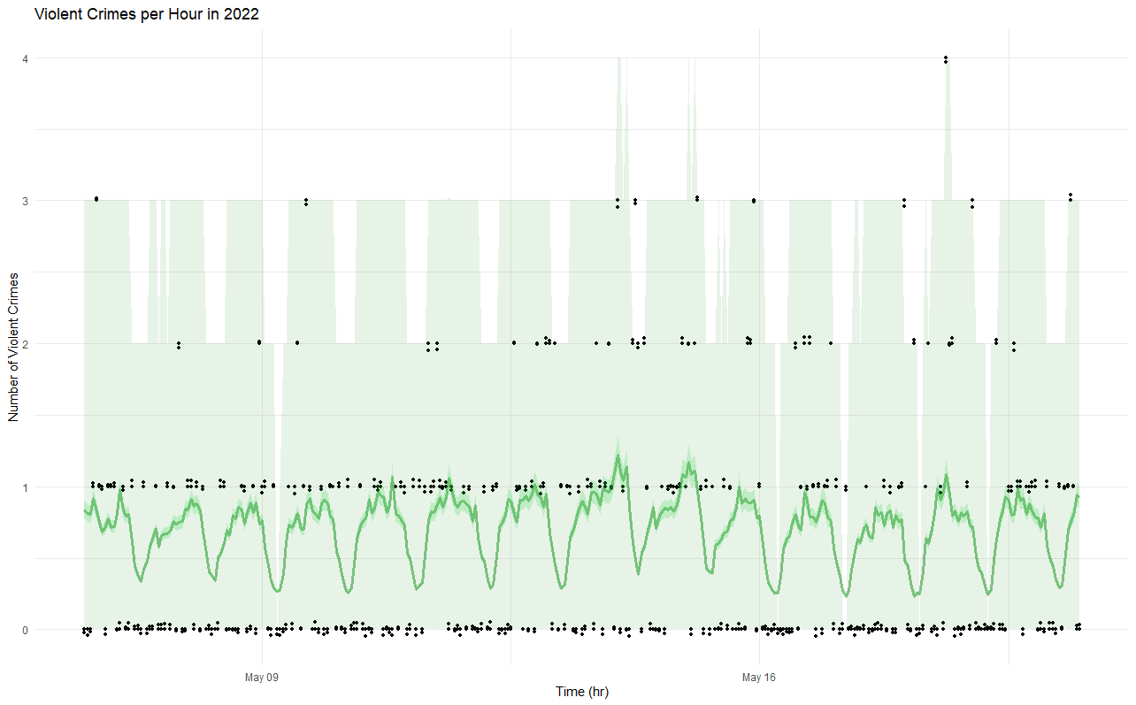
The Modeling Process
Model Estimation
Hour, Day, Month, Year
EDA
Lasso Variable Selection
Model Identification
Estimation
Maximum Likelihood Estimation
MSE 0.76 (Using the predicted mean)
Bootstrap sampling to simulate 95% predictive confidence intervals

Slide 21
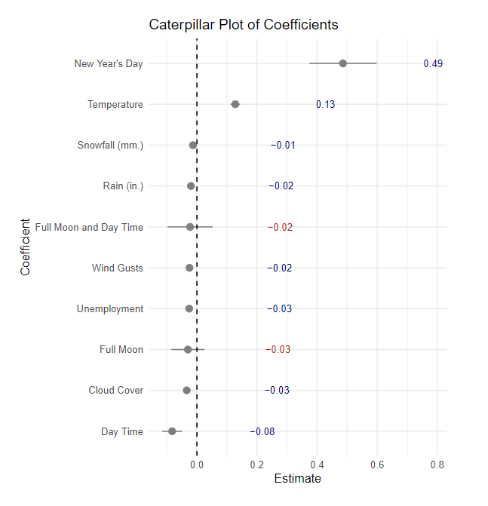
Concluding Effects from Model Estimation

Slide 22
Concluding Effects from Model Estimation

Slide 23




Recommendations

