Slide 1
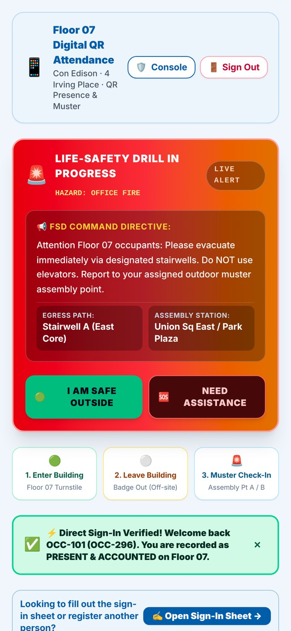
MusterCommand
One morning on one floor: Floor 07, Con Edison, 4 Irving Place
Robert Petillo · Samuel McFarlane
Pursuit AI Native Builder Fellowship · Con Edison Demo Day
Working prototype · every name and number is made up
Notes:
ROBERT: Thank you for making the time. I am Robert Petillo. This is Samuel McFarlane. We built MusterCommand, and today we want to walk you through one morning on a single floor.
ROBERT: Before we start, one thing to be clear about. Everything you will see runs on made-up data: made-up names, made-up counts, a made-up floor. We will point out the limits as we go.
Cue: pause after "made-up." Do not rush the disclosure. (0:00 to 0:20)

Slide 2



Two imperatives, one customer
Safety
Operational excellence
The person in the stairwell
Every person accounted for, in seconds, with a location, not an estimate.
The drill produces its own evidence as it happens, instead of half a day rebuilding what people remember.
Employee, contractor or visitor, with no time to learn a tool. One screen, two buttons, no training.
Notes:
SAM: We started with two things that have to be true at the same time. Safety means every person accounted for, in seconds, with a location, not an estimate. Operational excellence means the drill produces its own evidence as it happens, instead of someone spending half a day rebuilding what people remember.
ROBERT: The third one changed the design. On a floor, the customer is the person in the stairwell: employee, contractor, or visitor. They do not have time to learn a new tool. So the rule is one screen, two buttons, and no training.
Cue: Sam finishes on "no training." Robert picks up with "that is why the phone is the whole interface." (0:20 to 0:40)

Slide 3



Four minutes to evacuate, twenty to account
9:42
9:46
10:06
Alarm sounds
Floor clear
20 minutes: no one can say who is safe, missing, or needs help
All clear
195 people head for the stairwells
Four minutes. That part works.
24 minutes after the alarm
A roster printed at 8:00
One radio channel
Two names unaccounted for
Staff leads reach the street with this morning's paper list.
Headcounts come in one quadrant at a time.
A staff lead goes back up to check. The only record is a handwritten sheet.
Illustrative timings on a synthetic floor. Your drill records give the real numbers.
Notes:
ROBERT: It is 9:42 on Floor 07. The alarm sounds. One hundred ninety-five people start moving toward the stairwells.
ROBERT: At 9:46 the floor is clear. Four minutes. That part works.
ROBERT: Then the part that does not work. Staff leads reach the street with a roster printed at eight o'clock. Headcounts go over one radio channel, one quadrant at a time. Two names are unaccounted for, and nobody knows whether those two people are still inside. A staff lead goes back up to check.
ROBERT: At 10:06, all clear. Twenty-four minutes after the alarm.
SAM: And the only record is a handwritten sheet and what people remember.
ROBERT: For those twenty minutes, no one could say who was safe, who was missing, and who needed help. Not because anyone did anything wrong. Because there is no system that answers that question.
Cue: stop and count three seconds after the last line, then advance.
If asked about the timings: "They are illustrative on a synthetic floor. The shape is what matters. The pilot gives us your real numbers." (0:40 to 1:40)

Slide 4
Same alarm, everyone signed in that morning
8:00
Everyone scans in
8 minutes
QR at the entrance, badge or visitor pass, about two seconds. On the live roster before any alarm.
9:42
Staff lead declares
from alarm to everyone accounted for, instead of 24. Sixteen minutes back.
Every signed-in phone switches to evacuation, with the stairwell and meeting point on screen.
191
tapped "I am safe" by 9:50
9:46
Floor clear
The same four minutes. People do not walk faster.
1
tapped "I need help": a responder is routed by name
Everyone accounted for
2
resolve in the next minutes
9:50
Safe taps, help requests and badge-outs close the count. No radio roll call.
1
never badged in: shown as not in the building, not as missing
Illustrative breakdown of 195 people on a synthetic floor.
Notes:
SAM: Same floor, same alarm, one difference. At eight in the morning, everyone scans a QR code at the entrance. Badge or visitor pass, about two seconds. They are on the live roster before the alarm sounds.
ROBERT: At 9:42 the staff lead declares. Every signed-in phone switches to evacuation, with the stairwell and the meeting point on screen.
SAM: The floor is still clear at 9:46, in the same four minutes. We did not make people walk faster.
ROBERT: At 9:50, 191 of 195 have tapped "I am safe." One person tapped "I need help," and a responder is routed to them by name, not by radio.
SAM: Two of the remaining three resolve. The last one never badged in, and the system already knew that. It shows as not in the building, not as missing.
ROBERT: Everyone accounted for eight minutes after the alarm. Sixteen minutes back. The emergency works because the morning already happened.
The 191 / 1 / 2 / 1 breakdown is illustrative. If asked for real figures: "We need your floor data to produce real ones. That is the pilot." (1:40 to 2:20)

Slide 5
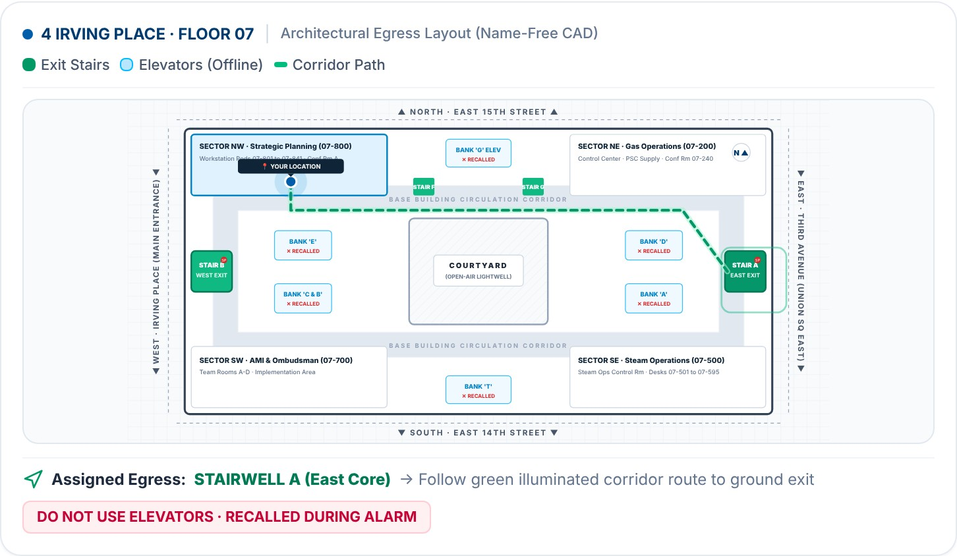



Every phone carries the floor map
A route, not just a stairwell name
Each phone draws the way out from that person's sector to the assigned exit.
Help has a location
When someone taps "I need help," the commander sees them pinned on the map with the nearest stairwell.
A rescue checklist
Four steps from first contact to safe outside. Each step is written to the audit log.
What every phone shows during a drill: the person's sector, the assigned stairwell, and a route along the corridors. Elevators are marked as recalled. No names appear on this map.
Prototype drawing of Floor 07. The layout needs to be checked against the building's own floor plan.
Notes:
SAM: This is the map every phone shows once a drill is declared. It knows which sector the person signed in to, so it draws their route along the corridors to the assigned stairwell, and it marks the elevators as recalled. There are no names on this map.
ROBERT: And this is how slide 4 works in practice. When someone taps "I need help," the commander doesn't get a radio call. They get that person pinned on the map, the nearest stairwell, and a four-step rescue checklist. Every step is written to the audit log.
SAM: One honest note: this is our drawing of Floor 07. Checking it against your floor plan is part of the floor data we're asking for.
Cue: point at the green route, then at the red pin icon. Keep it under 40 seconds. (2:20 to 3:00)
If asked whether the map is official: "No. It's our prototype drawing. We'd replace it with your plan."

Slide 6
What that morning changes
Safety
Operations
Time to all safe is measured, not estimated
Unaccounted people surface with a last known quadrant
Help requests reach a responder by name
Silence is never read as safety
The drill record writes itself as it happens
Compliance evidence is generated, not reconstructed
One sign-in serves attendance, visitors and drills
Data stays current between drills
Safety gets us in the door. Operational excellence is why it still gets used on a Tuesday with no drill scheduled.
Notes:
ROBERT: On the safety side: time to all safe is measured, not estimated. Unaccounted people surface with a last known quadrant. Assistance requests reach a responder by name. Silence is never read as safety.
SAM: On the operations side: the drill record writes itself as it happens. Compliance evidence is generated, not reconstructed. One sign-in serves attendance, visitors, and drills, so the data stays current between drills.
ROBERT: Safety gets us in the door. Operational excellence is why it still gets used on a Tuesday with no drill scheduled. (3:00 to 3:40)

Slide 7





How it is built, and its limits
How it is built
Limits today
Any phone browser
No app to install, no account to create
The roster is synthetic: made-up names on a made-up floor
Not connected to the fire alarm panel
Alerts reach phones with the app open; SMS and push are not connected
Audit log and roster survive a restart (saved to disk, auto-loaded)
AI drafts summaries; a person reviews them before they are official
React and TypeScript front end
One system, a different view for each role
Node and Express server
Live updates to every screen, so nobody reads a stale count
Hash-chained audit log
Every action recorded; edits to the record are detectable
Notes:
SAM: It runs in any phone browser. No app, no account. The front end is React and TypeScript. The server is Node and Express, with live updates to every screen, so nobody reads a stale count. Each role sees its own view of the same system. Alerts go out in six languages, with a read-aloud voice.
ROBERT: Now the limits. The roster is made up. It does not connect to the fire alarm panel. Alerts reach phones that have the page open; there is no text message or phone notification yet. And the audit log is held in memory, so a restart clears it.
Cue: let the limits sit. Do not add a qualifier. This is the trust moment. (3:40 to 4:25)

Slide 8
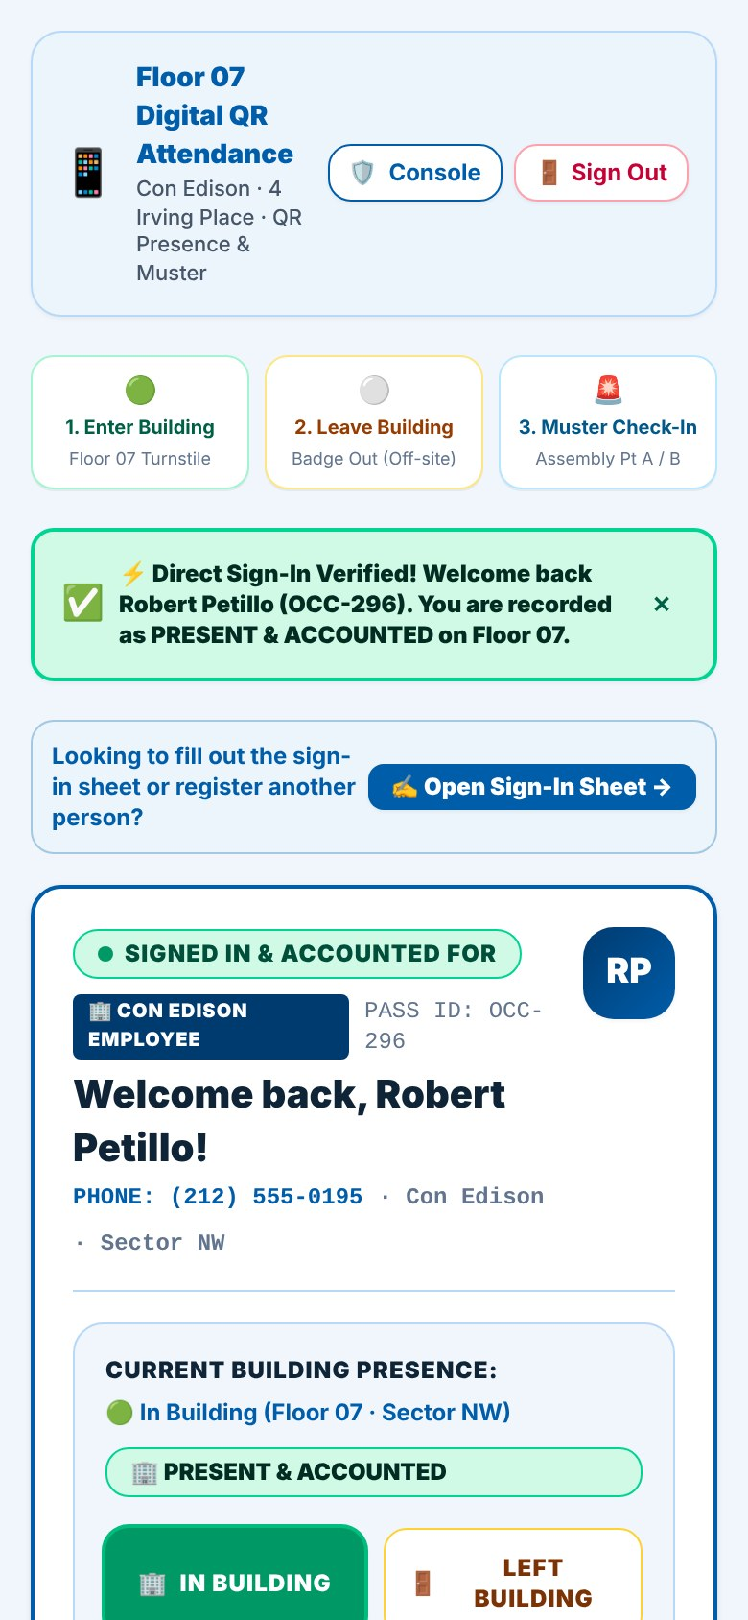
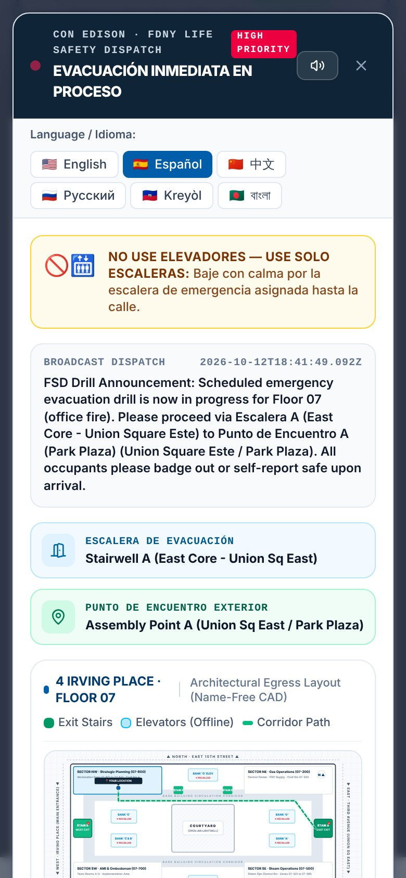
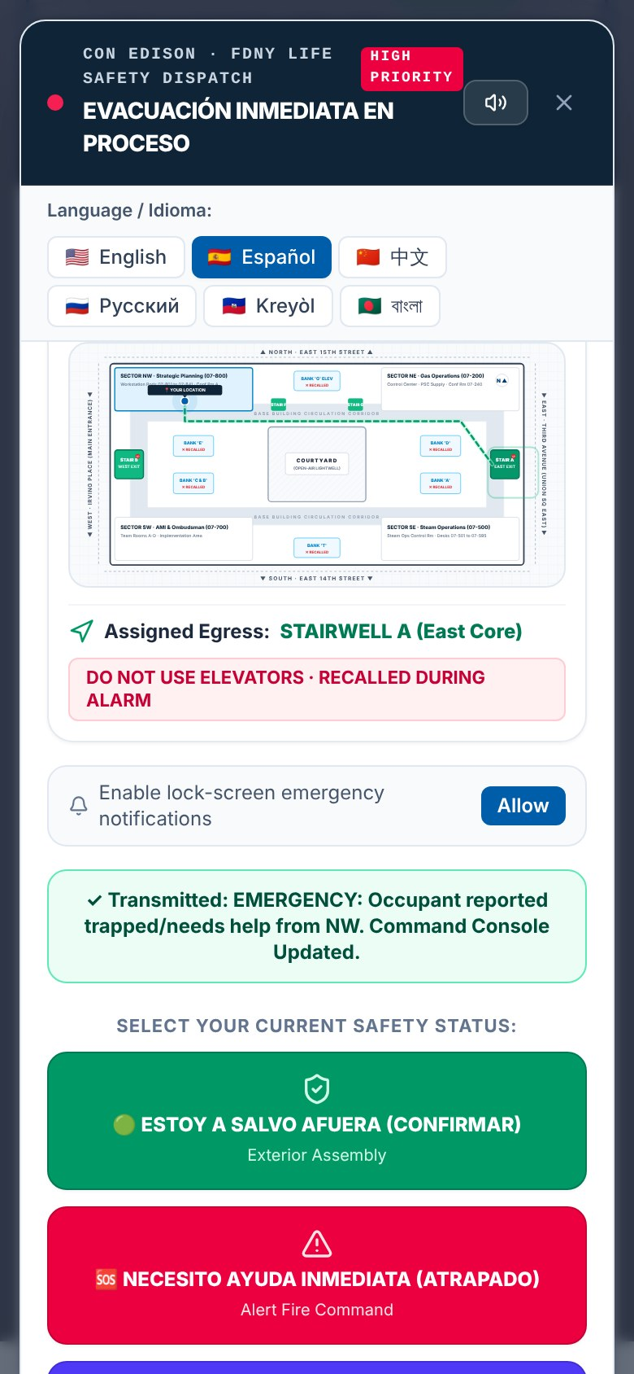
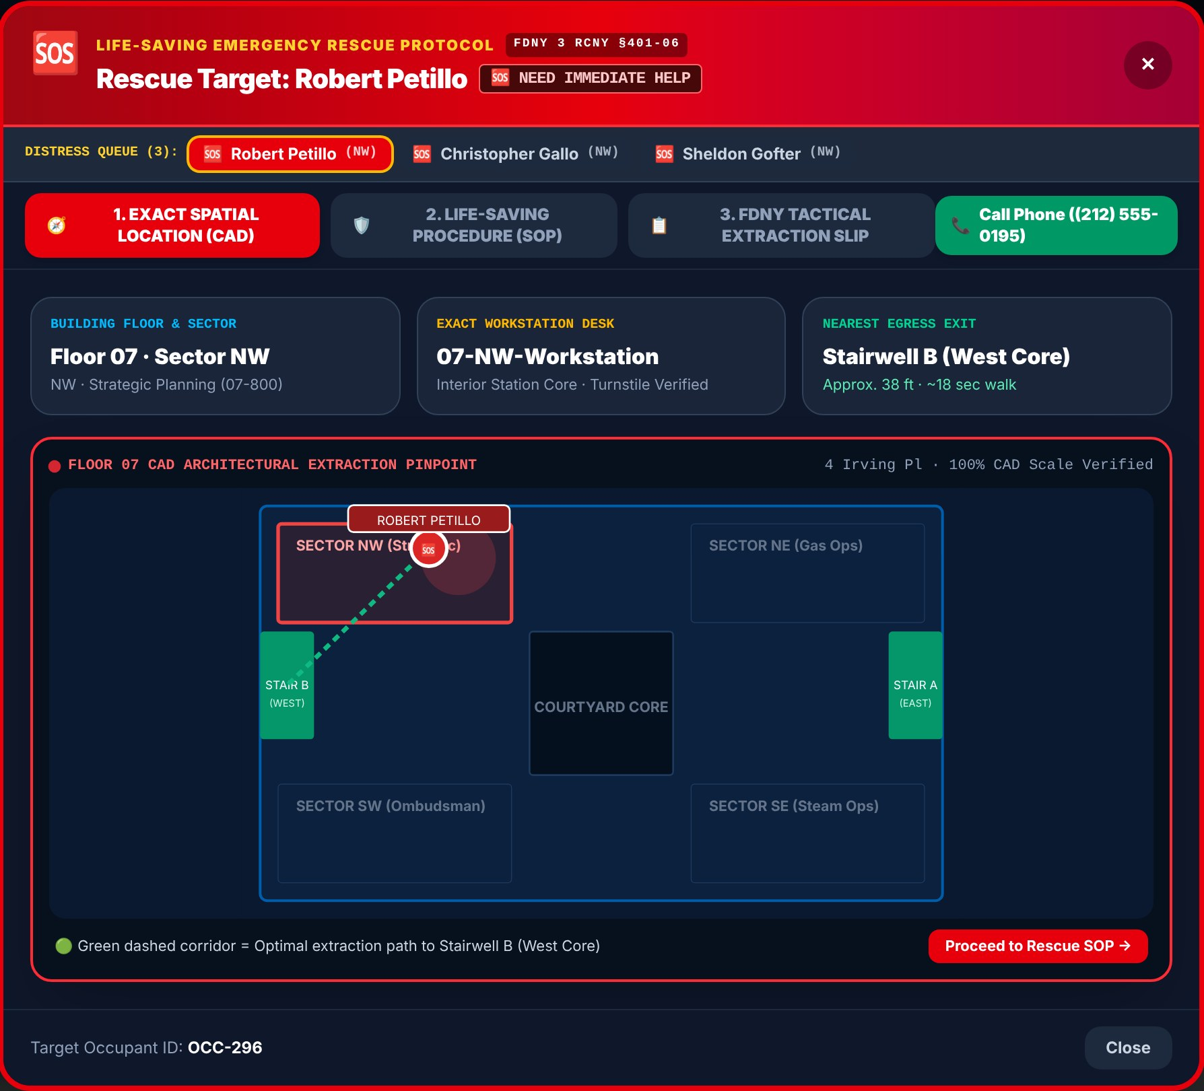
The phone demo, step by step
1
Sign in on the phone
2
Drill alert, six languages
3
"I need help"
4
Commander sees who, where, and the route
Screens from the working prototype on Oct 12. Names and phone numbers are made up.
Notes:
Setup: laptop on a phone hotspot, app running, signed in on Step 01 showing 195 / 195. Robert's phone has Wi-Fi off and opened the sign-in page from the Cellular 5G QR code.
1 ROBERT, phone: Fill Staff Lead (Robert Petillo), Entering Building, Sign In & Get Digital Floor 07 Pass. "This is what every person does on the way in. Two seconds. Now I am on the roster." SAM points at In building now: 195 becomes 196. "That reached the commander without a radio call."
2 SAM warns the room about the siren, then Declare Drill / Alarm, then Declare & Proceed to Step 04 Broadcast, then Send Emergency Alert Now. "Same as the alarm going off." ROBERT holds up the phone and taps Español: "Six languages, with the floor map and my route at the bottom."
3 ROBERT taps the red Necesito ayuda inmediata button: "Now I'm the person who can't get out."
4 SAM clicks I Understand & Egressing to close the alert, then Open Rescue SOP & FDNY Slip in the red banner. "There I am: Sector NW, my desk, the nearest stairwell and the route." If someone else is selected, click Robert Petillo in the distress queue. Then Life-Saving Procedure, then Life Saved — Mark Safe Outside. "Every step of that rescue is in the audit log."
Stop there. Don't seal and don't open the certificate.
Fallback: if the phone fails, use the backup tab on the laptop. If the app fails, say "We will use the screenshots," stay on this slide and talk through the four steps. Never troubleshoot in front of the room. (4:25 to 6:15)

Slide 9

What we need from Con Edison
1
2
3
Real floor data
Drill records
One floor to pilot
The quadrants, the stairwells, the assembly points, and how your roster represents contractors and visitors.
Timings from recent drills, so the baseline is your number, not our guess.
A single scheduled drill, observed beside the current paper process.
Leaving today with: a name for the floor data and a date for the first drill.
Notes:
ROBERT: One: real floor data. The quadrants, the stairwells, the assembly points, and how your roster represents contractors and visitors.
ROBERT: Two: drill records. Timings from recent drills, so the baseline is your number, not our guess.
ROBERT: Three: one floor to pilot. A single scheduled drill, observed beside the current paper process.
SAM: We are not asking for a decision today. We would rather be corrected now than build six more weeks on assumptions we invented.
ROBERT: What we would like to leave with today is a name for the floor data and a date for the first drill. Who is the right person for that?
Cue: do not end the meeting without a name or a date. If neither is offered: "Who should we follow up with, and by when?" (6:15 to 6:45)

Slide 10
Next steps are a conversation
We will not propose a build plan before we have seen your numbers.
We finish this phase
You share floor and drill data
Together, we define what comes after
1
2
3
Goal for today: agree on what "done" looks like on your floor.
Notes:
SAM: Here is what happens next. We finish this phase. You give us the real floor and drill data. Then we sit down and define what comes after. We will not propose a build plan before we have seen your numbers.
ROBERT: What we want to be true when we leave is that we all agree on what "done" looks like on your floor.
Cue: stop talking. Let them ask. Sam takes the first technical question; Robert takes the first floor question. (6:45 to 7:00)

Slide 11




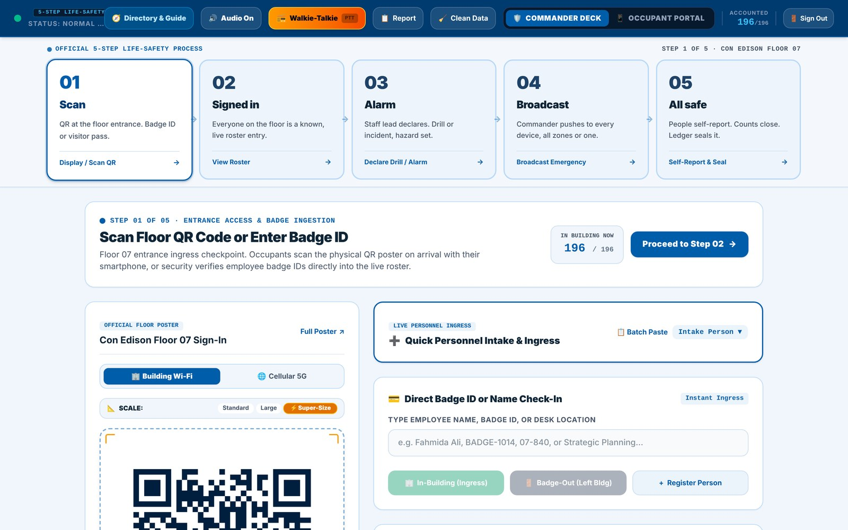
Five steps behind the timeline
01
02
03
04
05
Scan
Signed in
Alarm
Broadcast
All safe
QR at the floor entrance. Badge ID or visitor pass.
Everyone on the floor is a known, live roster entry.
Staff lead declares drill or incident and sets the hazard.
Alert posted to every open phone, by zone or all zones.
People self-report. Counts close. The log is sealed.
The commander console walks the staff lead through the same five steps, in order.
Notes:
SAM (only if asked): the five steps behind the timeline. 01 Scan at the entrance, 02 the live signed-in roster, 03 the staff lead declares, 04 the alert goes to every open phone, 05 people self-report and the record is sealed.

Slide 12
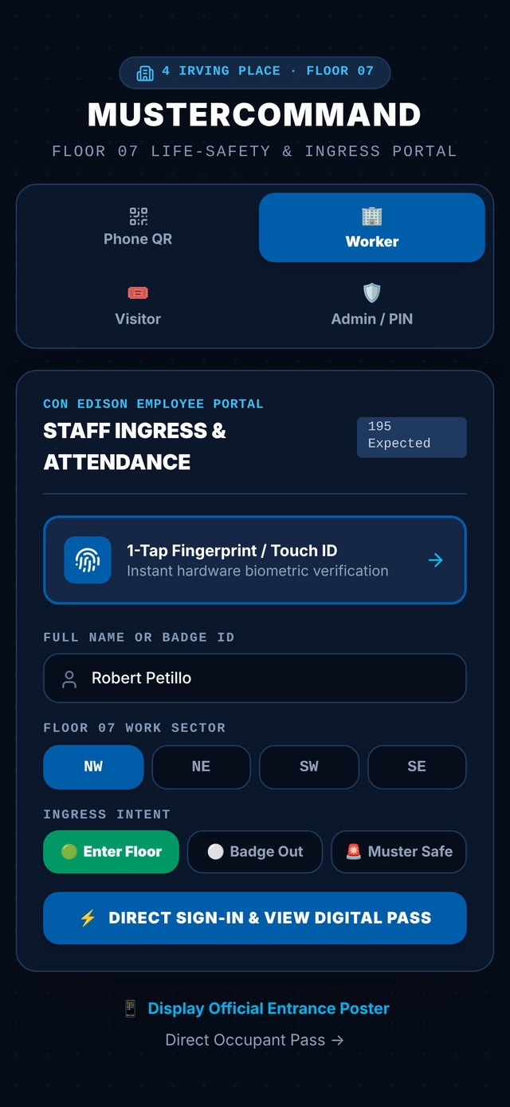



Who sees what
Fire Safety Director / commander
The full floor. Declares, broadcasts, and seals the record. PIN protected.
Staff lead / floor warden
Their quadrant. Sweeps, notes, and the walkie-talkie. PIN protected.
Auditor
The full floor and the drill record, read-only.
Employee, contractor, visitor
Their own pass and two buttons: "I am safe" and "I need help."
Privacy rules for visitors and contractors are not finished; we want HR and security in that conversation before a pilot.
Notes:
ROBERT (only if asked): the commander and the auditor see the full floor. Staff leads see their quadrant. Everyone else sees their own pass and two buttons. Privacy rules for visitors and contractors are not finished, and we would want your HR and security teams in that conversation before a pilot.

Slide 13




Four design rules
One screen, two buttons, no training
Silence is never read as safety
The person in the stairwell has no time to learn a tool.
During an alarm, nobody counts as safe until they say so or a warden confirms.
The drill writes its own record
It sits on top of the alarm
Evidence is captured as it happens, not rebuilt from memory.
It never replaces or touches the fire alarm panel.
Notes:
SAM (only if asked). If challenged on a design decision, ask: "Which one would you change?"
NOTE: the script mentions four design rules but never lists them. These four are taken from lines the script itself uses (slides 2, 5 and the Q&A). Confirm the wording with Sam before Wednesday.

Slide 14




Pilot readiness: features verified and active in today's demo
Everyone signs in with their own PIN
Contact numbers stay private
Personal PINs for commanders/wardens, plus 1-tap mobile phone connect for all 195 Floor 07 personnel.
Public screens never show phone numbers or internal network addresses.
The audit log survives a restart
Honest alert status
Saved to disk, checked at startup, archived instead of erased on reset.
A failed alert says "ALERT NOT SENT"; delivery is never claimed when it did not happen.
Integrated and live in today's demo build (survives restarts, private numbers, phone connect).
Notes:
Use only if asked "what about security" or "what if the server goes down."
SAM: These are the first hardening steps for a pilot: each commander and warden signs in with a personal PIN, every reset is logged, phone numbers kept off public screens, an audit log that survives a restart, and alert status that never claims a delivery that did not happen. They are built and tested on a separate branch and are not in the build you just saw.

