Slide 1

GPU investment and revenues
2026-02-06

Slide 2
prelude
until now: tech has done everything sales asks for
here:
  I'll present what investment that represents
  we'll see what we need from sales to make that possible

Slide 3
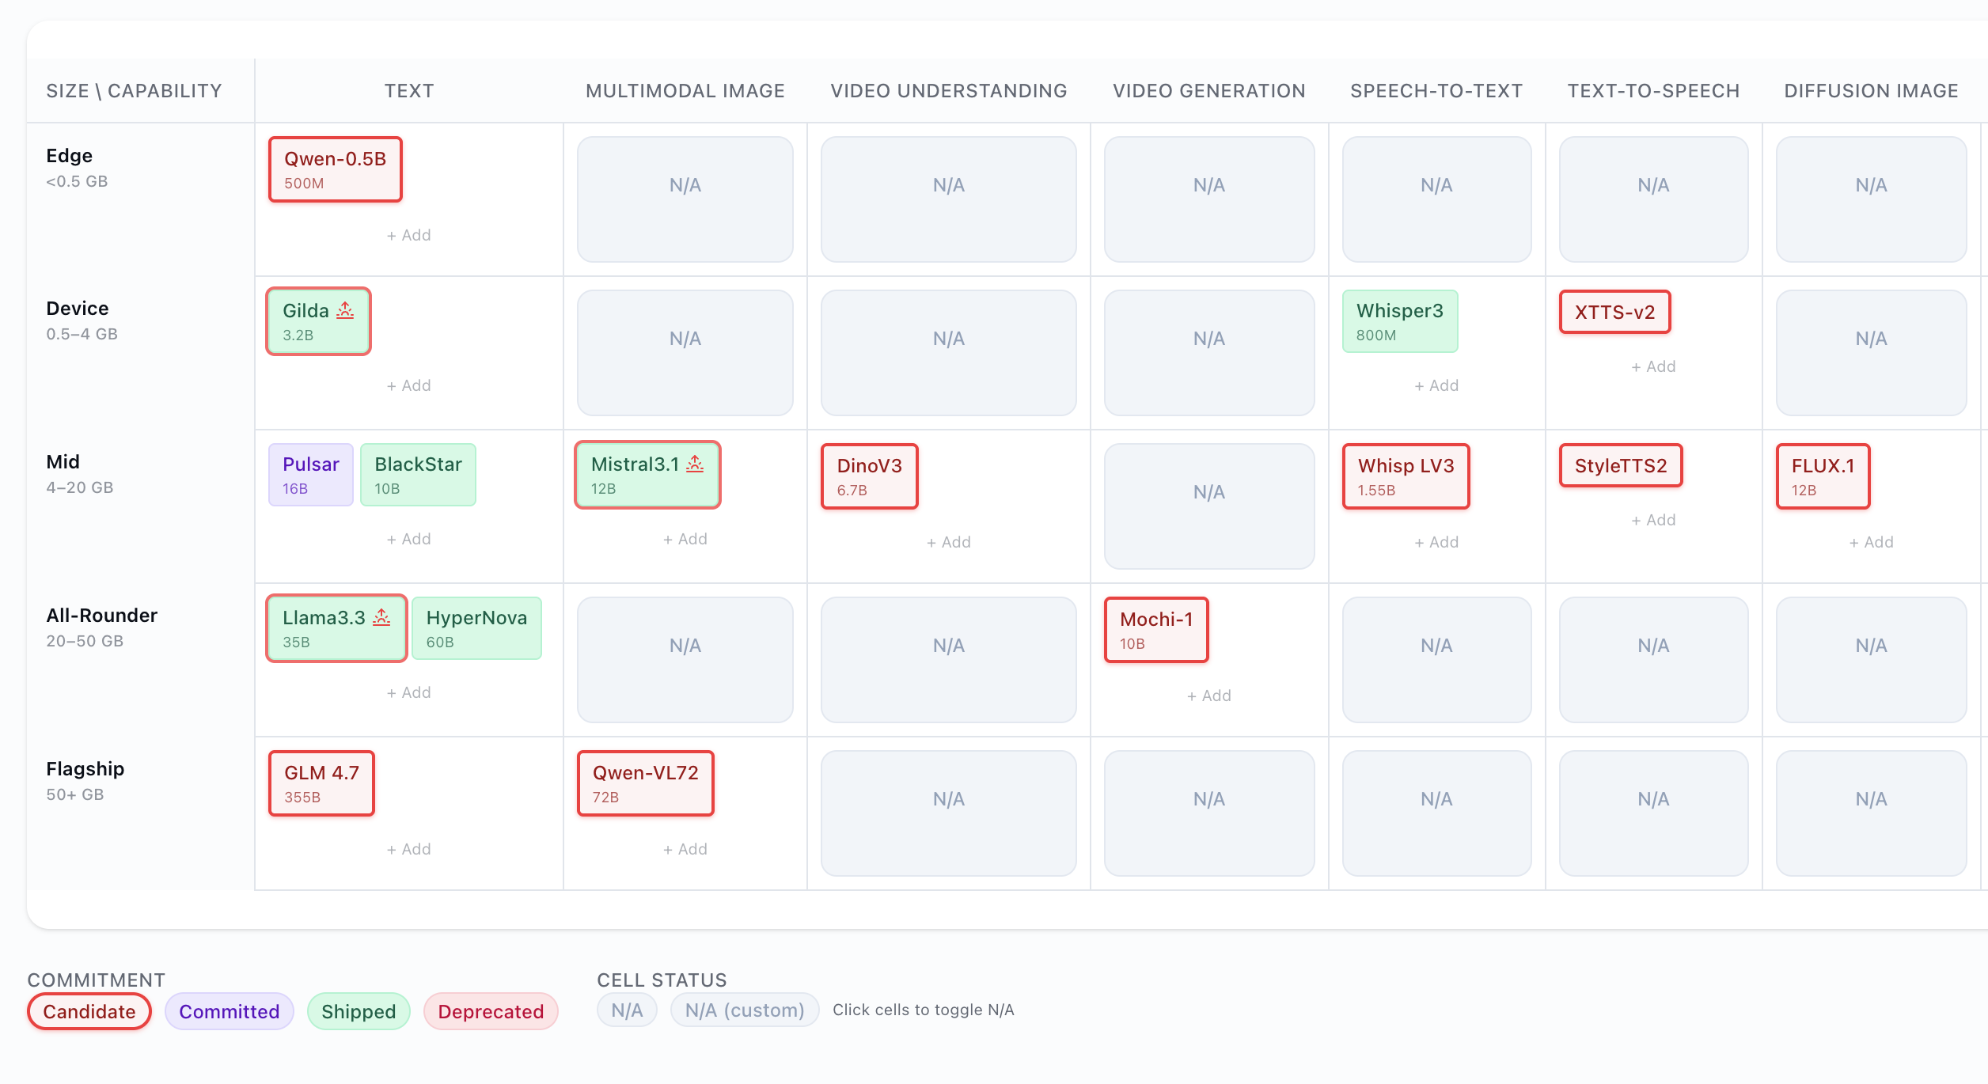
what do we need to do to be successful as a company?
self owned model
large coding model
new versions
etc
Can move approx 20% of this to HPCs

Slide 4
what investment does this represent
how much extra do we need?
what cost? 15M
  2M / text Multiverse original (4)
  0.5M for derivatives (8) & upgrades (6)
proposal: find a commercial contract to match this cost

Slide 5
what custom models does sales need?
currently mobilized
  64 nodes for AWS + HP (compression)
  23 nodes for API (16 active)
blocked: €57M revenue
  whisper, GLM 4.7, nemotron, ...
  also: any specialized models
need: 56 nodes
  demand from sales right now: 120 nodes
  = 7 medium models in parallel
  = 50 custom models in 2026

Slide 6
Proposal
let's be more selective:
  = 4 medium models in parallel
  need: 64 nodes => no need for new GPUs
  need: 23 nodes for API => no need for new GPUs

Slide 7
Conclusion
2026 GPU commit needed: 15M / year
Need sales to secure a commercial contract to match this

Slide 8
Q&A
How frequently are we renewing our models?
2x upgrades per year
which models are multiverse original?
all of them
need to build the technology to generate a new embedding
how much overlap between what sales will ask us to do & our portfolio roadmap
what cost? 15M
2M / text Multiverse original (4)
0.5M for derivatives (8) & upgrades (6)

Slide 9
include this spend into projected GPU spend
current process
sales secures opportunity
sales get budget approved for GPUs (on demand)
make some projections
how much are we spending on this this year?
what would be the cost (and savings) for GPUs if we commit?

