Slide 1


Building Web Apps with Blazor
Sam Nasr, MCSA, MVP NIS Technologies August 15, 2019

Slide 2



General Info
Bathrooms: end of hallway, on right side
Participation is encouraged
Please mute cell phones

Slide 3



Cleveland C#/VB.Net User Group
Meets every month
Free of charge , open to the public
Meeting info: https://www.meetup.com
Meeting Space courtesy of
Pizza and drinks courtesy of

Slide 4

Introduction
Sam Nasr (@SamNasr)
Software Developer since 1995
Sr. Software Engineer (NIS Technologies)
Certifications: MCSA, MCAD, MCT, MCTS
President - Cleveland C#/VB.Net User Group
President - .Net Study Group
Author for Visual Studio Magazine
Microsoft Most Valuable Professional (since 2013)

Slide 5
What is Blazor?
Blazor is a web UI framework based on C#, Razor, HTML
Used to build composable web UI.
Browser + Razor = Blazor!
Runs .NET assemblies in the browser via WebAssembly based .NET runtime
Built on Xamarin team’s plans to bring Mono to the web using WebAssembly.
Notes:
Mono: .NET Runtime

Slide 6
What is WebAssembly (WASM)?
Low-level assembly-like language with a compact binary format that runs in the browser
Provides near-native performance
Provides 3GL languages (C/C++, C#) with a compilation target so that they can run on the web.
Designed to run alongside JavaScript.
WebAssembly JavaScript APIs can load WebAssembly modules into a JavaScript app
Notes:
.CPP => .WAT => .WASM(Byte code)
https://mbebenita.github.io/WasmExplorer/

Slide 7

WASM Browser Support

Slide 8
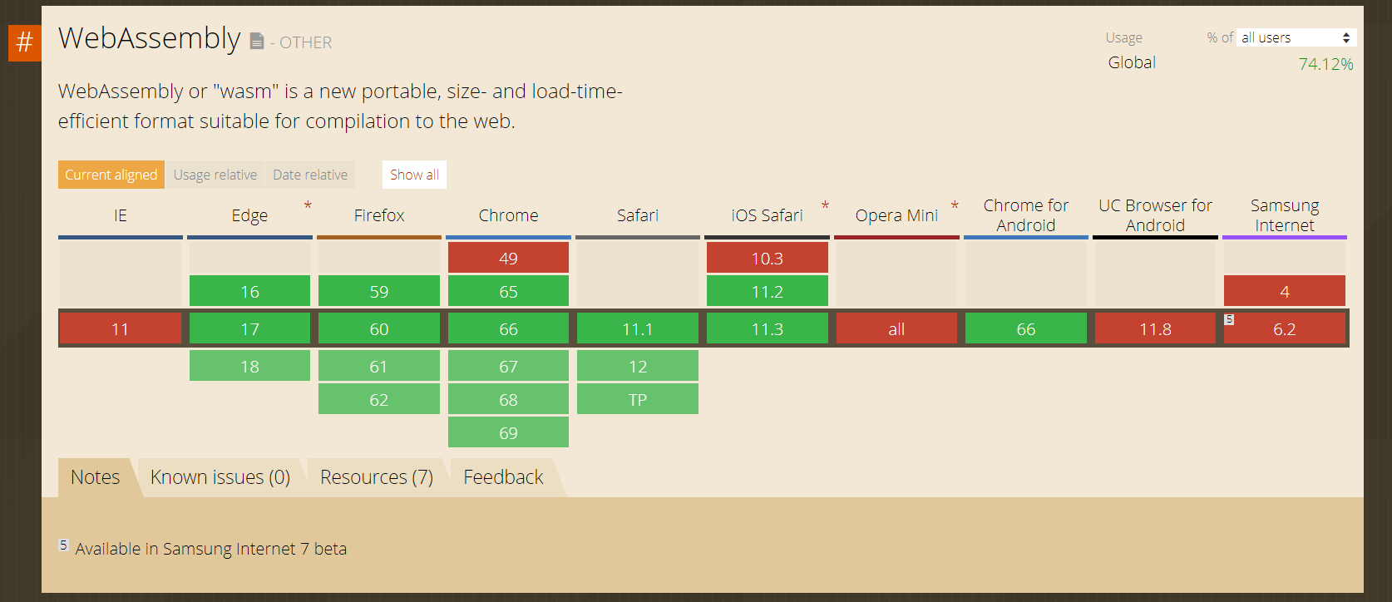
WebAssembly Support
Source: https://caniuse.com/#feat=wasm

Slide 9
What Blazor is NOT?
Not a way of deploying UWP/Xamarin apps in the browser
Not a Plug-in
Not a rebirth of Silverlight
Not a new version of defunct Script#
Not a transpilor
Not to be mistaken for “Blazer” (web browser for Palm handhelds)
Notes:
Blazor runs normal .NET assemblies in the browser using a WebAssembly based .NET runtime without any plugins or transpilation.
Transpilor: source-to-source compiler

Slide 10
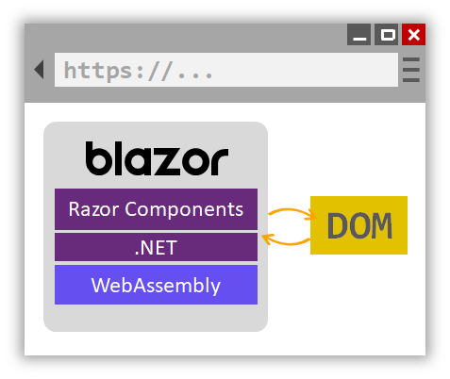
Blazor

Slide 11


Blazor Advantages

Slide 12
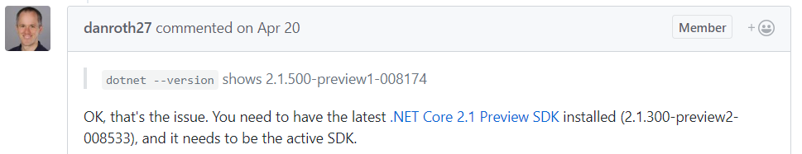
System Requirements
.NET Core 2.1 Preview 1 SDK (2.1.300-preview2-008533 active SDK)
Visual Studio 2017 (15.7 or later)
“ASP.NET Core Blazor Language Services extension”
Notes:
.NET Core 2.1 Preview 1 SDK from here.
Visual Studio 2017 (15.7 or later) from here.
“ASP.NET Core Blazor Language Services extension” from here.

Slide 13
System Requirements
Visual Studio 2019 Preview with the ASP.NET and web development workload
.NET Core SDK 3.0 Preview
Install the latest Blazor Language Services extension from the Visual Studio Marketplace.
  OR
  dotnet new -i Microsoft.AspNetCore.Blazor.Templates::0.9.0-preview3-19154-02

Slide 14
Demo
Demo #1

Slide 15
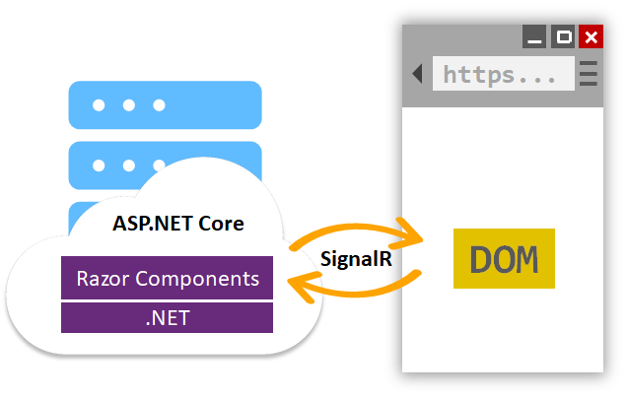
Blazor - DOM

Slide 16
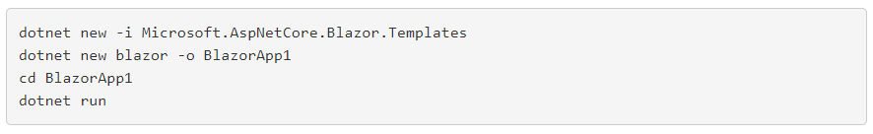
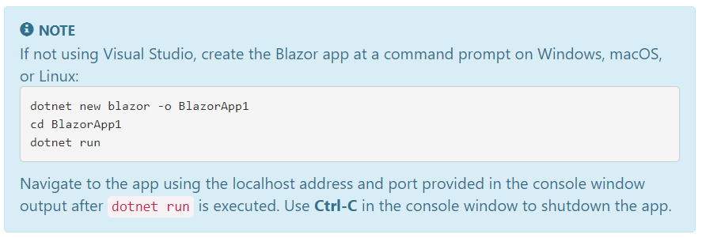
.NET Command Line Tools

Slide 17
FAQ
Is the total .NET standard 2.0 api supported? Things like TCP/UDP sockets, etc.?
Yes, .NET Standard 2.0 will be supported, but with some browser specific limitations. For example, you can’t open a TCP socket in the browser, so the related APIs would through PlatformNotSupportedExceptions.
Does Blazor compile my entire .NET-based app to WebAssembly?
No, only the .NET runtime itself is compiled to WebAssembly.
Can components be created/integrated into existing asp.net mvc 5 project?
Blazor itself has no coupling to any particular backend. Think of Blazor like you would any other client-side JavaScript framework, like Angular or React, but written in .NET.
Notes:
Can components be created/integrated into existing asp.net mvc 5 project?
Blazor itself has no coupling to any particular backend. Think of Blazor like you would any other client-side JavaScript framework, like Angular or React, but written in .NET. You can write your server pieces using whatever framework or language you want. You could write your server-side logic using ASP.NET MVC or ASP.NET Web API or really anything for that matter (Node, Python, PHP, etc). That said, we provide some nice integration with ASP.NET Core that makes it really easy to host Blazor apps with an ASP.NET Core backend. That’s what the “Blazor (ASP.NET Core hosted)” template sets up for you.

Slide 18
Questions?
Q&A

Slide 19

Recap

Slide 20
References
Getting Started with Blazor
https://docs.microsoft.com/en-us/aspnet/core/client-side/spa/blazor/get-started?view=aspnetcore-3.0&tabs=visual-studio
Blazor
https://blazor.net/

Slide 21

Consulting Education Custom Apps

Slide 22
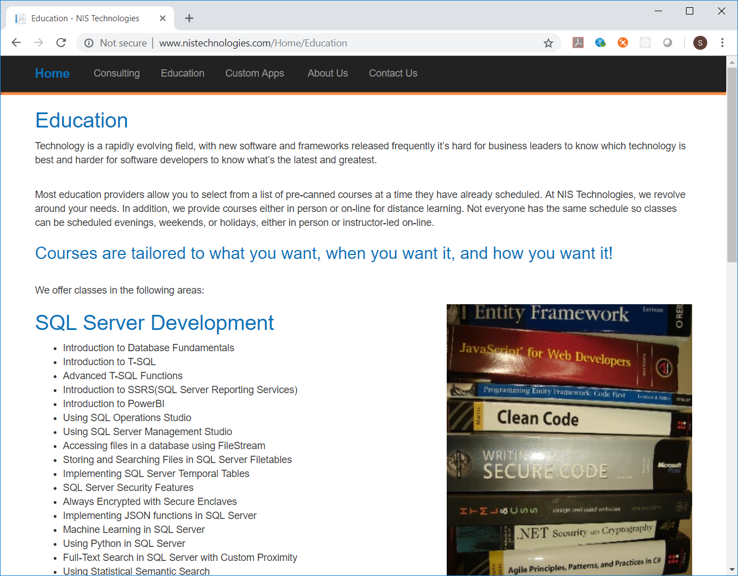

Slide 23

Contact Info
  snasr@nistechnologies.com
@SamNasr
http://www.linkedin.com/in/samsnasr
Thank you for attending!

