Slide 1


Using FileTables
Sam Nasr, MCSA NIS Technologies August 3, 2019

Slide 2
About Me
Sam Nasr (@SamNasr)
Software Developer since 1995
Sr. Software Engineer (NIS Technologies)
Certifications: MCSA, MCAD, MCT, MCTS
President - Cleveland C#/VB.Net User Group
President - .Net Study Group
Author for Visual Studio Magazine
5x Microsoft Most Valuable Professional

Slide 3



General Info
Down the hall (right side)
Participation is encouraged
Please mute cell phones

Slide 4

Cleveland C#/VB.Net User Group
Meets every month
Free of charge , open to the public
All topics related to .Net
Meeting info: https://www.meetup.com/Cleveland-C-VB-Net-User-Group/

Slide 5
What is a FileTable?
A table containing meta data on files in a specific directory
Table type with predefined schema
Utilizes FileStream feature and HierarchyID data type
Uses share specified in FileStream

Slide 6
FileTable Contents
Every row represents a file or a directory.
A FILESTREAM column for stream data and a file_id (GUID) identifier.
path_locator and parent_path_locator columns represent file/directory hierarchy.
10 file attributes
A type column that supports full-text search and semantic search over files and documents.

Slide 7
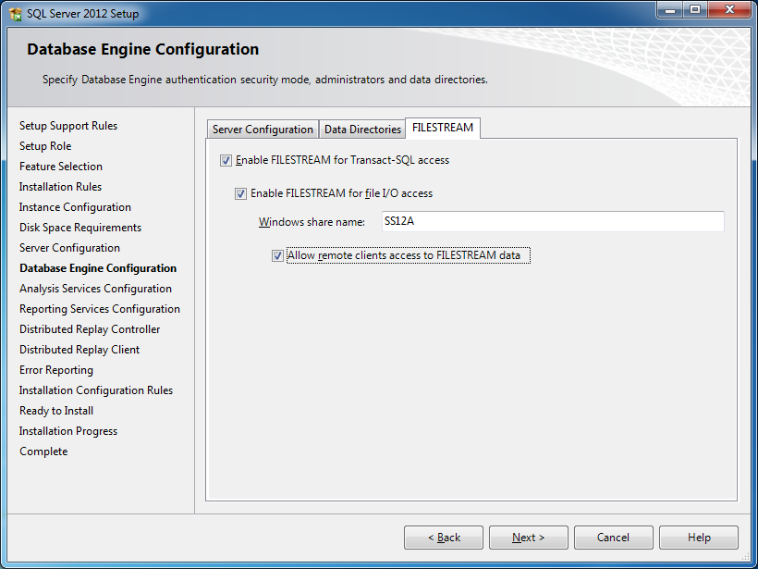
Enabling FileStream
Machine level
During installation

Slide 8
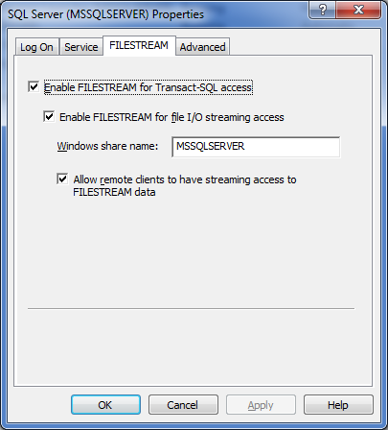
Enabling FileStream
Machine level
SQL Server Config Mgr
  SQL Server Services >
  SQL Server (MSSQLSERVER)

Slide 9
Enabling FileStream
Server Instance
Server Properties | “Advanced”
Stored Procedure
      EXEC sp_configure filestream_access_level, n
      RECONFIGURE
      n=0: disabled FileStream completely
      n=1: enabled for T-SQL access only
      n=2: enabled for full access (remote file streaming)

Slide 10
Streaming BLOBs
OpenSqlFileStream - native client API
GET_FILESTREAM_TRANSACTION_CONTEXT
  Returns a token that represents the current transaction context of a session.
UNC Path

Slide 11
Hierarchy ID
System Data Type
Variable length
Enables hierarchal representation of a tree
Use ToString() to convert hierarchyid to nvarchar(4000) data type.

Slide 12
Hierarchyid Method Reference
GetAncestor
GetDescendant
GetLevel
GetRoot
IsDescendantOf
Parse
Read
GetReparentedValue
ToString
Write

Slide 13
Enabling FileTable
Enable FILESTREAM at the Instance Level
Provide a FILESTREAM Filegroup
Enable Non-Transactional Access at the Database Level
Specify a Directory for FileTables at the Database Level

Slide 14
Demo
FileTables

Slide 15
Disable FileTable
Columns and data are not physically dropped from the table.
Files and sub-directories disappear from the file system and are not available for file i/o access.
Enforcement of all semantics stops after the FileTable namespace is disabled.
Notes:
FileTable columns and data are not physically dropped from the table.
The FileTable directory and the files and directories that it contains disappear from the file system and are not available for file i/o access.
System-defined FileTable columns cannot be dropped and recreated; otherwise, however, they behave like ordinary columns for DML operations.
Open file handles prevent the FileTable constraints from being disabled, since this operation requires a schema lock on the table.
Enforcement of all the FileTable semantics, including system-defined constraints and triggers, stops after the FileTable namespace is disabled.
--Disable
ALTER TABLE CarsDocStore
DISABLE CarsDocStoreSPACE;
GO

Slide 16
Re-enable FileTable
If inconsistencies are found, then an error is raised and the FileTable remains disabled;
If no inconsistencies are found, the FileTable is re-enabled.
Files and sub-directories become visible in the file system and become available for file i/o access.
The enforcement of FileTable semantics is restored.

Slide 17
Restrictions
Cannot change, drop, or disable the system-defined columns of a FileTable.
Cannot add new user columns, computed columns, or persisted computed columns to a FileTable.

Slide 18
Demo

Slide 19

Recap

Slide 20
Recap
A table containing meta data on files in a specific directory
Uses share specified in FileStream
Enabling FileTables
Enable FILESTREAM at the Instance Level
Provide a FILESTREAM Filegroup
Enable Non-Transactional Access at the Database Level
Specify a Directory for FileTables at the Database Level

Slide 21
Resources
FileTables
  https://docs.microsoft.com/en-us/sql/relational-databases/blob/filetables-sql-server?view=sql-server-2017
Create, Alter, and Drop FileTables
  https://docs.microsoft.com/en-us/sql/relational-databases/blob/create-alter-and-drop-filetables?view=sql-server-2017
Using FileTables & Demo
  https://visualstudiomagazine.com/articles/2012/10/25/using-filetables-in-sql-2012.aspx

Slide 22

Consulting Education Custom Apps

Slide 23
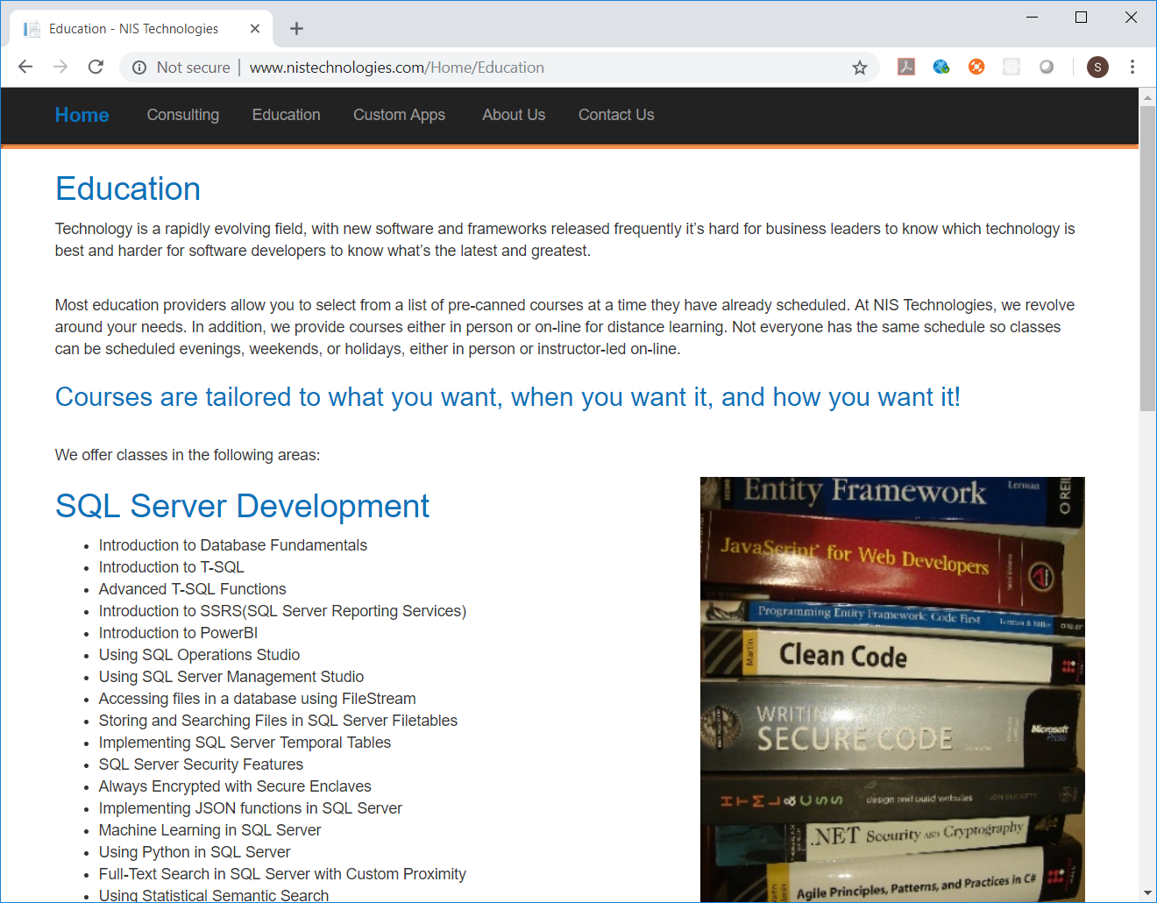

Slide 24

Contact Info
  snasr@nistechnologies.com
@SamNasr
http://www.linkedin.com/in/samsnasr
Thank you for attending!

