Slide 1


Features in SSRS 2017
Sam Nasr, MCSA NIS Technologies August 17, 2019

Slide 2

Cleveland C#/VB.Net User Group
Meets every month
Free of charge , open to the public
All topics related to .Net
Meeting info: https://www.meetup.com/Cleveland-C-VB-Net-User-Group/

Slide 3



Sponsors
Meeting Space courtesy of
Pizza and drinks courtesy of
Prizes courtesy of
Web Hosting courtesy of

Slide 4



General Info
End of hallway (left side)
Participation is encouraged
Please mute cell phones

Slide 5
About Me
Sam Nasr (@SamNasr)
Software Developer since 1995
Sr. Software Engineer (NIS Technologies)
Certifications: MCSA, MCAD, MCT, MCTS
President - Cleveland C#/VB.Net User Group
President - .Net Study Group
Author for Visual Studio Magazine
5x MVP (Microsoft Most Valuable Professional)

Slide 6
Agenda
Web Portal
  Comments
  Attachments
  Menu Bar
  PowerPoint Rendering and Export
  Branding Web Portal
  KPI
API
Mobile Report Builder

Slide 7
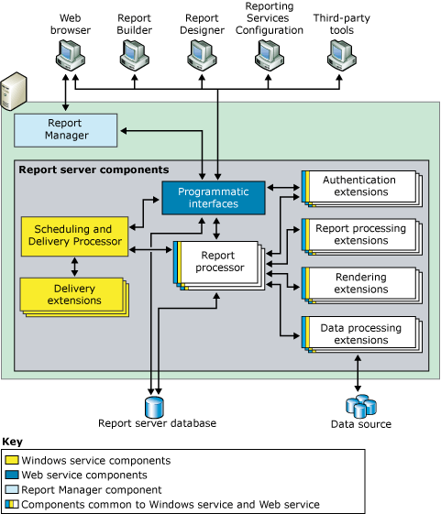
SSRS Architecture

Slide 8
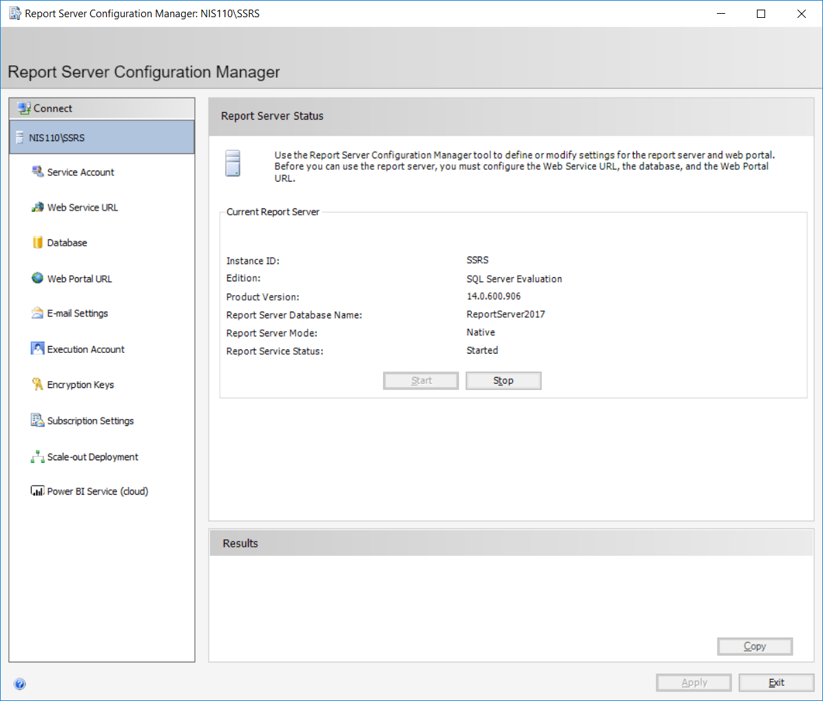
Report Server Config Mgr

Slide 9
Report Lifecycle
Authoring: Creating the report
Managing: Access rights
Delivery: Making the reports accessible

Slide 10
SSRS Architecture

Slide 11
Report Designer (SSDT)
Reports and related items organized in one container.
Test report solutions locally.
Deploy related items together.
Use project properties/config management to deploy to multiple environments.
Preserve a set of master copies for reports and related items.

Slide 12
Web Portal
Favorites/Browse Views
View, search, print, and subscribe to reports.
Create, secure, and maintain the folder hierarchy
Role-based security for item access and operations

Slide 13
Web Portal
Report execution properties, report history, and parameters
Create shared schedules and shared data sources
Data-driven subscriptions that role out reports to recipients
Linked reports to reuse existing reports

Slide 14
Web Portal Branding
Metadata.xml: Definition of contents
  colors.json: using LESS base style
  Image File (optional)
    jpg, jpeg, jpe, wav, bmp, pdf, img, gif, json, mp4, web, png

Slide 15
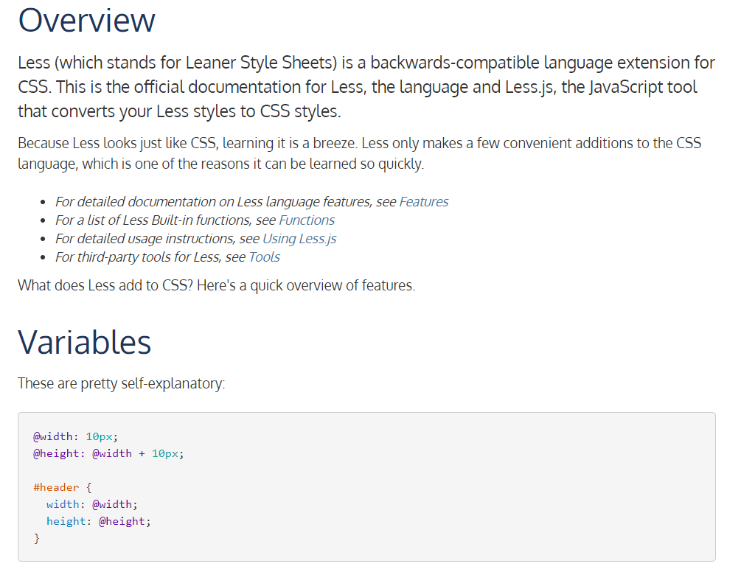
Colors.JSON
Use LESS base style: http://lesscss.org/

Slide 16
Colors.JSON
interface: items specific to reporting portal
  Primary Section – button colors, hover colors
  Secondary Section – title bar color, search bar, the left-hand menu, text color.
  Neutral Primary – Home background, Reports Area background
  Neutral Secondary – Text Box background, Folder Options background, Settings Menu
  Neutral Tertiary – Site Settings backgrounds
  Danger/Warning/Success Messages
  KPI colors (Good – Green, Bad – Red, Neutral – Orange, None – Black)
  theme: items specific to Mobile reports

Slide 17
REST APIs
Fully OpenAPI compliant RESTful APIs (+ 2010 SOAP WS)
Full programmatic access to portal items
  Download/upload
  Folder navigation
  Update cache
Base URL: http://server_name/reports/api/v2.0
API spec at SwaggerHub:
https://app.swaggerhub.com/apis/microsoft-rs/SSRS/2.0
Notes:
ReportService2005 and ReportService2006 endpoints are deprecated in SQL Server 2008 R2.
ReportService2010 endpoint includes the functionalities of both endpoints and contains additional management features.
https://docs.microsoft.com/en-us/sql/reporting-services/report-server-web-service/accessing-the-soap-api?view=sql-server-2017

Slide 18
Demo

Slide 19
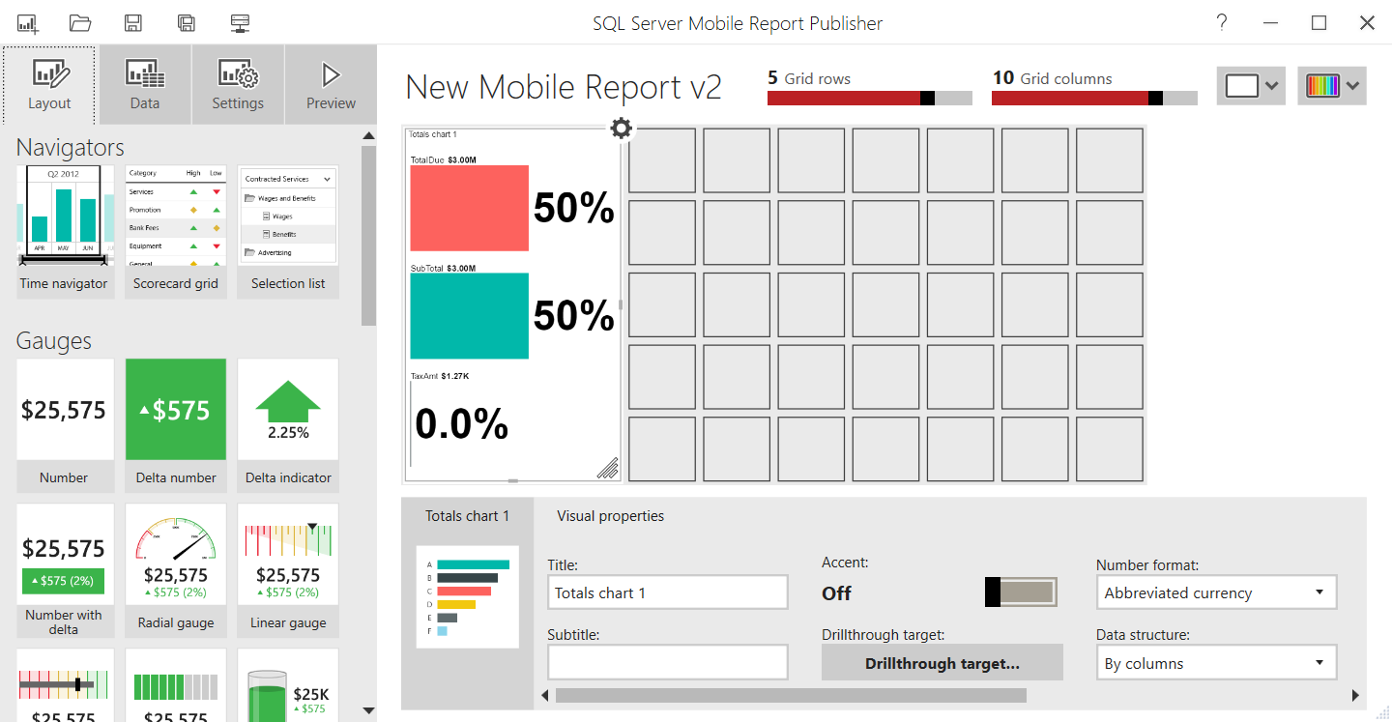
Mobile Report Builder

Slide 20
Gotchas
KPI cache longer than settings at times https://www.mssqltips.com/sqlservertip/4461/refresh-the-data-for-a-kpi-in-sql-server-reporting-services-2016/
Compilation errors with SwaggerHub demo code.
Removing SSRS automatically removes SSDT
SSRS Services may stop on OS Updates

Slide 21

Recap

Slide 22
Recap
Web Portal
  Comments
  Attachments
  Menu Bar
  PowerPoint Rendering and Export
  Branding Web Portal
  KPI
API
Mobile Report Builder

Slide 23
Resources
What’s new in SSRS 2017
https://docs.microsoft.com/en-us/sql/reporting-services/what-s-new-in-sql-server-reporting-services-ssrs?view=sql-server-2017
Rest APIs:
https://app.swaggerhub.com/apis/microsoft-rs/SSRS/2.0
Tutorials:
https://docs.microsoft.com/en-us/sql/reporting-services/reporting-services-tutorials-ssrs?view=sql-server-2017

Slide 24

Consulting Education Custom Apps
www.nistechnologies.com

Slide 25
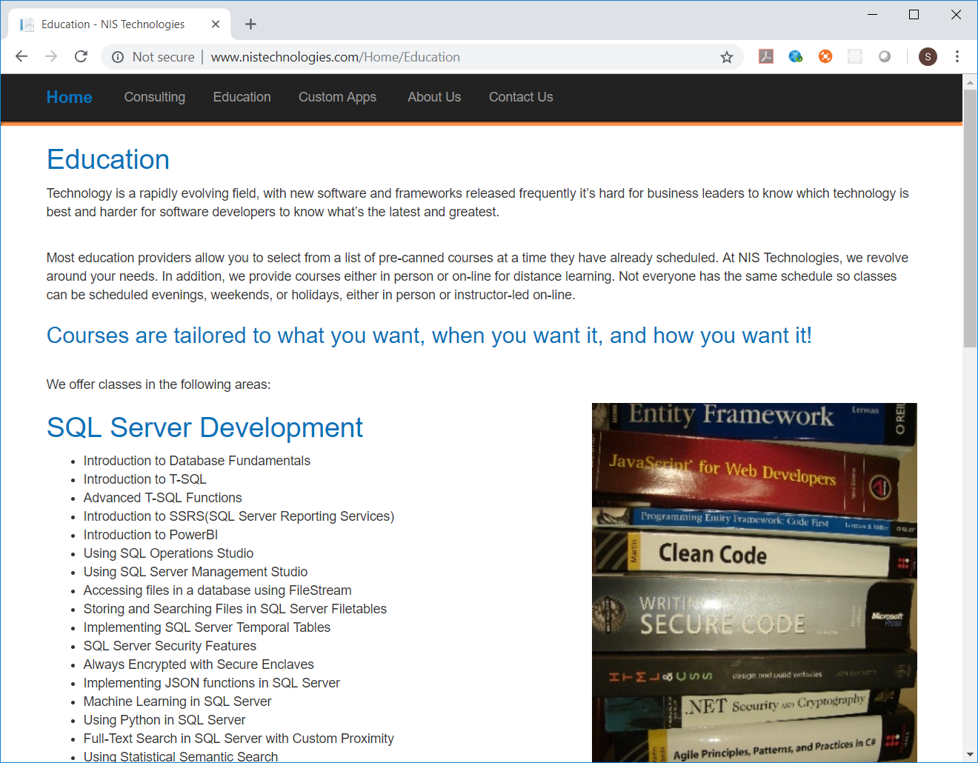

Slide 26

Contact Info
  snasr@nistechnologies.com
@SamNasr
http://www.linkedin.com/in/samsnasr
Thank you for attending!

