Slide 1
Improve Productivity with Git
By Sam Ni

Slide 2
Agenda
Connect Git to Stash and Shortcuts
Knowing to Git
Work with Git
Q&A

Slide 3
Connect Git to Stash and Shortcuts
SSH-Keygen
Ssh-keygen –t rsa –C sam.ni@jda.com
Add id_rsa.pub to stash
Shortcuts
Paste these alias to file “GitHome/etc/profile”
alias c="clear"
alias sl="git log --oneline "
alias lb="git branch"
alias lba="git branch -a"
alias lrg="git ls-remote | grep -i "
alias slg="git log --oneline --graph"
alias cm="git commit -m"
alias s="git show"
alias sp="git show --word-diff=porcelain"
alias f="git fetch -p"
alias p="git pull"
alias df="git diff“
…
Note: need to define environment var for “term=xterm” to get git display colorful output.

Slide 4
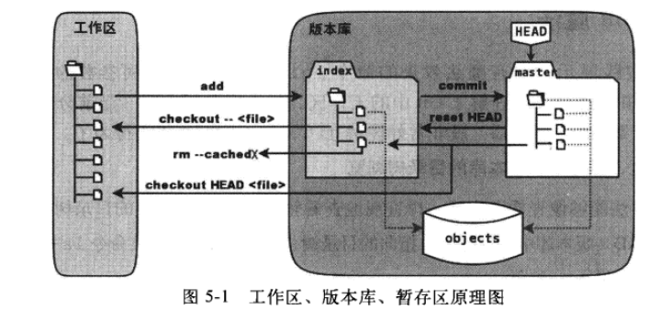
Knowing to Git
Working directory, Staging area, and repository

Slide 5
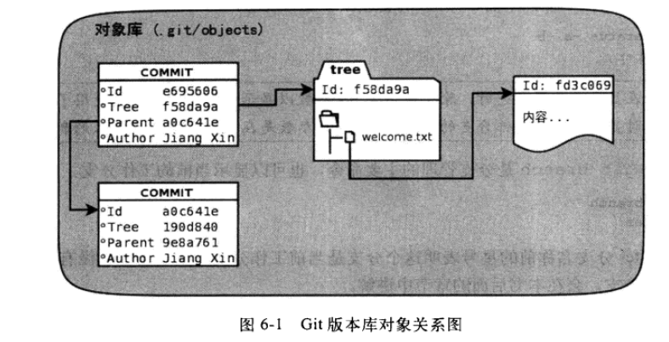
Knowing to Git
.git/Objects

Slide 6
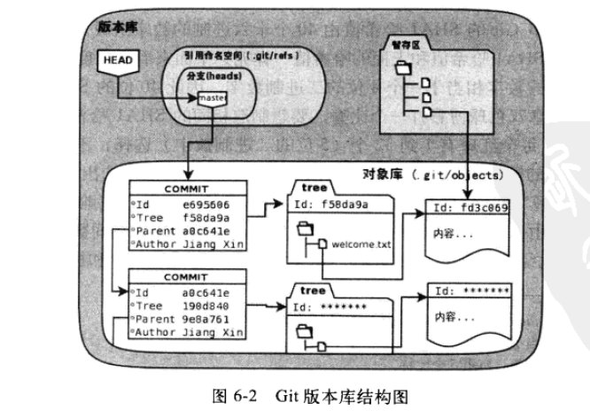
Knowing to Git
.git

Slide 7
Knowing to Git
What is HEAD, master and index?
.git/HEAD
ref: refs/heads/master
.git/refs/heads/master
f1177479c70b56837afd50a6c05a747ea8bc3255
.git/Index
What does HEAD^ and HEAD~n mean?

Slide 8
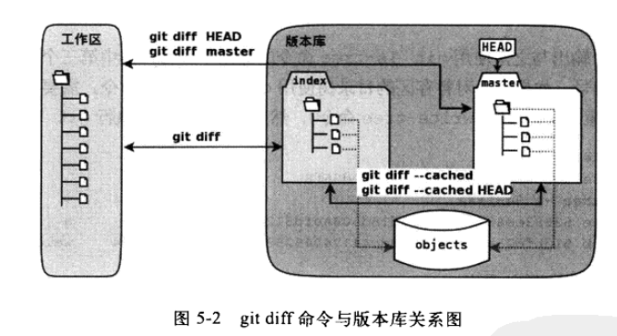
Knowing to Git
Git diff

Slide 9
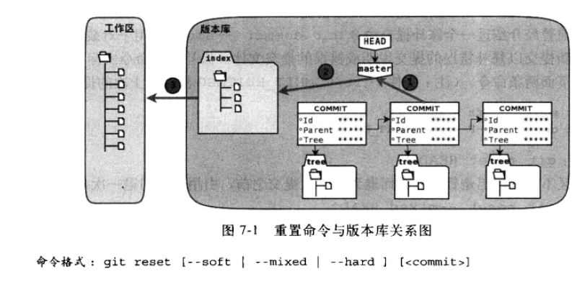
Knowing to Git
Git reset

Slide 10
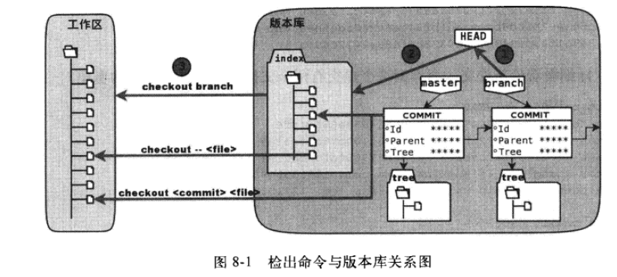
Knowing to Git
Git checkout

Slide 11
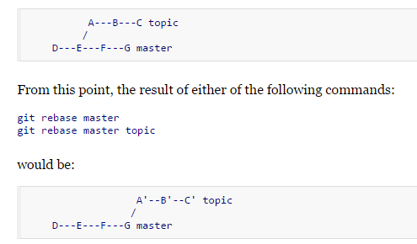
Knowing to Git
Git rebase

Slide 12
Knowing to Git
Git stash(save your work temporary and clean work directory)
.git/refs/stash
Git reflog(find lost commit)
.git\logs\refs\heads\master

Slide 13
Work with Git
Git log: alias(sl, slg)
Git status: alias(ss)
Git show: alias (s)
Git add: alias(au)
Git ls-files: alias(lf)
Git branch: alias(lb, lba,gpb)
Git blame: alias(blm)
Git commit: alias(cm)
Git checkout: alias(co)
Git diff: alias(df,dfc)
Git grep: alias(gp)
Git merge:alias(mg)
Git fetch:alias(f)
Git pull:alias(p)
Git push origin :alias(po)
Git cherry-pick:alias(chp)
Another useful script for formating patch:
alias fp='perl -i.bak -pe "s/(if|for|while)\(/\1 \(/ if/^\+/;
s/(?<! )(?<!<)(?<!>)(?<!-)(?<!=)(?<!!)(==|<|>)/ \1/g if/^\+\s*(else)?\s*if/;
s/(==|<|>)(?! )(?<!<)(?<!>)(?!-)(?!=)(?!!)/\1 /g if/^\+\s*(else)?\s*if/;
s/\)\{/\) \{/g if/^\+/;
s/\t/ /g if/^\+/;
s/[ ]+(?=\r|\n)// if /^\+/;
" '

Slide 14
Q&A
Thank you.
04/12/2015

