Slide 1
Introduction to Artificial Intelligence Course Project Introduction
October 9, 2025

Slide 2
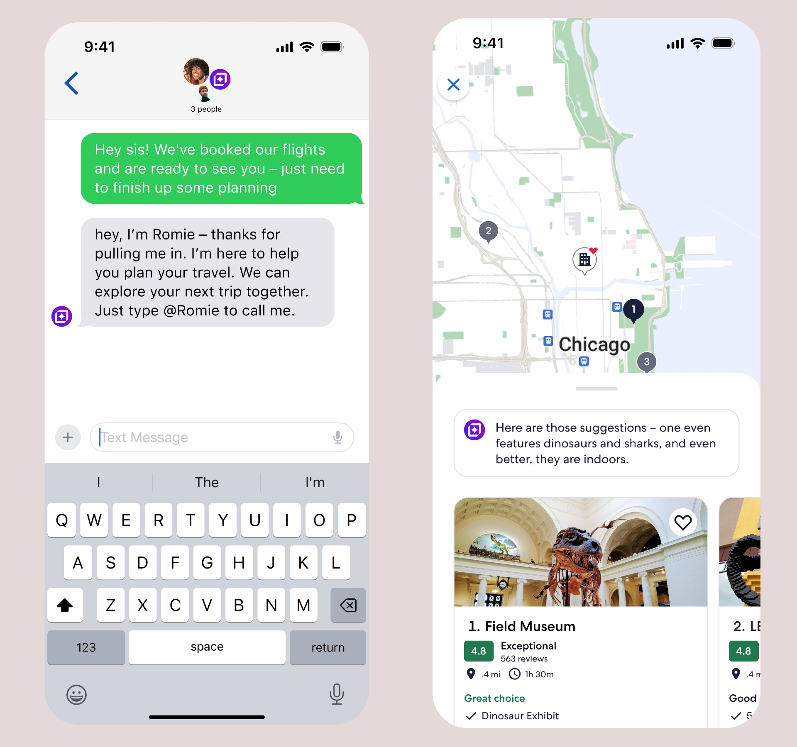
Examples of AI Agents
AI agents are software systems that use AI models to complete tasks on behalf of humans.
Example: Travel assistant agent
Tasks: Help users plan trips.
Inputs: User’s request, such as “Find me a 5-day trip to Chicago under $1500”)
Flight and hotel data, weather, visa rules.
Actions: Search flights and hotels, compare prices, and book reservations.

Slide 3
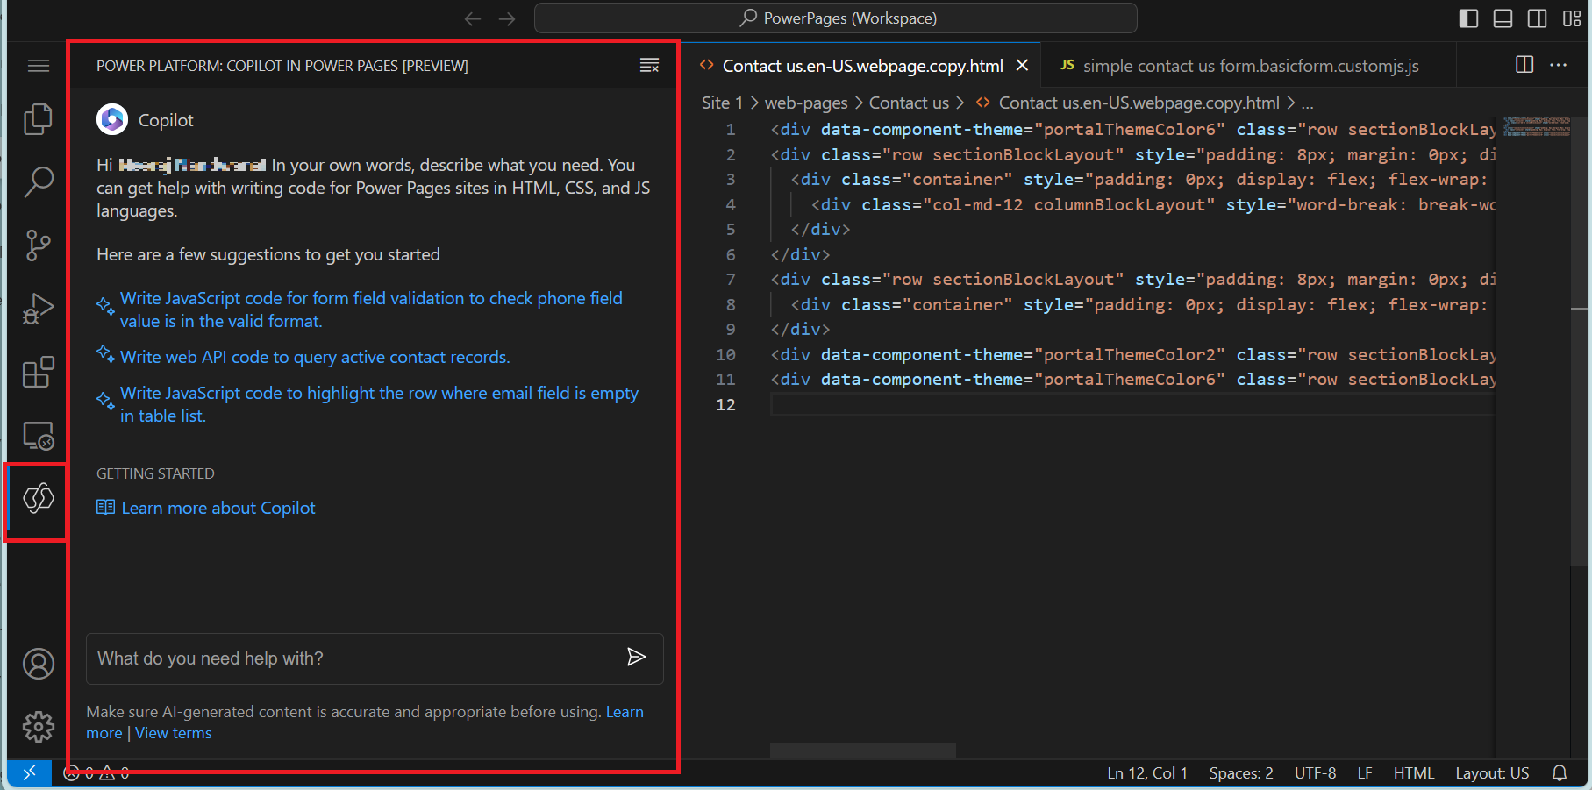
Examples of AI Agents
Example: Software engineering agent
Tasks: Assist with programming-related activities such as generating code snippets and suggesting fixes
Inputs: A codebase, error messages, project requirements, and version control data
Actions: Analyzing the code, detecting issues, proposing corrections, and generating new functions

Slide 4
A Project Example
We provide an example of an agent system that uses a GPT-style language model to retrieve information from a database.
In this example, we will walk through and implement the following.
A search method that, given an input query, retrieves the most relevant documents from a database.
Prompting strategies that guide language models to generate actions for solving a task.
Loading and using GPT-style language models to produce outputs that follow a defined format.
Building an agent system capable of performing database retrieval by combining the components.

Slide 5
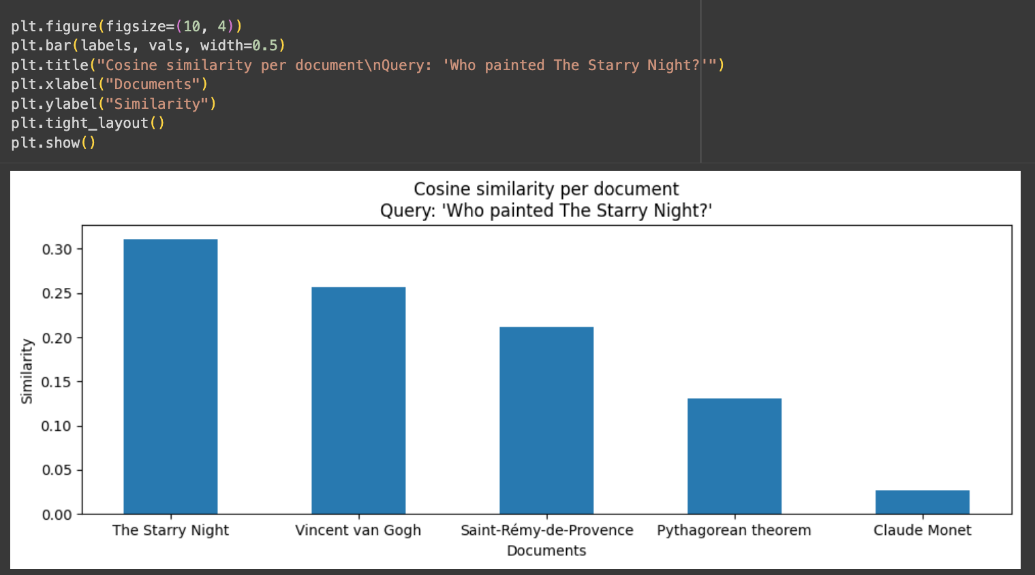
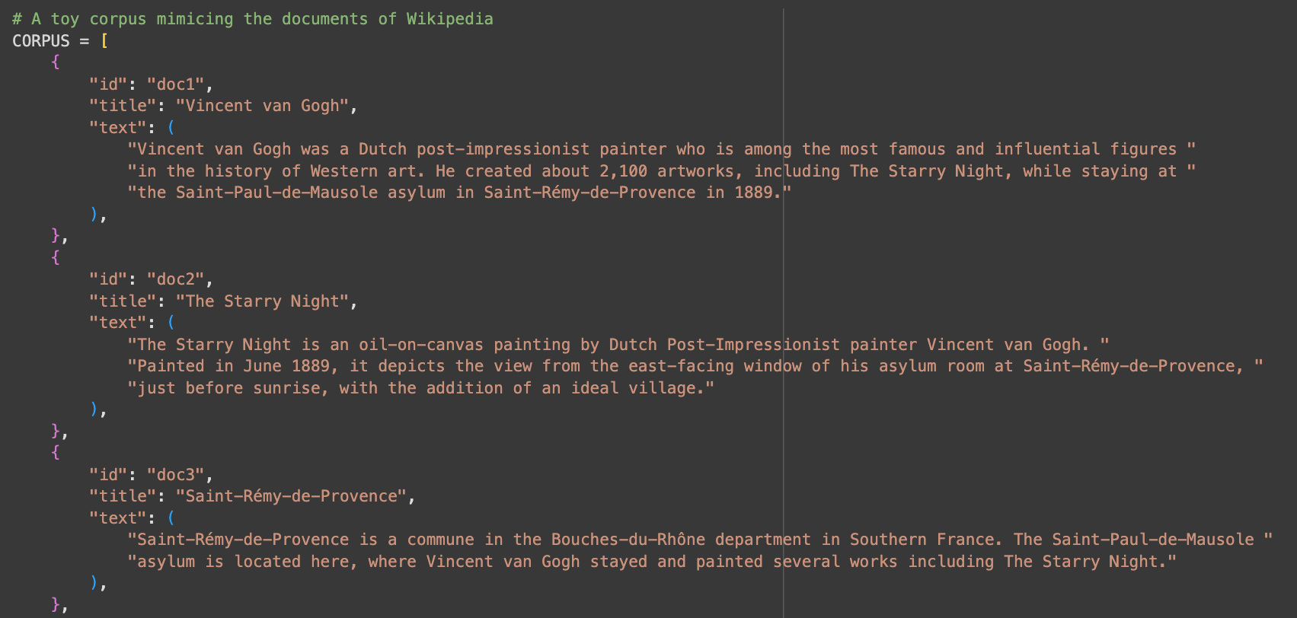
1. Set up the Knowledge Base and Search Methods
In the example project, we will begin with a small corpus of a dataset as an example and build a search method that finds the most related document given an input query.
First, we define a small Wikipedia-style corpus as our knowledge base
Second, we will implement a search method to find the most relevant documents based on a query

Slide 6
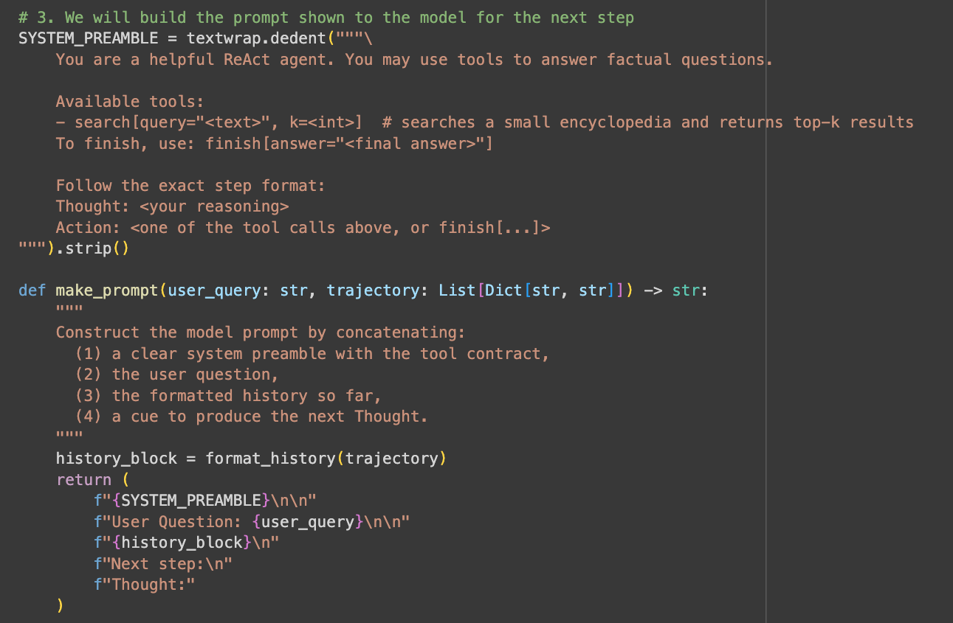
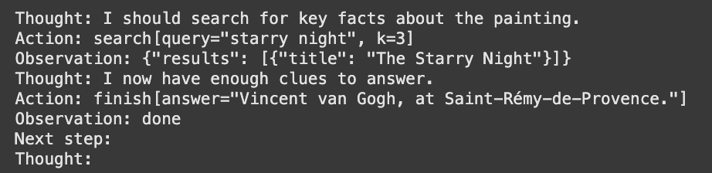
2. Designing Prompting Techniques
In the second step, we will build prompting techniques, which prompt a language model to generate thoughts with actions based on input queries.
We will implement a few functions to format prompts for language models
An example of prompt for language models

Slide 7
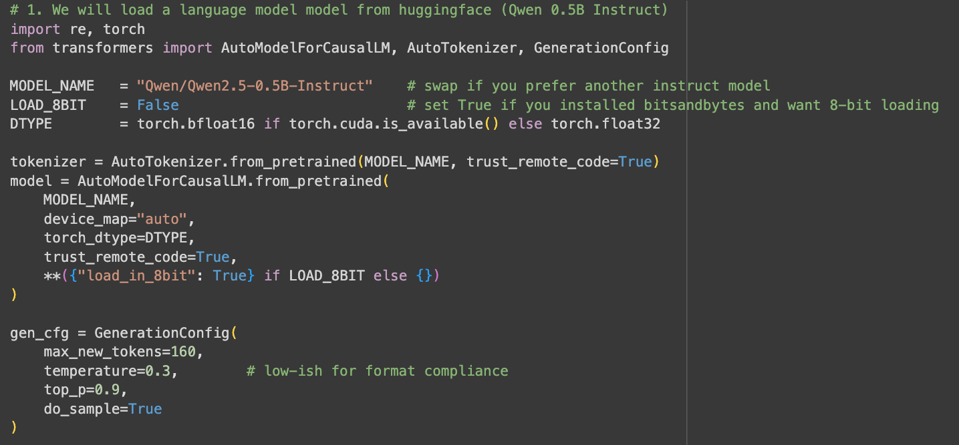
3. Building a Language Model Interface
Next, we will load a language model as the base model for the agent system.
We will define the interaction between the language model and the knowledge base/external tools, using the defined prompting format.
We will learn to use pretrained language models from the Huggingface website.

Slide 8
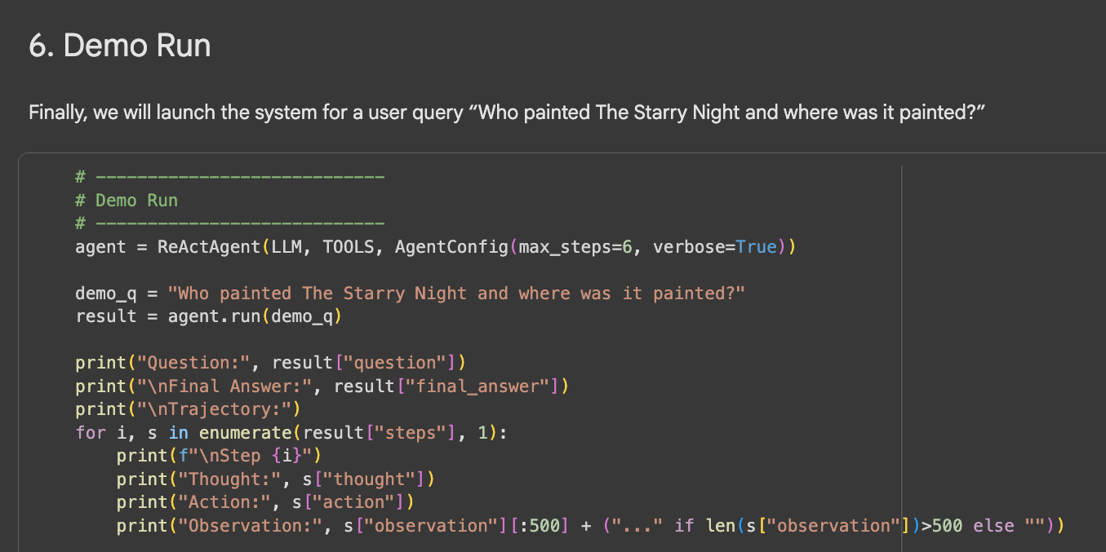
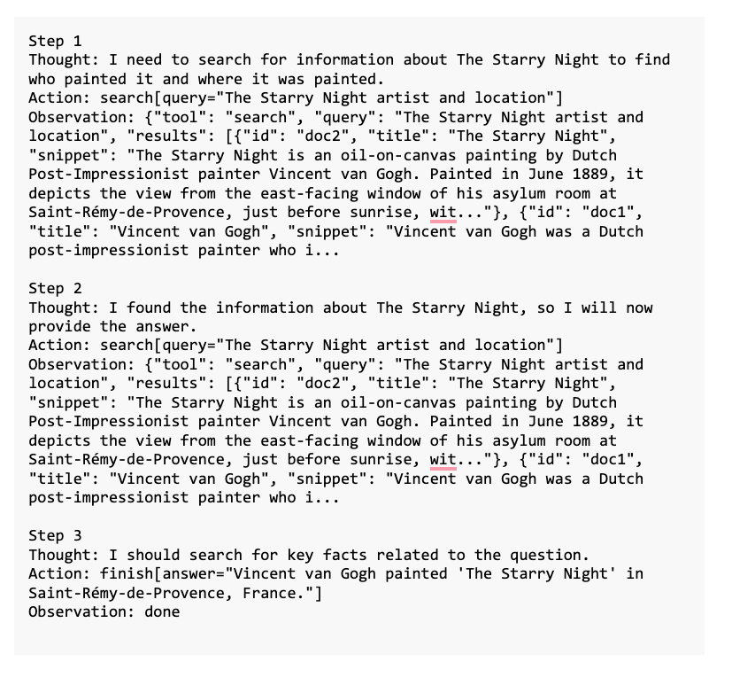
4: Integrating Components into an Agent System
Finally, we will put everything together as an agent system, including the external database, the information search tools, and a base language model.
After this step, we can create a small demo to run the agent system.

Slide 9
Extension of the Project
We provide possible directions for further development of the project.
Extend the knowledge base: One can wire the agent to a larger data source, such as search engine APIs, a structured database
Extend the abilities of the system: One can define more actions or tools besides search, such as translation or summarization tools.
Improving reasoning capabilities of the model: One can design more performant prompting techniques or explore fine-tuning the model.

