Slide 1
Docker + Kubernetes
A quick overview/tutorial for docker and kubernetes
Tpt – Sam Oh
Notes:
Today I will provide a high level overview of both Docker and Kubernetes. Before I start, I’d like to lay out the exact goals I have for this presentation. By the end of this presentation, I’d like you to have a conceptual understanding of both Docker and Kubernetes and the importance of both. I also want to empower you by giving enough of a basic understanding of how each actually works so that you can dive in and learn more yourselves. And with that, I’ll get started. (lmk if the goals are accomplished by the end)

Slide 2
Setup/Overview
Please download https://github.jpl.nasa.gov/TPT/docker-kubernetes-sample
All slides (in note form) are here. Also the tools to get started for writing your own Dockerfile/manifest files for Kubernetes are here
The layout of this presentation is as follows
1. High level overview of Docker
Hands-on tutorial of Docker
2. High level overview of Kubernetes
Minikube
3. Tutorial of Kubernetes
Notes:
First, I hope you have already downloaded your code, if not please do so now. **Have github opened on separate page and briefly explain basic idea of tutorial/notes and answers and also direct people to the wiki.**
In order to accomplish the presentation goals stated before, I will follow this format starting with a high level overview of Docker and a hands-on tutorial, then a high-level overview of Kubernetes and a hands-on tutorial that builds off of the previous tutorial. I’ll pause briefly after each slide, so feel free to ask questions then, but also don’t worry if you don’t get a clear understanding from the high level conceptual overview (these things are best learned from doing).

Slide 3
Docker
1. What is Docker?
2. Why Docker?
3. Pertinent terms (and visualiztion)
4. Typical Docker Workflow
Notes:
The high-level overview of docker will be broken up into these four components, **read each**

Slide 4
1. What is Docker?
Docker is a Software container platform to allow for containers to be used across devices with the same dependencies and environment.
Automates the repetitive tasks of setting up/configuring dev environments
So how is this any different than a VM? Sounds similar enough
Notes:
First, I’ll start with a formal definition of Docker and deconstruct what it means in the next couple slides. What does this do? It **read next point**. Now I know what you are probably thinking – **click** how is this different than a VM? That leads us to our next slide, Why Docker?

Slide 5
2. Why Docker?
A Docker container is much more lightweight than a VM
When creating a VM, one must bundle an entire OS.
A container just grabs the libraries and settings required to make the software work.
This results in a more efficient, lightweight, self-contained system that is easily transportable

Slide 6
2. Why Docker?
Notes:
As explained before, a VM (as shown in this diagram), bundles up all the necessary requirements and packages but also copies an entirely new guest OS underneath the dependencies. This can be tedious, time-consuming, and not as portable as a container. Docker, on the other hand, utilizes containers which build on top of the Host OS but still copies over all the software dependencies to make the environment work. This results in an extremely portable, isolated environment.

Slide 7
3. Pertinent Terms
Docker image
A lightweight, stand-alone, executable package that includes everything needed to run a piece of software, including the code, a runtime, libraries, environment vars, and config files.
Docker Container
Also known as a runtime instance of an image (make a container from an image). It is what the image becomes in memory when it is actually executed.
Notes:
So as I mentioned before, I will not deconstruct the official definition by explaining away some of the unfamiliar terms. Half the battle with learning these new technologies is simply understanding the different terms they use…
A docker image, is … A docker image is analogous to a code repository on github in that both can be easily pushed to a central service, and can be pulled and used by others.
A docker container is …

Slide 8
3. Pertinent Terms
Docker Registry
Collection of docker images. Dockerhub is the most notable. We have our own docker registry at https://registry.jpl.nasa.gov
Dockerfile
This is the file in an application that defines a portable image.
In this file, you define what goes on in the environment inside the container.
We'll walk through writing a Dockerfile together later in this tutorial.
Notes:
Following the git analogy from earlier, a docker registry would simply be the equivalent of github, it is a central service that holds docker images where images can be pushed and pulled.
Finally, the most central term to understand is the Dockerfile. This is a file that is included in the working directory of your repo and it is basically a set of instructions that define how to build your docker image.

Slide 9
4. Typical Docker Workflow
Docker pull
Dockerfile
Docker build
Image
Registry
1.
2.
Docker push
Docker run
Container
3.
Notes:
Here is a small flow chart I made to demonstrate a typical docker workflow. One way to start is to simply write a dockerfile (capital D) in the working directory of your repo, and then run docker build on the command line to create the docker image. Now that you have the image, you can push the image to your registry (to save it and allow others to access it similar to github) using docker push, or you can run the container using the image using the docker run command. Another workflow is to simply pull an image you want to use from the registry then run the container. One important part of docker is also that each new image (whose components are specified in the dockerfile) actually build off of previous images which are pulled from the registry. We’ll see this in the hands-on tutorial.

Slide 10
Hands-on Tutorial
Setup
1. Creating Docker image
2. Running Docker container
3. Pushing docker image to jpl registry
Notes:
I’m going to walk you through the typical docker workflow, starting with creating the dockerfile to create the docker image. But in order to get started, we need to download all the requirements.

Slide 11
Setup/Download
Install docker
https://docs.docker.com/docker-for-mac/install/#install-and-run-docker-for-mac
Install and run docker (stable channel)
To ensure docker is running, run “docker --version”

Slide 12
1. Creating Docker image (with dockerfile)
Open up your empty Dockerfile
Demo
Python Container
Explain app.py
Docker build –t tpt-app .
Notes:
To get started, I’m going to demo how to write the dockerfile and walk through each line of code. Please follow along (you don’t have to type along with me – all the solutions are in answer.txt and the annotated solutions in notes.txt so you can copy paste at the end of my explanation).
**Pull up your empty dockerfile and start to type out the commands that you need one by one.**
First, just write the first line, then run docker build –t python-image .
Then run “docker run –it python-image:latest”
Now what just happened here? (ask ppl question)
Now continue with the rest of dockerfile.

Slide 13
2. Running Docker container
docker run -it -p 5000:5000 tpt-app:latest
Notes:
At this point you should have a docker image built. To double check that it is indeed built with the correct name, run “docker images” to get a listing of images. Now, run the docker run command to construct a container from the docker image with the –p flag which specifies the port and the –it flags which allocate a tty for the container process

Slide 14
3. Pushing docker image to jpl registry
Easy to push to dockerhub or registry (will need to provide credentials for both)
Log in
docker login registry.jpl.nasa.gov
Create a repository on the registry
This can be done as such…
Tag image for upload
docker tag <image> registry.jpl.nasa.gov/…
Push image
docker push username/repository:tag
Notes:
Now, we are going to push the docker image you created to the jpl registry.

Slide 15
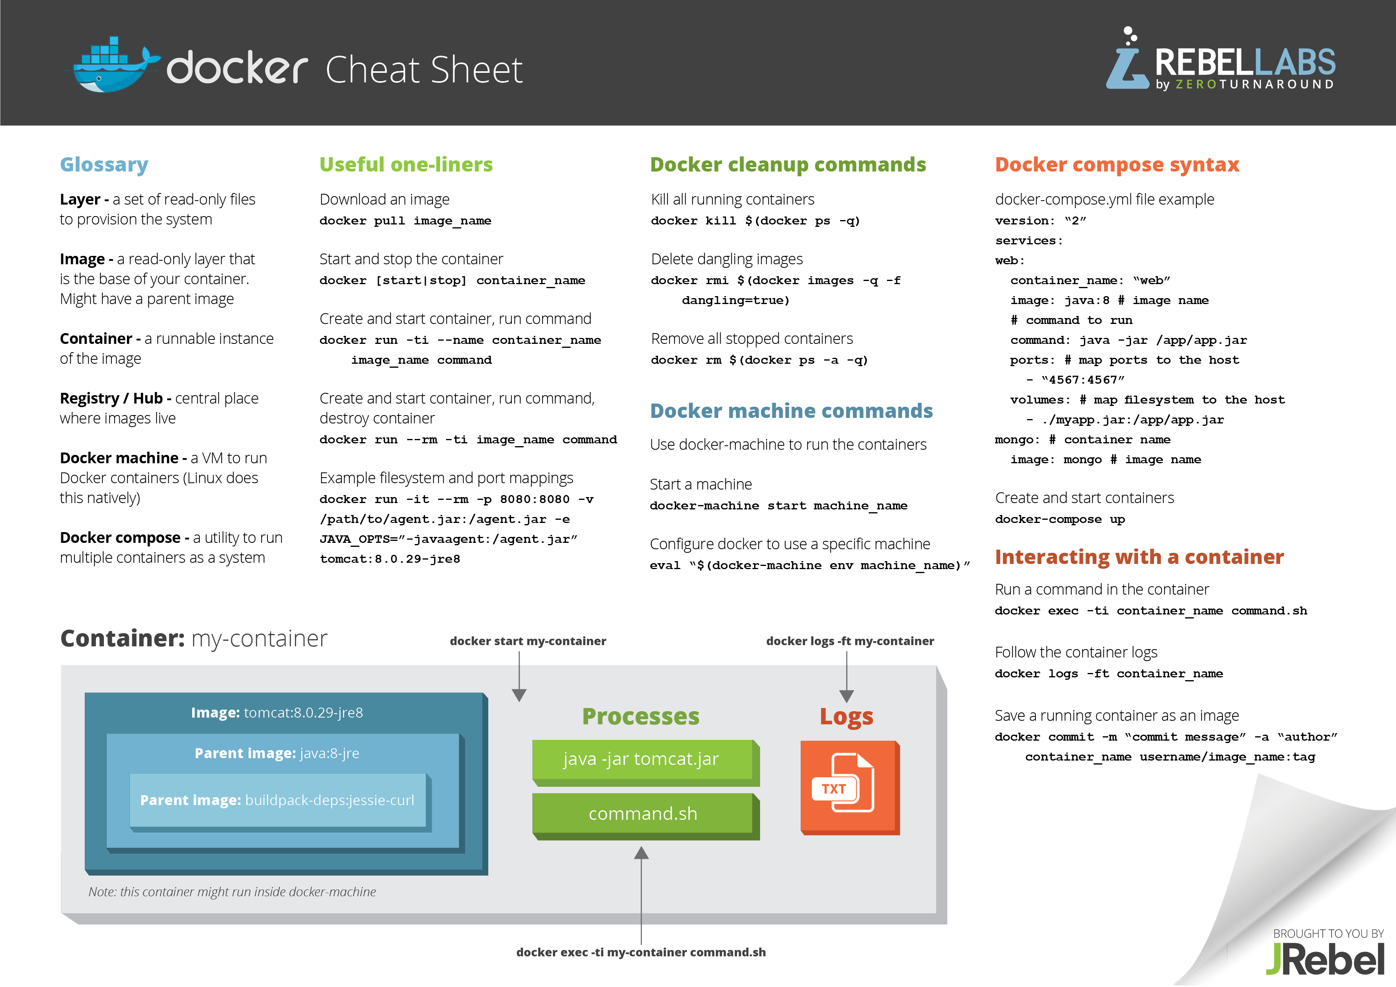
Common Commands
List of my personal cheat sheet commands available on github
https://zeroturnaround.com/wp-content/uploads/2016/03/Docker-cheat-sheet-by-RebelLabs.png

Slide 16
Kubernetes
1. What is Kubernetes?
2. Why Kubernetes?
3. Pertinent Terms (and visualizations)
4. Typical Kubernetes Workflow
Notes:
Now I will introduce a high-level overview of Kubernetes and also a quick hands-on tutorial using Kubernetes that builds off the previous part.

Slide 17
1. What is Kubernetes
Limitations of Docker
“Kubernetes is an open source system for automating deployment, scaling, and management of containerized applications.”
Captain of ship
Notes:
In order to understand the role of kubernetes and the importance of a tool like kubernetes, we first have to understand the limitations of docker. Docker is really good at creating isolated, lightweight containers that run the way we want wherever we want, however, once we have many docker containers (as in the case with the microservices infrastructure), we will need a way to scale, work with, and control different containers easily. Kubernetes does just this.
Kubernetes is an open source system for automating deployment, scaling, and management of containerized applications. It is a container orchestration tool provided by Google. This is the way that Docker and Kubernetes go together – docker creates the containers for apps, and kubernetes is the "captain" of the ship of docker containers. (Kubernetes means helmsman/governor in Greek).

Slide 18
2. Why Kubernetes
Seamless deployment and rolling updates
Load balancing
Extremely flexible
Notes:
The video got into this a little bit, but Modern web services expect applications to be available 24/7 and developers need to deploy new versions sometimes several times a day. Containerization helps package software to serve these goals, enabling applications to be released/updated in an easy/fast way without downtime. Kubernetes helps you make sure these containerized applications run where/when you want and helps them find the resources/tools they need to work.
Other technologies include Docker Swarm, Amazon ECS (EC2 container service), and Mesos. You can read up more on the other technologies which are very similar, but Kubernetes is the most comprehensive and flexible service. The downside is that there is a larger learning curve to start using Kubernetes.

Slide 19
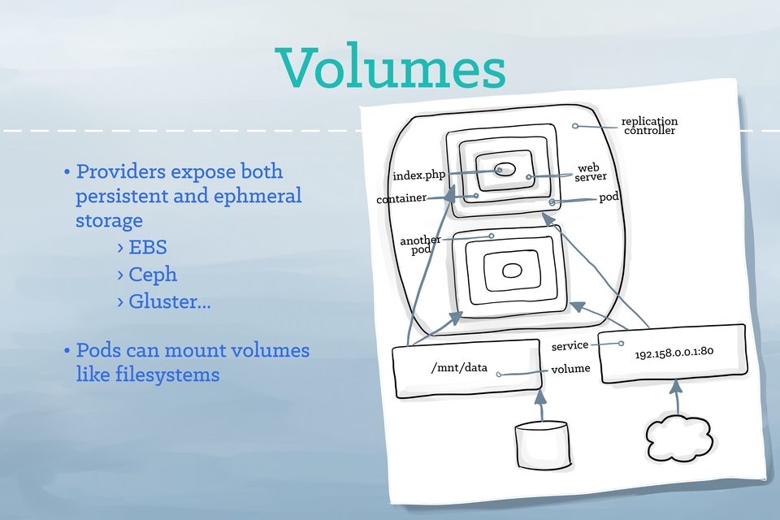
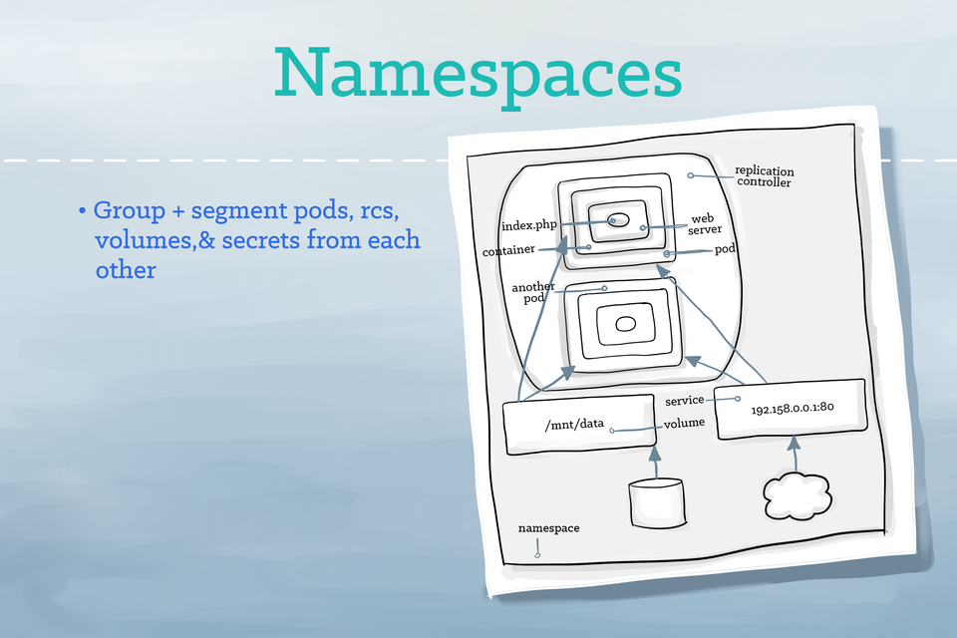
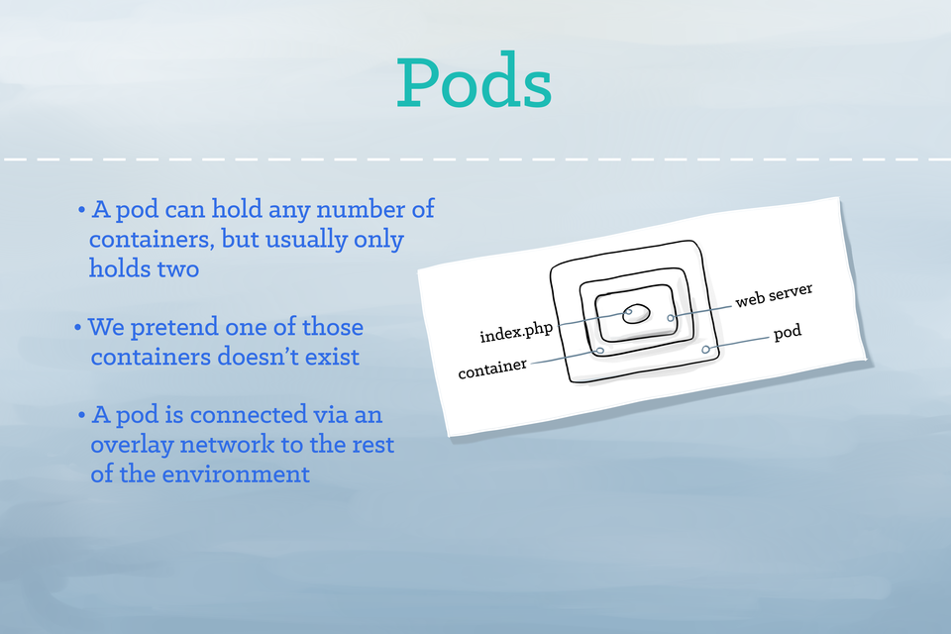
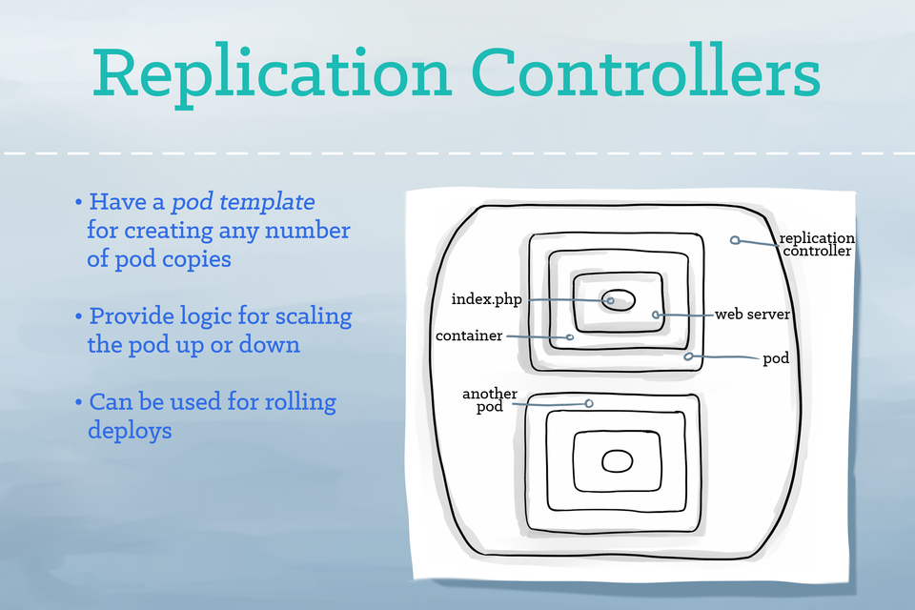
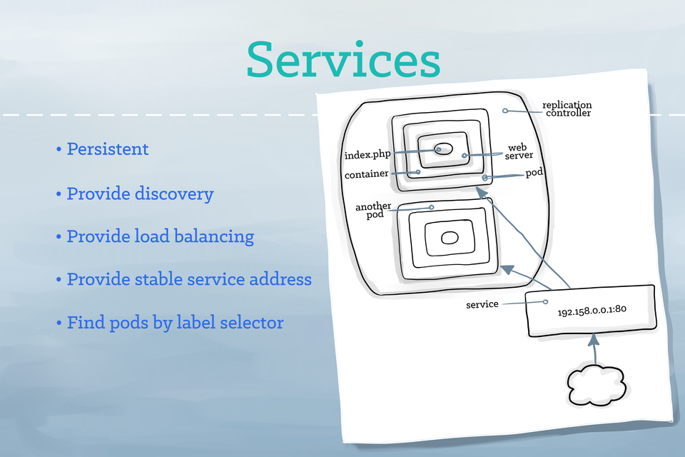
3. Pertinent Terms
Pods
Replica Set
Deployments
Services
Ingress
Namespace
Volume
Cluster
Minikube
Notes:
Pods: you can think of a pod as “basically a container for a docker container”. Usually only hods one container except sometimes holds 2 if the containers are tightly coupled.
Replica Set: Framework for defining horizontally scaled pods. Responsible for handling replicated pods. If containers go down, this will start up another contianer and kill the container when the first one comes back online. This used to be in charge of rolling updates, but now rolling updates are performed using deployments
Deployments: a Deployment provides declarative updates for both Pods and ReplicaSets (the new generation of the ReplicationController). Basically, a deployment manages different replicasets which manages and detects the health of different pods.
Services: Application gateway/load balancer. A unit that acts as a basic load balancer/ambassador for other containers. Services provide an interface with a group of pods. Allow you to simplify your pod designs since they group together a logical collection of pods based on your labels.
Ingress: Services and pods have IPs only routable within the cluster. An ingress provides a way to expose your application to the outside world. An ingress controller is responsible for fulfilling the Ingress, usually with a loadbalancer
Namespace: A namespace is used in an environment with many users spread across multiple teams/projects. Namespaces provide a scope for names. For example, for the sentry app, I have namespaces for testing, staging, and production environments (and these namespaces correspond to the url).
Volume: If you want to store data (for now we are still storing data on AWS) on kubernetes, use a volume so that data doesn’t get lost if a postgres pod goes down.
Cluster: Group of computers that Kubernetes coordinates to work together as a single unit (has to do with the abstraction level of Kubernetes. In other words, Kubernetes allows you to deploy containerized applications to a cluster without having to tie the application to an individual machine!!) These are the primary compute resources managed by Kubernetes.
Minikube: lightweight Kubernetes implementation that creates a VM on local machine and deploys a simple cluster containing only one node

Slide 20
4. Typical Kubernetes Workflow
1. Set kubectl config context using “kubectl config set-context [minikube/kube] --namespace=tpt-app”
2. Write your manifest files for each kubernetes resource you’d like to create
3. Create the resources using the manifest files you wrote
Notes:
Kubernetes workflow is pretty straightforward.

Slide 21
Minikube
1. Purpose
2. Demo
3. JPL Minikube (why)
1. Official Minikube creates separate VM from docker for mac
2. More difficult to manage two docker environments
Notes:
Minikube is a tool that allows developers to run kubernetes locally. Unfortunately, the official minikube is configured to create it's own VM and run its own version of docker in the VM. We'd much rather have the same version of Docker (Docker for Macs) running throughout (there are also some other smaller issues), so we'll use an inhouse version of minikube that can be found [here](https://github.jpl.nasa.gov/jTeam/minikube).
The purpose of Minikube is simply to be able to test a deployment to the kubernetes cluster locally. Minikube will respond in a very similar way to the kubernetes deployment, and it will be easier to debug/understand locally so it is a great tool to use prior to kubernetes deployments.
Also, you won’t be able to access the kubernetes dashboard because of permissions, so the minikube dashboard is a nice place to learn more about kubernetes and also to understand how kubernetes works with a nice UI.
Why JPL minikube?
Two main reasons. First, the virtualenvironment that Docker for Mac uses is different than the one created by minikube (Docker shares the underlying OS, but is only able to use Linux OS, so if you are using a Mac, docker runs on top of a Linux VM). This underlying vm for your mac and also for minikube is different which can cause future problems.
This is bad becuase minikube docker does not include the network integrations that docker for mac has.
It is more difficult to manage two docker environments
Also doesn’t have an ingress controller (load balancer)

Slide 22
Hands-on Tutorial
1. Write Kubernetes manifest files
2. Create a kubernetes cluster and deploy locally to minikube using docker image
3. From Minikube to Kubernetes
4. Rolling Updates
Notes:
Overview of this part of tutorial

Slide 23
Setup/Downloads
Install kubectl with homebrew (get homebrew if you don’t already have it)
Brew install kubectl
Go to https://github.jpl.nasa.gov/jTeam/minikube and download the code.
Then cd into the directory and run ./install.sh
Now, if you run “minikube”, you should get a usage response
Run “minikube start”
Now checkout the dashboard at https://kube-system.vcap.me

Slide 24
1. Write Kubernetes manifest files
Files in manifests folder
Tpt-ns.yml
Tpt-deploy.yaml
Tpt-svc.yaml
Tpt-ing.yaml
<user>-secret.yml (I will show you how to set this up)
Notes:
Now, open yup your repo. Inside the manifest folder there should be four files. I’ll walk you through writing the manifest files for eachfile and then you can copy/paste from asnwer.txt as before (while filling in the necessary changes).

Slide 25
2. Deploy to Minikube
Point kubectl config to minikube
Kubectl config set-context –namespace=tpt-tut minikube
Create namespace, deployment, service, and ing with manifest files that you wrote
Kubectl apply –f <NAME>.yaml –record
This is basically the same for kubernetes deployment too (we’ll get into that later)
Notes:
The final steps are just to configure kubectl to point to the correct configurations, and then now create the necessary resources using the manifest files you wrote.
If this step doesn’t work, then make them stop and start minikube again. Explain that minikubectl is an alias for kubectl --context=minikube. If you don’t immediately have the tool then restart your terminal.

Slide 26
2. Deploy to Minikube
3. Now, visit the dashboard for minikube at default.vcap.me/ and make your way over to correct namespace.
4. Visit the site and see that it is up on Minikube

Slide 27
3. From Minikube to Kubernetes
Differences
No dashboard (no permission)
Less permissions (less kubectl commands)
Must sign in/auth with JPL credentials (and change configuration to correct config)
Provisioned AWS namespaces instead of ones created by us.
How to deploy to Kubernetes
~/.kube/config: https://kube-login.jws.jpl.nasa.go
~/.kube/ca.pem: https://kube-login.jws.jpl.nasa.gov/ca
Set configuration “kubectl config set-context kube –namespace=(provisioned-namespace-here)
Create resources using manifest files you already wrote.
Notes:
For the final point, make sure to mention that usually there is a makefile to automatically run (show how it works for sentry) and you have to create dynamic variables to change the name and namespace values in each.

Slide 28
Rolling Updates + Maintenance
Now say we want to change something in the application.
Go to app.py, and change ‘Go TPT’ to something else.
What could we do to reflect this in our deployment?
First, rebuild the docker image, retag the image, and push the image to the registry with a new tag (say v2)
Now, run ‘kubectl edit deploy <deployname> and edit the yaml file to pull the appropriate tag.
Now the update should be happening, to check the update, run ’kubectl rollout status deploy <deployment name>’ (if you are using minikube, you can also check on dashboard)

Slide 29
Common Commands
Kubectl get po/deploy/svc/ing/ns
Kubectl apply –f <FILENAME>
Kubectl exec –it <POD> bash
Kubectl config set-context minikube –namespace=tpt-app
Kubectl logs <pod ID>
kubectl edit [pods/deployments/services/ingresses] <resource name>
kubectl rollout status deploy <deployment name>

Slide 30
Future Difficulties/Resources
https://kukulinski.com/10-most-common-reasons-kubernetes-deployments-fail-part-1/
https://kukulinski.com/10-most-common-reasons-kubernetes-deployments-fail-part-2/

