Slide 1


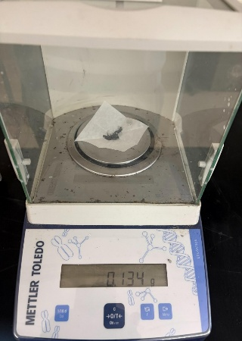
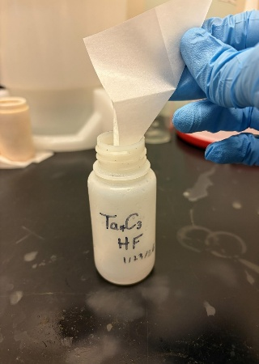
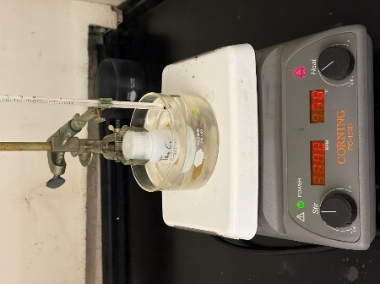
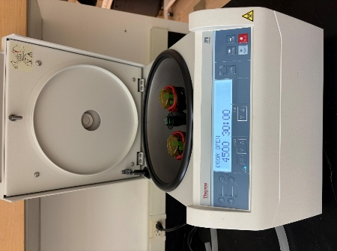
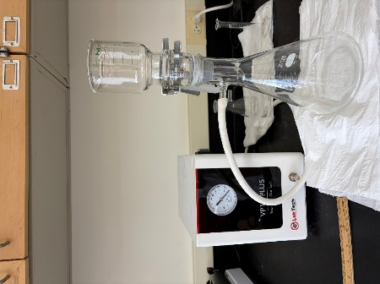
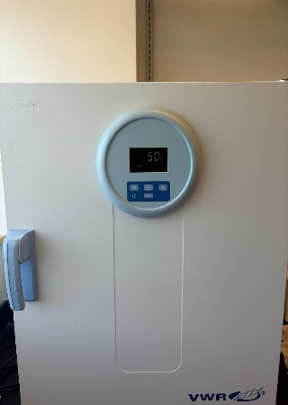
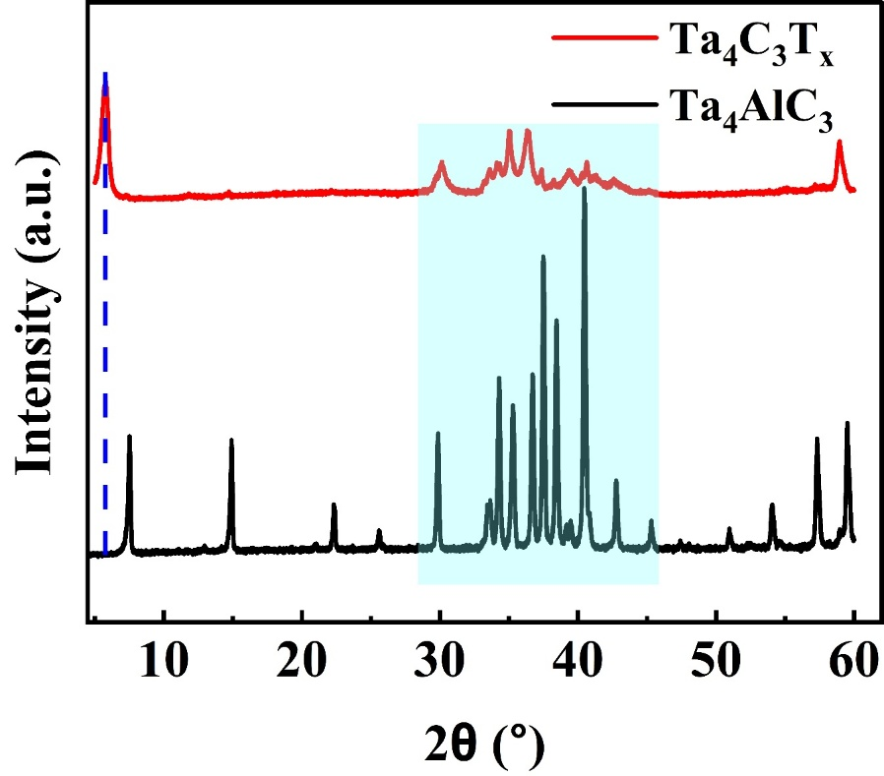
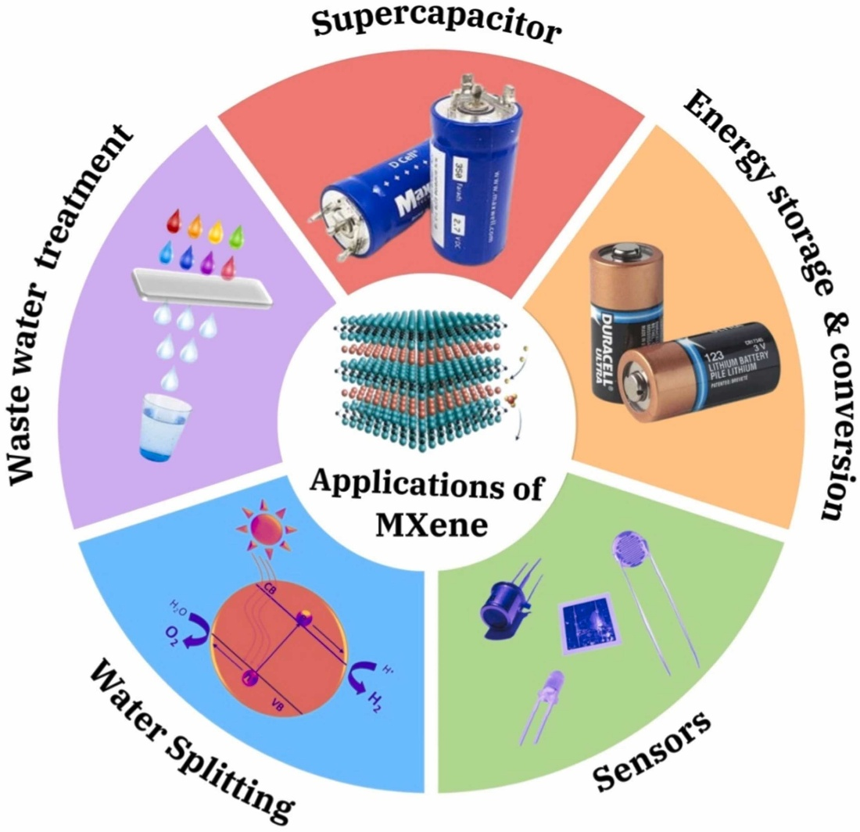
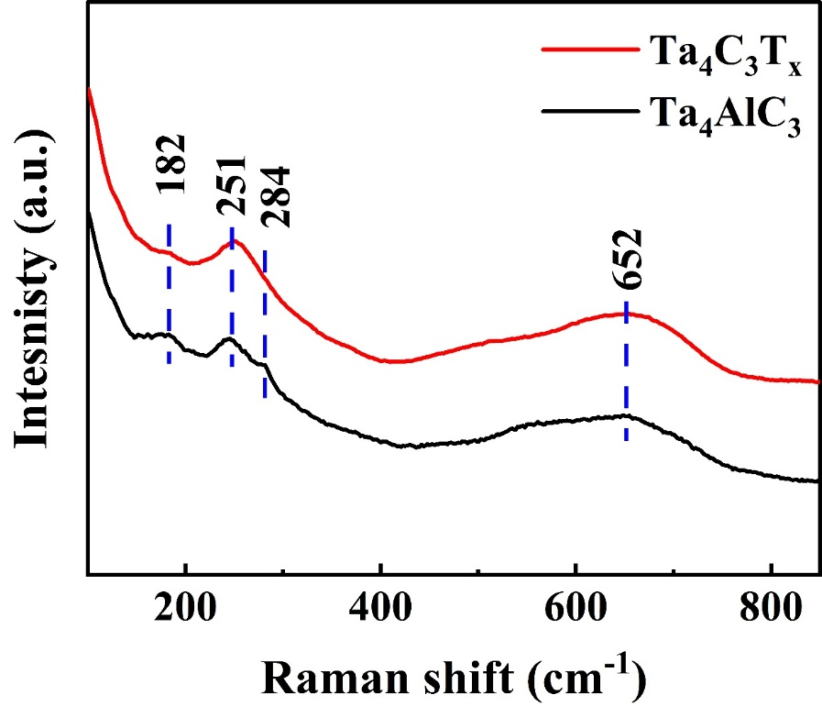
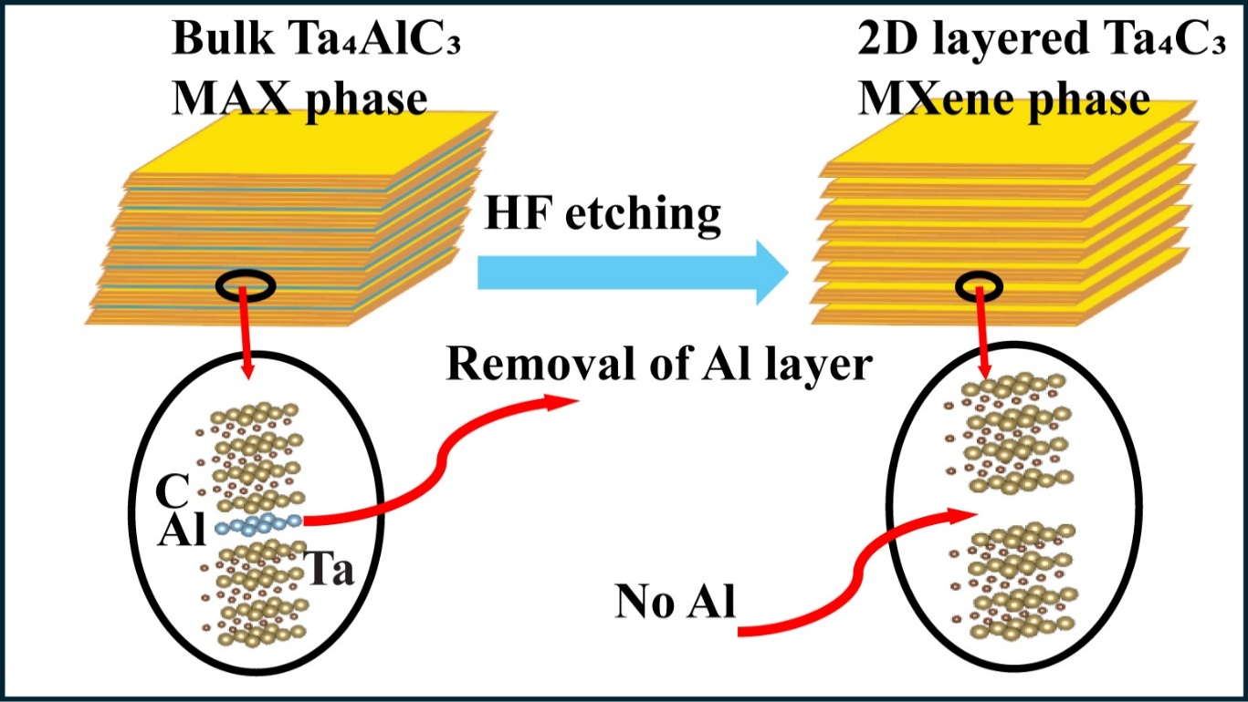
Structural and Compositional Properties of Ta₄C₃Tₓ MXene
Jianna Evans, Safal Ghimire, Peshal Karki, Nisha Hiralal Patel Makani, Bhoj Gautam
Department of Chemistry, Physics and Materials Science, Fayetteville State University, Fayetteville, North Carolina 28301, United States
Abstract
Synthesis Procedure
Results & Conclusion
Tantalum carbide (Ta₄C₃Tₓ) is expected to possess high structural stability. However, the enhanced stability of Ta-based MAX phases poses challenges in the etching process, making it difficult to determine the optimal parameters for MXene synthesis. This study focuses on adjusting synthesis parameters to develop an optimized process for producing Ta₄C₃Tₓ MXenes. Structural and compositional properties were investigated using XRD, SEM, and Raman spectroscopy analyses. XRD plays a key role in evaluating a material’s structural integrity. By varying parameters such as etching duration and HF quantity, Ta₄C₃Tₓ was successfully synthesized. Increasing HF quantity while reducing etching time led to improved synthesis outcomes, ensuring complete removal of aluminum as evidenced by the disappearance of the characteristic Al peak around 7°, confirming successful etching. Selective etching of A-site atoms (Al) from the MAX phase generates MXenes terminated with -O, -OH, and/or -F functional groups. These surface terminations influence interlayer spacing observed in XRD patterns and strongly affect the structure, stability, and electronic and optical properties of the resulting material.
Our study indicates that the optimal amount of HF to use for this methods was 0.9:0.001 HF:MAX molar ratio
The inter-layer spacing has increased after etching, as indicated by the (002) angle shift in the XRD pattern
Al-layers have been etched in MXene as indicated by reductions of peaks in both XRD pattern and Raman spectra
Formation of −O, −OH, and/or −F surface functional groups are implied by the broadened peaks between 20° and 45° in the XRD pattern
a. Weigh MAX (0.134 g )
b. Stir MAX phase with 48 wt.% HF
c. Stir solution in oil-bath for 3 days (72 h) at 35 °C
d. Wash slurry until pH 7 is reached
e. Remove supernatant through vacuum filtration
f. Oven dry leftover powder at 50 °C for 12 h
a
Characterization
Future Directions
XRD
Downard shift and broadening of the (002) to lower angle of 5.8° in Ta₄C₃T_{x}, confirms expansion of the c lattice space
Al etching is shown by the sharp reduction and broadening of the Al-related peaks near 30°- 40°.
Prepare MXene-Cellulose Bio-composites utilizing methyl cellulose and cellulose acetate
Measure charge transfer, capacitance, and bandgap of Bio-composite material
Make flexible MXene-Cellulose composite paper for bio-sensing applications
Introduction
Figure 1. XRD spectra of MAX and MXene phase materials highlighting Al relevant peaks.
Acknowledgements
Tantalum-based MXenes, such as Ta₄C₃Tₓ, exhibit high electrical conductivity and strong optical nonlinearities, making them well-suited for energy storage, catalysis, optoelectronic, and photonic applications.
SEM
The synthesis and characterization work was supported by DOE BES award number DE-SC0024611.
a
b
MAX Phase depicts Bulky Morphology
MXene phase depicts layered structure
References
Figure 2. SEM images of MAX (left) and MXene (right) surface morphology.
Stavrou, Michalis, et al, Adv. Opt. Mat. 2025, 13, 2403277
L. Dong, H. Chu, Y. Li, et al, Appl. Mater. Today 2022, 26, 101341
L. Lan, Z. Ni, et al, Langmuir 2024, 40, 20945
S. Ullah, T. Najam, A. ur Rehman, et al, J. Alloys Compd. 2024, 1001, 175172
A. Rafieerad, W. Yan, K. N. Alagarsamy, A. Srivastava, N. Sareen, R. C. Arora, S. Dhingra, Adv. Funct. Mater. 2021, 31, 2106786.
Raman
Al-related peaks (182 cm⁻¹ and 284 cm⁻¹) are significantly reduced in Ta₄C₃T_{x} compared to those in Ta₄AlC₃
Other prominent peaks (251 cm⁻¹ and 652 cm⁻¹) are associated with the Ta and C layers
MAX Phase: Parent material consisting of M (transition metal), X (a carbon/nitrogen), and “A” group element
Etching: Process of selectively removing “A” group element from MAX Phase
MXene: Layered 2D structure resulting from etching (with acid or other methods)
Contact Information
Figure 3. Raman spectra reveals bonding environment of Ta and C layers.
Dr. Bhoj Gautam, Department of Chemistry, Physics and Material Science
Fayetteville State University, Fayetteville, NC-28301
Email: bgautam@uncfsu.edu, Phone: 910-672-1653

