Slide 1


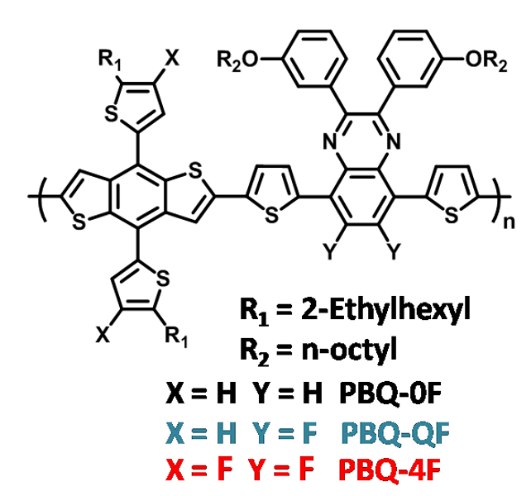
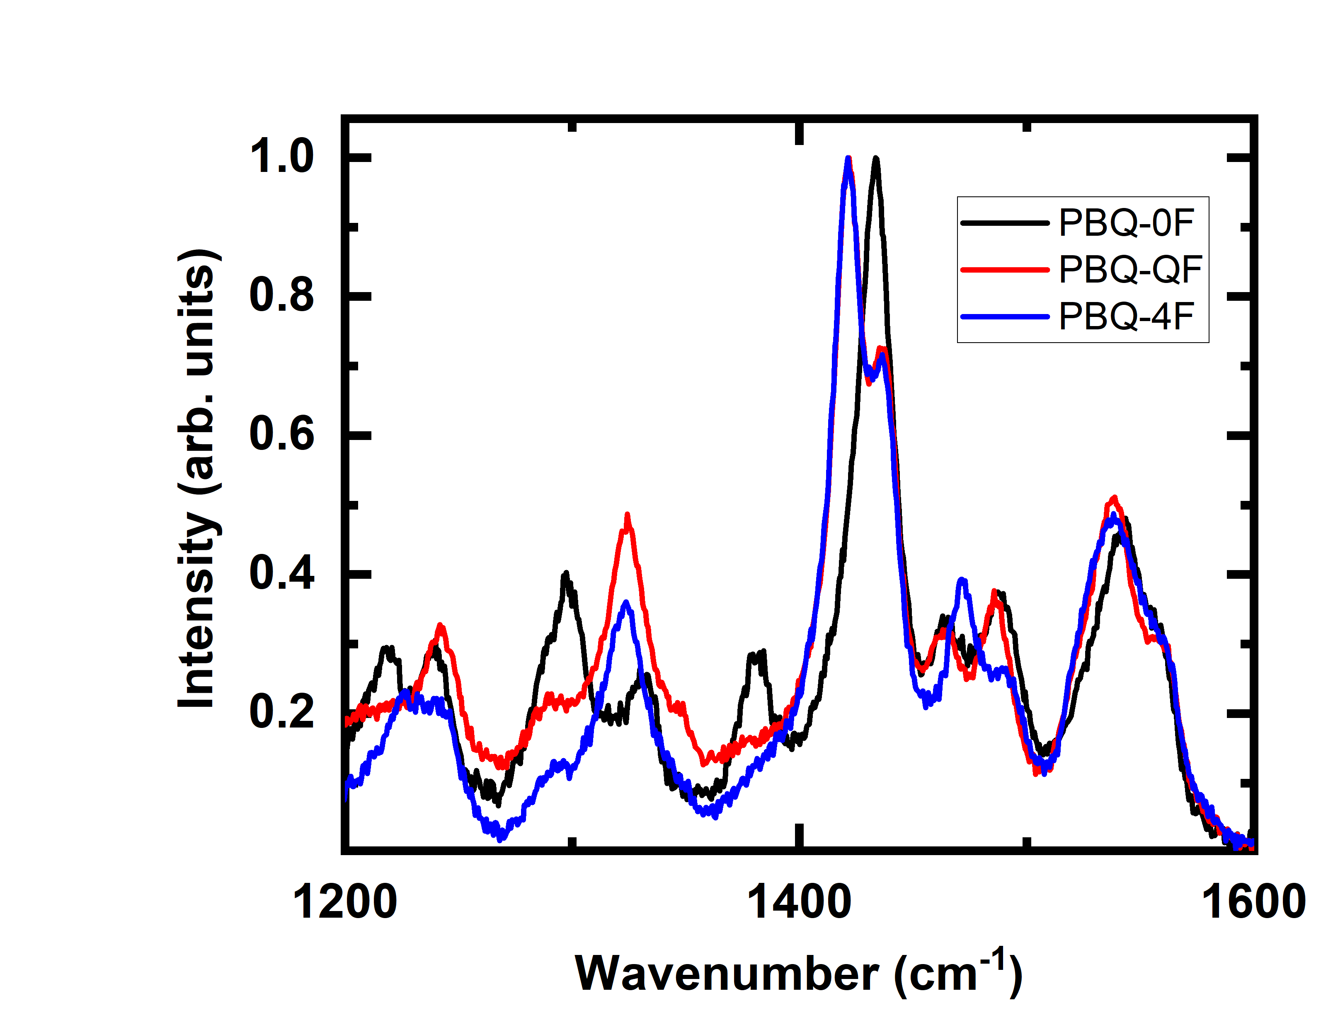
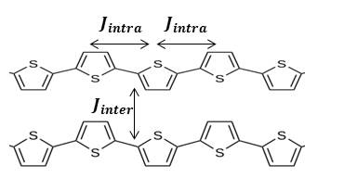

Impact of Fluorination of Conjugated Polymer on Aggregation and Charge Photogeneration
Jianna Evans¹, Shubo Han², Jianhui Hou³, Bhoj Gautam²
¹Department of Math and Computer Science, Fayetteville State University, Fayetteville, North Carolina 28301, United States
²Department of Chemistry, Physics and Materials Science, Fayetteville State University, Fayetteville, North Carolina 28301, United States
³State Key Laboratory of Polymer Physics and Chemistry, Beijing National Laboratory of Molecular Sciences, Institute of Chemistry, Chinese Academy of Sciences, Beijing
100190, P. R. China
Materials
Raman Spectra Polymer Films
Introduction
Conjugated polymers have an extreme potential for applications in opto-electronics, including solar cells, light emitting diodes, and thin-film organic transistors, and inter and intra chain exciton coupling in polymers impact their electrical and optical properties. When the molecular arrangement leads to the transition dipole moments being oriented along the polymer backbone, strong intrachain electronic coupling is obtained (J-aggregation). In contrast, parallel packing of multiple chains favor strong interchain electronic coupling (H-aggregation). It has been reported that addition of fluorine atoms in the chemical structure of conjugated polymers changes the electronic coupling
a
b
Figure 2. Chemical structure of PBQ polymers.
Thin Film Preparation:
1420 cm⁻¹ peak is absent in PBQ-0F and 1433 cm⁻¹ peak is enhanced in this polymer compared to fluorinated ones.
1380 cm⁻¹ peak is absent in fluorinated polymers.
Solutions were prepared by dissolving PBQ-0F, PBQ-QF and PBQ-4F polymer powders in chlorobenzene.
Thin films were prepared by spin coating the corresponding solutions on glass at 1000 rpm for 40s.
Figure 5. Raman spectra of PBQ-0F, PBQ-QF and PBQ-4F polymers.
Figure 1. Exciton coupling between polymer chains is dominate in H-aggregation and coupling along the chain is dominate in J-aggregation.
Summary
Figure 3. Optical image of PBQ polymer film.
.
All three polymers have similar band gap.
The relative intensity of relative intensity of 0-0 to 0-1 vibronic peaks is greatest for PBQ-4F and least for PBQ-0F indicating different aggregation behavior.
Electron delocalization in conjugated polymers is influenced by the fluorine atom substitution as suggested by Raman results.
Our observations indicates that fluorination of donor polymer can result different power conversion efficiency in bulk heterojunction polymer solar cells.
Both morphology and chemical composition (e.g. fluorination) of charge transfer copolymers impact power conversion efficiency in bulk heterojunction solar cells. In this work, conjugated polymers with different numbers of fluorine atoms were used to study the effect of fluorination in optical properties of polymers. Thin films of three custom-synthesized conjugated polymers named PBQ-0F, PBQ-QF and PBQ-4F were prepared by spin coating the solutions. The relative intensity of 0-0 to 0-1 is greatest for PBQ-4F and least for PBQ-0F. This suggests that PBQ-4F has J-like aggregation whereas PBQ-0F has H-like aggregation. We also used Raman spectroscopy in these polymers, which is considered as a non-destructive method that has proven to be highly suitable for studying polymer backbone structure, conformation, and electron delocalization. There are several Raman modes apparent in the spectrum. Surprisingly, we didn’t observe the 1380 cm⁻¹ peak in fluorinated polymers. In addition, 1420 cm⁻¹ peak is absent in PBQ-0F and 1433 cm⁻¹ peak is enhanced in this polymer compared to fluorinated ones. These observations indicate that electron delocalization in conjugated polymers is influenced by the fluorine atom substitution.
Abstract
Absorption Spectra
a
b
Acknowledgements
The authors acknowledge funding from the NSF HRD 1900998.
References
Z. Zheng, O. M. Awartani, B. Gautam et. al, Adv. Mater. 2017, 29, 1604241.
D. Liu, W. Zhao, J. Hou et. al. , Macromolecules 2015, 48, 5172.
J. R-H., J. Wade et. al., J. Mater. Chem. A, 2014, 2, 20189
Both polymers have same band gap and very similar spectral coverage.
Optical cross section strengths for 0-0 and 0-1 vibronic transitions depends on choice of solvent and fluorination
Contact Information:
Dr. Bhoj Gautam, Department of Chemistry, Physics and Material Science
Fayetteville State University, Fayetteville, NC-28301
Email: bgautam@uncfsu.edu, Phone: 910-672-1653
Figure 4. Absorption spectra of PBQ-0F, PBQ-QF and PBQ-4F polymers.

