Slide 1
Talent Management
DDS Analytics – Zackary Gill, Mai Loan Tran

Slide 2
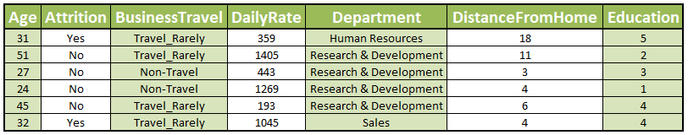
Overview
Final model: 85% accuracy
37 Factors, 1170 entries

Slide 3
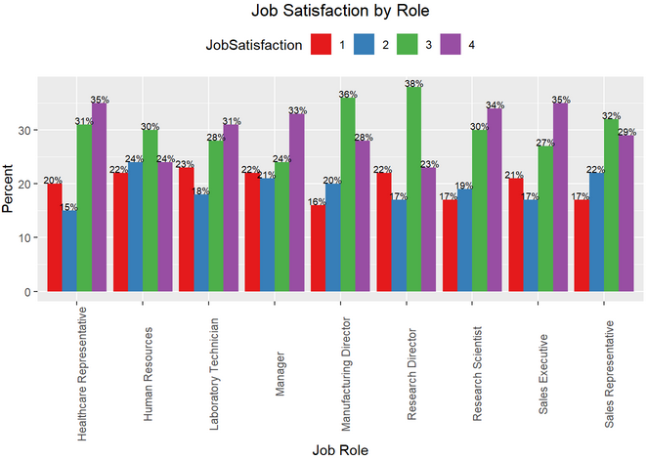
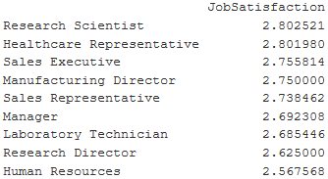
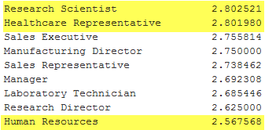
Job Satisfaction
Differences not statistically significant
Mean Satisfaction
2.8 vs 2.6

Slide 4
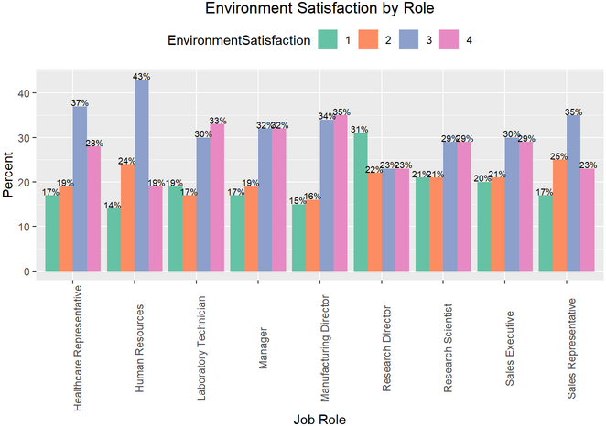
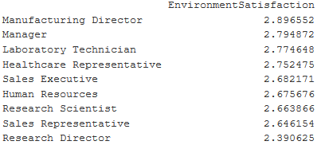
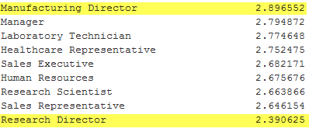
Environment Satisfaction
Differences not statistically significant
Mean Satisfaction
2.9 vs 2.4

Slide 5
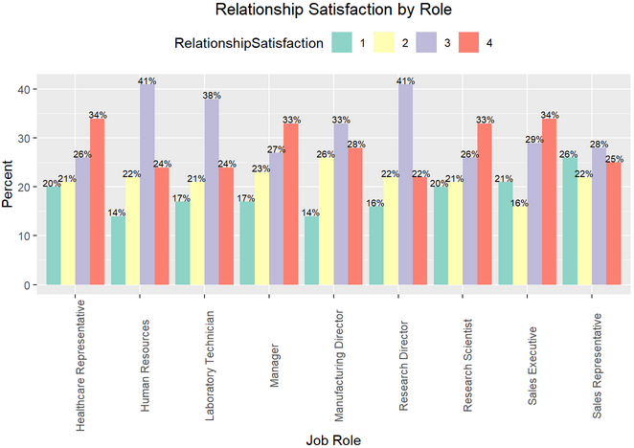
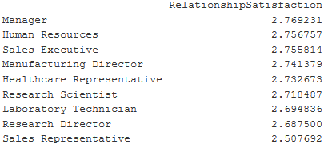
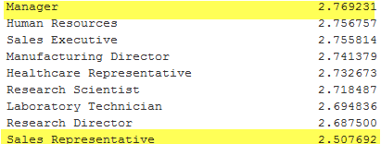
Relationship Satisfaction
Differences not statistically significant
Mean Satisfaction
2.8 vs 2.5

Slide 6
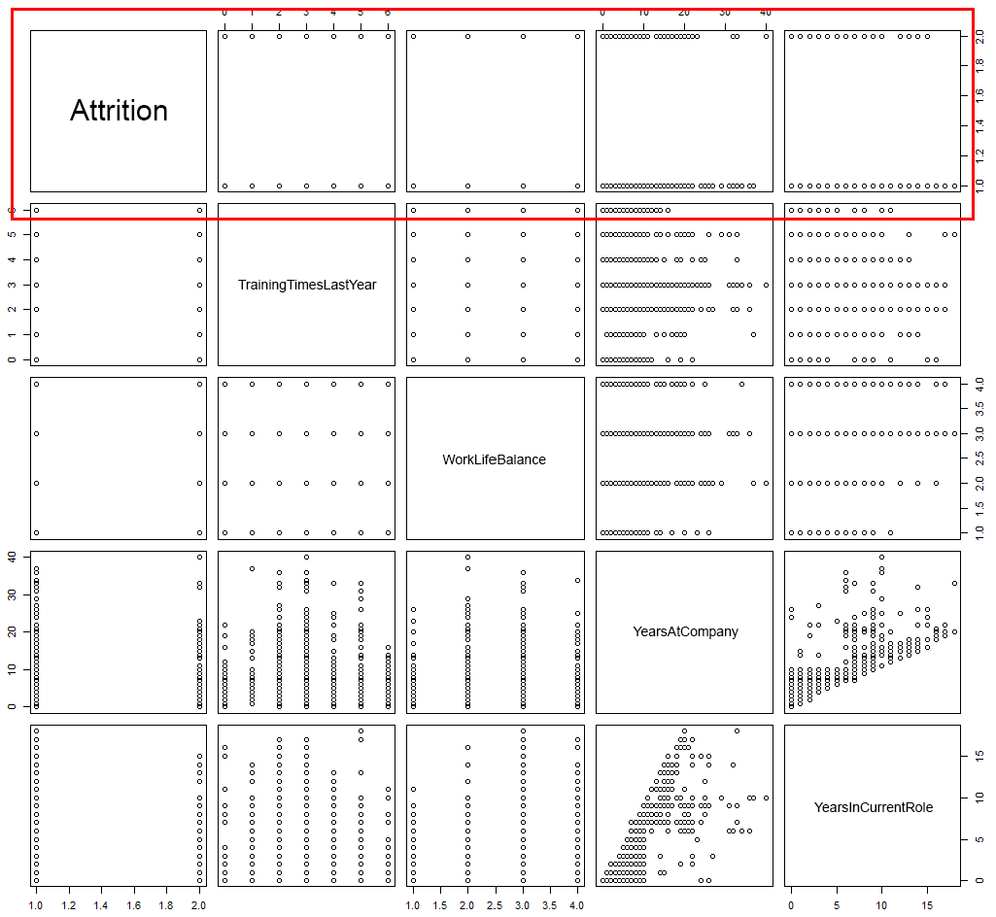
Plotting
Attrition
No single factor

Slide 7
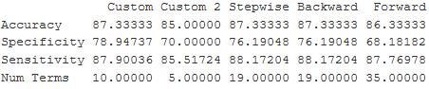
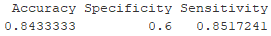
Modeling Attrition
Logistic Regression
k-Nearest Neighbors
2 models, 85% to 87.3% Accuracy
Final model: 85% accuracy
Job Involvement, Overtime, Marital Status, Job Role,
Number of Companies Worked For

Slide 8
Credits
Zackary Gill
Mai Loan Tran
https://www.free-powerpoint-templates-design.com/abstract-green-background-for-streaks-design-powerpoint-templates/
https://youtu.be/L2MqJn9BWqw

