Slide 1
Talent management
mSDS 6306-404 Case study 2
Notes:
Good Morning
Thank you for joining us today
We’re excited to share with you the results of our analysis of the domestic beers and breweries

Slide 2
Objective
Determine factors that lead to turnover (attrition)
Identify job role's specific trends
Predict employee turnover for talent management by conducting analysis of existing employee data

Slide 3
methodology
Performed exploratory data analysis of 1170 employees with 37 variables
Plotted all variables against one another to identify correlation, and if yes, the direction of the relationship
Performed testing for statistical significance of attrition against the differing pairs of variables
Analyzed job role trends from the survey of job satisfaction, environment satisfaction, relationship satisfaction, and work life balance
Utilized four different statistical models to determine the best prediction model with the highest overall accuracy rate
Notes:
Our methodology is to perform an exploratory data analysis of the collected data
That is we wrangled with the data by quantifying, merging, plotting it to identify and determine relationships for insights

Slide 4
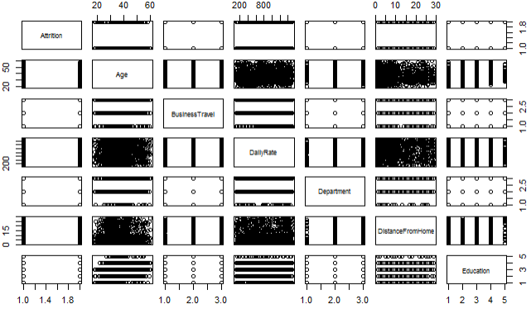
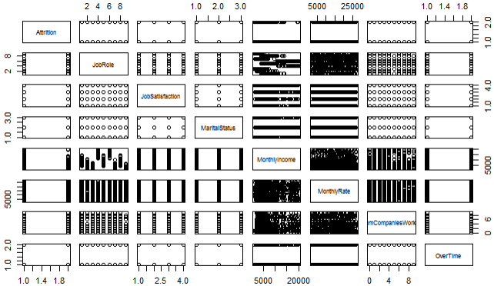
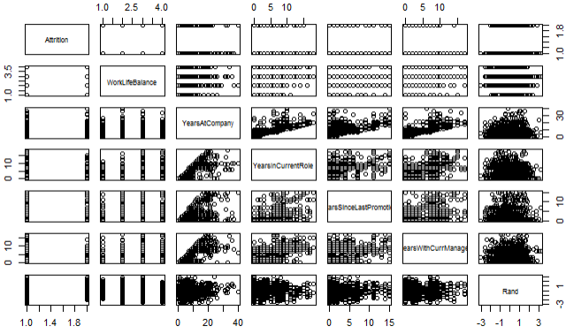
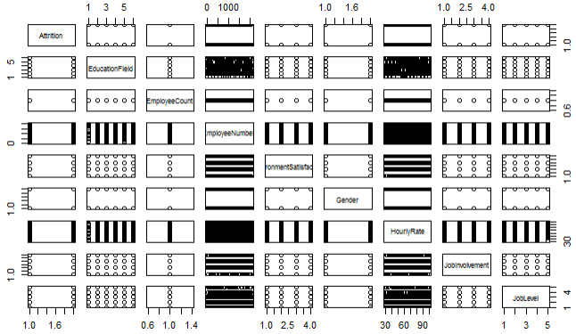
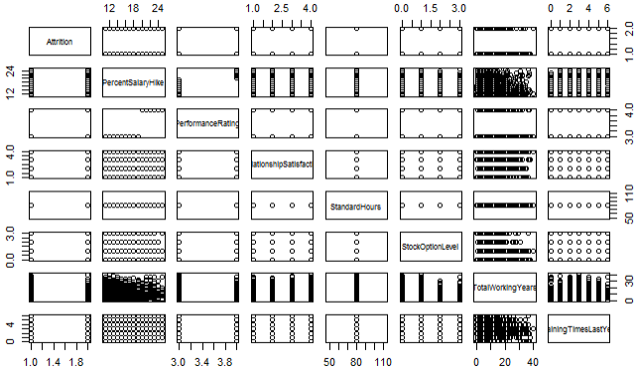
Plots of all variables

Slide 5
What is the statistical significance of attrition against other variables?
 |  | p-value
1 | Monthly Income | 0.000000008709424
2 | Job Level | 0.00000001128308
3 | Total Working Years | 0.00000004575077
4 | Years in Current Role | 0.0000000678404
5 | Years with Current Manager | 0.0000004870058
6 | Stock Option Level | 0.000002810696
7 | Job Involvement | 0.000004046543
8 | Years at Company | 0.00004180637
9 | Environment Satisfaction | 0.00004809215
10 | Job Satisfaction | 0.002175252
11 | Work Life Balance | 0.008
12 | Training Times Last Year | 0.02282312
13 | Daily Rate | 0.0229
14 | Commute Distance from Home | 0.031
Of the 37 variables, our preliminary analysis suggested that there are 14 statistically significant variables
Notes:
Of the 37 variables, our preliminary analysis suggested that there are 14 statistically significant variables with attrition using the Welch’s ANOVA test
That is, we found the p-value, or probability of observing by random chance a result as extreme or more extreme than what was observed under the assumption that a given has no impact with attrition
Surprisingly, Job Role was not among the variables that held statistical significance with Attrition, so given the four survey questions about job satisfaction, environment satisfaction, relationship satisfaction, and work life balance we decided to further explore the responses by role

Slide 6
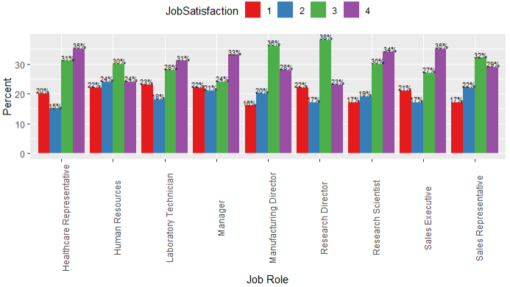
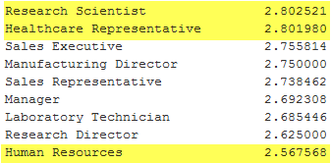
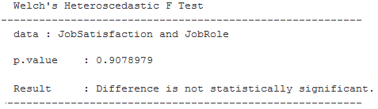
How important is job satisfaction?
Job Satisfaction Mean by Role
Notes:
While there was not a statistical significance in job satisfaction between the roles (p-value 0.9079), Research Scientists and Healthcare Representatives both have the highest equal mean in job satisfaction at 2.80 in Medium-High range. Human Resources have the lowest mean at 2.57.

Slide 7
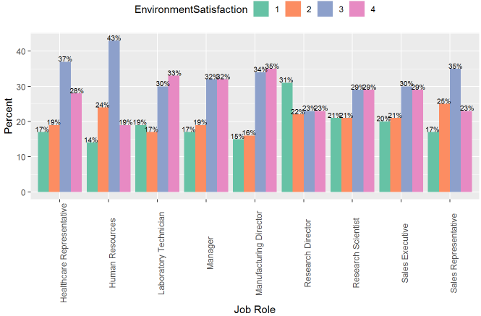
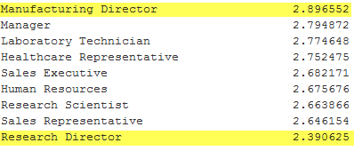
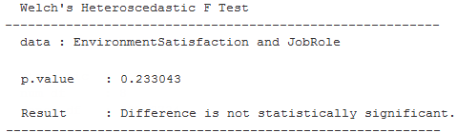
How important is satisfaction with the environment?
Environment Satisfaction Mean by Role
Notes:
The mean environment satisfaction for all job roles is 2.71 in Medium-High range
Manufacturing Directors have the highest mean environment satisfaction at 2.90
Research Directors have the lowest mean environment satisfaction at 2.39
The difference is not statistically significant at p-value 0.2330.

Slide 8
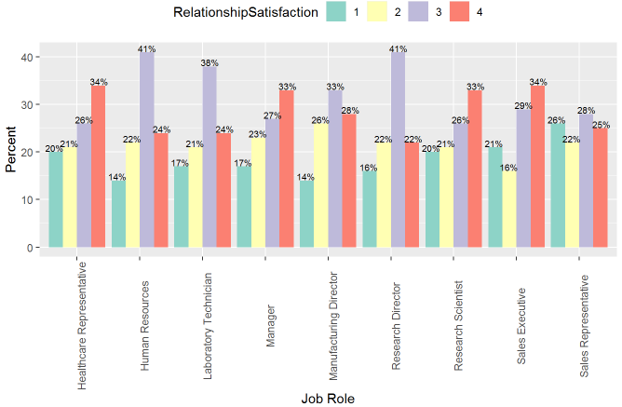
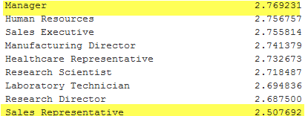
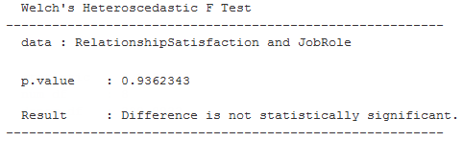
How important is relationship satisfaction?
Relationship Satisfaction Mean by Role
Notes:
The mean relationship satisfaction for all job roles ranged from a mean of 2.50 to 2.77
Albeit at a p-value 0.9362, the difference is not statistically significant between the roles.
Managers have the highest mean relationship satisfaction
Sales Representatives have the lowest mean.

Slide 9
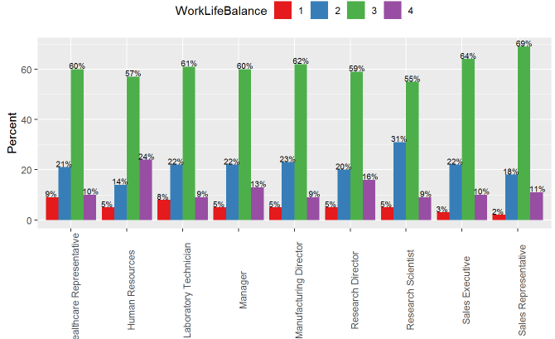
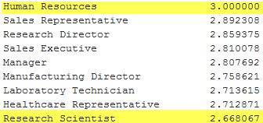
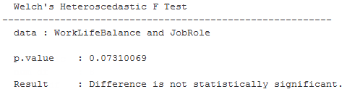
How important is work life balance?
Work Life Balance Mean by Role
Notes:
55% or more of the survey responses within each job role suggest a better work life balance.
Human Resources personnel have the highest mean at 3.0
Research Scientists with the lowest mean work life balance at 2.67.

Slide 10
CUSTOM Prediction model
1 | Business Travel
2 | Commute Distance from Home
3 | Job Involvement
4 | Job Role
5 | Marital Status
6 | Number of Companies Worked
7 | Overtime
8 | Years at Company
9 | Years Since Last Promotion
10 | Relationship Satisfaction
11 | Environment Satisfaction
With 87.3% Overall Accuracy, managing to these variables in developing and retaining employees could reduce and prevent attrition.
Notes:
With an 87.3% overall accuracy, our custom regression model identified 11 factors contribute to turnover.
Job Involvement was the only variable that overlapped with our preliminary analysis
Relationship Satisfaction and Environment Satisfaction while not by themselves are significant with Job Role, the are contributing factors to turnover in conjunction with the other variables
Managing these factors in developing and retaining employees could reduce and prevent attrition.

Slide 11
CrEDITS
ZACKARY GILL & MAI LOAN TRAN
YouTube:

