Slide 1
Modeling Attrition
and other factors
DDS Analytics – Zackary Gill, Mai Loan Tran

Slide 2
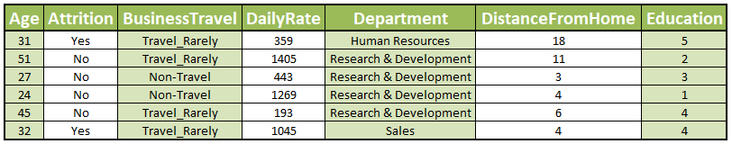
Introduction
Final model: 87.3% accuracy
37 Factors, 1170 entries

Slide 3
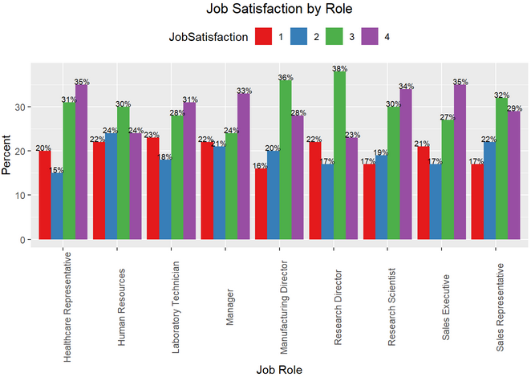
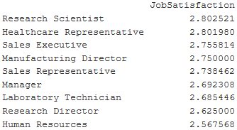
Job Satisfaction
Differences not statistically significant
Mean Satisfaction
2.8 vs 2.6

Slide 4
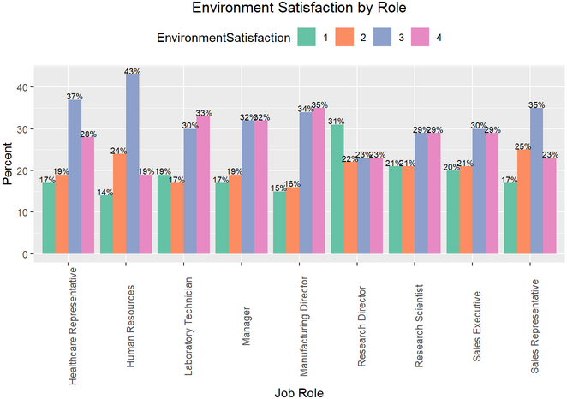
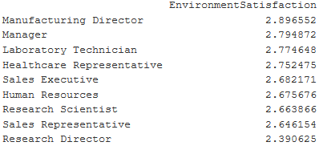
Environment Satisfaction
Differences not statistically significant
Mean Satisfaction
2.9 vs 2.4

Slide 5
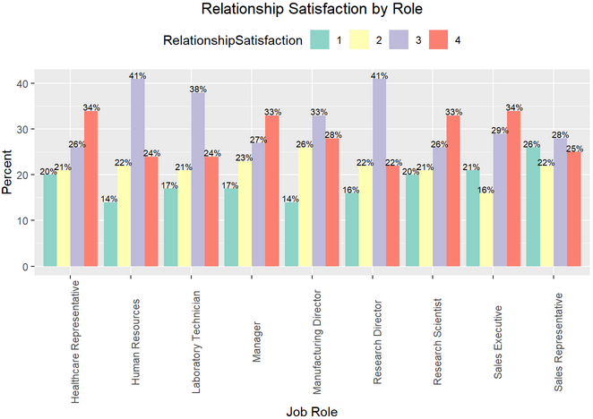
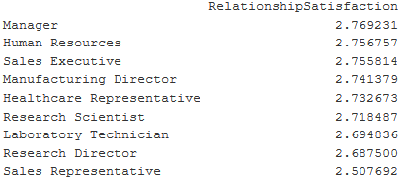
Relationship Satisfaction
Differences not statistically significant
Mean Satisfaction
2.8 vs 2.5

Slide 6
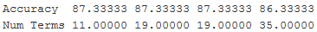
Modeling Attrition
Years since last promotion & Job Satisfaction
Final model: 87.3% accuracy
business travel, commute distance, environment satisfaction,
job involvement, job role, job satisfaction, marital status,
number of companies worked, overtime, relationship satisfaction,
years at company

Slide 7
Credits
Zackary Gill
Mai Loan Tran
https://www.free-powerpoint-templates-design.com/abstract-green-background-for-streaks-design-powerpoint-templates/

