Slide 1
Talent management
mSDS 6306-404 Case study 2
Notes:
Hello
Thank you for joining us today
We’re excited to share with you our talent management analysis from your employee data

Slide 2
Objective
Determine factors that lead to turnover (attrition)
Identify job role-specific trends
Predict employee turnover for talent management

Slide 3
methodology
Performed exploratory data analysis of 1170 employees with 37 variables
Plotted all variables against one another to identify correlation, and if yes, the direction of the relationship
Performed testing for statistical significance of attrition with each of the other variables
Analyzed job role trends from the survey of job, environment, relationship satisfaction, and work life balance
Tested different statistical models to determine the best prediction model with the highest overall accuracy rate

Slide 4
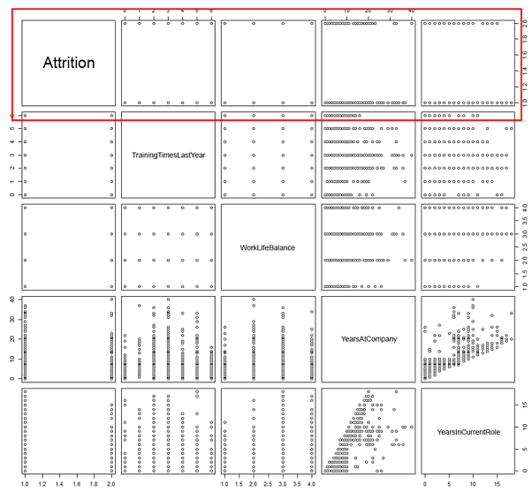
Example of correlation assessment
Attrition vs…
Training Times Last Year
Work Life Balance
Years at Company
Years in Current Role
Etc.
Training Times Last Year vs…
Work Life Balance
Years at Company
Years in Current Role
Etc.
Work Life Balance vs…
Years at Company
Years in Current Role
Etc
Years at Company vs…
Years in Current Role
Etc.
Etc…for all 37 variables in pairs
Notes:
An example of our correlation assessment compared the values of Attriotion vs. Training Times Last Year, Work Life Balance, Years at Company, then each of the subsequent variables with one another in pairs

Slide 5
What is the statistical significance of attrition against other variables?
 |  | Significance
1 | Monthly Income | ***
2 | Job Level | ***
3 | Total Working Years | ***
4 | Years in Current Role | ***
5 | Years with Current Manager | ***
6 | Stock Option Level | ***
7 | Job Involvement | ***
8 | Years at Company | ***
9 | Environment Satisfaction | ***
10 | Job Satisfaction | **
11 | Work Life Balance | **
12 | Training Times Last Year | *
13 | Daily Rate | *
14 | Commute Distance from Home | *
Of the 37 variables, our preliminary analysis suggested that there were 14 statistically significant variables that could contribute to attrition
Significance codes: 0 ‘***’ 0.001 ‘**’ 0.01 ‘*’ 0.05 ‘.’ 0.1 ‘ ’
Notes:
Of the 37 variables, our preliminary analysis suggested that there are 14 statistically significant variables with attrition that could contribute to attrition
Surprisingly, Job Role was not among the variables that held statistical significance with Attrition.
Given the four survey questions about job, environment, relationship satisfaction, and work life balance, we decided to further explore the responses by role.

Slide 6
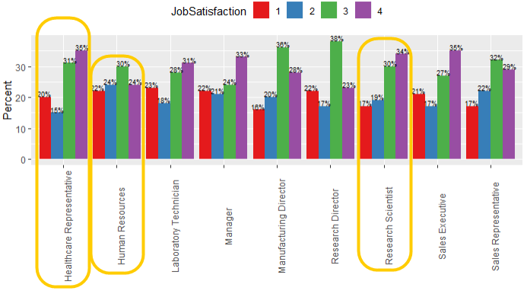
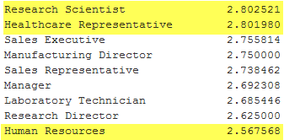
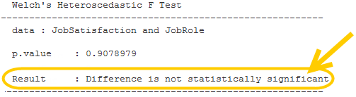
How important is job satisfaction?
Job Satisfaction Mean by Role
1 = Low 2 = Medium 3= High 4 = Very High
Notes:
So, how important is job satisfaction?
While there was not a statistical significance in job satisfaction between the roles (p-value 0.9079),
Research Scientists and Healthcare Representatives both have the highest equal mean in job satisfaction at 2.80 in Medium-High range.
34% of Research Scientists reported Very High job satisfaction
35% of Healthcare Representatives reported the same
Human Resources have the lowest mean at 2.57 with 30% reporting High job satisfaction
The second question in the survey was how important is environment satisfaction?

Slide 7
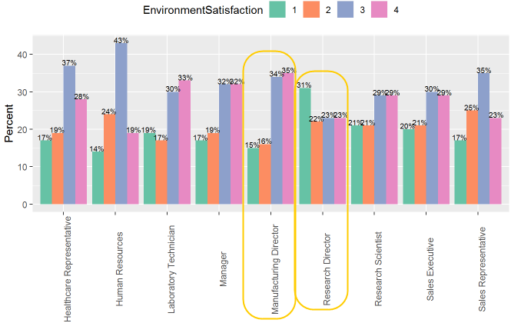
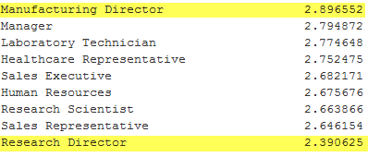
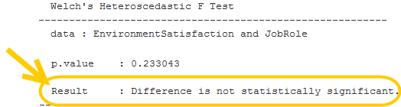
How important is satisfaction with the environment?
Environment Satisfaction Mean by Role
1 = Low 2 = Medium 3= High 4 = Very High
Notes:
The mean environment satisfaction for all job roles is 2.71 in Medium-High range
Manufacturing Directors have the highest mean environment satisfaction at 2.90 with 35% reported as Very High
Research Directors have the lowest mean environment satisfaction at 2.39 with 31% reported as Low
The difference is not statistically significant at p-value 0.2330.
So how about relationship satisfaction?

Slide 8
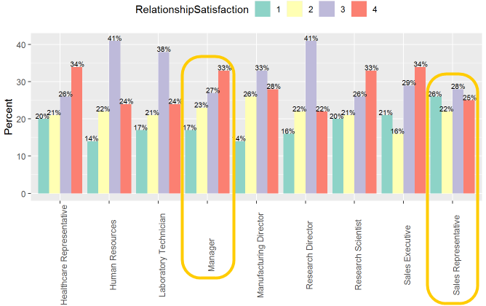
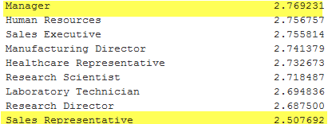
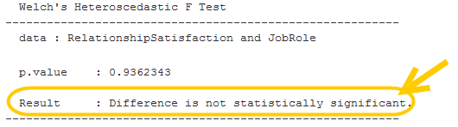
How important is relationship satisfaction?
Relationship Satisfaction Mean by Role
1 = Low 2 = Medium 3= High 4 = Very High
Notes:
The mean relationship satisfaction for all job roles ranged from a mean of 2.50 to 2.77
Albeit at a p-value 0.9362, the difference is not statistically significant between the roles.
Managers have the highest mean relationship satisfaction with 33% reported as Very High
Sales Representatives have the lowest mean with a reported 26% Low to and 28% High
Lastly, what about work life balance by job role?

Slide 9
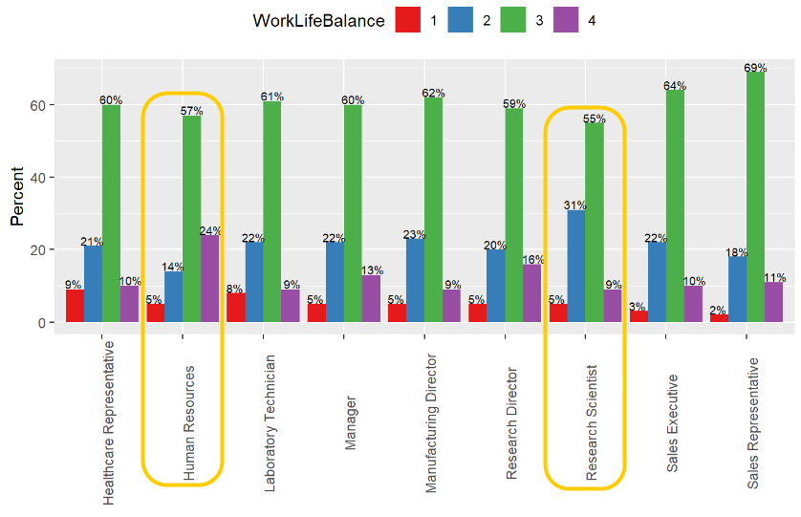
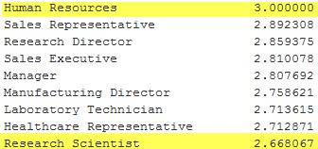
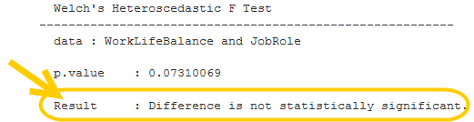
How important is work life balance?
Work Life Balance Mean by Role
1 = Low 2 = Medium 3= High 4 = Very High
Notes:
55% or more of the survey responses within each job role reported a better work life balance.
Human Resources personnel have the highest mean at 3.0
Research Scientists with the lowest mean work life balance at 2.67.
Given the lack of evidence for statistical significance with job roles, do any of these four variables contribute to our prediction model?

Slide 10
LOGISTIC REGRESSION MODEL
 |  | Significance
1 | Business Travel | ***
2 | Environment Satisfaction | ***
3 | Job Involvement | ***
4 | Job Satisfaction | ***
5 | Number of Companies Worked | ***
6 | Overtime | ***
7 | Commute Distance from Home | **
8 | Job Role | 0.1 to ***
9 | Marital Status | 0.1 to ***
10 | Relationship Satisfaction | 0.05
One of our custom logistic regression model yielded ten (10) variables with an 87% overall accuracy
Environment, Job, and Relationship Satisfaction were identified as contributing factors in conjunction with the other seven (7) variables while not statistical significant in of itself with Job Role
Only Job Involvement overlapped with our preliminary analysis
Significance codes: 0 ‘***’ 0.001 ‘**’ 0.01 ‘*’ 0.05 ‘.’ 0.1 ‘ ’
Notes:
Job Involvement was the only variable that overlapped with our preliminary analysis
Job, Relationship, and Environment Satisfaction while not by themselves are significant with Job Role, they are contributing factors to turnover in conjunction with the other variables
But managing to less variables would surely be less complex?

Slide 11
Conclusion
Model | Logistic Regression #1 | Logistic Regression #2 | kNN
Specificity (True Negative) | 78.95 | 70.00 | 54.54
Sensitivity (True Positive) | 87.90 | 85.52 | 85.12
Accuracy | 87% | 85% | 84%
Number of Variables | 10 | 5 | 5
1 | Job Role
2 | Number of Companies Worked
3 | Overtime
4 | Job Involvement
5 | Marital Status
We caution against the illegal practice of Marital Status as a variable in hiring
We recommend the management of talent be based on job role, number of companies worked, overtime, and active polls of job involvement
Notes:
As it turns out, there is a logistic regression model that provides an 85% accuracy rate with 5 variables as opposed to the 87% overall accuracy
These five terms using a k Nearest Neighbor model yields an 84% overall accuracy rate
Comparing all 3 models and there statistics, we recommend the simpler 5-variable logistic regression
We hope this helps you with your predictions in attrition
Thank you very much for your time
We welcome further questions and feedback from you

Slide 12
CrEDITS
MAI LOAN TRAN
ZACKARY GILL
YouTube: https://www.youtube.com/watch?v=gYZH6v3FLzw&feature=youtu.be

