Slide 1
Case Study 2
Meredith Ludlow
DDS 6306

Slide 2
Variable Selection
If a variable doesn’t have an effect on attrition then that variable would have the same attrition rate as the data set as a whole.
Found the attrition rate for training data as a whole.
Found the attrition rate for every level of all variables under consideration.
The numerical variables were divided into levels based on a range of their values.

Slide 3
Whole Data Set
Attrition | Percent
No | 0.8393162
Yes | 0.1606838
Relationship Status Attrition
Business Travel Attrition
Level | No | Yes
1 | 0.8090909 | 0.1909091
2 | 0.8410042 | 0.1589958
3 | 0.8457300 | 0.1542700
4 | 0.8505747 | 0.1494253
 | No | Yes
No Travel | 0.9090909 | 0.0909091
Frequent Travel | 0.7511111 | 0.2488889
Rare Travel | 0.8538922 | 0.1461078

Slide 4
Finding the Top Contributing Variables
We want to find the variables whose attrition rates are the most different from the attrition rate of the entire data set.
Found the average absolute difference of the attrition rate of the variables from the attrition rate of the whole data set.

Slide 5
Top 7 Contributing Variables
Variable | Average Distance
Overtime | 0.0965591
Job Role | 0.0863453
Job Involvement | 0.0839687
Job Level | 0.0736389
Marital Status | 0.0678095
Stock Option Level | 0.0664531
Work-Life Balance | 0.0600852

Slide 6
Predicting the Attrition Rate
Fed the top 5 variables plus the seventh into a KNN model
KNN model looks at a point’s nearest neighbors to determine what its attrition label (Yes or No) should be.
Set at k=3.
Accuracy was 85.67%
Sensitivity was 86.36%
Specificity was 71.43%

Slide 7
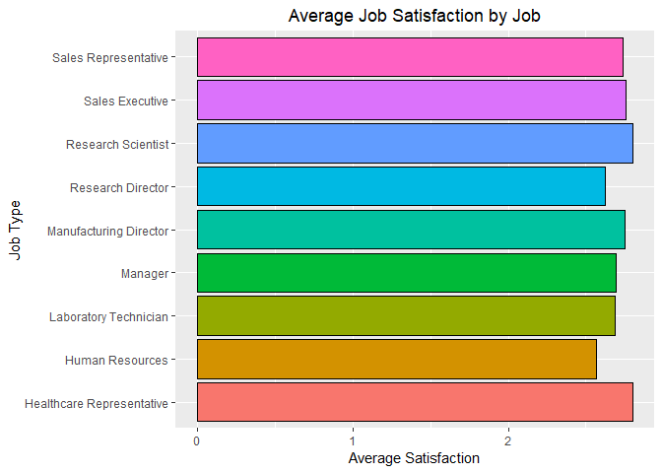

Slide 8
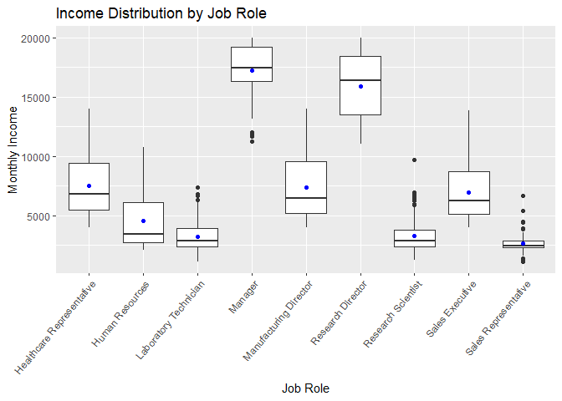

Slide 9
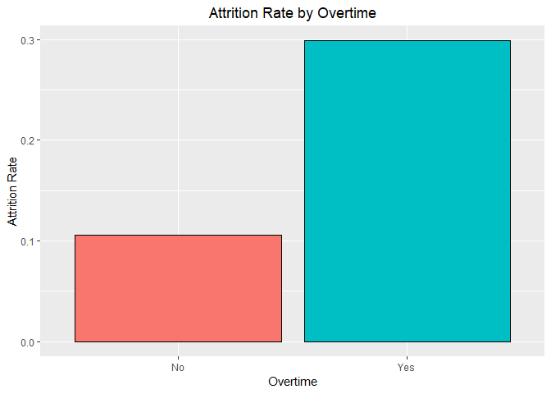
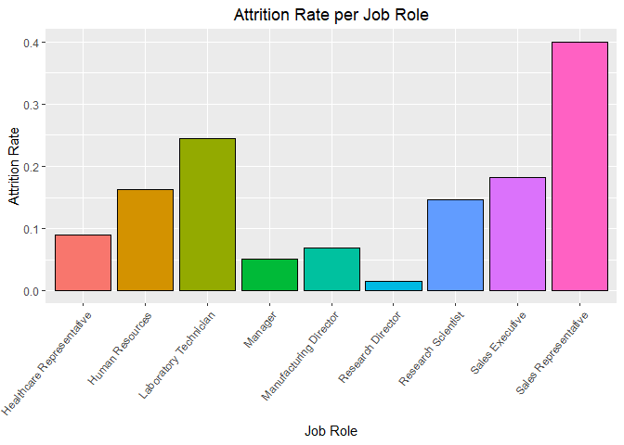
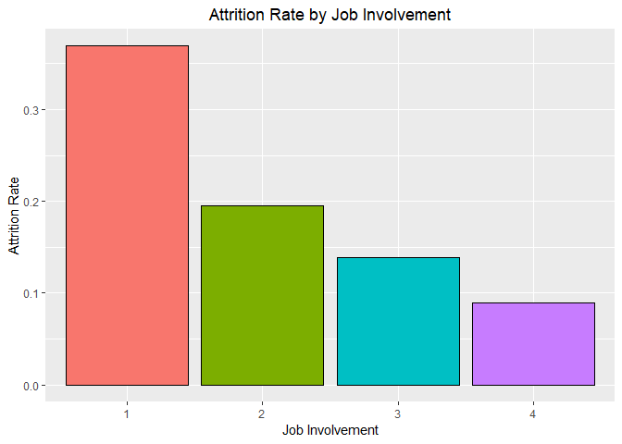
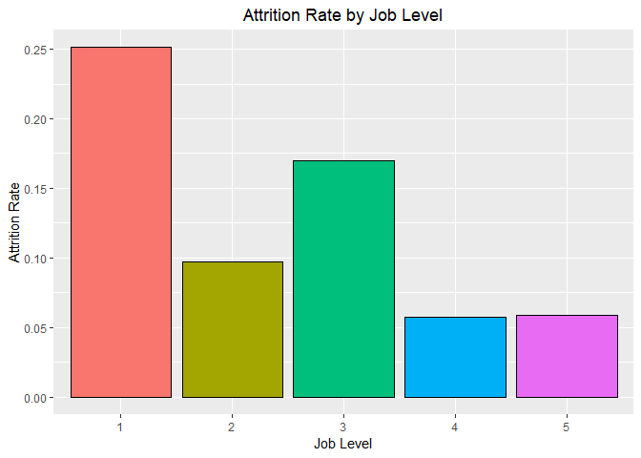
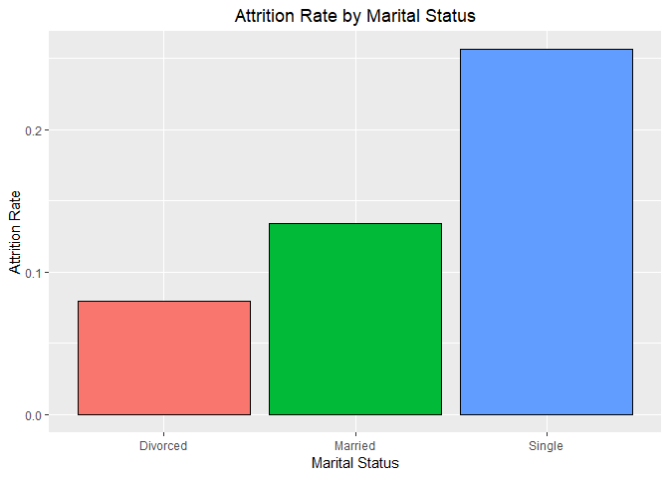
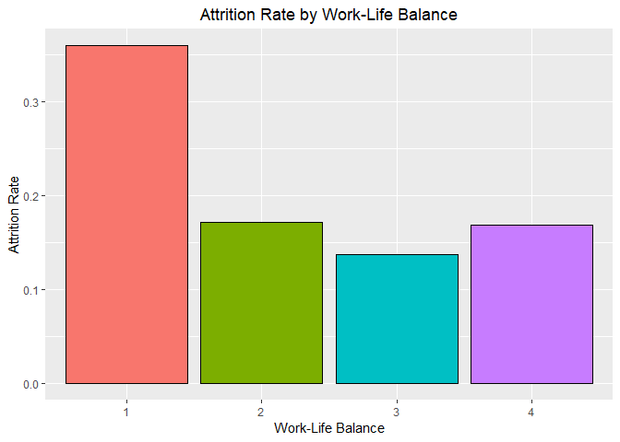

Slide 10
Conclusion
Single people have higher attrition than married and divorced people.
Overtime has a high attrition rate.
Attrition influenced more by the actual content of the job.

