Slide 1
Talent Management Through Data Analytics
Team JKT
DDS Analytics

Slide 2
DDS Analytics
Data analytics company specializes in talent management solution for Fortune 1000 companies
Iterative process of developing and retaining employee
Leverage data science for talent retention
Identifying turnover factors
Predicting employee attrition

Slide 3
Outline
Purpose: to identify factors that are associated with employee attrition
Who are leaving?
Why they are leaving (factors impacting their high attrition rate)?
Dataset: 1470 employee attrition data, 35 features, average 16% attrition rat
Analytical approaches: R, logistic regression, naïve Bayse and random forest models
Predicting future attrition

Slide 4
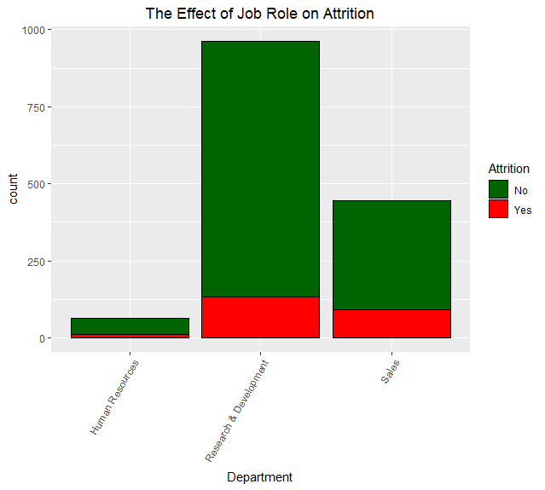
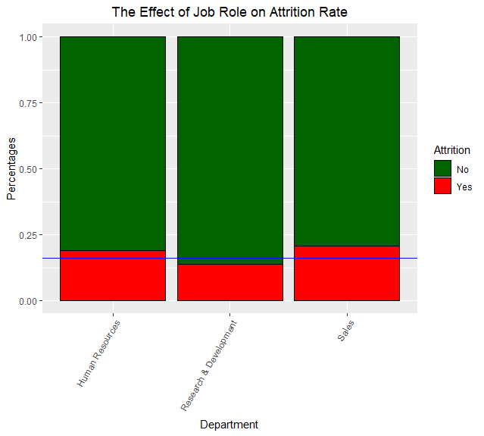
Who is leaving?

Slide 5
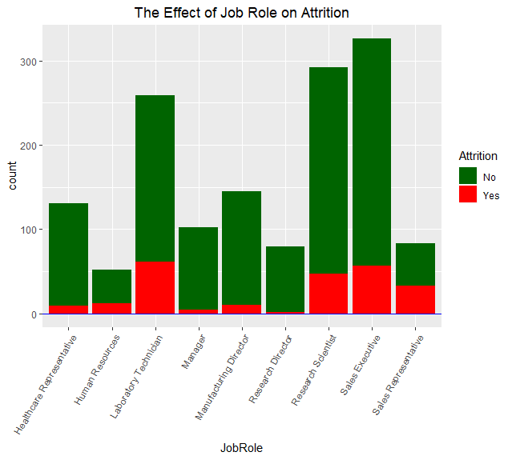
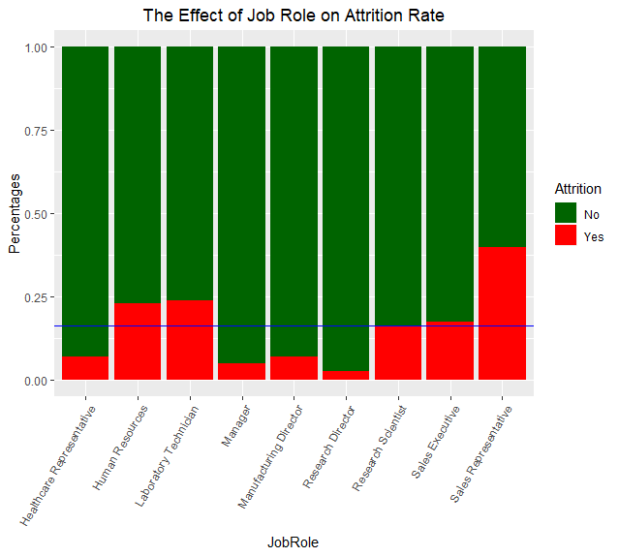
Who Are Leaving?

Slide 6
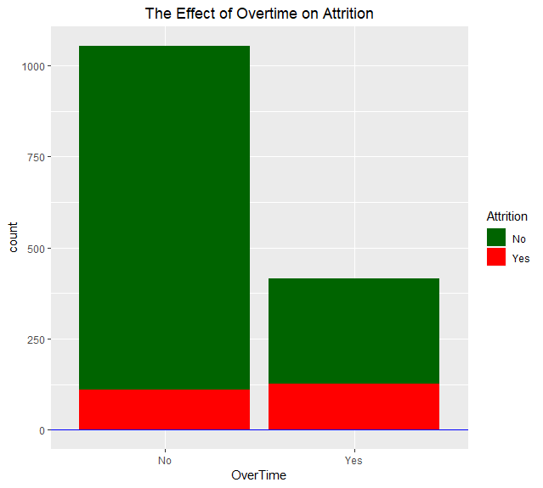
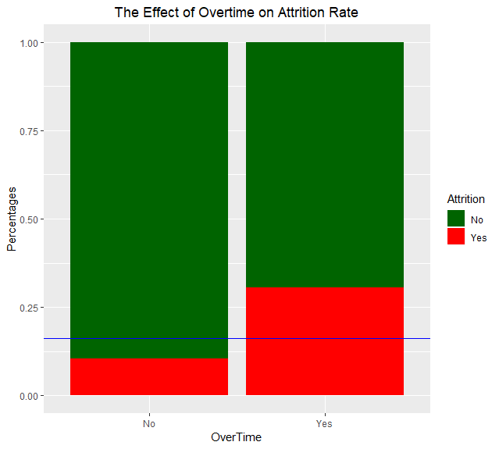
Top Factor Associated With High Attrition Rate: Working Over Time

Slide 7
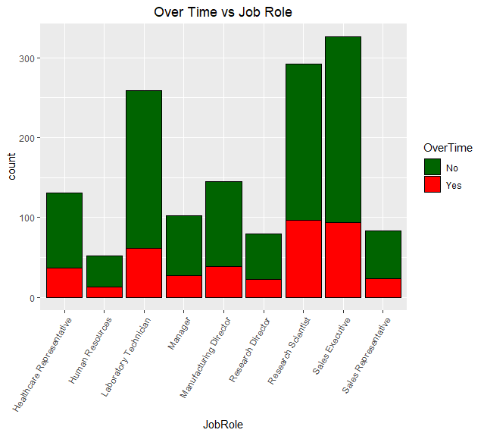
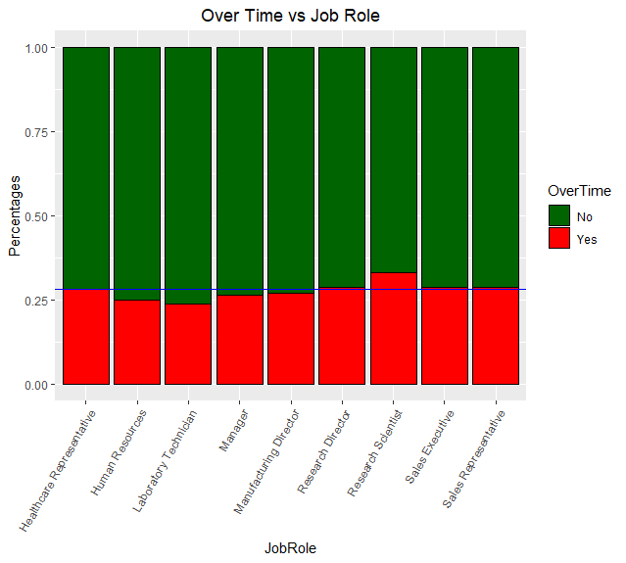
Over Time Rates Are Similar Among All Jobs

Slide 8
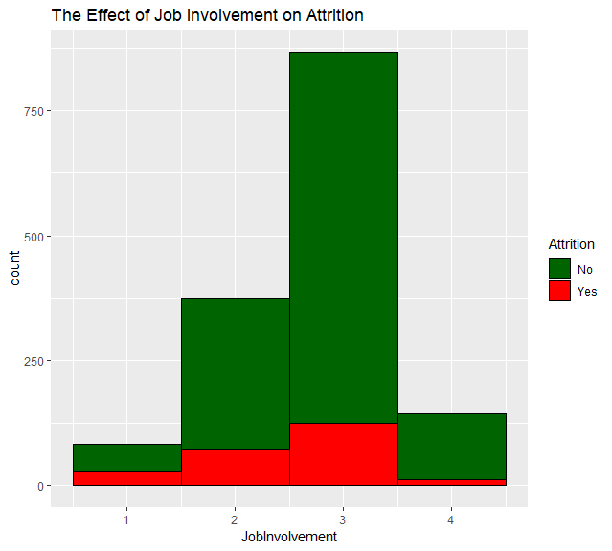
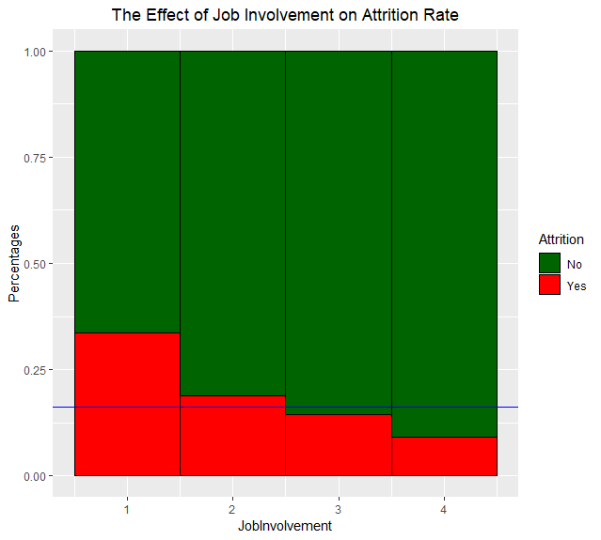
2nd Factor Associated With High Attrition Rate: Poor Job Involvement

Slide 9
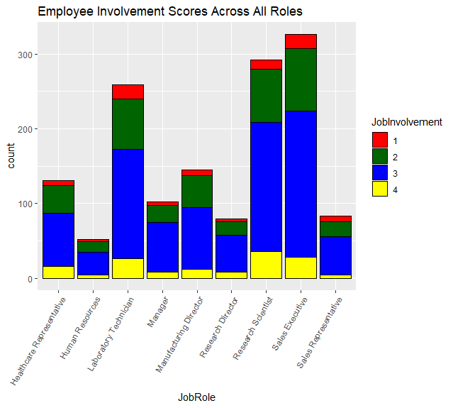
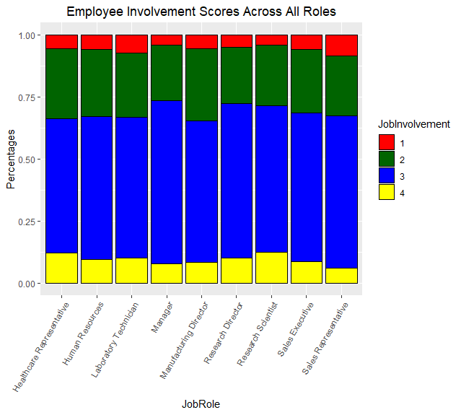
Job Involvements Are Lower Among Sales Reps And Lab Techs

Slide 10
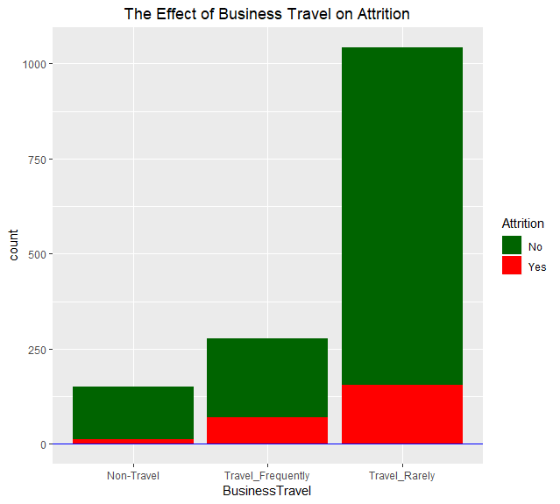
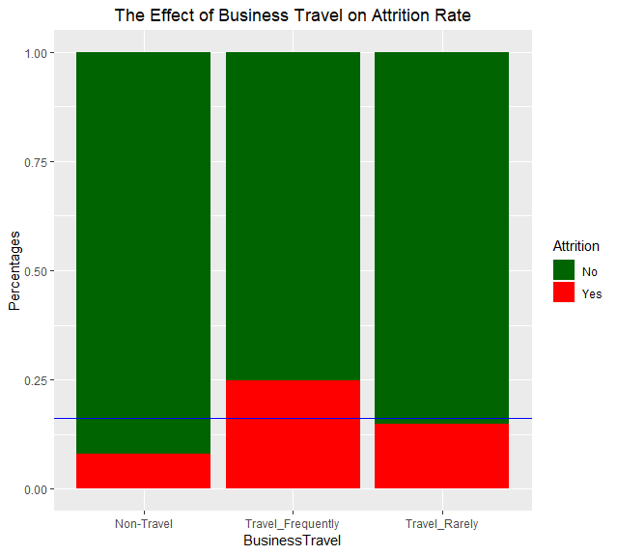
3rd Factor Associated With High Attrition Rate: Frequent Business Travel

Slide 11
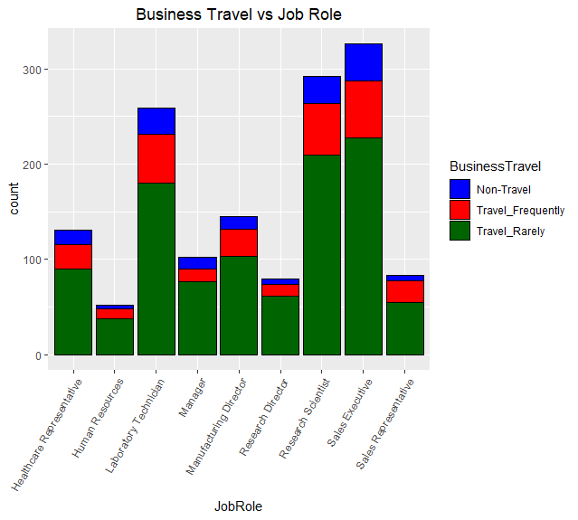
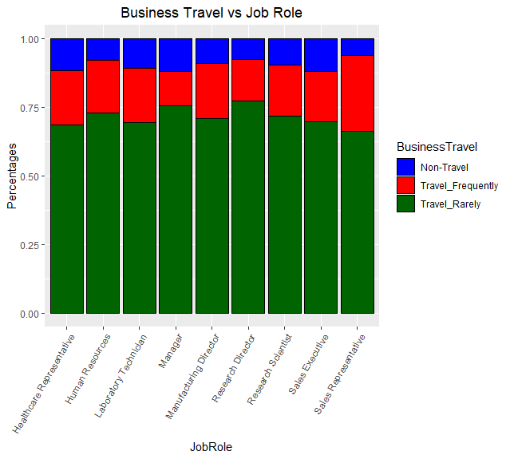
Sales Reps Have Much Higher Rate of Travel
Conclusion: 1. Higher turnover rates among sales reps and lab techs are likely due to combination
of factors
2. Working overtime appears to be a company-wide issue in terms of employee attrition

Slide 12
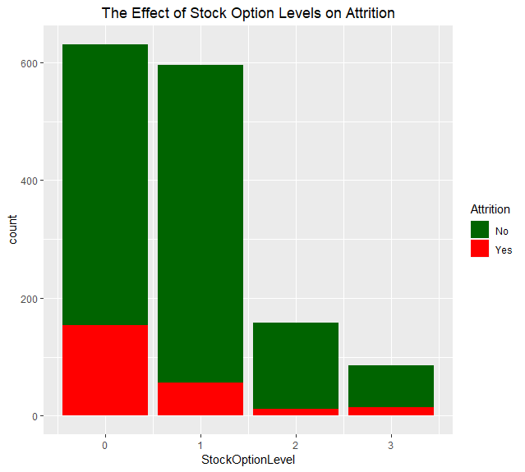
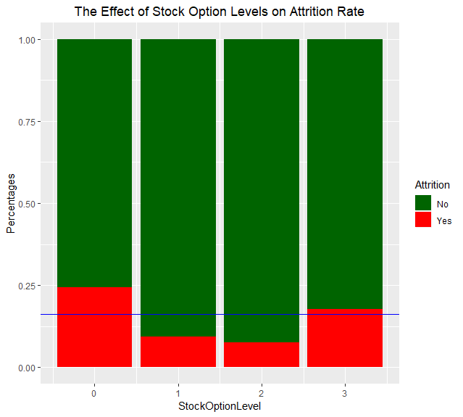
Top Factor Associated With Low Attrition Rate: Stock Options

Slide 13
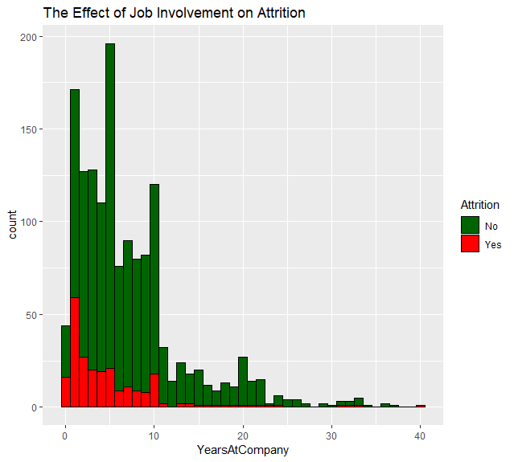
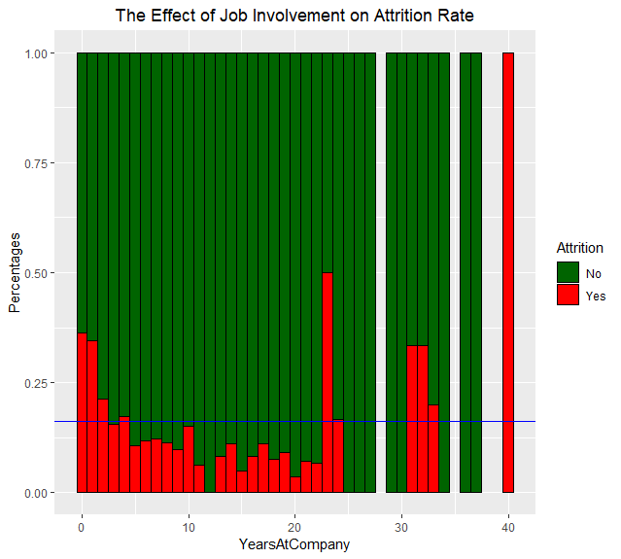
2nd Factor Associated With Low Attrition Rate: At Least Three Years With Company

Slide 14
Conclusion and Recommendations
Overtime is the influential factor – ways to improve work/life balance
Job involvement: developing strategy to keep employee engaged
Travel: developing strategy to reduce travel needs
How to keep young/new employee:
More time with manager: Mentoring
The first three years are the key
Stock options?

