Slide 1
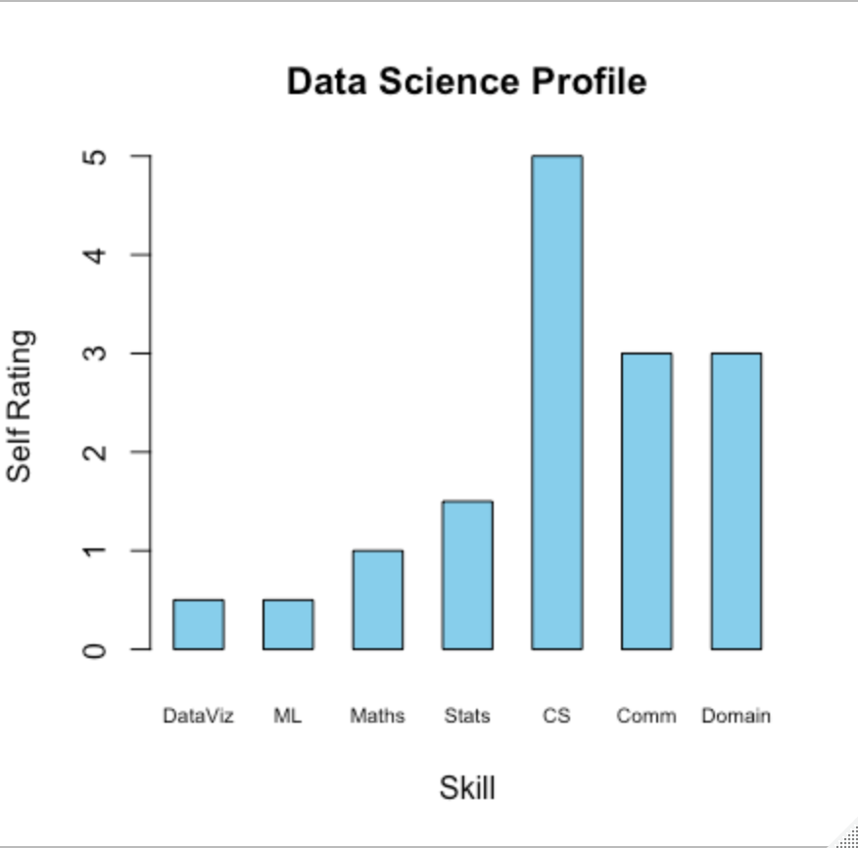
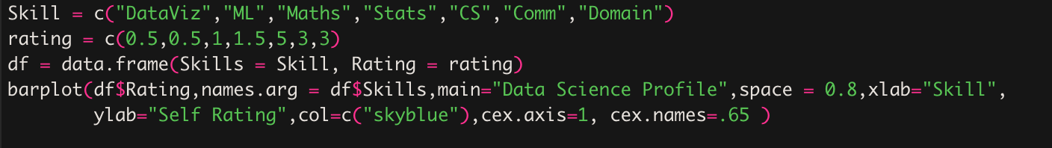
Data Science Profile

Slide 2
Generate Population
Generate population chi-square distribution
Distribution is heavily right skewed
R function rchisq – generates required population
rchisq(n, df, ncp = 0) – function to generate n random numbers for df degrees of freedom
Population size n = 10,000,000
Degrees of freedom (df) is equal to 2
ncp – non-centrality parameter is 0
rchiq(10000000,2)

Slide 3
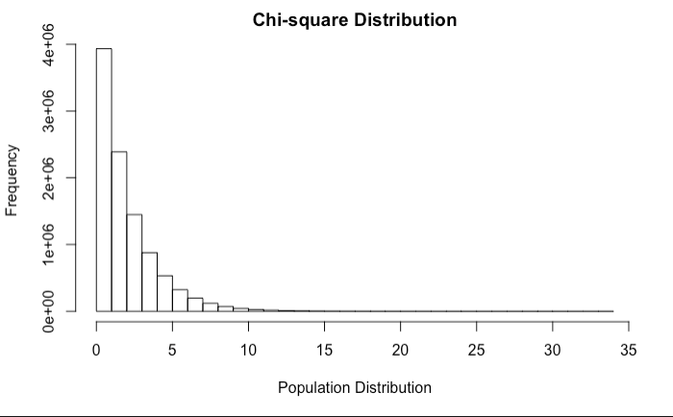
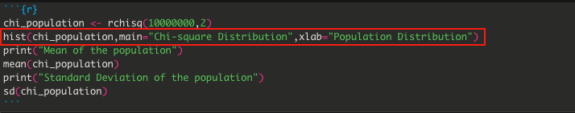
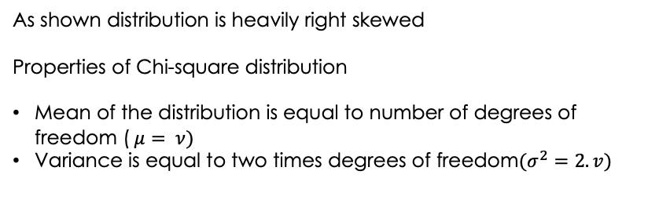
Population Distribution
As shown distribution is heavily right skewed Properties of Chi-square distribution Mean of the distribution is equal to number of degrees of freedom ($μ= ν)$ Variance is equal to two times degrees of freedom$(σ^{2}=2.v)$

Slide 4
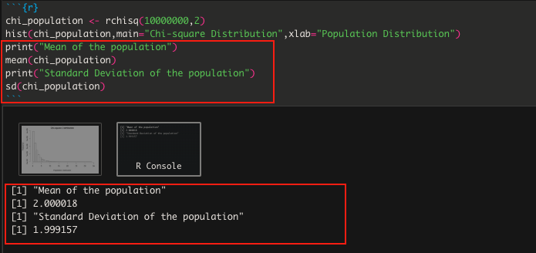
Mean and Standard Deviation of the Population
This population coming from chi-square distribution with 2 df.
Mean and SD are almost equal to degrees of freedom.

Slide 5
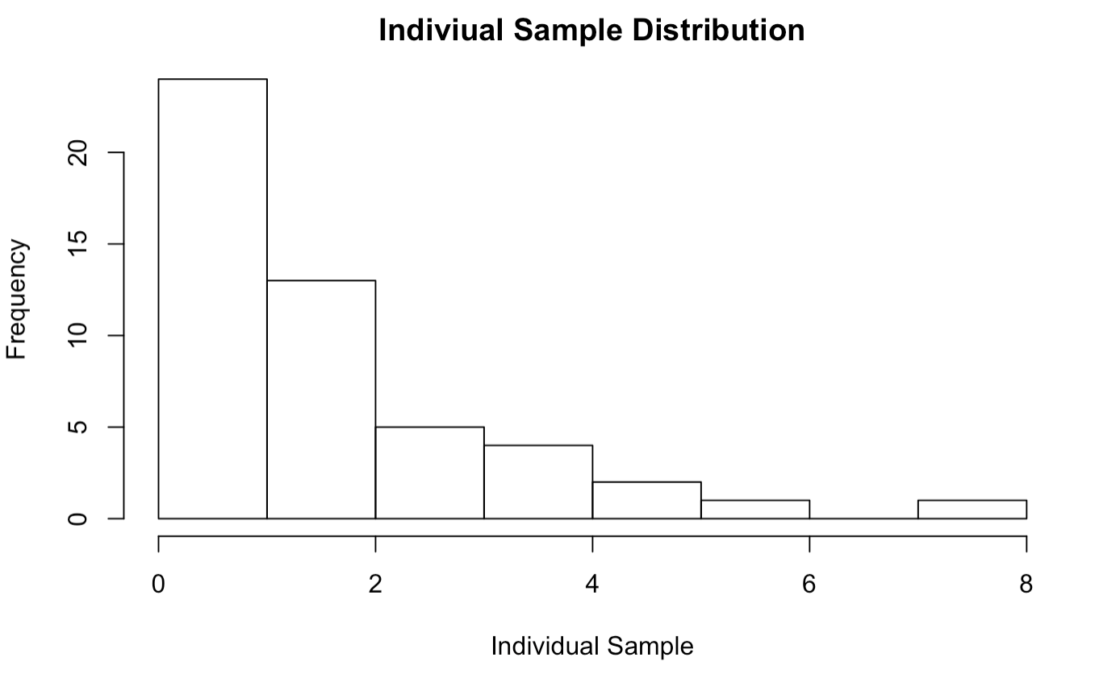
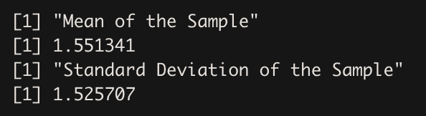
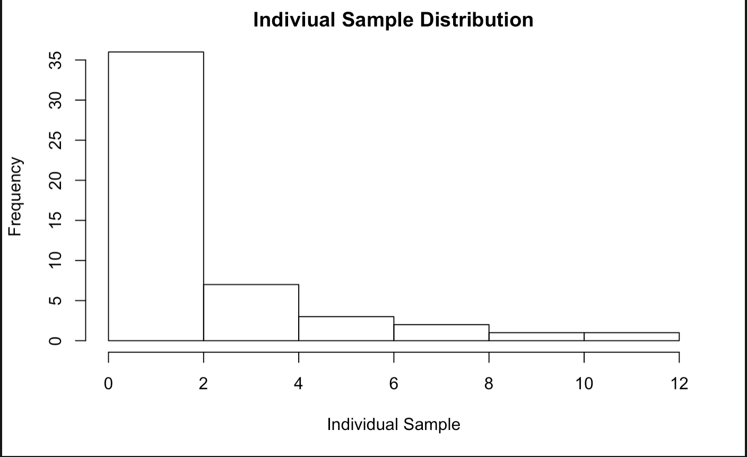
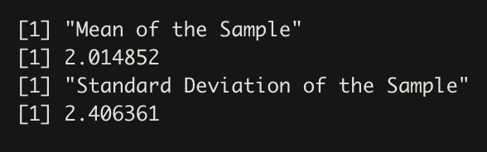
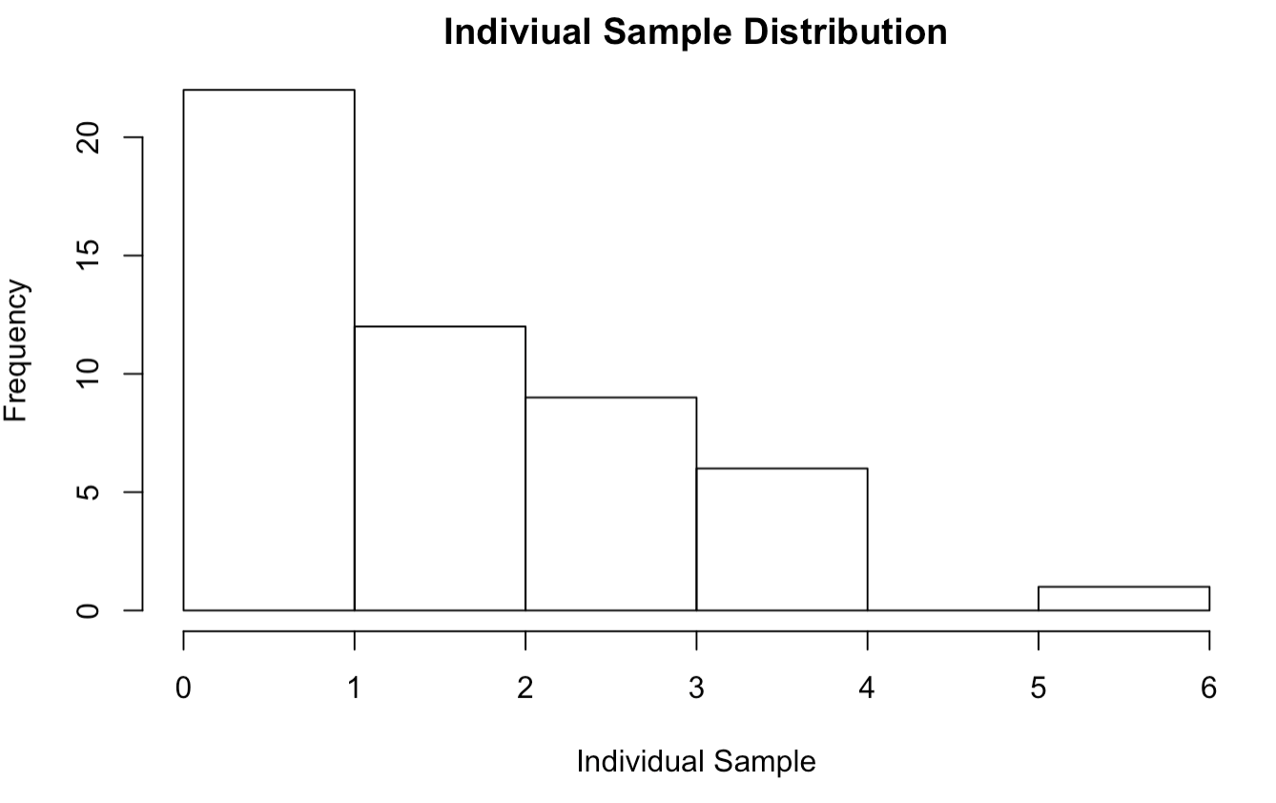
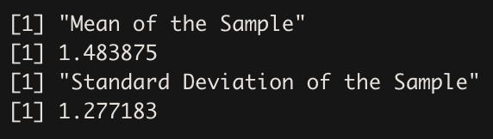
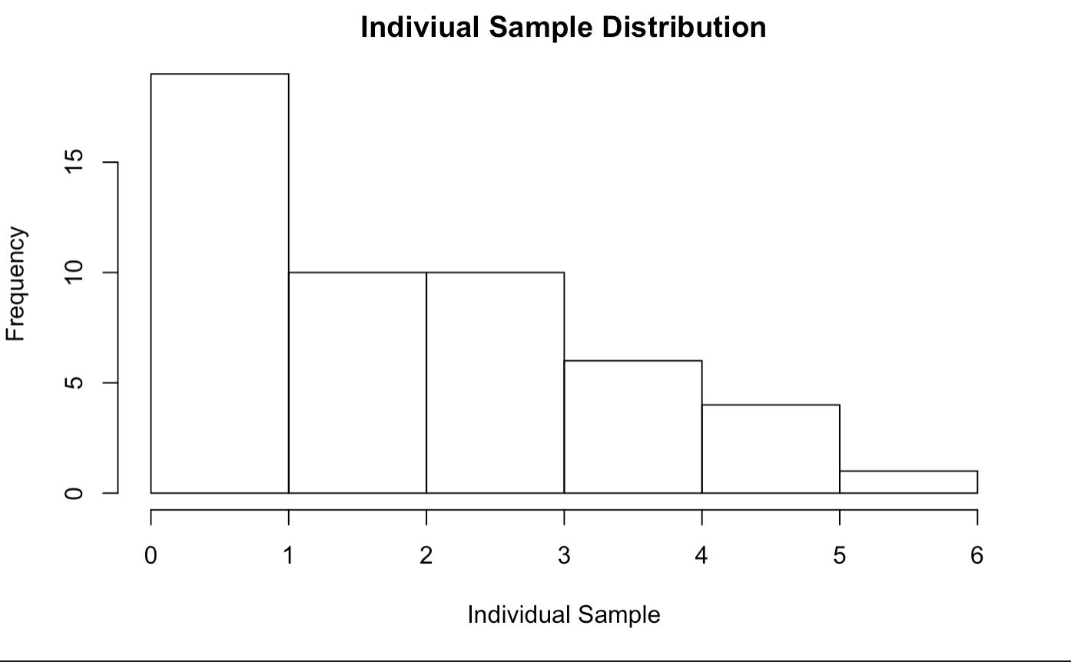
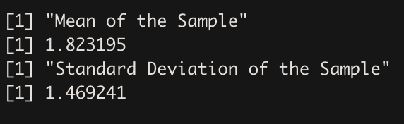
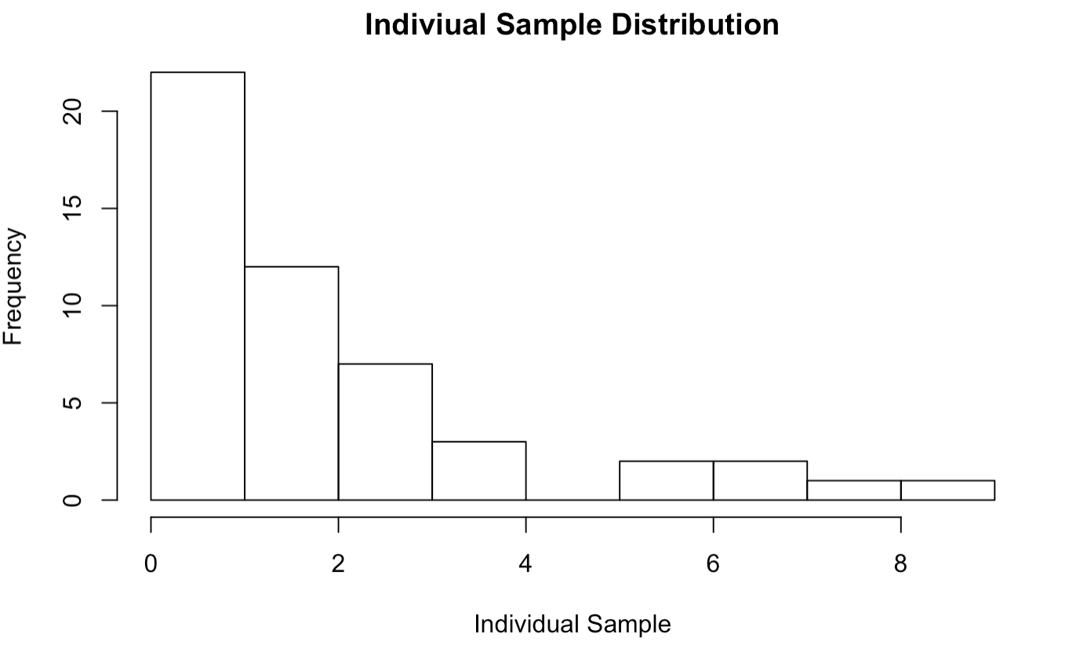
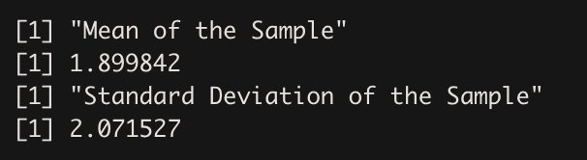
Individual Samples
As shown individual samples (of size 50) drawn from chi-square population
of 10,000,0000 is also right skewed.
However, distribution of all samples should be approximately normally
Distributed as shown in next slide

Slide 6
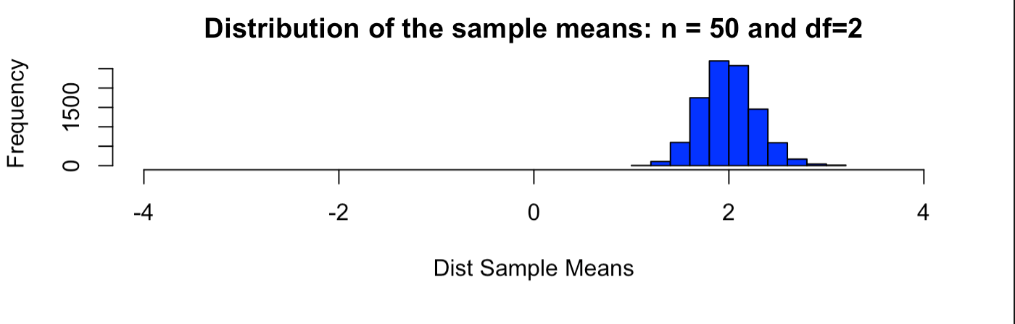
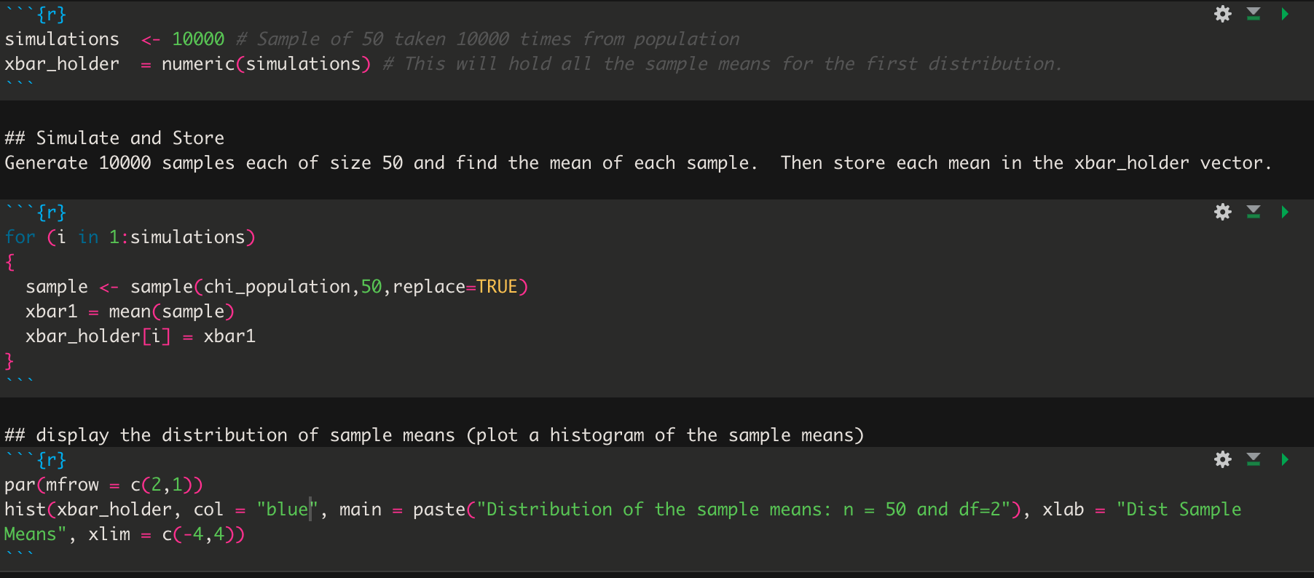
Central Limit Theorem Sampling distribution of Sample Means
As shown, Distribution of sample means drawn from chi-squared population (right skewed) is normal.

Slide 7
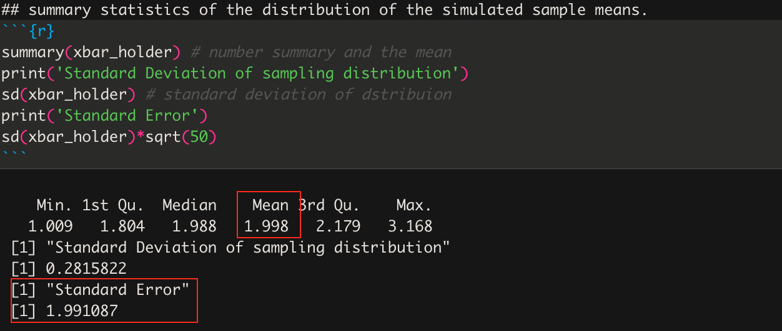
Mean and SD of Sampling Distribution
Standard Deviation for sampling distribution = s /sqrt(n) . Standard error is approximately equal to df

Slide 8
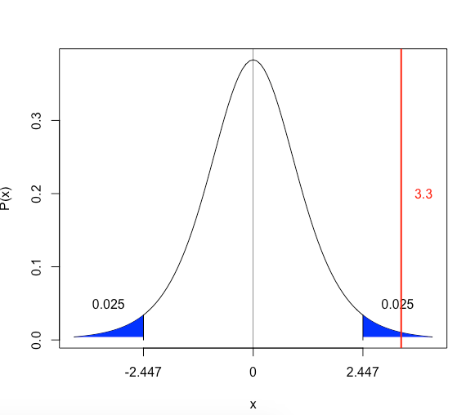

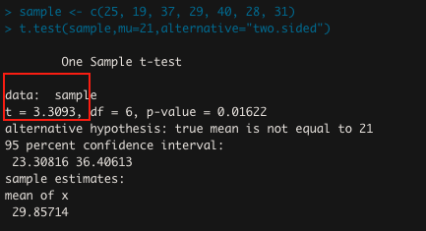
Hypothesis Test
Step 1: Ho and Ha
Ho : Mean age is equal to 21
Ha : Mean age is not equal to 21
Step 2 : Critical value (Significance level – 0.05)
Step 3 : Test-Statistic
t-statistic = 3.30
Step 4 : p-value
p-value = 0.01622
Step 5 : Decision
Reject Ho as test statistics > critical value and p-value < 0.05
Step 6 : Conclusion
There is strong evidence to suggest that true mean age of patron at beachcomber at 7:00pm is
different than 21 (p-value=0.01622,alpha=0.05,two-sided t-test). We are 95% confident
That mean age at beachcomber at 7:00pm is between 23 and 36 which doesn’t include age 21.
This is random sample at specific time. So inferences cannot be generalized to population seen
at other times. Causal inferences cannot be made as this is not randomized experiment

Slide 9
Key takeaways
Reproducible Research
Github
Rstudio
R basics
R Markdown
Central Limit theorem
chi-square distribution

Slide 10
Questions
Is reproducible research protected by any licenses like GPL?

