Slide 1
Web Services: API and YouTube.
Durante Samuele Orazio

Slide 2
What is a
Web Service?

Slide 3

Web Services
1
Definition
Web services are a key component in achieving interoperability between applications and systems on the web, allowing them to communicate and share data seamlessly. They play a crucial role in the development and operation of modern web applications.

Slide 4
Benefits/Properties of Web Services
1
2
Interoperability
Loose Coupling
3
4
Location Transparency
Communication Protocols

Slide 5
Difference between
SOAP and REST

Slide 6
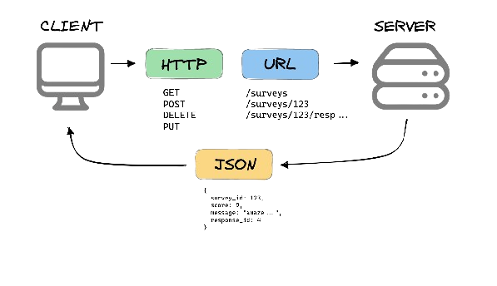
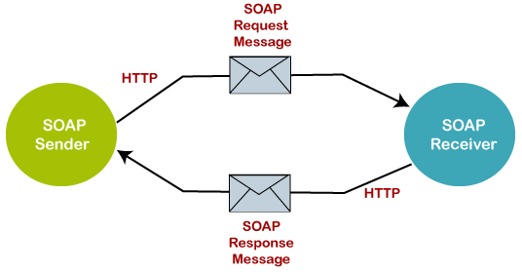
2 approach, 2 scenarios
2
SOAP
REST

Slide 7
NOW
My app

Slide 8
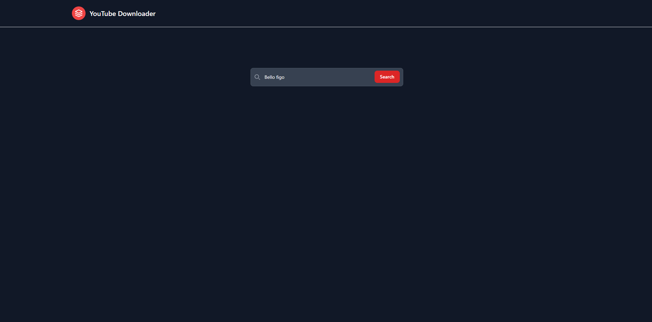
Youtube Downloader
It is a software that allows to search for videos on YouTube and the ability to download them in various formats and qualities.

Slide 9
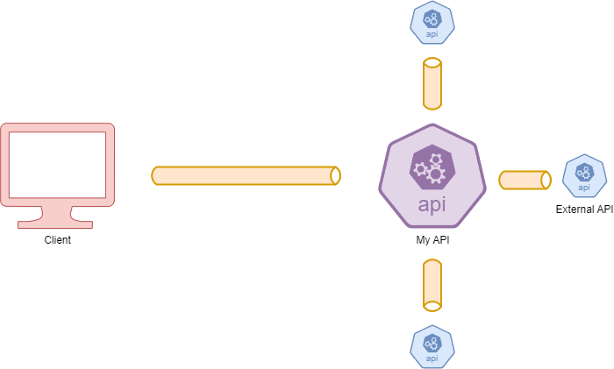
My App
Scheme

Slide 10
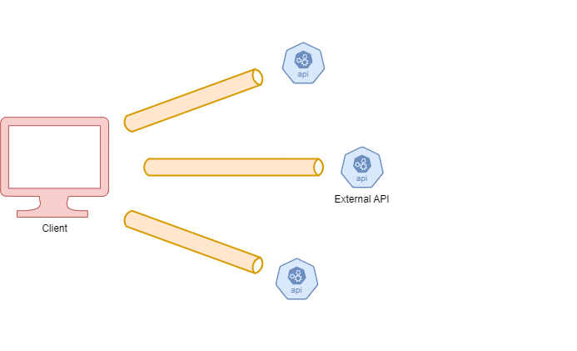
Normal App
Scheme

Slide 11
NOW
a demo

Slide 12
NOW
the code

