Slide 1
Web Services: API and YouTube.
Durante Samuele Orazio

Slide 2
What is a
Web Service?

Slide 3

Web Services
1
Definition
Web services are a key component in achieving interoperability between applications and systems on the web, allowing them to communicate and share data seamlessly. They play a crucial role in the development and operation of modern web applications.

Slide 4
Benefits/Properties of Web Services
1
2
Interoperability
Loose Coupling
3
4
Location Transparency
Communication Protocols

Slide 5
Difference between
SOAP and REST

Slide 6
2 approach, 2 scenarios
2
SOAP
REST
SOAP is a messaging protocol that allows programs running on disparate operating systems to communicate with each other. It uses XML for message format and relies on application layer protocols, most often Hypertext Transfer Protocol (HTTP) or Simple Mail Transfer Protocol (SMTP), for message negotiation and transmission.
REST is an architectural style for web communication, facilitating interaction between systems. These systems are stateless, using standard HTTP methods for data transactions. Known for its simplicity and scalability, REST is often used in cloud services and social networking sites. A web service following REST principles is termed RESTful.

Slide 7
NOW
My app

Slide 8
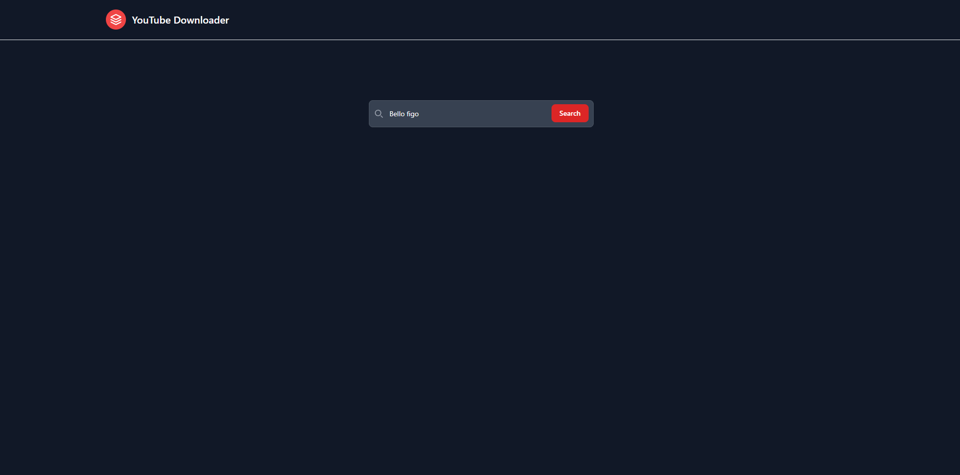
Youtube Downloader
It is a software that allows to search for videos on YouTube and the ability to download them in various formats and qualities.

Slide 9
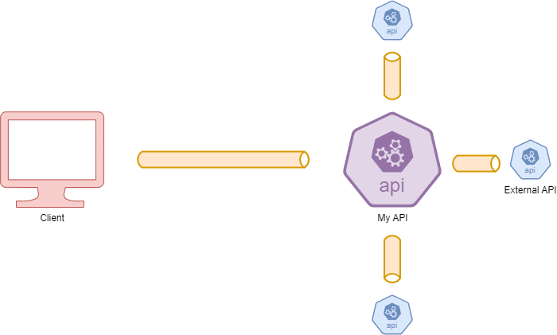
My App
Scheme

Slide 10
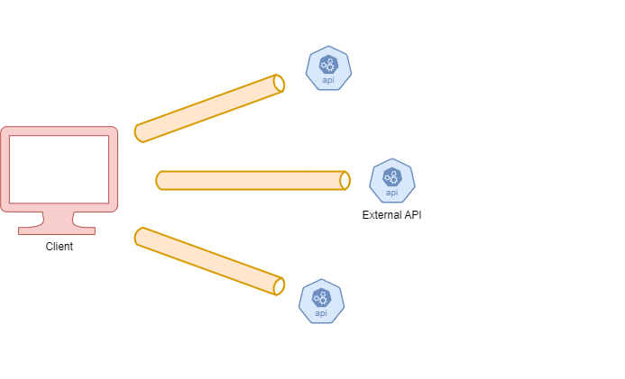
Normal App
Scheme

Slide 11
NOW
a demo

Slide 12
NOW
the code

