Slide 1
Introduction to JavaScript
Unit 1

Slide 2
What is JavaScript?
A scripting language used to make static web pages dynamic.
A client-side scripting language.
Makes web pages respond to user actions.
Adds special effects to web pages.
JavaScript is not the same as Java.
JavaScripts do not need to be compiled before execution.

Slide 3
What are static web pages?
Static webpages are used to display flat content.
Static webpages do not allow user interaction.
Examples of static pages are personal blog pages and faculty web pages.

Slide 4
What are dynamic web pages?
Dynamic webpages are used to display content that can change based on user actions.
JavaScript is used in the creation of dynamic web pages.
Dynamic websites, such as online shopping websites
(e-commerce), make use of JavaScript to allow user interaction.

Slide 5
Features of JavaScript
Object-based: means JavaScript can work with objects.
  An object is a special kind of data which has properties and methods associated with it.
  Objects use methods. Methods are actions that can be performed by objects.
Client-side (scripting language): means JavaScript runs in the client and not in the web server .
  Web browsers like Internet Explorer and FireFox are clients.

Slide 6
How to use JavaScript
Internal JavaScript: code is placed within HTML document.
For example:
<html>
<head>
<title>
</title>
</head>
<body>
<script type = “text/javascript”>
document. write(“Hi.. I’m writing Java Script”);
</script
</body>
</html>
External JavaScript: code is saved externally as a .js file and referenced in the HTML document using ‘src’ attribute.
For example:
<html>
<head>
<title>
</title>
</head>
<body>
<script type = “text/javascript” src = “filename.js”>
</script
</body>
</html>

Slide 7
How to use JavaScript
JavaScript code goes inside <script> and </script>
The ‘type’ attribute is used to specify which scripting language we are using. It is always included whether we are using internal or external JavaScript.
<script type="text/javascript">
…
</script>
The ‘src’ attribute is used only for external JavaScript to reference JavaScript code written in a .js file.
<script type=“text/javascript” src=“filename.js”>
...
</script

Slide 8
How to use JavaScript
document.write is a method in JavaScript used to display text on the web page when viewed in a browser.
JavaScript is case sensitive –
document.write is not the same as Document.write
Command lines in JavaScript end with a semicolon.
…
document.write(“Hello World!");
…

Slide 9
Why use External JavaScript?
An external JavaScript file can be referenced in many HTML documents instead of having to write it repeatedly for each document.
When JavaScript code is very long it is most efficient to include it in an external file.
Using external JavaScript can help webpages render faster.

Slide 10
JavaScript in <head>
JavaScript can be placed in the <head> section of an HTML document.
When we use <script> within the <head> tags, the JavaScript is intended to be executed when called by the user.

Slide 11
Example of JavaScript in <head>
<html>
<head>
<title>
Simple JavaScript in Head
</title>
<script type="text/javascript">
function message()
{
alert("This alert box was called with the onclick event");
}
</script>
</head>
<body onclick="message()">
</body>
</html>

Slide 12
JavaScript in <body>
JavaScript can be placed in the <body> section of an HTML document.
When used in <body>, JavaScript will be executed while the page loads.

Slide 13
Example of JavaScript in <body>
<html>
<head>
<title>
Simple JavaScript in Body
</title>
</head>
<body>
<script type = “text/javascript”>
document.write(“Hi.. I’m in body”);
</script>
</body>
</html>

Slide 14
Comments in JavaScript
JavaScript allows the use of comments to help to:
  Describe the function of a line of code.
  Disable a line of code by simply commenting out.
  Debug the script by using commented parts of code to check if it is causing an error.

Slide 15
Types of JavaScript Comments
Single line comments are used to add comments in a single line of JavaScript code.
  Denoted by //
For example:
…
document.write(“comment”); // single line comment
…

Slide 16
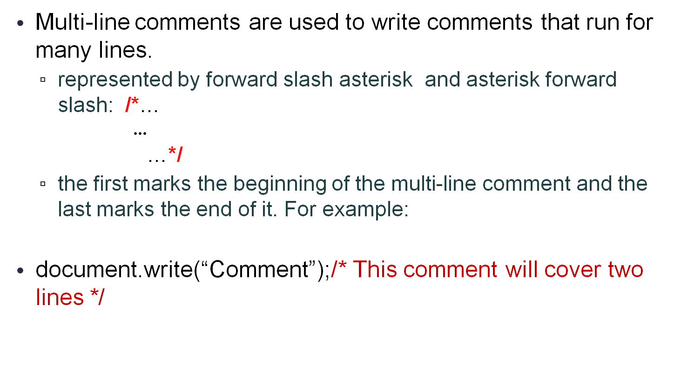
Types of JavaScript Comments

