Slide 1
UFO Sightings : Interactive Map and Charts
Group Members : Dylan McKibbin, Tamer Abdelaal,
Sam Portelli and Samir Barua
Australian UFO Research Department

Slide 2
Project Outline
Commissioned by the Australian Defence Force.
Prepare a high-level analysis of UFO sightings around the world to determine the quantity, types and locations of UFO sightings.
Provide visualisation tools to help understand the top locations where UFO sightings have occurred and whether there is a trend of increased sightings and threats posed by these sightings.

Slide 3
Data Source
Data.World website:
https://data.world/timothyrenner/ufo-sightings
Data set :
100,000 UFO sighting reports.
National UFO Research Center (NUFORC).

Slide 4
Data Source
Meta Data (12 Fields)
Summary Report | Country | City/ State | Date_Time
Shape | Duration | Stats | Report_link
Text | Posted | City_Latitude | City_Longitude

Slide 5
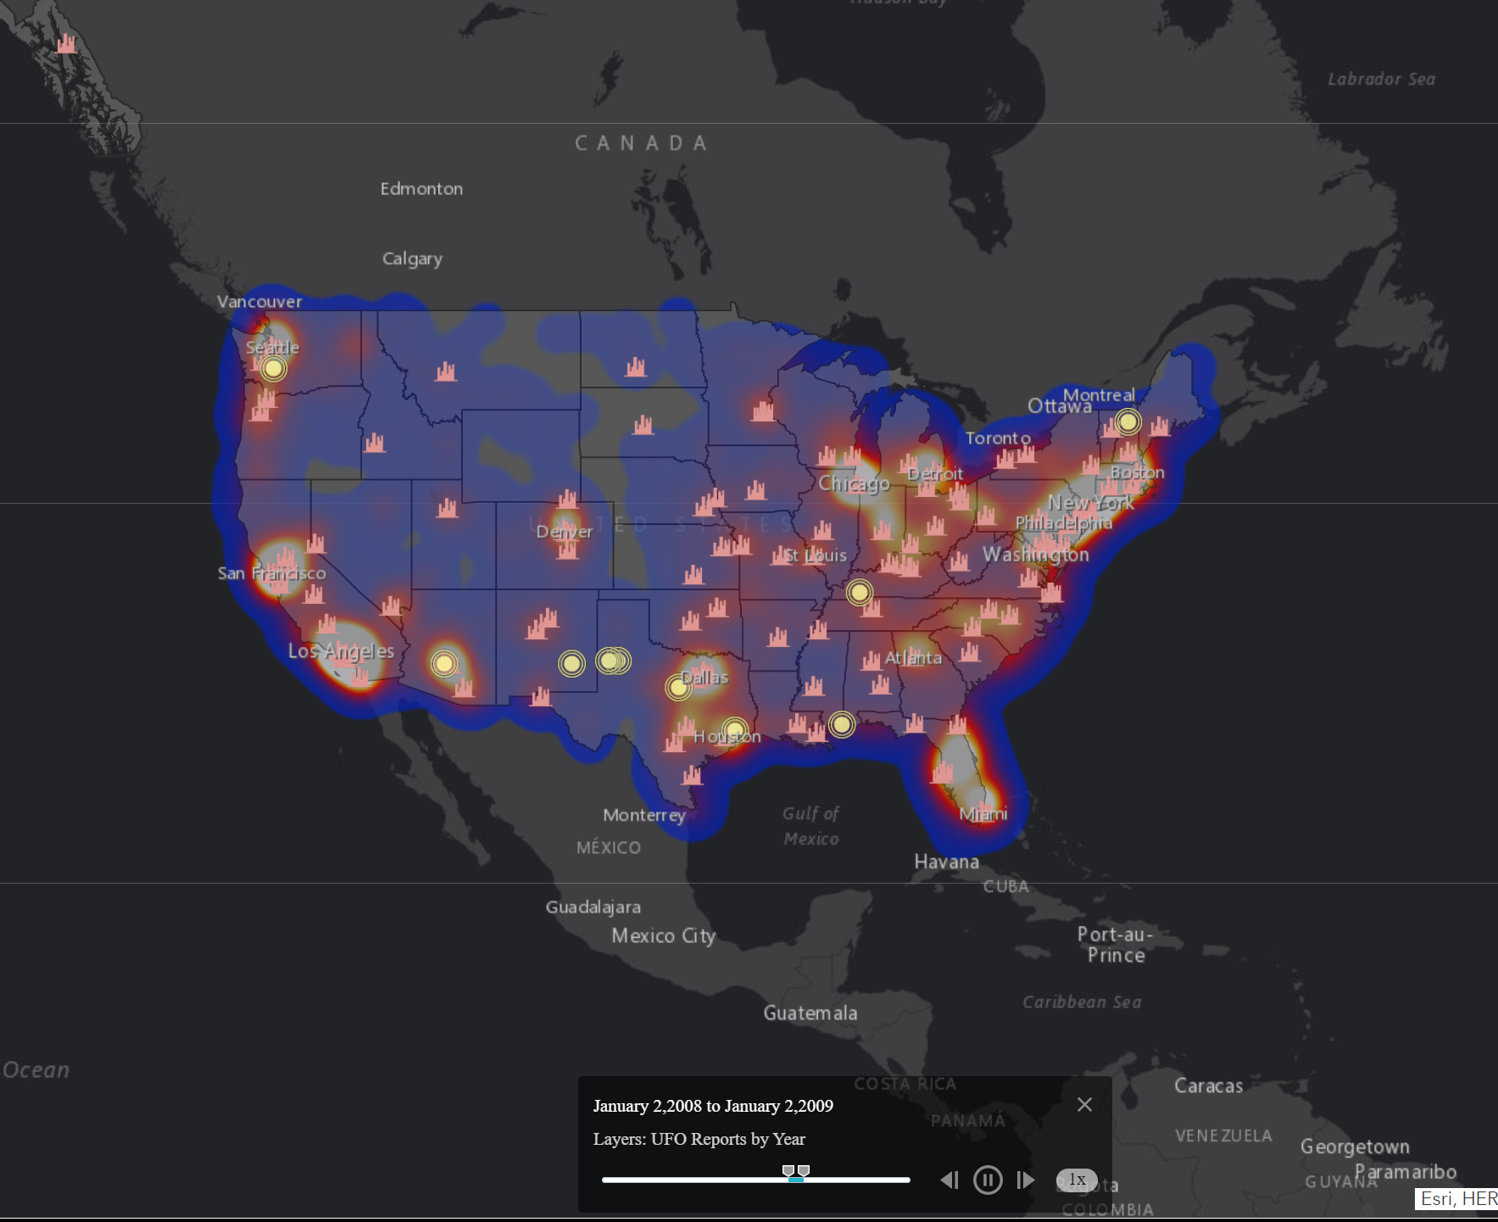
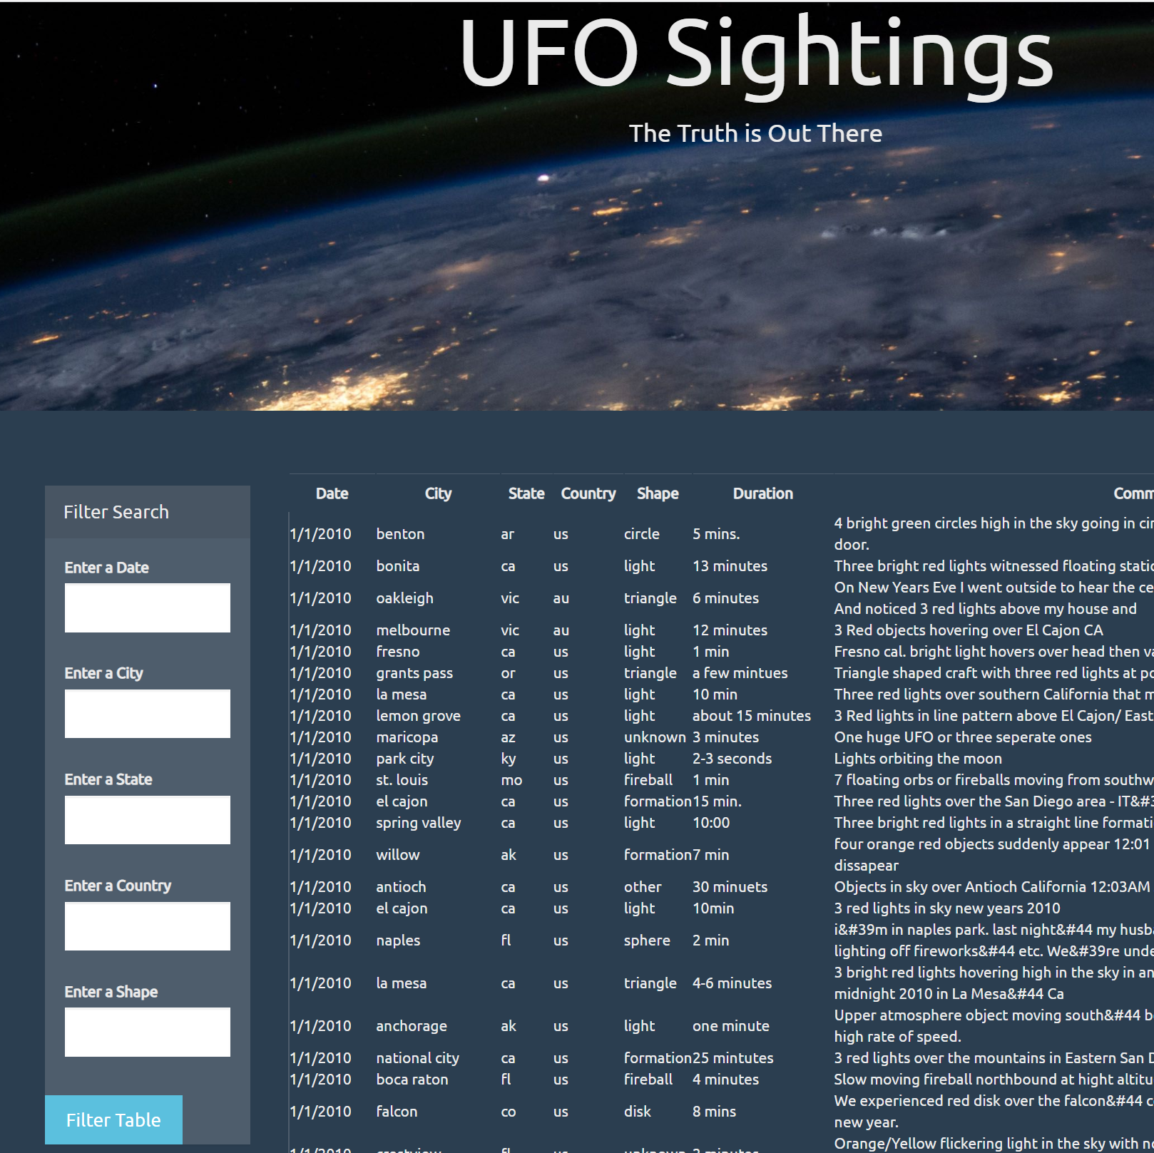
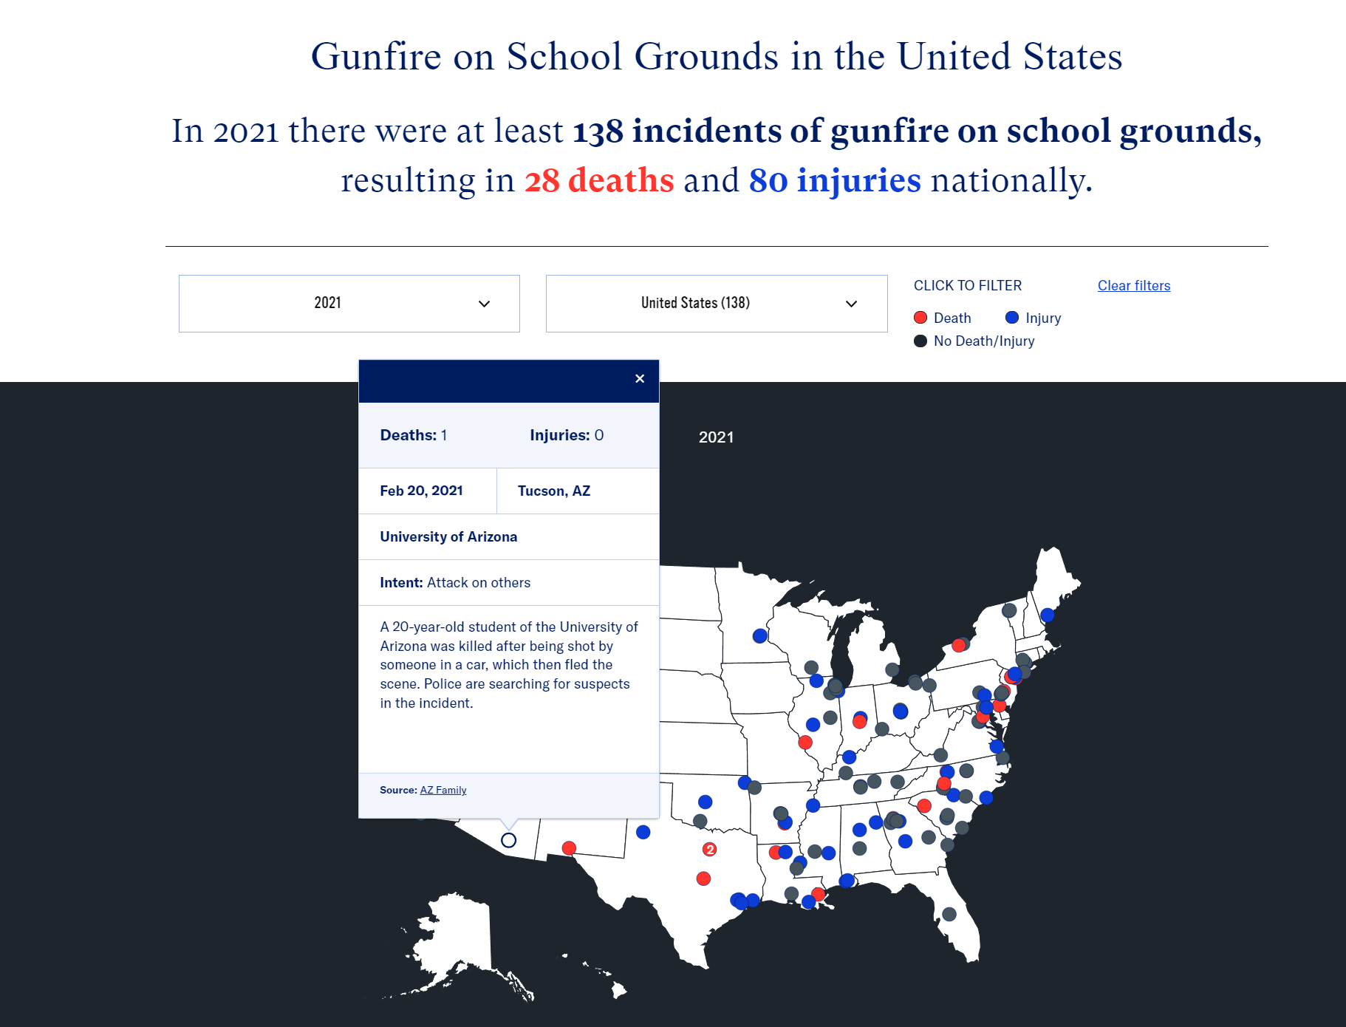

Inspiring Visualisations
https://www.arcgis.com/apps/webappviewer/index.html?id=ddda71d5211f47e782b12f3f8d06246e
javascript-challenge/UFO-level-2/index.html
https://everytownresearch.org/maps/gunfire-on-school-grounds/
https://animejs.com/

Slide 6







Coding Schema

Slide 7
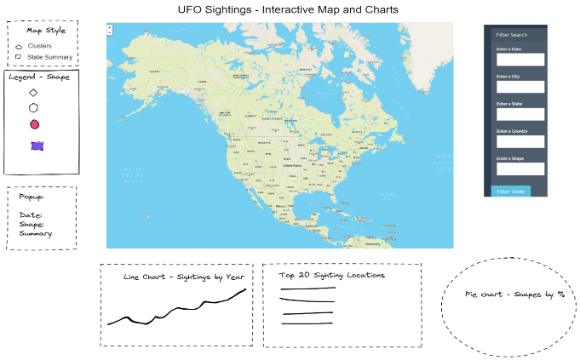
Final Design

Slide 8
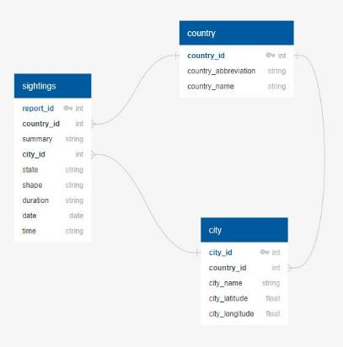
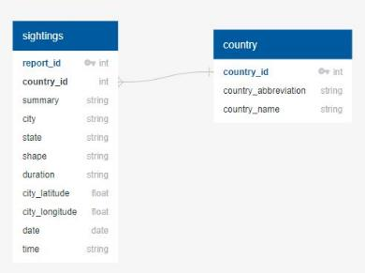
ETL Process
Database v1.
Database v2.

Slide 9
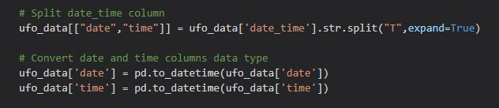
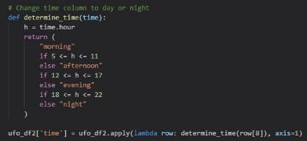
Integrating Time of Day
Choose between:
Morning
Afternoon
Evening
Night

Slide 10
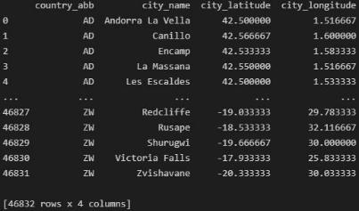
Geocodes of other Countries and Normalising Data
M49 Code (country_abb) from
United Nation Statistics website: https://unstats.un.org/unsd/methodology/m49/overview/

Slide 11


Loading into Database

