Slide 1
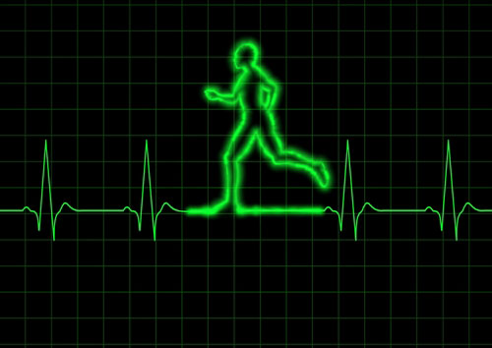

Sixth-sense
START

Slide 2

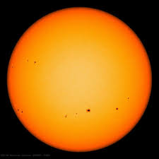


SYMTOMS
DIESEAS

Slide 3

SELECT THE NAME OF THE DIESEAS
DIESEAS 1

Slide 4
Description:
DIESEAS NAME

Slide 5
CHOOSE DESIRED BODY PART
HEAD
EYES
NOSE
EARS
TEETH
CHEST
BELLY
HANDS & LEGS

Slide 6



CHOOSE YOUR SYMPTOMS
SYMPTOM 1

Slide 7

DOCTOR’S SPECIALIST
CHARDIOLOGIST

Slide 8
INSERT YOUR DESIRE PALCE
FOR AMBULANCE
TYPE YOUR DESIRE PLACE

Slide 9
CHARDIOLOGISTS
CHARDIOLOGIST 1
____________contact info__________________
------------------------------------------------------------------
------------------------------------------------------------------
CHARDIOLOGIST 2
------------------------------------------------------------------
------------------------------------------------------------------
CHARDIOLOGIST 3

Slide 10
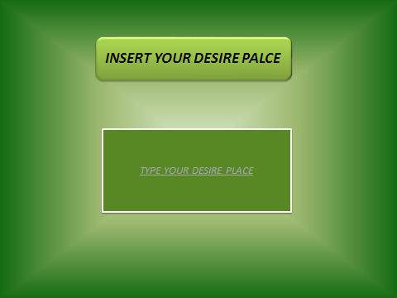

Slide 11
AMBULACE INFORMATION
AMBULENCE 1
____________contact info__________________
------------------------------------------------------------------
------------------------------------------------------------------
AMBULANCE 2
------------------------------------------------------------------
------------------------------------------------------------------
AMBULANCE 3

