Slide 1
Final Project
Sam Pritchard

Slide 2
Premise
Option one from the project options.
Grade assignments by walking into them, avoid the annoying students.
Students will chase the player around, until Jody drinks his Pepsi.
Then he can deal with students and they run away.
If you grade all assignments, you win.
If the students bother you 3 times, you lose.

Slide 3
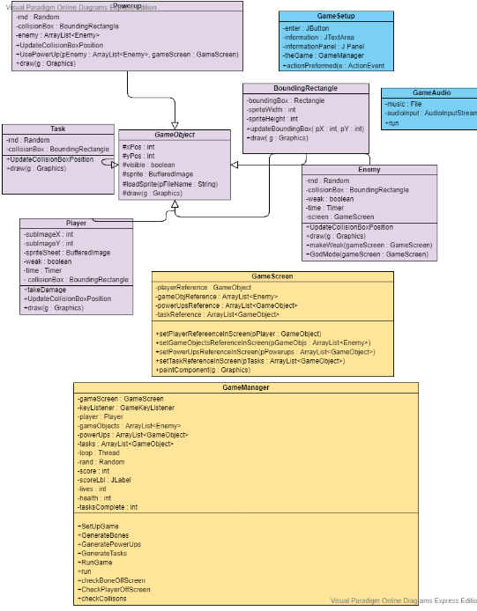
UMl

Slide 4
Issues
Enemies were killing the player too quickly, needed to add some invincibility to the player so they could get away.
Getting the enemy image to change when the player drank the Pepsi was a bit of an issue, I ended up using a Timer and delay for it.

Slide 5
Overview
Overall, the game works well and is playable. The enemies will react to the player and try to beat them.
Biggest thing was finding free .wav files. I kept the music from the framework because I wasn’t able to find another to use.
I changed the player sprite, but it’s a little cut off when he walks up, other than that, it does change direction and walk.
The enemies change sprite when Jody is able to help them, they also change their movement patterns.

