Slide 1

bankovní projekt
Tým 1: Adam, Ankush, Ben, Jordán, Sam

Slide 2
Contents
Demographic Information
Age
Competitor Banks
Region
Individual Metrics
Fraud and Money Laundering
Defaults
Overdraft utilization
Employment Status
Income to Debt ratio
Gender
Age
https://github.com/SamPurle/Banking_Team_1
Notes:
We decided to split our presentation into two main sections: of general demographics and individual metrics
Demographics: modelled demographic information to better inform our overall business decisions and marketing material
Whereas Individual metrics are to support the offering of products to our customers on an individual level.
We began our project by compiling a centralized cleaning script to make the tables more user-friendly & manageable. We will share our github link if you would be interested in reading through this at a later date or the code that gets
Here are some of the points we will talk through, and I will now hand over to Sam who will talk about Age and competitor banks.

Slide 3
Demographics
How can we optimise our business decisions to suit the wider market?

Slide 4
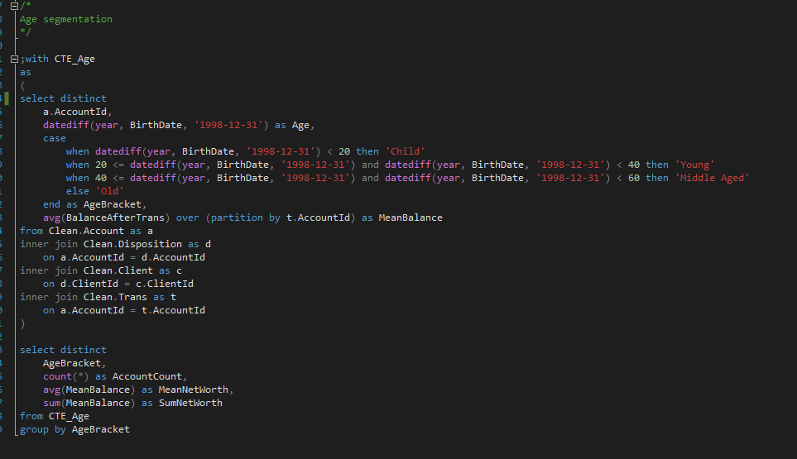
Age Segmentation
Calculate customer Age at End Date of the dataset
Bin Age into categories
Nested aggregate/window functions to determine average and total Net Worth of customers by Age Bracket

Slide 5
Age
Cross-reference with census data to determine market penetration by age bracket, and use this to influence marketing
Offer commission-based financial advice service to relatively high Net Worth customers in the Young and Middle Aged bracket, to avoid decrease in Net Worth with Age

Slide 6
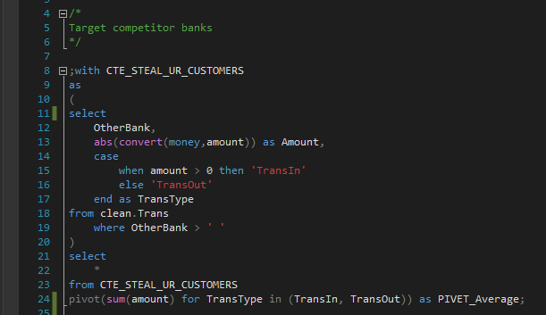
Competitor Banks
Case function to separate IN and OUT
Pivot SUM of transaction value partitioned by Bank for transactions IN and OUT

Slide 7
Business Accounts
High influx of capital implies Businesses employing skilled workers, presumably with large cashflow
Examine account features
Imitate non-existing features
Highlight relative strengths of Berkha’s business accounts in marketing material

Slide 8
High Net Worth Individuals
Filter by income metric, or transaction value
Funds could be going to Stock brokerages, or paying for high-value assets and mortgages
Offer savings products and brokerage services
Introduce spending mechanisms to keep customers within ecosystem

Slide 9
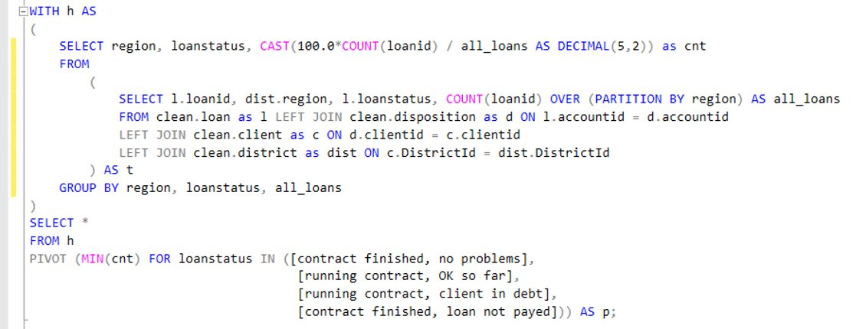
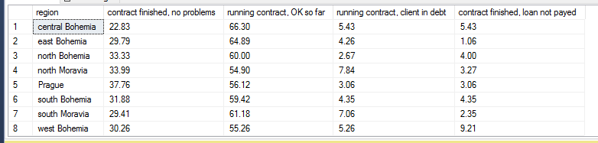
Loan Status by Region
Identify regions which have clients defaulting on loans the most.
Helps to spot areas of risk.

Slide 10
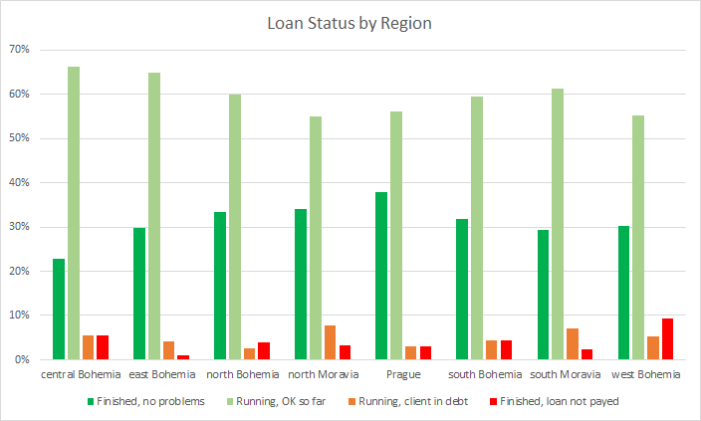
Loan Status by Region
Identify regions which have clients defaulting on loans the most.
Helps to spot geographical areas of risk.

Slide 11
Individual Metrics
How can we use customer information to inform our decisions?

Slide 12
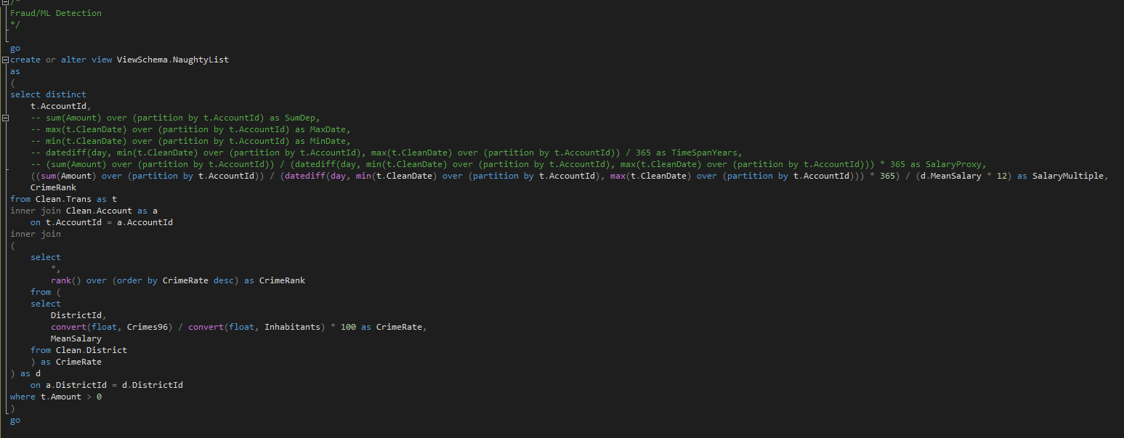
Fraud and Money Laundering

Slide 13
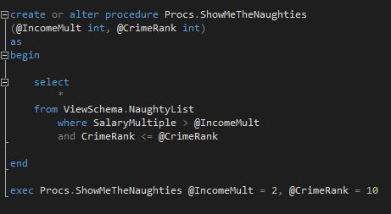
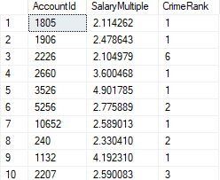
Due Diligence
Ask customers for supporting information if activity is consistently unexpected
Report suspicious activity to law enforcement/tax authorities
Implement k-means/RFC machine learning model
Avoid fines

Slide 14
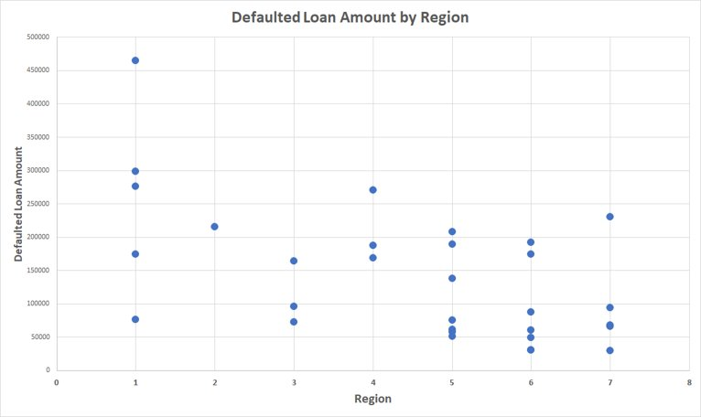
Defaulted Loan Amounts
Plotting loan amount by region helps to spot trends and outliers.

Slide 15
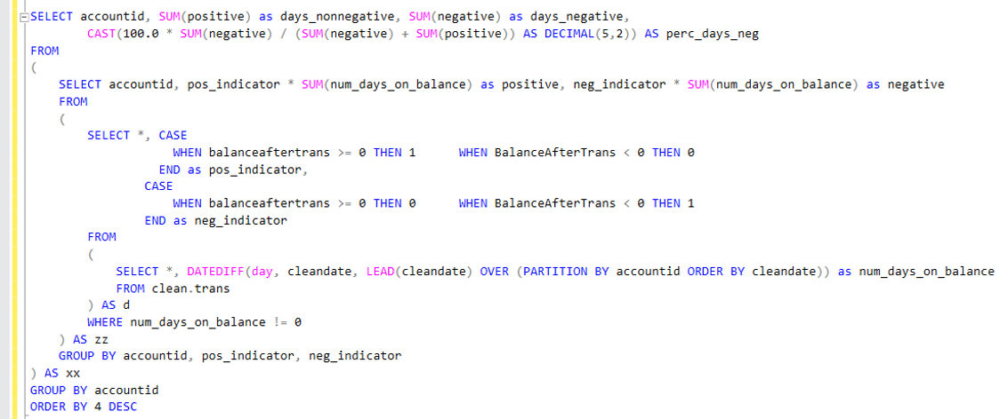
Accounts in Overdraft
Accounts spending a considerable amount of time in overdraft could be at risk.
This information could prompt discussion

Slide 16
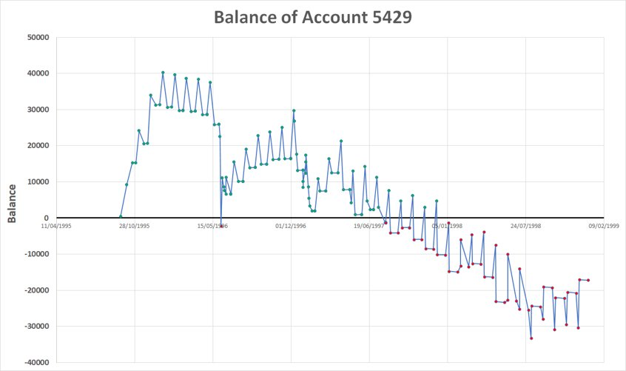
Accounts in Overdraft
Mean: 0.33
Standard deviation: 2.36
Accounts spending a considerable amount of time in overdraft could be at risk.
Account ID​ | Days non-negative​ | Days negative​ | Percent days negative​
5429​ | 688​ | 508​ | 42.47​
2260​ | 1010​ | 658​ | 39.45​
3374​ | 1326​ | 817​ | 38.12​
3711​ | 377​ | 225​ | 37.38​

Slide 17
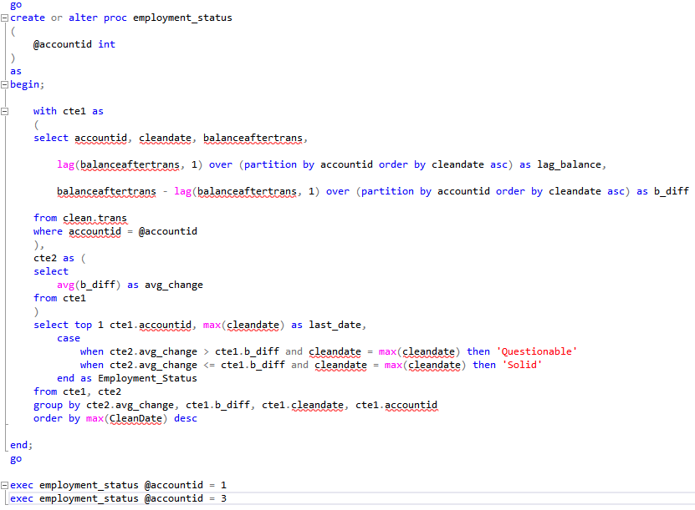


Employment Status
- Create Stored Procedure around variable @accountid to quickly find the estimated Employment Status of a specific account holder.
- Use avg & lag to find the average change in account balance over all transactions.
- Determine Employment Status based on whether most recent change in account balance is greater or less than the average.

Slide 18
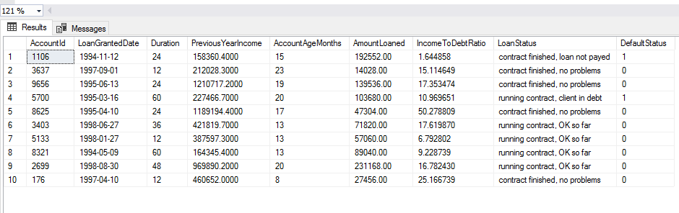
Income to Debt Ratio (IDR)
IDR = The previous 12 months' income to the account
((Loan Amount/ Loan Duration)*12)
Hypothesis: People who have a low income to debt ratio are more likely to default on their debt.
Test: Calculate The income to debt ratio for every customer that has taken out a loan and see if the average defaulted loan was given to a person with a lower IDR.

Slide 19
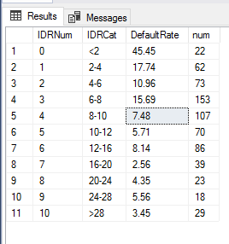
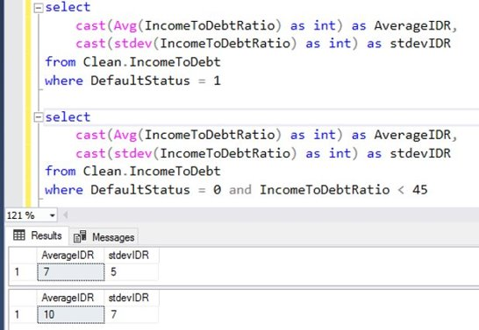

Slide 20
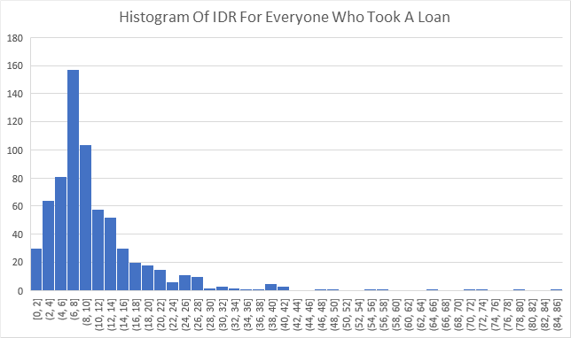
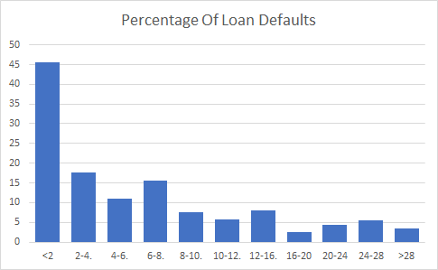
Business Outcome
People with a higher income to debt ratio do pay back their loans more often
However we want to loan as much money as possible to be profitable.
The IDR function should be used to calculate the amount you should loan to a person

Slide 21
Loan profiling - Gender
Key findings
Similar number of male & female customers
Males and Females are equally likely to pay off their loans
Worse case ~10% of customers may default on loans
Target those in debt to provide support
Loan Status | Male Count | Female Count
Contract finished, no problems | 100 | 103
Contract finished; loan not payed | 14 | 17
Running contract, ok so far | 199 | 204
Running contract, client in debt | 21 | 24
Who pays off their loans?
Profiling
Offer more relevant products to customers
Notes:
Ben’s slide
To obtain this data we had to do some cleaning to the raw data as gender was originally encoded into the birthdate (for some reason).
I then looked at a combination of loans, transactions and client data with the goal of identifying trends in loan behaviour to use in conjunction with Jordan's findings on Income-debt ratio to better direct
Worst case of 10% estimated by everyone who is in debt ends up not completing their loan payment
As Jordan mentioned on the previous slide the IDR can be used to help influence who we target to support.
The next metric we wanted to consider was age in order to identify age-relevant products.

Slide 22
Loan profiling - Age
Key Findings
Most loans are taken out by Young & middle-aged people
All age groups are equally likely to be a good candidate for loan (surprising...?)
Identifier | Age
Child | 0-20
Young | 20-40
Middle Aged | 40-60
Old | 60+
Good Loan | Bad Loan
Running contract, OK so far | Running contract, client in debt
Contract finished, no problems | Contract finished; loan not payed
Notes:
Grouped by these age categories as mentioned earlier
Grouped the categories on the previous slide into 'good loans' and 'bad loans'
some of you may be shocked to see that children pay off loans just as frequently as adults...

Slide 23
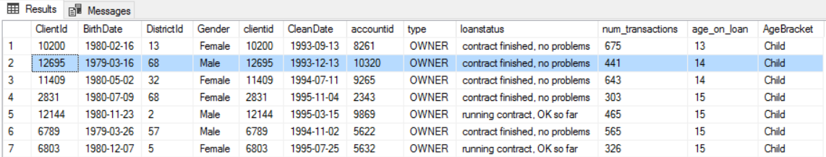
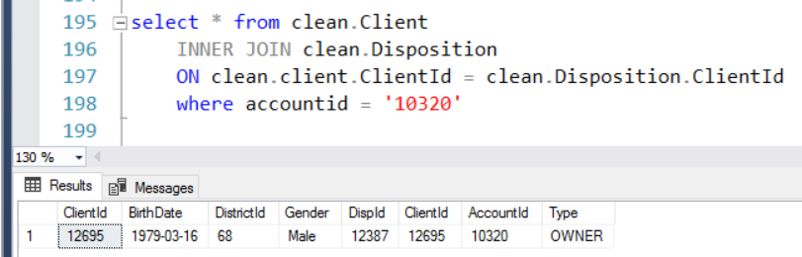
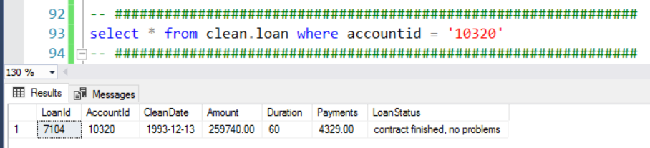
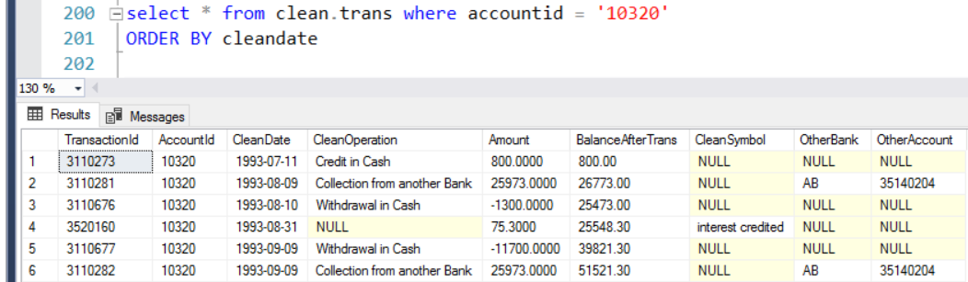
Loan profiling – An interesting case
AccountId = '10320'
Key Findings
Loan
259,740 Kč = £8,761
Age 14
Successfully paid off
Not a shared account
~1 transaction every 5 days
Conclusion: potential 'young-investor' education schemes
Or, better implemented fraud-detection
Notes:
This is a bit of a messy slide but the code is just in case there are any questions. I will talk you through it:
Decided to highlight an account I found particularly interesting based on the outcome of my previous slide
These key findings I have summarized on the right are the result of a number of queries across different tables (with joins)

Slide 24
Takeaways
Implement or improve Financial Advice service
Target specific competitors and customers with marketing and product offerings
Refine Fraud detection algorithm
Use individual metrics, e.g. IDR, to influence loan acceptance, capital allocation, and interest rate
Enrich demographic data with Census data, and transaction data with Payee Checking Service
Investigate “Young People in Business” scheme
Track Credit card balance

Slide 25
Děkuji za poslech
Thank you for listening

